Slide 1
RURAL PUBLIC TRANSIT And WORKFORCE

Slide 2
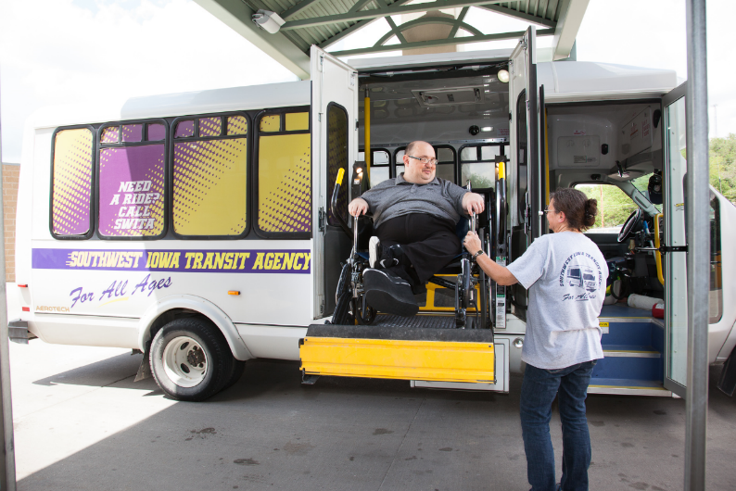
Traditional view of rural public transportation: Elderly and Disabled.
Still incredibly important, but not necessarily an area of growth.

Slide 3
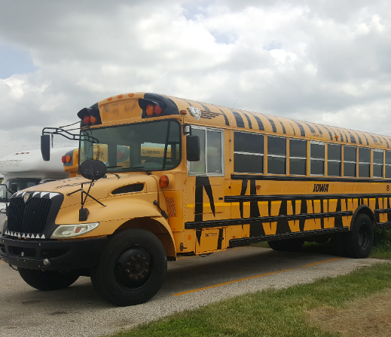
History of Work Routes for SWITA has included several false starts, a steep learning curve, important partnerships, and a willingness to think outside the public transit box.

Slide 4
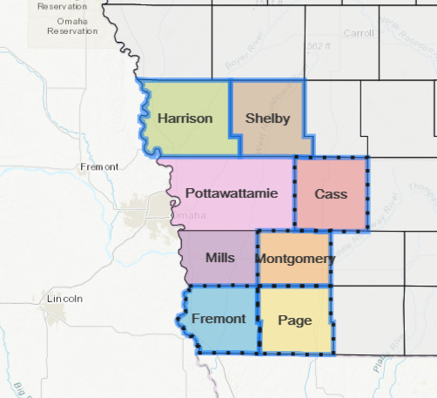
Our Service Area:
Equivalent to the size of the State of Connecticut.

Slide 5
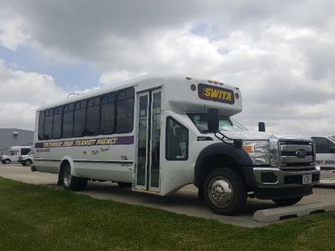
OUR CAPABILITES
84 Drivers
63 Light duty buses (seat between 16-20)
28 Mini-Vans
4 Sedans
3 medium duty buses (seat between 33-40)
2 SUV’s

Slide 6
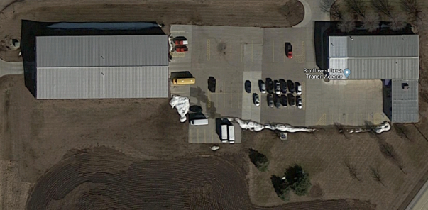
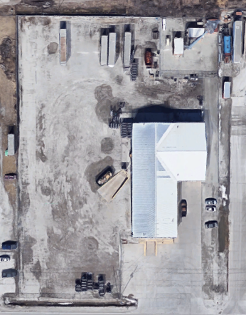
Council Bluffs Satellite Facility
Atlantic Main/Repair Shop/Office Facility

Slide 7
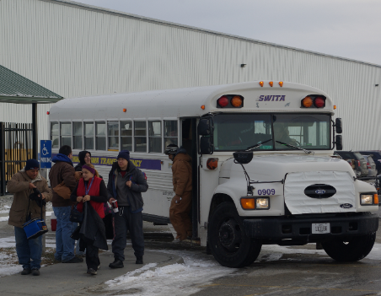
CURRENT WORK ROUTES
MENARDS
UPTOWN STAFFING(OSI ROUTES)
CDS VAN POOL
PSSI (OSI) ****Started 6/18****
PSSI (MONOGRAM)****Started 7/18****
MONOGRAM FOODS---HARLAN, IA****Started 8/18****
AMERICAN HYDRAULICS---RED OAK, IA****Started 4/18****
AMERICAN HYDRAULICS---CRESTON ROUTE****8/19 projected start****
PSSI (Poultry)****8/19 Start***

Slide 8
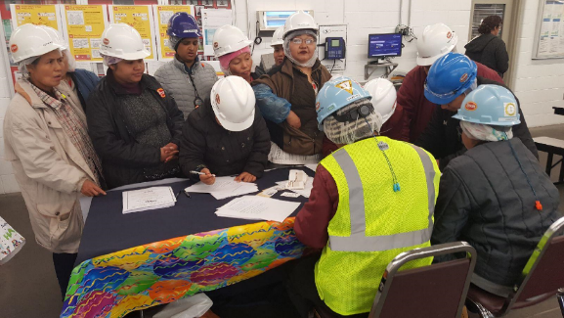
WORK ROUTE RIDERSHIP BY YEAR
FY15: 26,434
FY16: 25,614
FY17: 25,963
FY18: 39,953
FY19: 56,201
FY20: 65,500*

Slide 9
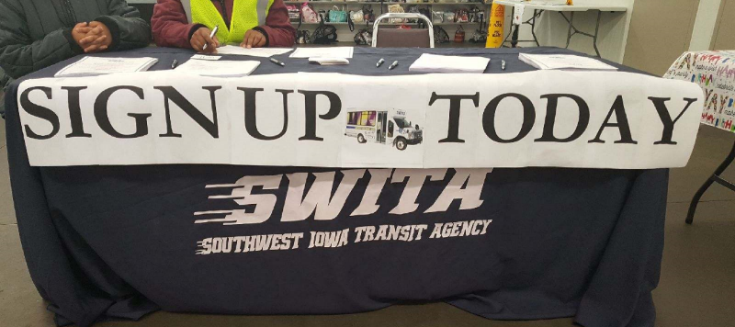
THE PROCESS

Slide 10
Rural Public Transit and Workforce

