Slide 1
FY 2021 Public Transit Infrastructure Grant Program

Slide 2
Public Transit Infrastructure Grant Program
Program created by 2006 General Assembly
Funds vertical infrastructure projects for public transit
All 35 public transit systems are eligible

Slide 3
Project Evaluation Criteria
No more than 40-percent of the appropriation can be awarded to an individual transit system
Structural integrity of existing facilities
Safety enhancements to existing facilities
New facilities
Projects should be “shovel ready” and capable of completion in 18 months

Slide 4
Available Funding and Application Summary
Available Funding:
Annual appropriation: $500,000
Underrun/withdrawals: $653,488
Funds available: $1,153,488
Application Summary:
Total number of projects: 3
Total project costs: $3,368,920
Total amount requested: $1,375,136

Slide 5
List of Applications Recommended
PROJECT NAME | SPONSOR | TOTAL PROJECT COST | REQUESTED AMOUNT (% of Total Project Cost) | RECOMMENDED AMOUNT (% of Total Project Cost)
West Burlington Vehicle Storage Facility | Region 16 | $500,000 | $400,000 (80%) | $400,000 (80%)
Remodeled Bus Storage and Administrative Facility | Cedar Rapids | $2,400,000 | $600,000 (25%) | $461,395 (19%)
New HVAC system | Ames (CyRide) | $468,920 | $375,136 (80%) | $292,093 (62%)

Slide 6
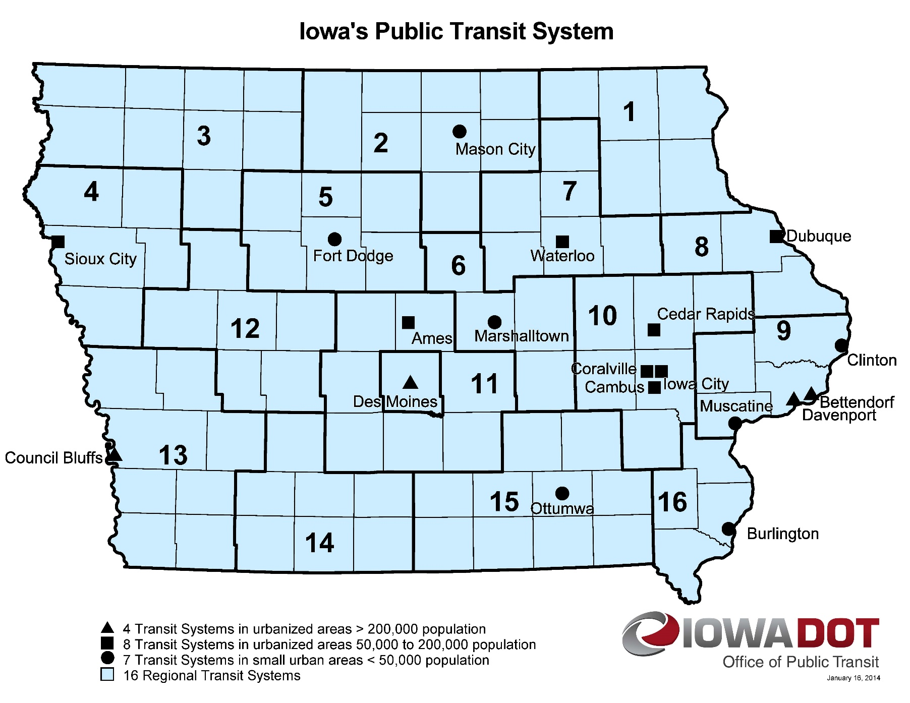
Map of Applications Received
Application received
Application recommended for funding
Notes:
18 Transit Systems

Slide 7
QUESTIONS?
Sree Mitra
Transit Program Manger
Sreeparna.mitra@iowadot.us
For more information on Iowa’s public transit and intercity bus programs, visit
www.iowadot.gov/transit

Slide 8
West Burlington
Vehicle Storage Facility
Currently Region 16 stores approximately 90% of its vehicles outside and uncovered. The West Burlington storage facility will be the initial focus of multi-phase approach to improving the vehicle storage needs for Region 16 Public Transit area of Southeast Iowa.
Total Cost: $500,000
Requested: $400,000
(80%)
Return to List of Applications Recommended

Slide 9
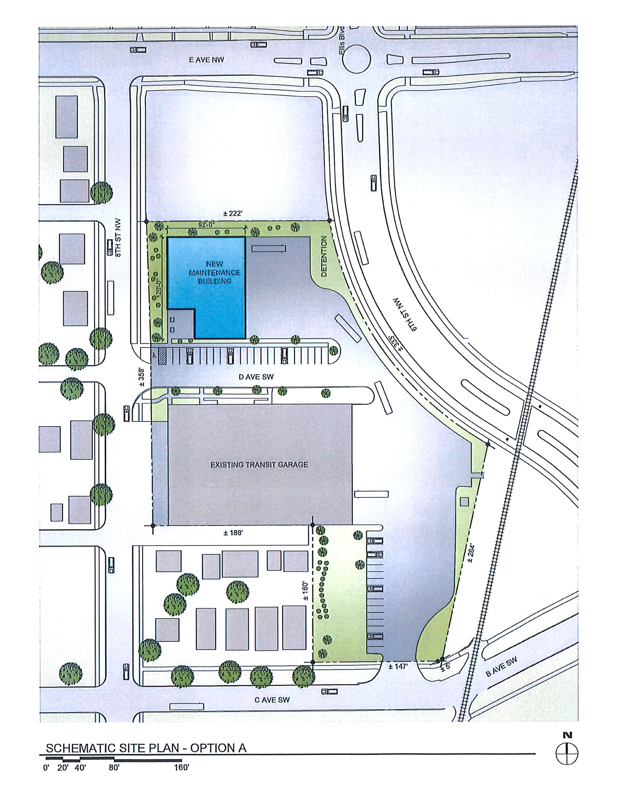
New Bus Storage and Administrative Facility –Cedar Rapids
The proposed transit fleet maintenance facility would be constructed just north of the existing bus garage to replace Cedar Rapids’ large-parts/tire storage building, outdoor storage area, and several parking spots when demolition for the 6th St & Ellis Blvd NW connector project begins later this summer. The road construction project will take approximately 8,800 square feet of useable storage space from the existing transit garage property, and there is no room on site to replace any of that lost storage capacity.
Total Cost: $2,400,000
Recommended: $461,395 (19%)
Return to List of Applications Recommended

Slide 10
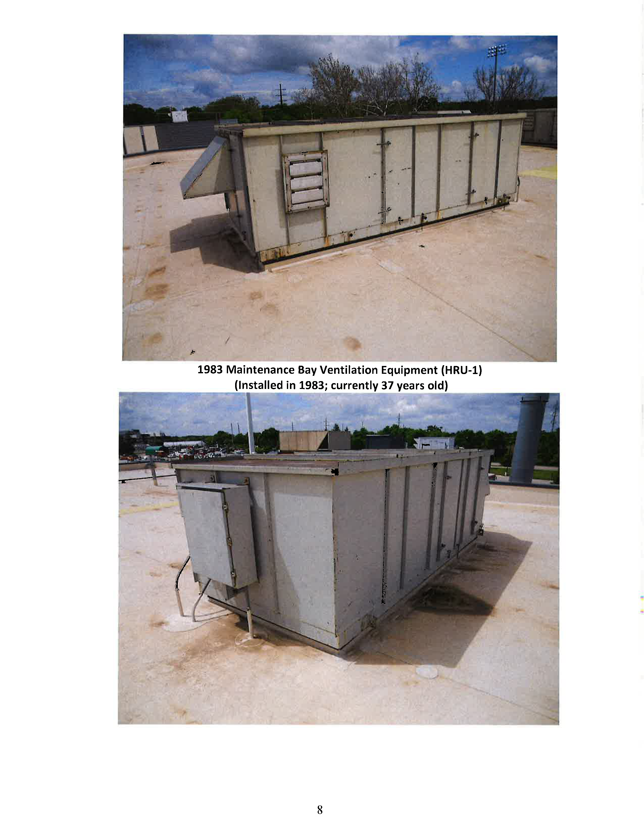
New HVAC system – Ames (CyRide)
This project will replace outdated HVAC equipment at two separate areas of the CyRide bus maintenance facility.
Maintenance Bay Ventilation Improvements (built in 1983, the HVAC for this area is 37 years old. Project improves air quality by improving space temperature and humidity control, increasing ventilation, and upgrading controls).
2) Southwest Bus Storage HVAC Replacement (built in 1989 the HVAC for this area is 31 years old, project will improve air quality and upgrade ductwork, pipework and CO/No₂ controls)
Total Cost: $468,920
Recommended: $292,093
(62%)
Return to List of Applications Recommended

