Slide 1
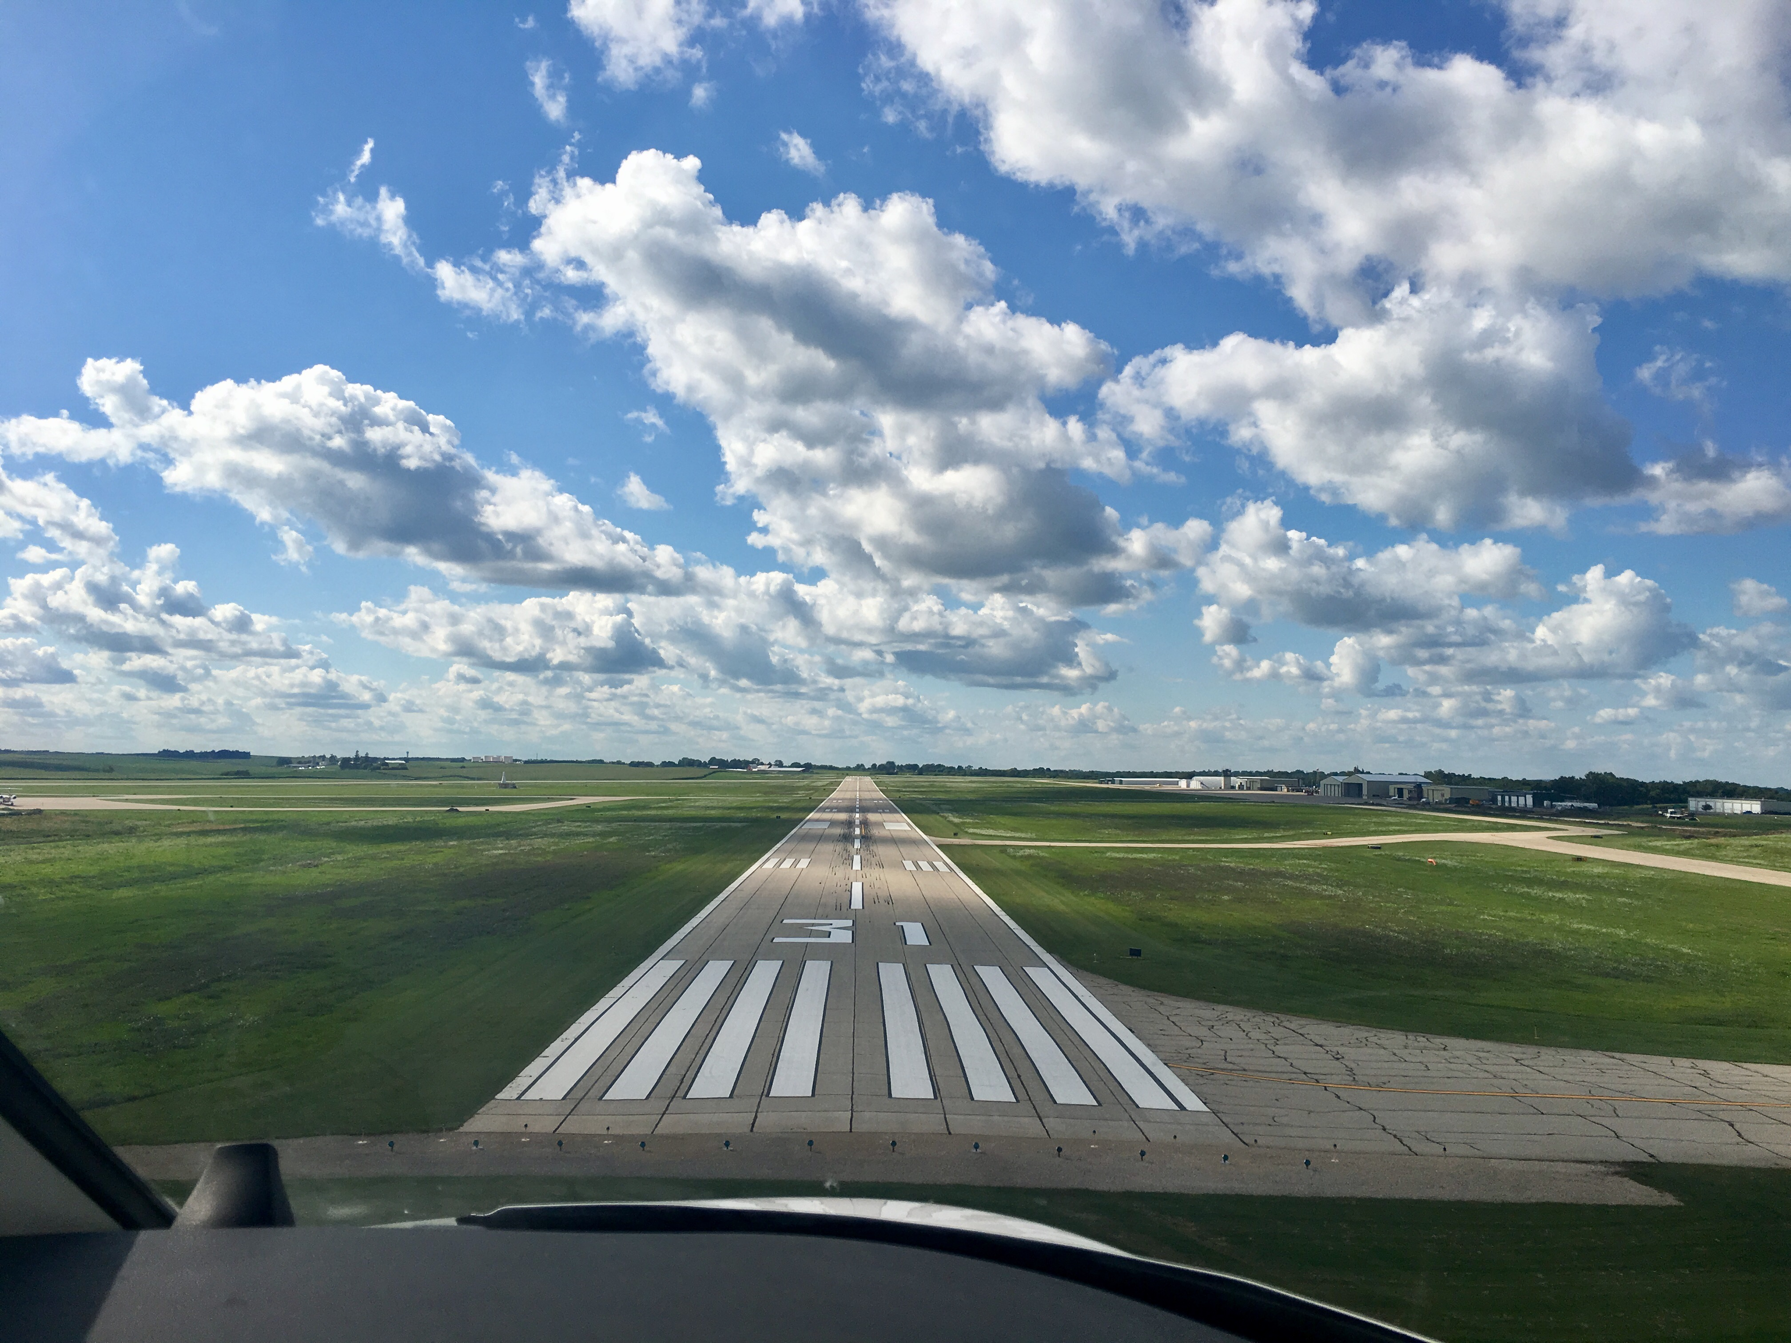

FY21 State Aviation Program
Funding Recommendation

Slide 2

State Aviation Program - AIP
Includes Airport Improvement Program (AIP)
Public-owned airport sponsors may apply for grants to assist in the preservation and development of the airfield and related infrastructure.
Eligible projects are funded up to 85% and generally include planning and improvements related to enhancing airport safety, capacity, security and environmental concerns.

Slide 3
Project Evaluation Criteria
Airport Role (5-20 Points)
Local participation (5-30 Points)
Multi-jurisdictional support (0-10 Points)
Type of project (5-30 Points)
Justification (5-20 Points)

Slide 4
Available Funding and Application Summary
Available Funding:
  FY21 Funds Available: $ 2,987,621
  Aviation Safety Programs: $ (596,040)
  Aviation Development Programs: $ (468,000)
  Funds available for projects: $ 1,923,581
Application Summary:
  Total number of applications: 30
  Total project costs: $11,033,100
  Total amount requested: $7,196,852

Slide 5
List of Applications Recommended
PROJECT NAME | SPONSOR | SCORE | TOTAL PROJECT COST | REQUESTED AMOUNT (% of Total Project Cost) | RECOMMENDED AMOUNT (% of Total Project Cost)
General Aviation Taxilane | Des Moines International Airport | 85 | 1,039,800 | 363,930 (35%) | 363,930 (35%)
Paving for West T-Hangar Relocation | The Eastern Iowa Airport | 80 | 3,537,768 | 1,813,394(51%) | 383,000(10%)
Construct General Aviation Taxilane - Final Phase | Mason City Municipal Airport | 75 | 547,142 | 383,000 (70%) | 383,000 (70%)
2 Stall Hangar Approach Paving | Algona Municipal Airport | 70 | 68,000 | 51,000 (75%) | 51,000 (75%)
Reconstruct Row E Taxilane - Phase 1 | Southeast Iowa Regional Airport | 70 | 50,775 | 42,651 (84%) | 42,651 (84%)
Reconstruct Taxilane F West | Fort Dodge Regional Airport | 70 | 325,000 | 260,000 (80%) | 260,000 (80%)
Rotating Beacon and Other Site Improvements | Marshalltown Municipal Airport | 70 | 150,000 | 120,000 (80%) | 120,000 (80%)
Apron Expansion | Newton Municipal Airport | 70 | 400,000 | 320,000 (80%) | 320,000 (80%)
Jump to applications not recommended for funding

Slide 6
State Aviation Program - GAVI
General Aviation Vertical Infrastructure(GAVI)
Public owned general aviation airport sponsors may apply for projects that include landside development and renovation of airport terminals, hangars, maintenance buildings, and fuel facilities.
Eligible projects are funded up to 85%
Funds are subject to annual appropriation

Slide 7
Project Evaluation Criteria
Airport Role (5-20 Points)
Local participation (5-30 Points)
Multi-jurisdictional support (0-10 Points)
Type of project (10-30 Points)
Justification (5-20 Points)

Slide 8
Available Funding and Application Summary
Available Funding:
  FY21 Funds Appropriated: $650,000
  Underrun: $124,100
  Funds available for projects $774,100
Application Summary:
  Total number of applications: 13
  Total project costs: $1,586,461
  Total amount requested: $1,003,100

Slide 9
List of GAVI Applications Recommended
PROJECT NAME | SPONSOR | SCORE | TOTAL PROJECT COST | REQUESTED AMOUNT (% of Total Project Cost) | RECOMMENDED AMOUNT (% of Total Project Cost)
2 Stall Hangar Extension | Algona Municipal Airport | 85 | 384,000 | 150,000 (39%) | 150,000 (39%)
Hangar Upgrade | Webster City Municipal Airport | 80 | 65,921 | 32,960 (50%) | 32,960 (50%)
Terminal Building Rehabilitation Project | Spencer Municipal Airport | 80 | 140,000 | 70,000 (50%) | 70,000 (50%)
Replace Bi-Fold Hangar Door | Cherokee County Regional Airport | 75 | 45,000 | 22,500 (50%) | 22,500 (50%)
Hangar Demolition | Webster City Municipal Airport | 75 | 30,000 | 15,000 (50%) | 15,000 (50%)
Terminal Hangar Bi-Fold Door Replacement | Ankeny Regional Airport | 75 | 120,000 | 75,000 (63%) | 75,000 (63%)
Install Bi-Fold Doors | Harlan Municipal Airport | 70 | 101,140 | 75,000 (74%) | 75,000 (74%)
Fuel Pump and Dispenser Improvement | Lamoni Municipal Airport | 70 | 16,000 | 8,000 (50%) | 8,000 (50%)
Hangar Rehabilitation | Rock Rapids Municipal Airport | 70 | 66,000 | 49,500 (75%) | 49,500 (75%)
Rehabilitate Hangar Doors | Vinton Veterans Municipal Airport | 65 | 85,000 | 68,000 (80%) | 68,000 (80%)
T-Hangar Drainage Improvement | Perry Municipal Airport | 60 | 68,400 | 58,140 (85%) | 58,140 (85%)
Snow Removal Equipment Building Addition | Sioux County Regional Airport | 55 | 195,000 | 150,000 (77%) | 150,000 (77%)
Jump to applications not recommended for funding

Slide 10
State Aviation Program - CSVI
The Commercial Service Vertical Infrastructure (CSVI) program provides funding for landside development and renovation of terminals, hangars, maintenance buildings, and fuel facilities at commercial service airports.
Appropriated funds are distributed to the commercial service airports formula with no local match required.
    50% evenly split between the airports
    40% based on enplanements
    10% based on cargo activity

Slide 11
Available Funding and Application Summary
Available Funding:
  FY21 Funds Appropriated: $1,000,000
  Funds available for projects: $1,000,000
Application Summary:
  Total number of projects: 8
  Total project costs: $37,182,355
  Total amount requested: $1,000,000

Slide 12
List of CSVI Applications Recommended
PROJECT NAME | SPONSOR | SCORE | TOTAL PROJECT COST | REQUESTED AMOUNT (% of Total Project Cost) | RECOMMENDED AMOUNT (% of Total Project Cost)
Parking Garage Addition | Des Moines International Airport | N/A | 21,440,934 | 376,123 | 376,123
Equipment Wash Facility | Dubuque Regional Airport* | N/A | 500,000 | 69,958 | 69,958
Terminal Exterior Renovation, Renovate SRE Building, Hangar Insulation, Hangar A Construction | Fort Dodge Regional Airport* | N/A | 120,000 | 64,106 | 64,106
Replace Entrance Road Lighting | Mason City Municipal Airport | N/A | 135,000 | 64,090 | 64,090
Terminal and Hangar Improvements | Sioux Gateway Airport | N/A | 135,097 | 71,104 | 71,104
Terminal Upgrades | Southeast Iowa Regional Airport | N/A | 121,857 | 64,135 | 64,135
Cargo Logistics Facility | The Eastern Iowa Airport | N/A | 14,602,007 | 223,394 | 223,394
Hangar Rehabilitation | Waterloo Regional Airport | N/A | 127,460 | 67,090 | 67,090
* Airports requesting to use funds from previous years on FY21 projects

Slide 14

QUESTIONS?
Shane Wright
Aviation Program Manager
Shane.Wright@iowadot.us

Slide 15
List of AIP Applications Not Recommended
PROJECT NAME | SPONSOR | SCORE | TOTAL PROJECT COST | REQUESTED AMOUNT (% of Total Project Cost) | RECOMMENDED AMOUNT (% of Total Project Cost)
Taxiway C and FBO Ramp Shoulder Replacement | Sioux Gateway Airport | 65 | 505,000 | 404,000 (80%) | 0
Hangar Apron Pavement Rehabilitation | Fairfield Municipal Airport | 65 | 122,886 | 104,453 (85%) | 0
Construct Turnaround for Runway End 18 | Osceola Municipal Airport | 65 | 348,260 | 296,021 (85%) | 0
Taxiway D Access Road, Utilities, and Apron Grading | Ankeny Regional Airport | 65 | 626,654 | 281,994 (45%) | 0
Construct Apron and Taxiway for Hangars | Iowa City Municipal Airport | 65 | 399,675 | 339,723 (85%) | 0
Apron Reconstruction | Ottumwa Regional Airport | 65 | 335,500 | 285,175 (85%) | 0
Tip Down Pole for Beacon and Obstruction Removal | Pocahontas Municipal Airport | 65 | 70,000 | 59,500 (85%) | 0
Fuel System Repair and Modifications | Washington Municipal Airport | 60 | 296,600 | 252,110 (85%) | 0
Apron and Taxiway Reconstruction | Estherville Municipal Airport | 60 | 252,100 | 214,285 (85%) | 0
Jet A Fuel Facility | Forest City Municipal Airport | 60 | 254,000 | 215,900 (85%) | 0
Install Security Gate and Fence | Iowa Falls Municipal Airport | 60 | 45,000 | 38,250 (85%) | 0
Electrical Rebuild for Hangar Area | Sibley Municipal Airport | 60 | 17,500 | 14,875 (85%) | 0
Taxiway and Apron Improvements | Lamoni Municipal Airport | 60 | 257,600 | 180,320 (70%) | 0
Taxiway and Apron Grading and Paving | Monticello Regional Airport | 60 | 345,400 | 293,590 (85%) | 0
Jet A Fuel System Replacement | Oelwein Municipal Airport | 60 | 193,400 | 164,390 (85%) | 0
Fuel System Improvements - Phase 1 | Sheldon Regional Airport | 60 | 37,500 | 31,875 (80%) | 0
Reconstruct T-Hangar Taxilanes | Waverly Municipal Airport | 55 | 299,850 | 239,880 (85%) | 0
Fencing and Entrance Road Drainage Improvements | Creston Municipal Airport | 55 | 210,000 | 178,500 (85%) | 0
Drainage Improvements | Le Mars Municipal Airport | 55 | 61,130 | 51,960 (85%) | 0
Parking Lot Expansion | Iowa City Municipal Airport | 45 | 79,800 | 67,830 (85%) | 0
Parking Lot Expansion | Knoxville Municipal Airport | 40 | 136,760 | 116,246 (85%) | 0
Apron Joint Seal Replacement | Webster City Municipal Airport | 35 | 20,000 | 12,000 (60%)
Jump to applications recommended for funding

Slide 16
List of GAVI Applications Not Recommended
PROJECT NAME | SPONSOR | SCORE | TOTAL PROJECT COST | REQUESTED AMOUNT (% of Total Project Cost) | RECOMMENDED AMOUNT (% of Total Project Cost)
Install New AvGas Fuel Facility | Manchester Municipal Airport | 60 | 270,000 | 229,000 (85%) | 0.00
Jump to applications recommended for funding

