Slide 1
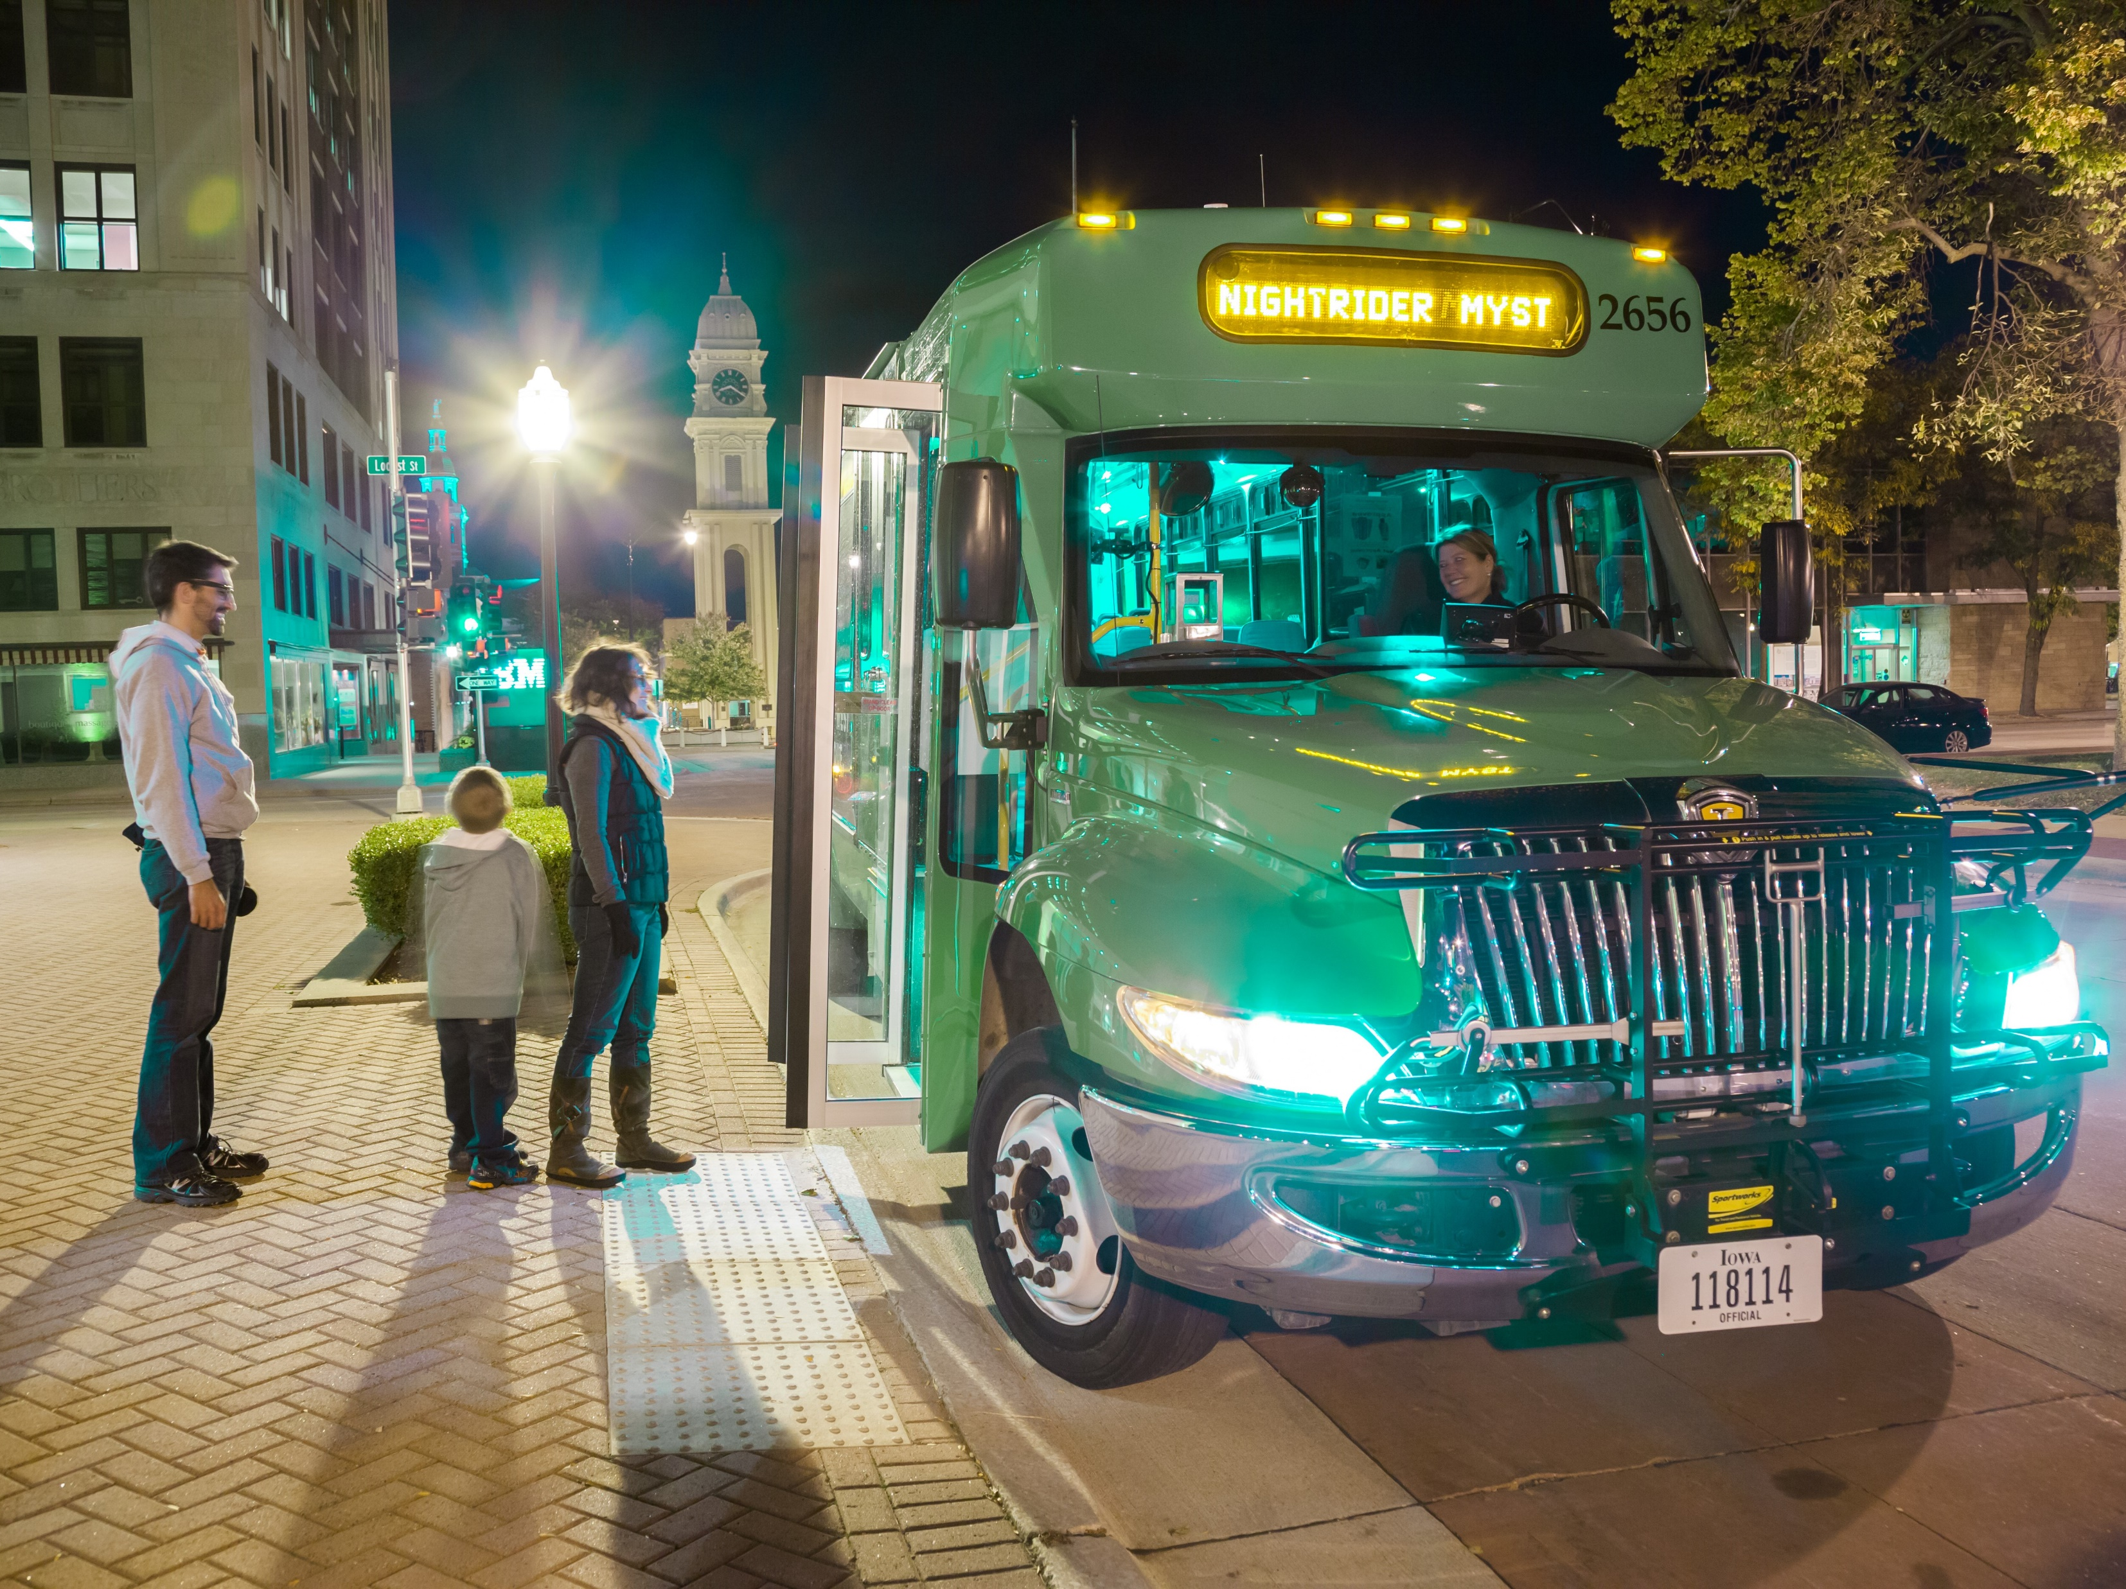

JOE DRAHOS
SYSTEMS PLANNING BUREAU | PASSENGER PLANNING
PLANNING, PROGRAMMING & MODAL DIVISION
Iowa Department of Transportation
800 Lincoln Way, Ames, IA 50010
Office: 515.239.1772 Email: joseph.drahos@iowadot.us
Iowa Public Transit Long Range Plan
Transportation Commission Meeting
July 14, 2020

Slide 2
Agenda
Iowa Public Transit Long Range Plan
Transit Plan
Introduction & Background
Iowa’s Transit Context
Needs and Strategies
Financing
Implementation & Evaluation
Comments & Feedback
Next Steps

Slide 3
Transit Plan
Iowa Public Transit Long Range Plan

Slide 4
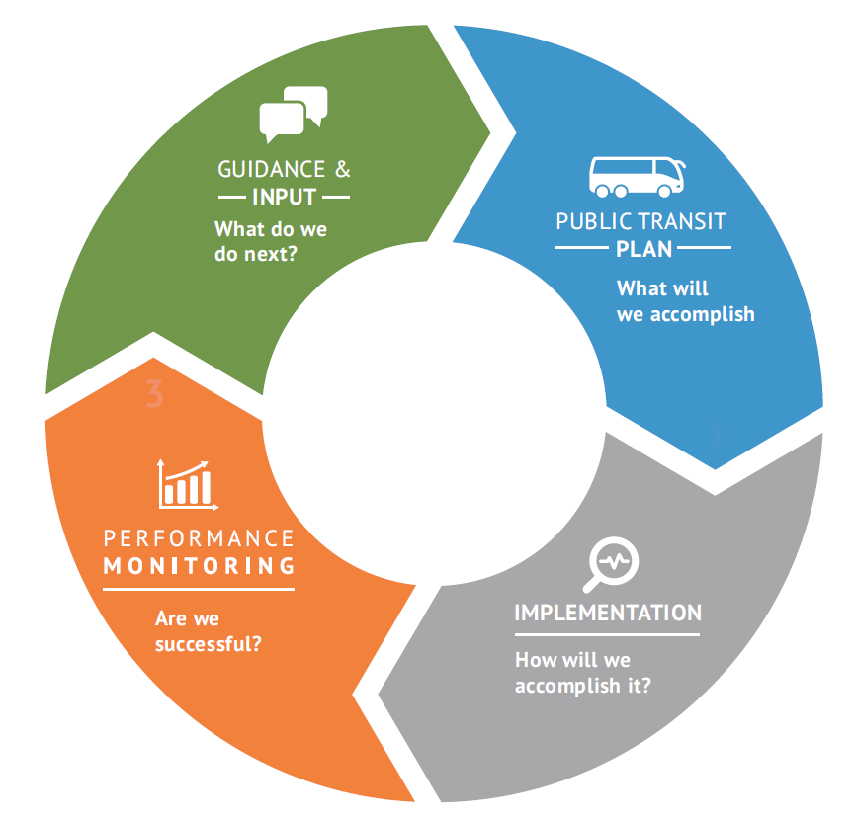
Chapter 1: Introduction & Background
Iowa Public Transit Long Range Plan
Challenges in Public Transit
Declining Ridership
Overextended transit system
Stigma of public transit
Previous Planning Efforts
Iowa in Motion Transit System Plan
Iowa Statewide Passenger Transportation Funding Study
Iowa Park and Ride System Plan
Iowa in Motion 2045 State Transportation Plan
Iowa Transit Asset Management Group Plan
Stakeholder Involvement
Interagency and external
Transit agencies
The Planning Process
1999
2009
2014
2017
2018

Slide 5
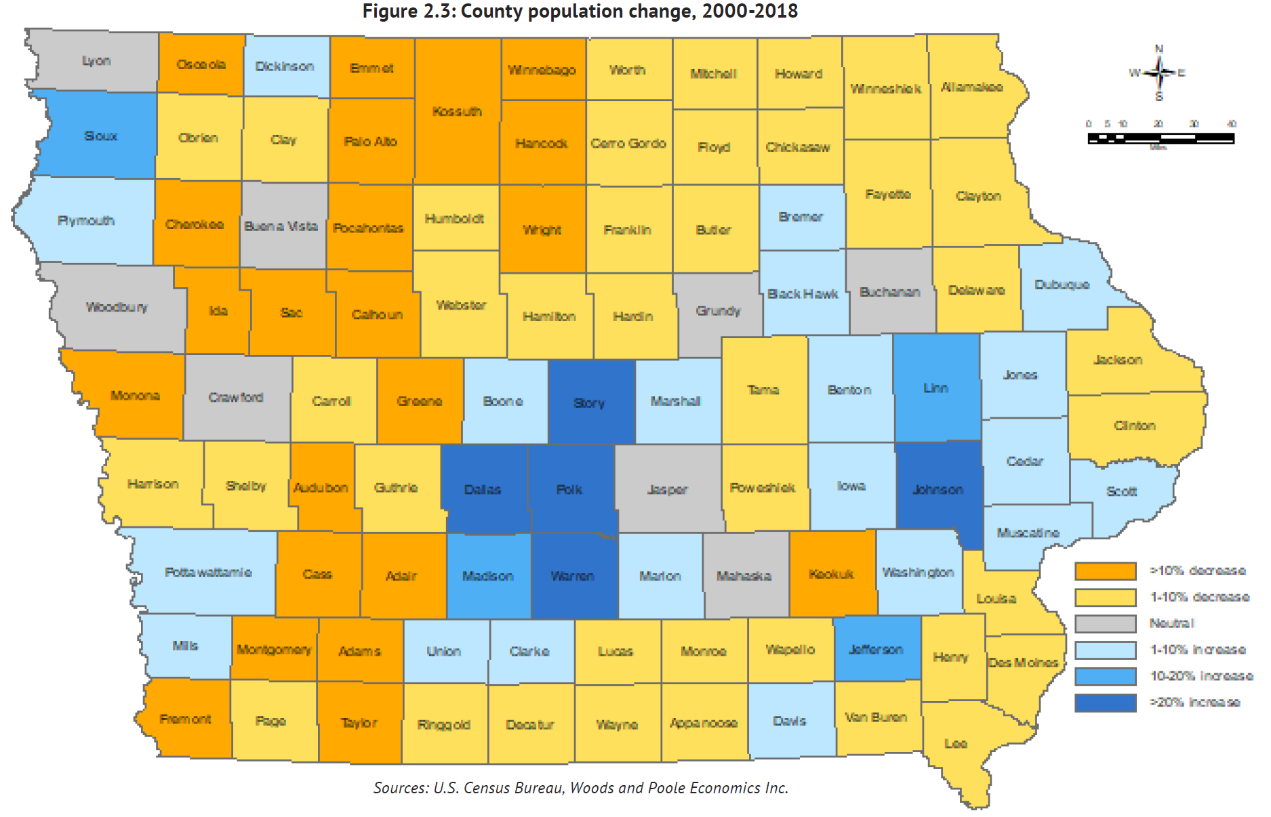
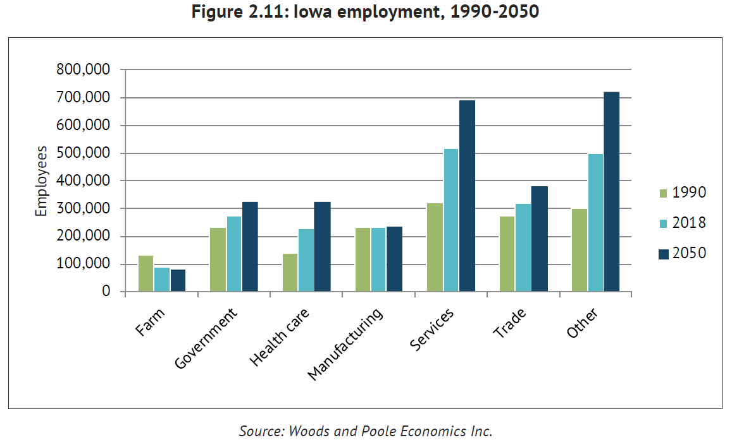
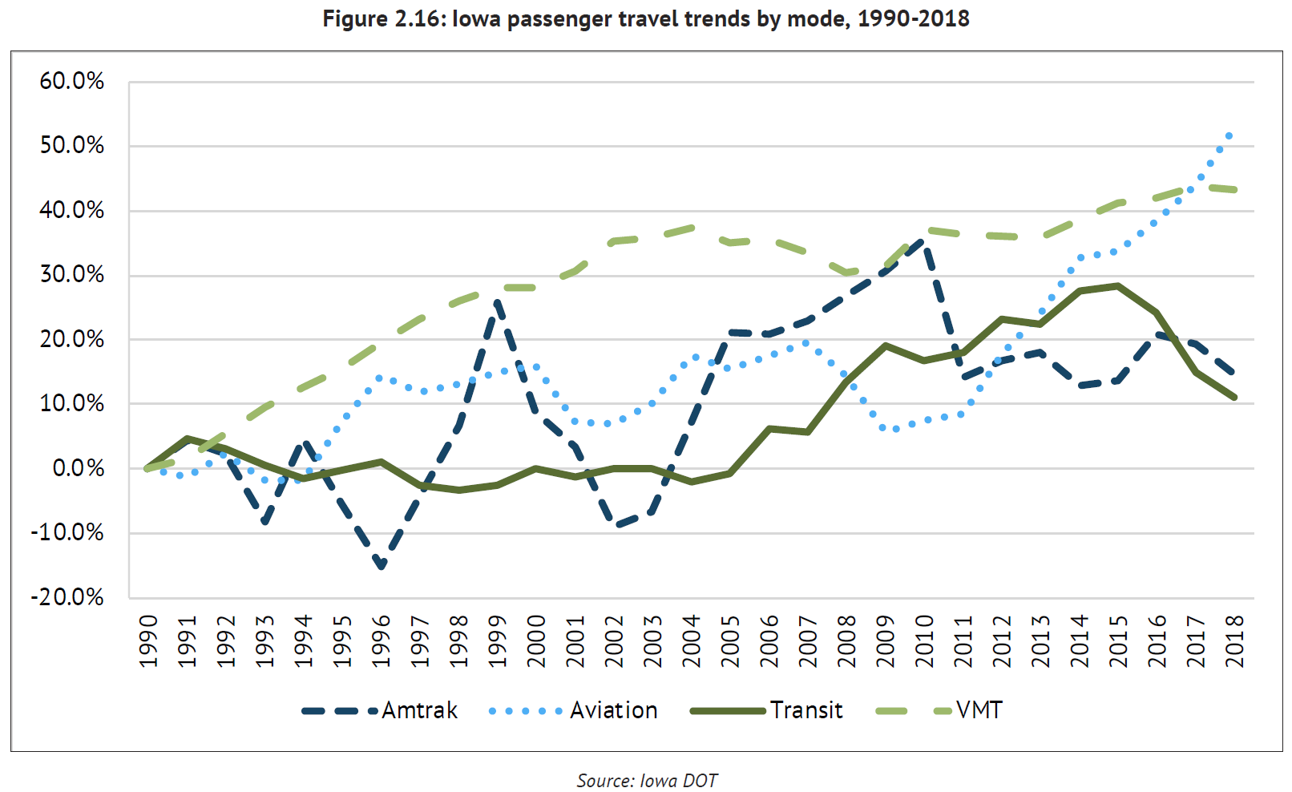
Chapter 2: Iowa’s Transit Context
Iowa Public Transit Long Range Plan
Population Trends
Growth rate decreasing
Rural decreasing, urban increasing
Aging rural population
Economic Trends
Farm and manufacturing sectors not growing
Service and other (financial) sectors growing
Employment throughout rural and urban is growing
Passenger Trends
Travel across all modes increasing more than Iowa’s population growth
Single-occupancy driving most common mode
Impacts of automated vehicles, shared systems, transportation network companies, and COVID-19 are not known

Slide 6
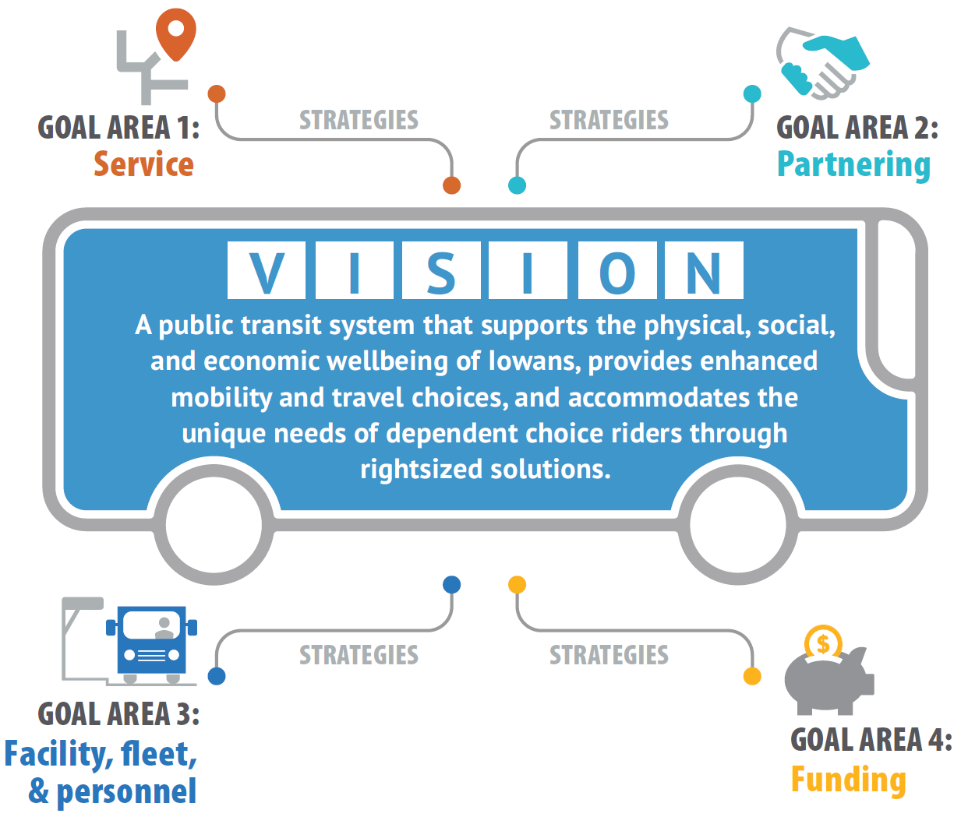
Chapter 3: Needs and Strategies
Iowa Public Transit Long Range Plan
Transit Agency Needs
Right-sizing an aging vehicle fleet
Maintaining and protecting capital assets
Critical driver shortages
Transit Dependent Populations
Forecasting targeted areas of transit need
Selecting appropriate means of addressing need
Vision and Strategies
Service strategies focused on maintaining or expanding services, connecting employees to jobs, and making the system more accessible
Partnering focused on integration of government, non-profit, and private services for efficiency and to provide more options
Facility, fleet, and funding strategies focused on cost-effective ways to maintain a state of good repair and improve upon the net positive benefit-cost impact of transit service

Slide 7
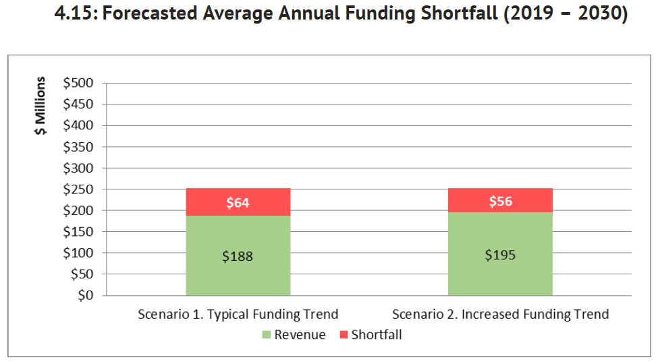
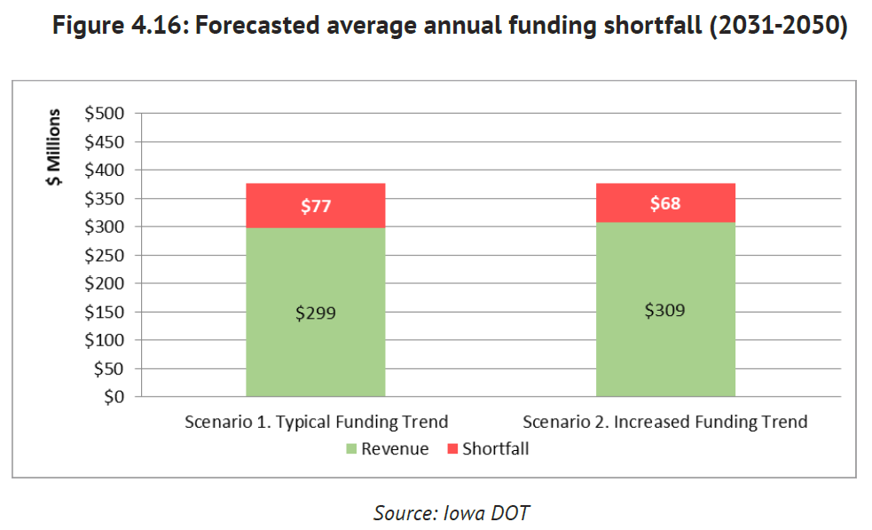
Chapter 4: Financing
Iowa Public Transit Long Range Plan
Anticipated Costs and Revenue
Operating expenses represent the largest share
Local funding accounts for greatest share
Shortfalls
Depending on sustainment of funding levels, annual average shortfalls will be as much as $77 million by 2050
Impacts decisions on maintaining service levels
Economic Impact
Studies show a net benefit of over $2 for every $1 spent on transit in urban areas
Rural areas showed a little more than $1 for every $1 spent on transit, due mostly to low population density and larger service areas

Slide 8
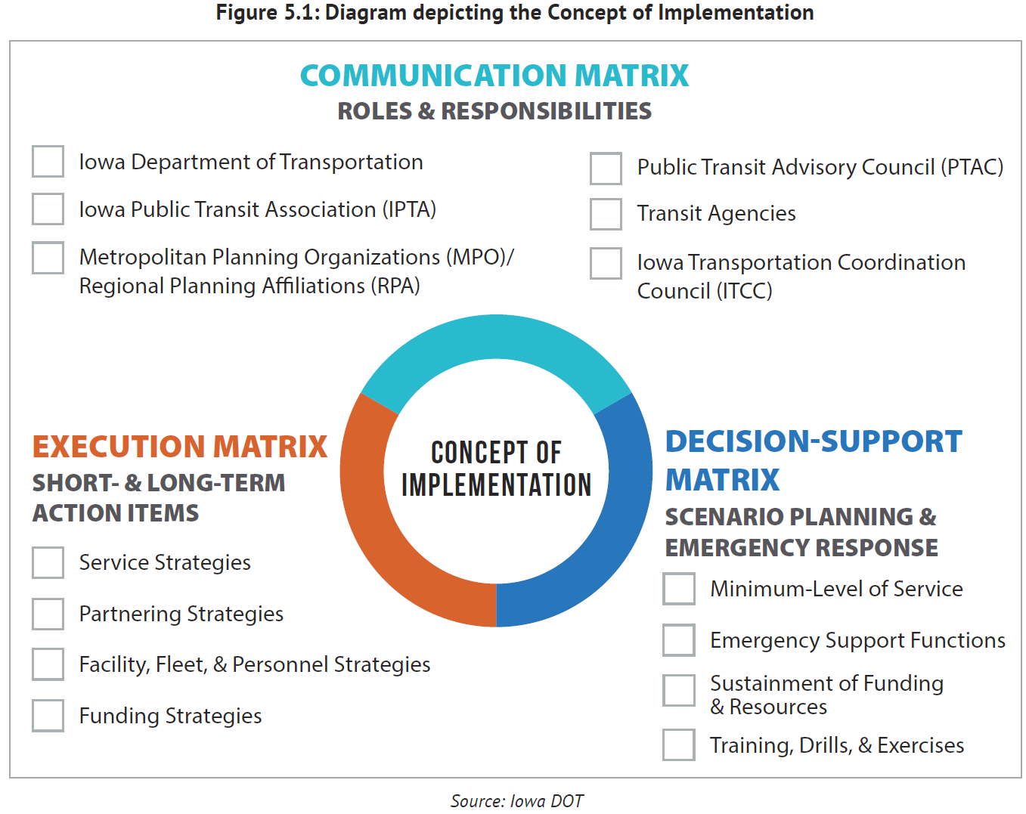
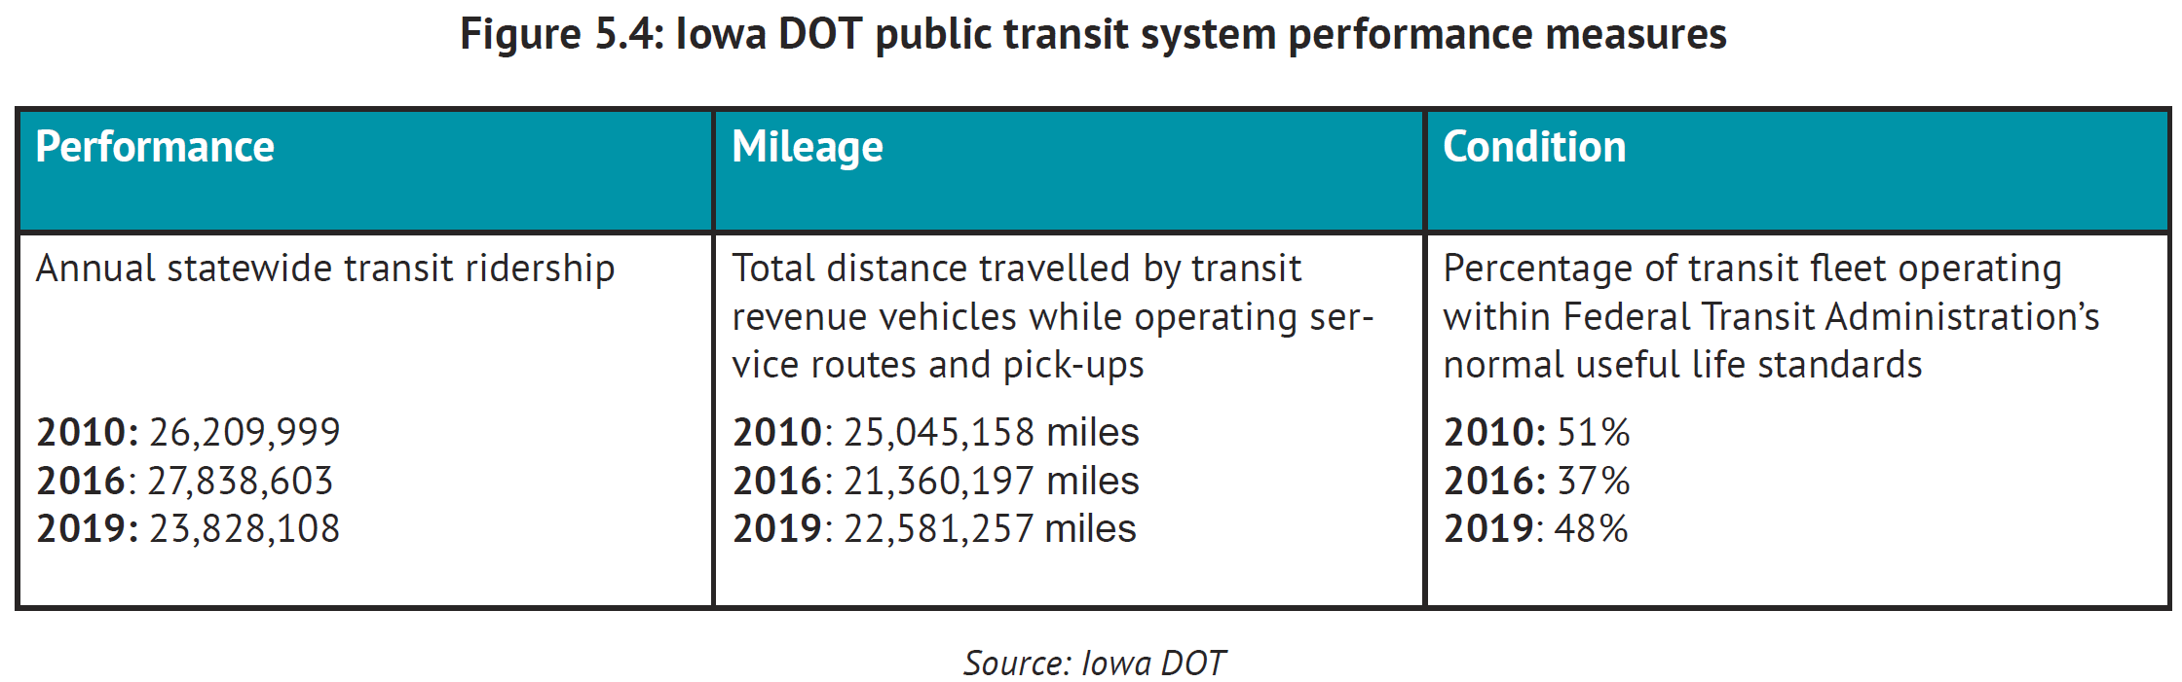
Chapter 5: Implementation & Evaluation
Iowa Public Transit Long Range Plan
Concept
Our partners and stakeholders that can help us implement our vision
Track implementation progress through the execution of actions that support our strategies
Ensuring that essential services and businesses receive the necessary transportation support that is vital to their continued operation
Evaluation
Performance measures for asset management
Performance measures for safety plans
Performance measures for the overall system

Slide 9
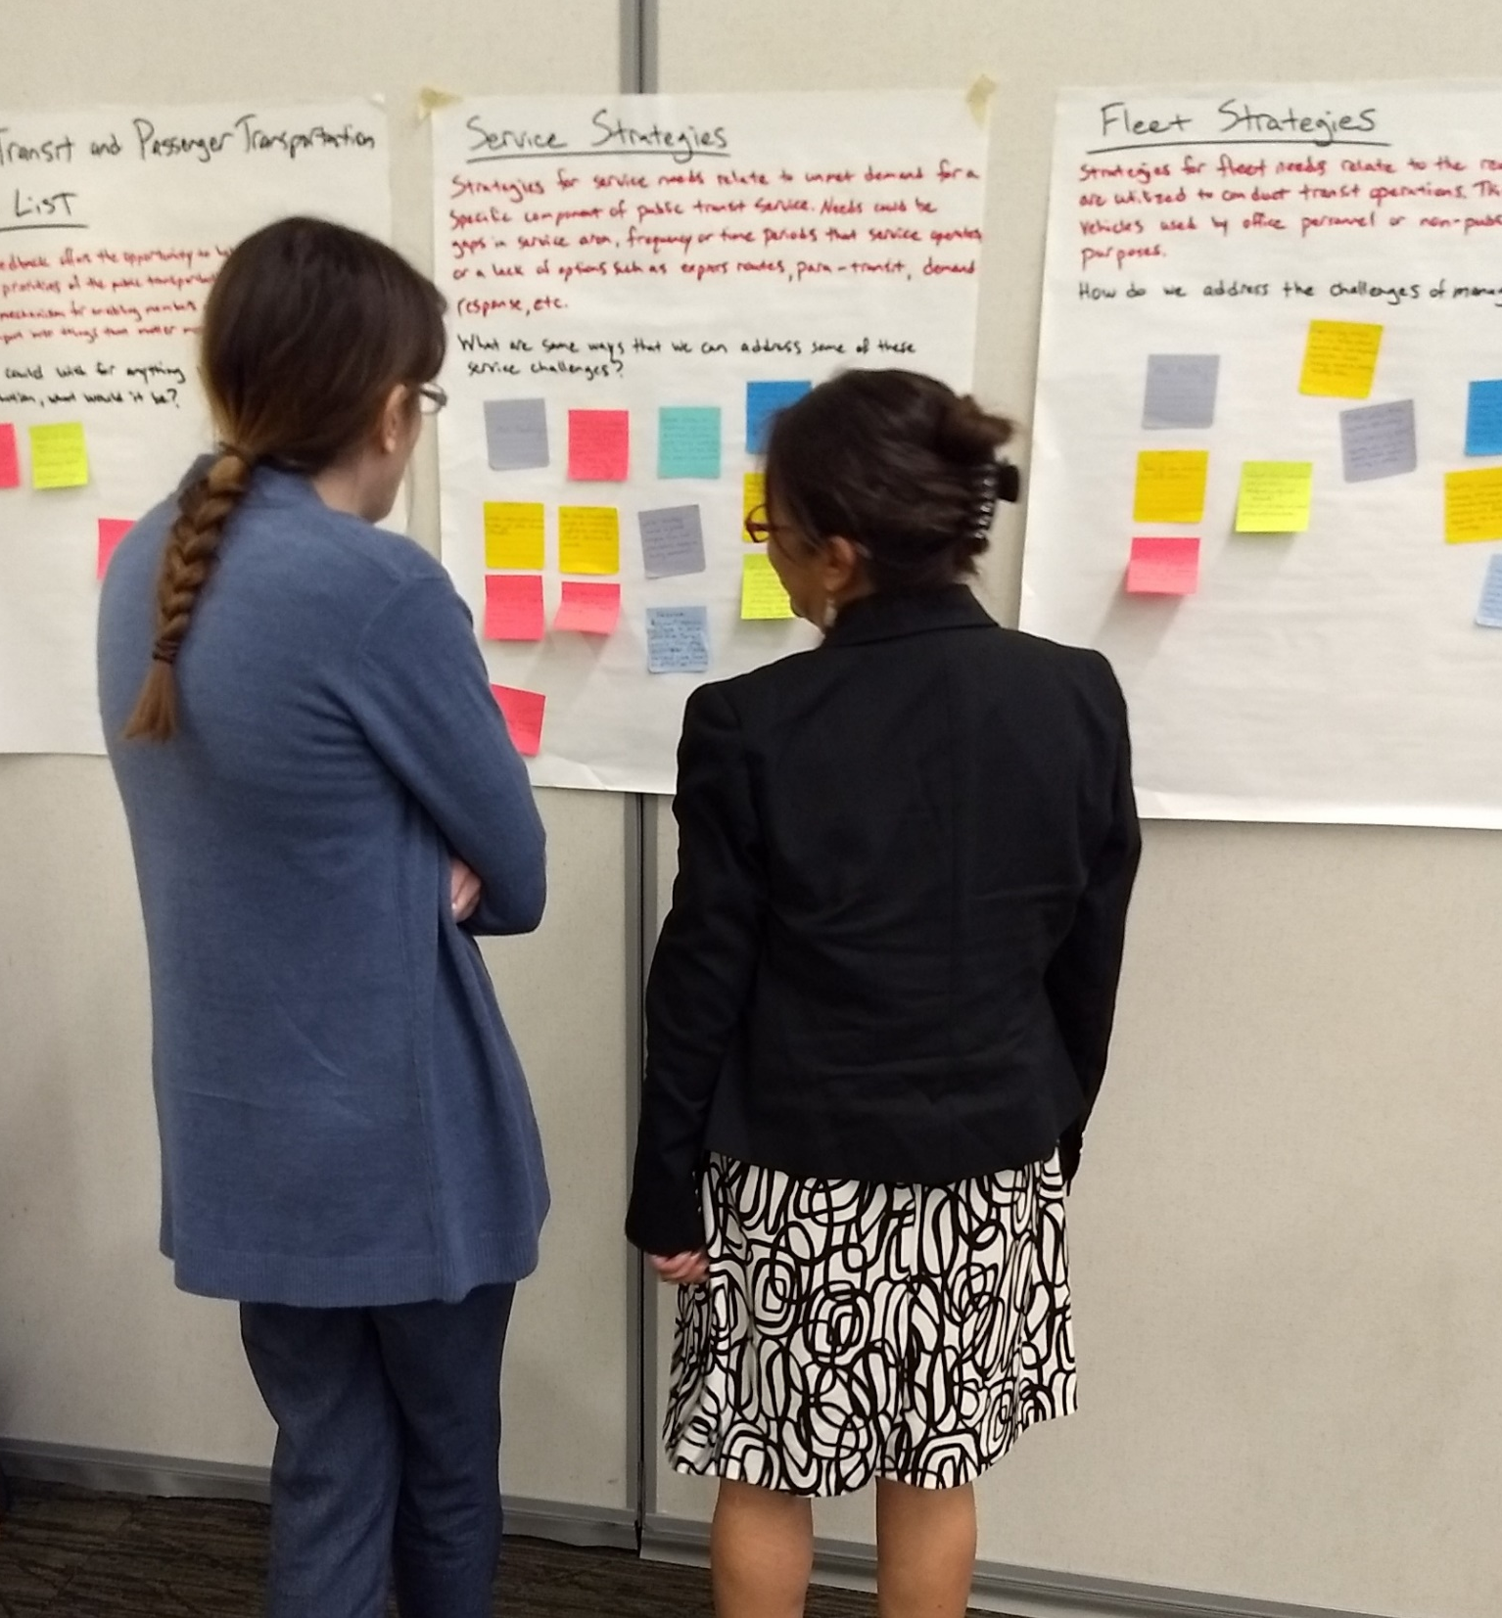
Comments & Feedback
Iowa Public Transit Long Range Plan
Transit Agencies
Provided initial guidance on needs within the public transit system across Iowa. Participated as a member of the external stakeholder group and shared demographic insights helping with the transit dependency analysis.
Public
Shared initial input on the transit needs survey results with ideas and strategies. Refined strategy prioritization through the public survey and feedback on the Plan during the 45-day public comment period.
Stakeholders
Consisted of non-profit advocacy groups, public transit agencies, state agency representatives, and select members from the DOT.
External stakeholders reviewed products, refined strategies, and helped craft themes to address the needs of a diverse spectrum of transit users.
Internal stakeholders brought subject matter expertise from different modes of transportation as well as providing perspective on the relationship between the DOT and public transit users
External Stakeholder Membership
Cedar Rapids Transit
Marshalltown Transit
Southwest Iowa Transit Agency (SWITA)
AARP
American Cancer Society
University Centers for Excellence in Developmental Disabilities (UCEDD)
Veteran’s Affairs
Iowa State University – Extension & Outreach
Iowa Department of Public Health
Internal Stakeholder Membership
Aviation
Rail Transportation
Location & Environment
Driver & Identification Services
District Planner

Slide 10
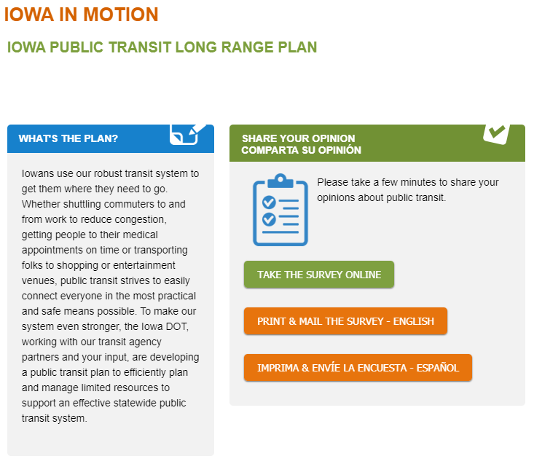
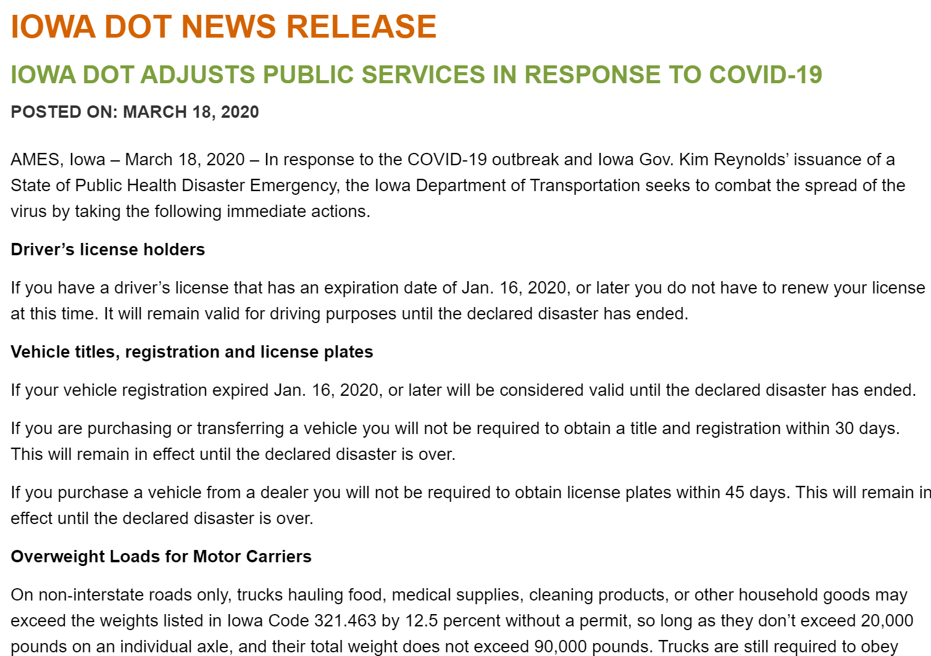
Comments & Feedback
Iowa Public Transit Long Range Plan
Early Engagement
March 2019 Transit Needs Survey by all 35 transit agencies
Identified challenges, barriers, and needs
Continuous Engagement
Shared findings, analyses, progress reports at more than 25 separate presentations and events with stakeholder groups and key transit partners
Maintained publicly accessible website
Challenges of keeping the public and stakeholders engaged during major national events
Sustaining Engagement
Communication Matrix to be leveraged during the course of its implementation after the Plan is published

Slide 11


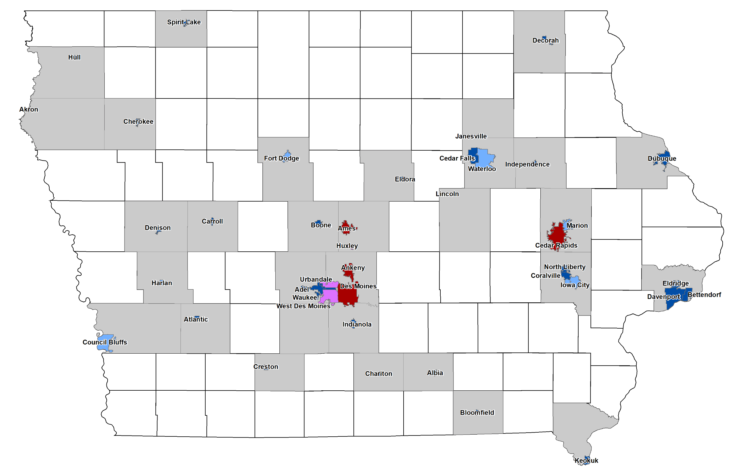
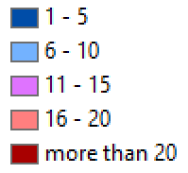
Comments & Feedback
Iowa Public Transit Long Range Plan
45-day Public Comment Period
Began 18 May 2020
Ended 1 July 2020
Review of the Plan
Chapters available as .pdf and viewable to the public
Online submission form to share comments and contact information
Results
2x letters representing multiple entities and organizations
Iowa Primary Care Association
Iowa Environmental Council
8x individual comments
Zero news media contact reports
846
Total number of web page views
490
Number of unique users
Notes:
Out of State page-views:
Omaha 34
Santa Clara 6
Chicago 6
Minneapolis 4
Madison 4
47 – location not set

Slide 12
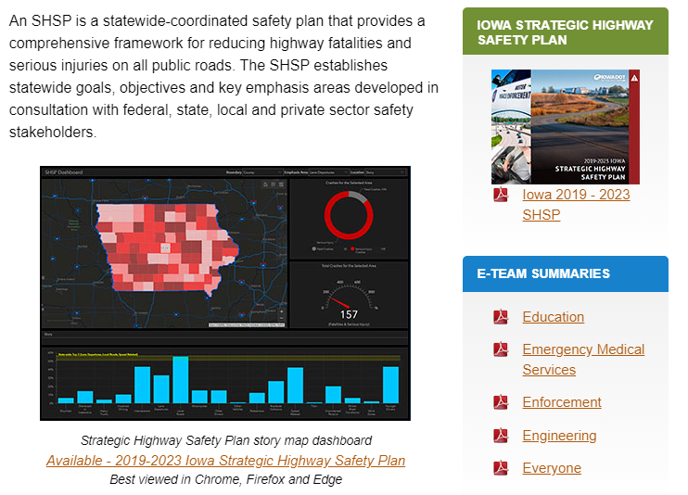
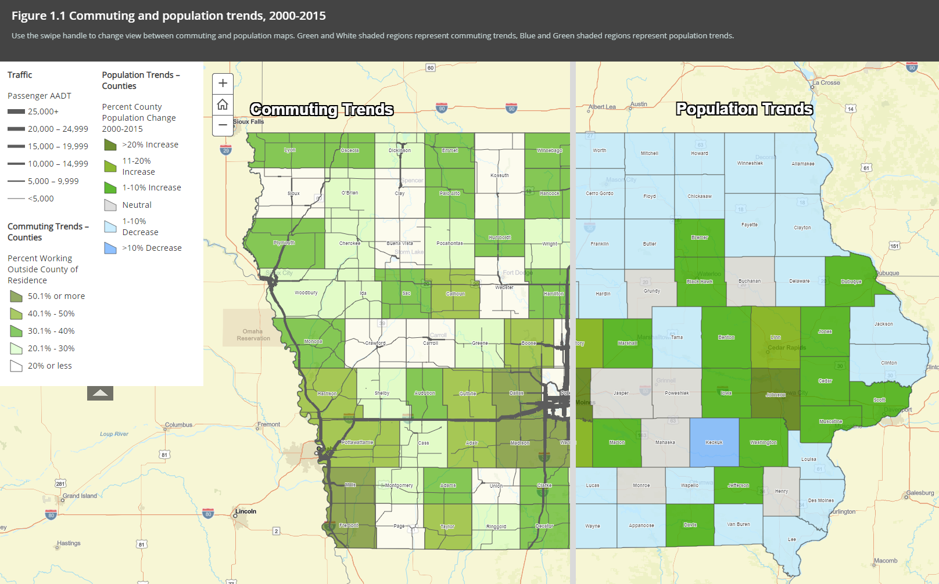
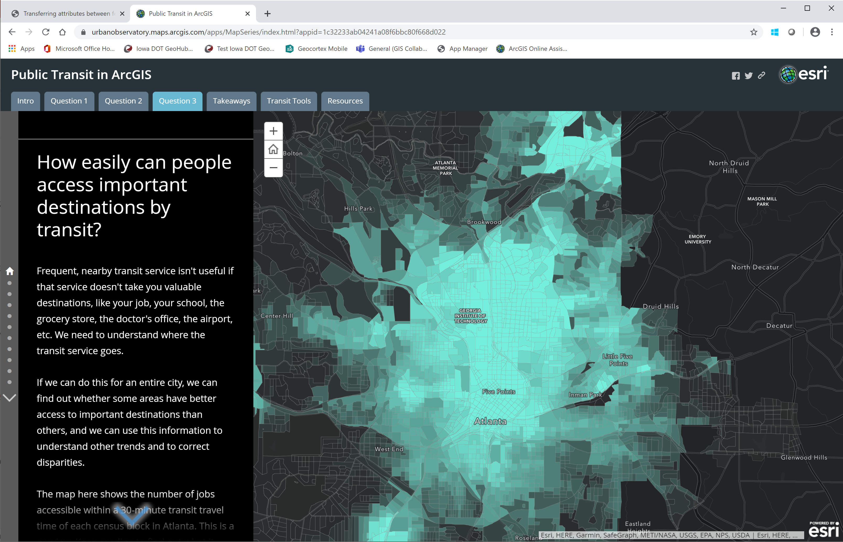
Next Steps
Transit Dependency Analysis
Example 1 – DOT SHSP web page
Data Sharing
Individual meeting with each Transit Agency
Passenger Transportation Summit
Iowa Public Transit Association
Data available to agencies
Web Application
Interactive web mapping application through ArcGIS Online (AGOL)
Strategic Highway Safety Plan (SHSP) example
ArcGIS Transit Tools example
[CANCELLED]
[CANCELLED]
Example 2 – ArcGIS Transit Tools

Slide 13
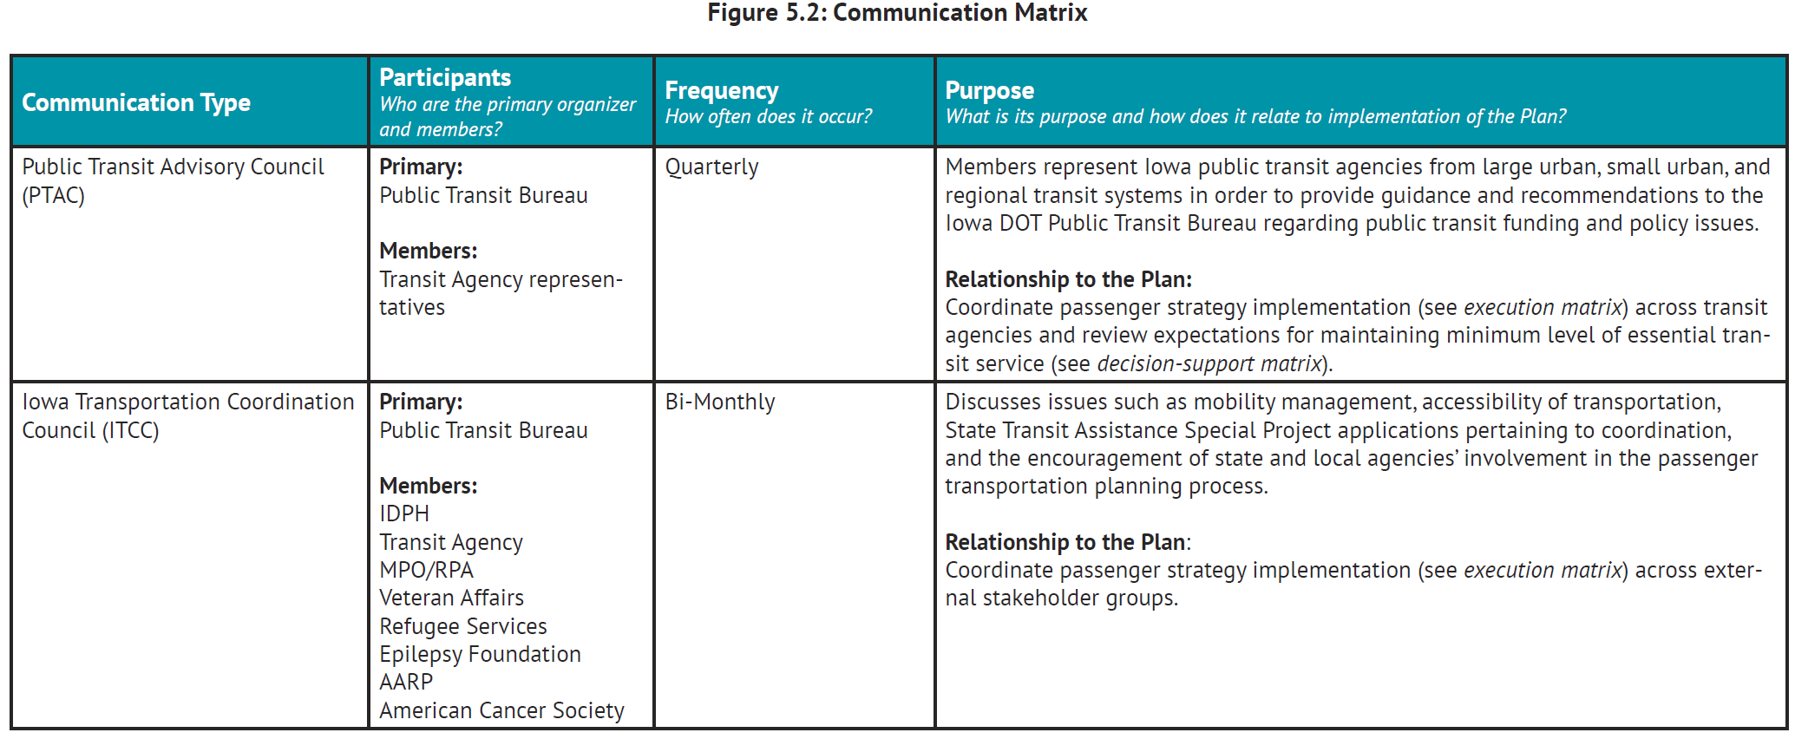
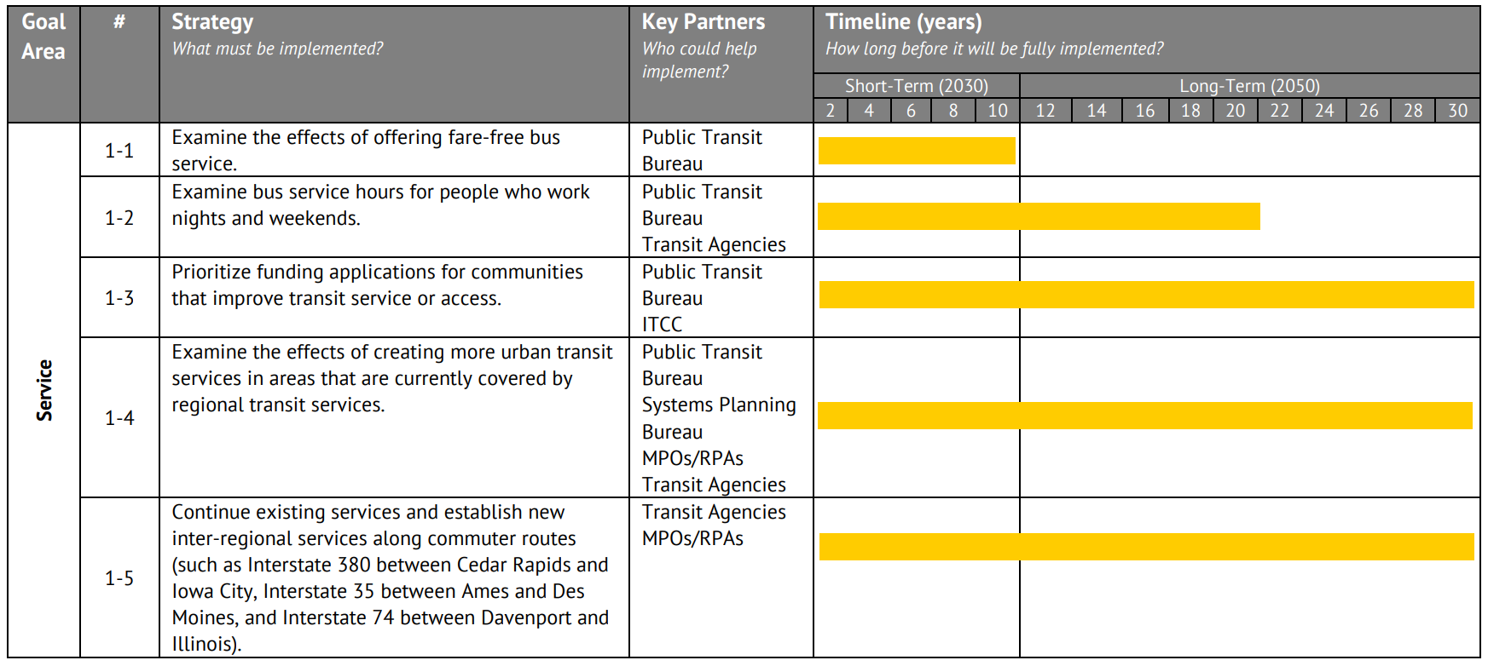
Next Steps
Transit Dependency Analysis
Implementation
Maintaining contact with partners who will help implement the Plan.
Leverage those partnerships to execute the vision of the Plan through executing strategies, action items, and projects.
Setting realistic goals for project completion dates.
Defining a “minimum level of essential transit service”
Devising an appropriate response mechanism to guarantee essential services during disruptive events

Slide 14
THANK YOU
Questions
Iowa Public Transit Long Range Plan
FOR YOUR ATTENTION
What are your questions?

