Slide 1
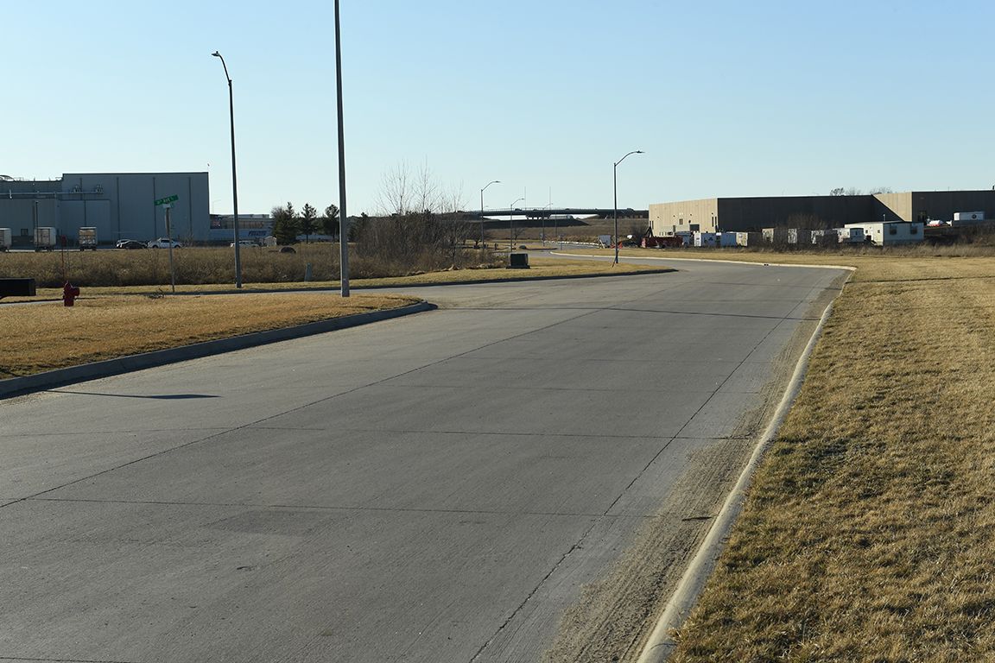
Revitalize Iowa’s Sound Economy Program
Iowa Transportation Commission Workshop
July 13, 2021

Slide 2
City of Ames Settlement
Immediate Opportunity award was approved by the Transportation Commission on April 8, 2014.
Project is associated with development of an expansion of the Iowa State University Research Park, facilitating the creation of jobs at Workiva (formerly WebFilings):
Contingency required creation of 365 new full-time jobs
138 jobs have been documented by payrolls (38%)
Final eligible total project costs = $4,487,459.75
Total RISE reimbursement = $3,589,967.80 (80%)

Slide 3
University Research Park Local Development Policy
University research park policy approved by the Transportation Commission on December 11, 2018.
Policy approved due to university research parks having a higher likelihood of generating economic development than a general local development site.
Provides RISE participation up to 70 percent of eligible project costs for Local Development projects in university research parks.
Project monitoring is accomplished through annual reporting documenting business development and job creation. This provides more credit than a typical Local Development project.

Slide 4
Option 1: Immediate Opportunity Settlement
50% of project costs are credited (equivalent to existing local development policy), remaining RISE reimbursed costs are prorated based on compliance with job creation contingency to determine settlement.
Final eligible total project costs = $4,487,459.75
80% RISE funds disbursed = $3,589,967.80
Less credit of 50% of total project costs = $2,243,729.88
RISE Differential = $1,346,237.92
% of job creation contingency unfulfilled = 62%
Settlement = RISE Differential x 62% = $834,668 (rounded)

Slide 5
Option 2: Modified Immediate Opportunity Settlement
70% of project costs are credited (equivalent to existing university research park local development policy), then prorate settlement based on lack of job creation.
Final eligible total project costs = $4,487,459.75
80% RISE funds disbursed = $3,589,967.80
Less credit of 70% of total project costs = $3,141,221.83
Difference between 80% and 70% reimbursement = $448,745.97
% of job creation contingency unfulfilled = 62%
Settlement = RISE reimbursement difference x 62% = $278,223 (rounded)

Slide 6
Comparison
 | OPTION 1 | OPTION 2
A. RISE Funds Dispersed | $3,589,967.80 | $3,589,967.80
B. Eligible Project Costs | $4,487,459.75 | $4,487,459.75
C. Percent of Costs Credited | 50% | 70%
D. Costs Credited (BxC) | $2,243,729.88 | $3,141,221.83
E. RISE Differential (A-D) | $1,346,238 | $448,746
F. Unfulfilled contingency | 62% | 62%
Settlement (ExF) | $834,668 | $278,223

Slide 7
Next Steps
Transportation Commission selects a settlement option – staff recommends Option 2.
Settlement amount is provided to the city of Ames and repayment schedule is agreed to.
The proposed settlement is recommended for approval at a future Transportation Commission Business meeting.

Slide 8
QUESTIONS?
Craig Markley, Systems Planning Bureau
craig.markley@iowadot.us
515-239-1027

