Slide 1
FY 2017 & FY 2018 Highway-Railroad Crossing Safety Program
(Project Cost Amendments)
July 13, 2021

Slide 2
Program
FHWA Funding available for states to improve warning devices at railroad crossings. (23 USC Section 130)
Amount of appropriation funded by FHWA is determined by the number of public crossings in the state.
Iowa currently has 4,950 public railroad crossings.

Slide 3
Project Evaluation Criteria
Benefit-Cost Ratio
Formula includes:
Number of accidents
Exposure Index: (number of trains x number of vehicles)
Train traffic
Vehicle traffic
Predicted Accidents: (train speed, roadway speed, number of traffic lanes, number of tracks)
Existing warning devices vs. possible upgrades
On-site safety diagnostic review
An application must be filed with the department

Slide 4
Available Funding and Application Summary
90% Federal Funds from FHWA
10% match by Highway Authority or Railroad
Applicant can be either Highway Authority or Railroad, or combination of the two
FFY 2017 FHWA appropriation for Iowa was $5,059,655
FFY 2018 FHWA appropriation for Iowa was $5,053,515

Slide 5
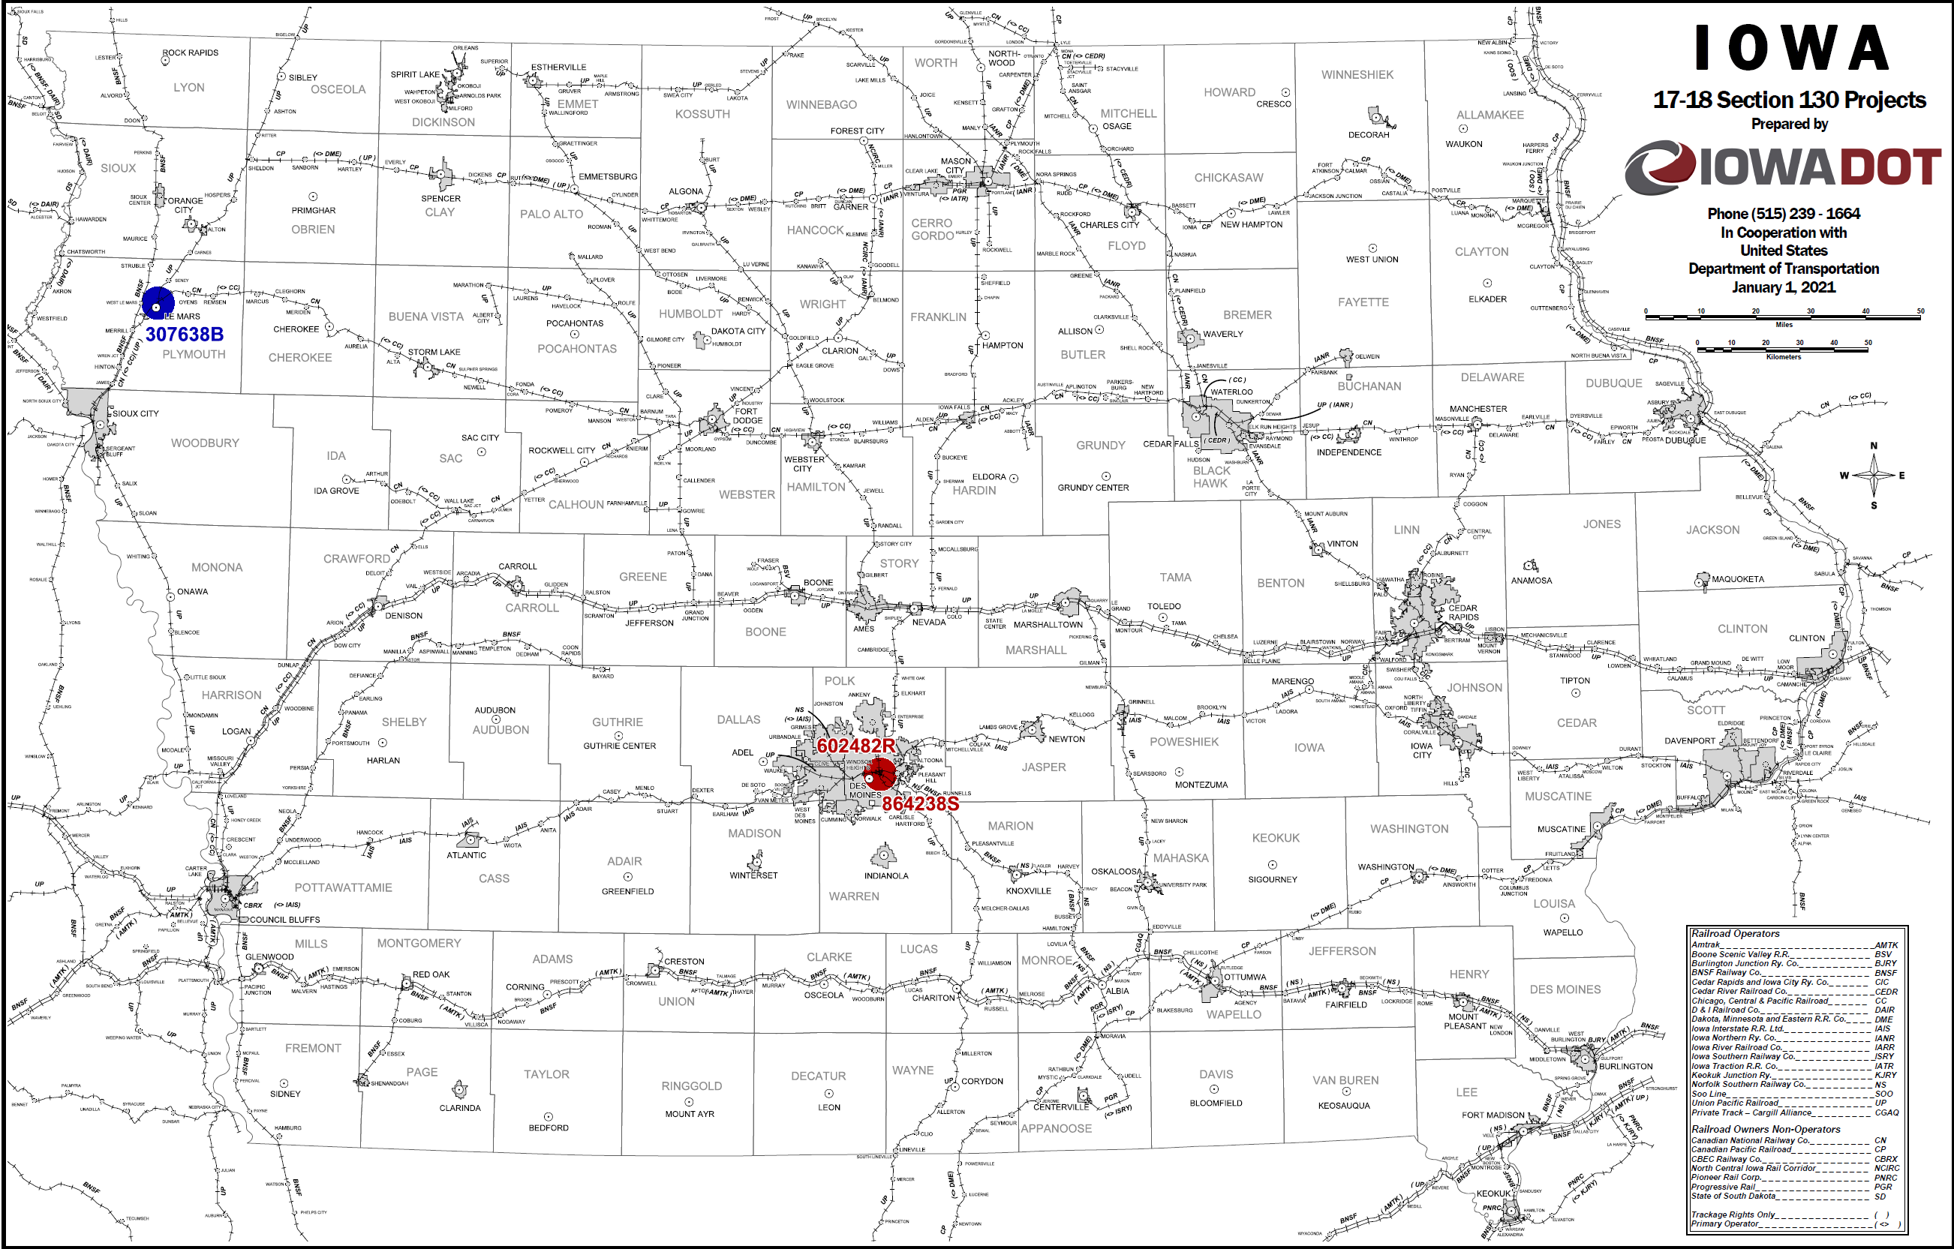
Map of Affected Projects

Slide 6
FY 17 Project RRP-RR00(186)--8A-00 Maury Street, Des Moines (864238S / 602482R)
Originally approved funding was for the installation of signal lights and gates for the Norfolk Southern Railroad crossing.
The signals need to be interconnected to the adjacent Union Pacific Railroad crossing signals, so the entire intersection is closed when a train approaches on either track. UP did not want to participate in this process until recently. Now that UP is participating, an additional gate needs to be installed on SE 22nd Street to truly prevent motorists from entering the intersection. Additionally, UP will remove their gate on the east side of their railroad crossing.

Slide 7
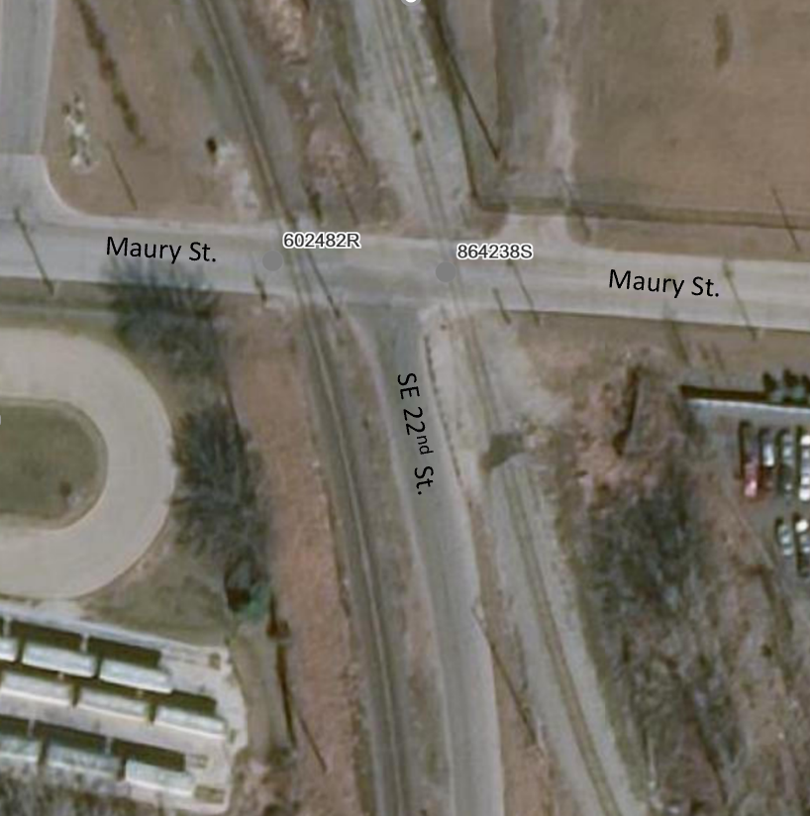
Maury Street Project Aerial

Slide 8
FY 18 Project RRP-RR10(197)--8A-00 IA 3, Le Mars (307638B)
Originally approved funding was for the installation of signal lights and gates.
Signals could not be installed because the Fareway parking lot entrance is within the prescribed placement of the signals / gates. Fareway would not approve the closure of this entrance.
Fareway recently allowed the closure of the parking lot entrance. This requires that the lighting and striping within the parking lot be reconfigured.
In addition, the roadway curbside parking is being eliminated along with a business entrance on the south side of the roadway, near the railroad crossing; and a median is being installed.
The District will be purchasing temporary and permanent right-of-way easements necessary for the project.

Slide 9
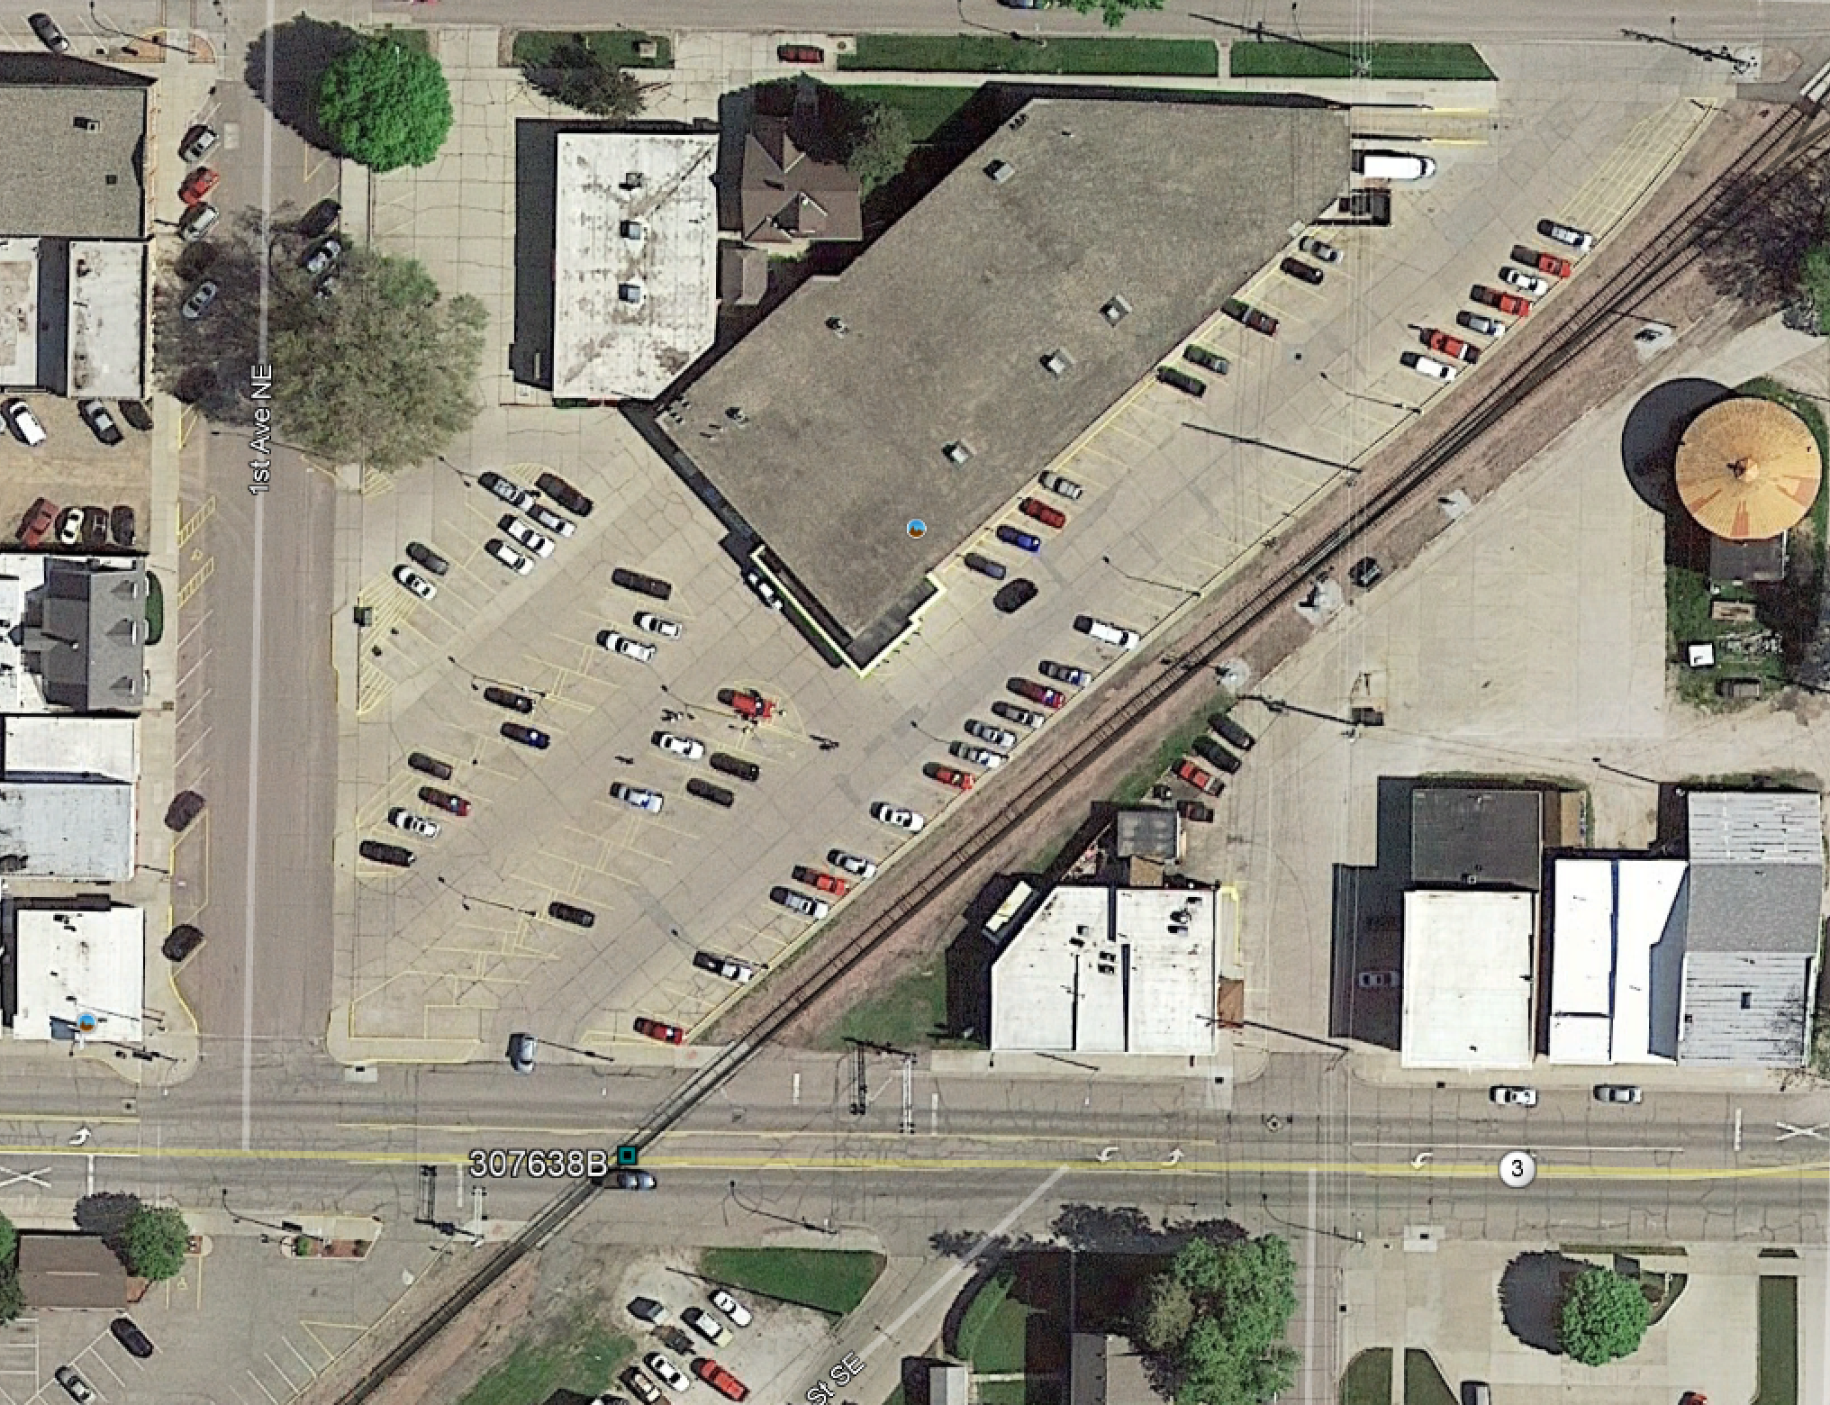
IA 3 Project Aerial
Fareway

Slide 10
List of Previously Awarded Applications
ORIGINAL APPROVED AMOUNT
NEW REQUESTED AMOUNT
NEW RECOMMENDED AMOUNT
PROJECT NAME
SPONSOR
Maury Street, 864238S (NS) 602482R (UP) | Norfolk Southern Railroad Union Pacific Railroad City of Des Moines | $380,000 | $692,080 | $692,080
Highway IA 3, 307638B | Union Pacific Iowa DOT, District 3 | $225,000 | $395,000 signals $234,326 roadway $629,326 | $629,326
TOTALS: $605,000 $ 1,303,406 $ 1,303,406

Slide 11
Proposed Action
Approve cost increase associated with one FY 2017 project and one FY 2018 project previously approved for funding by the Transportation Commission
A comprehensive Diagnostic Review revealed that additional safety measures were necessary at both railroad crossings.
It has taken several years working with stakeholders to agree upon and coordinate the additional work necessary at each location. The additional work carries additional costs.
The additional project costs are offset by three other projects that Union Pacific Railroad has cancelled in the last year.
Additional costs associated with project RR00(186)
Maury St., Des Moines: $ 312,080
Additional costs associated with project RR10(197) IA 3, Le Mars: $ 404,326
Total additional costs for both projects: $ 716,406
Total costs associated with the three cancelled UP projects: $1,341,000
Cost difference: + $ 624,594

Slide 12
QUESTIONS?
Kristopher Klop
Interim Section 130 Program Manager
kristopher.klop@iowadot.us

