Slide 1
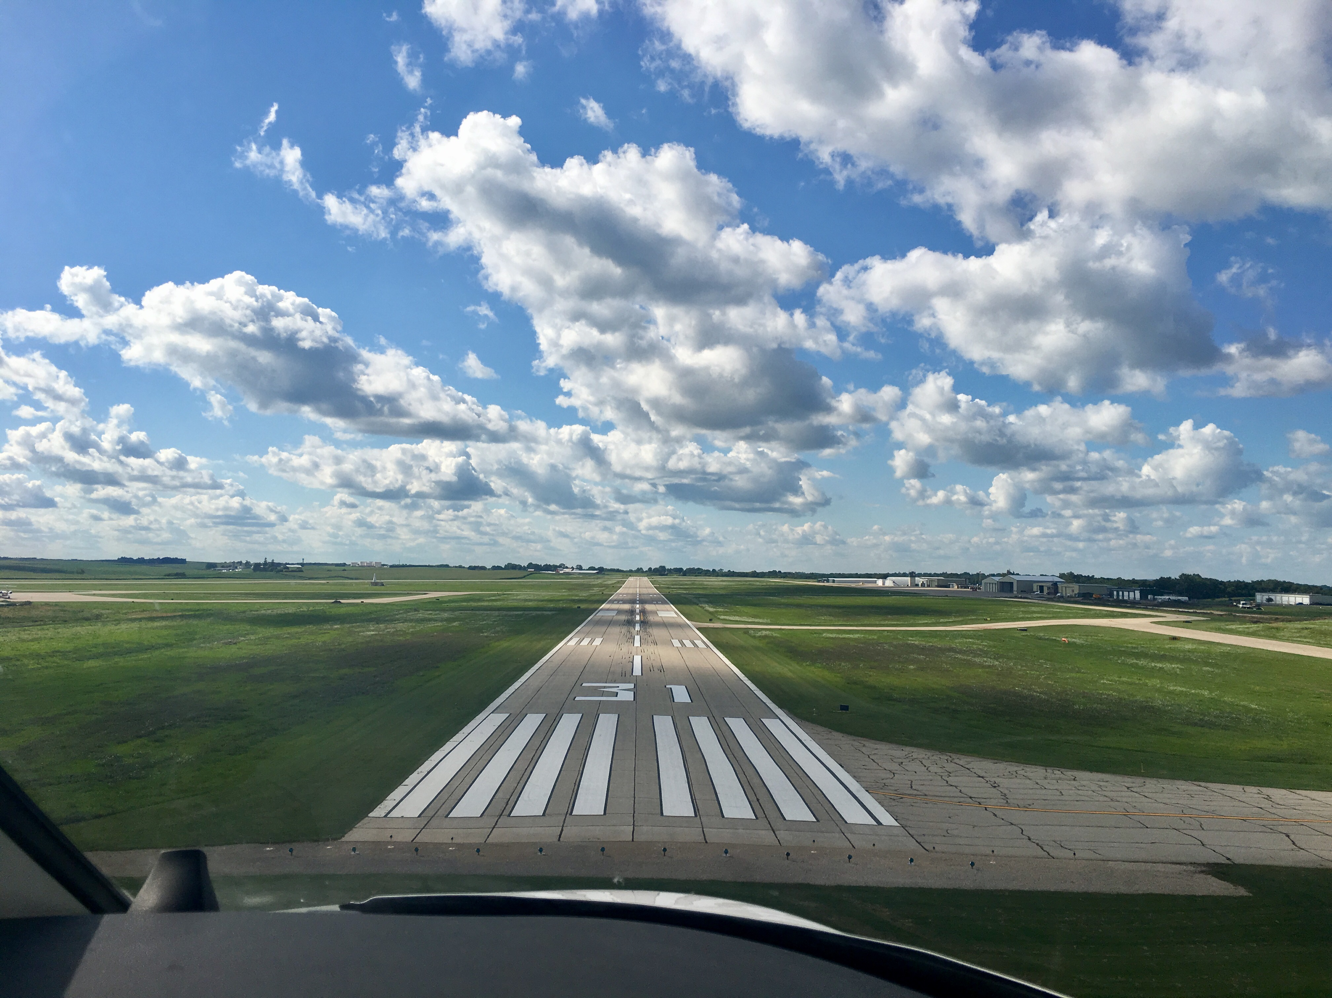

FY22 State Aviation Program
Funding Recommendation

Slide 2

State Aviation Program - AIP
Includes Airport Improvement Program (AIP)
Public-owned airport sponsors may apply for grants to assist in the preservation and development of the airfield and related infrastructure.
Eligible projects are funded up to 85% and generally include planning and improvements related to enhancing airport safety, capacity, security and environmental concerns.

Slide 3
Project Evaluation Criteria
Airport Role (5-20 Points)
Local participation (5-30 Points)
Multi-jurisdictional support (0-10 Points)
Type of project (5-30 Points)
Justification (5-20 Points)

Slide 4
Available Funding and Application Summary
Available Funding:
  FY22 Funds Available: $ 4,040,038
  Aviation Safety Programs: $ (410,420)
  Aviation Development Programs: $ (468,000)
  Funds available for projects: $ 3,161,618
Application Summary:
  Total number of applications: 44
  Total project costs: $12,752,886
  Total amount requested: $6,326,436

Slide 5
List of Applications Recommended
PROJECT NAME | SPONSOR | SCORE | TOTAL PROJECT COST | REQUESTED AMOUNT (% of Total Project Cost) | RECOMMENDED AMOUNT (% of Total Project Cost)
Construct Fuel Farm Improvements | The Eastern Iowa Airport | 90 | 5,000,000 | 305,000(6%) | 305,000(6%)
Taxiway D Apron and Access Road Paving | Ankeny Regional Airport | 85 | 694,850 | 312,682(45%) | 312,682(45%)
Relocate ASOS and SWS Equipment | Des Moines International Airport | 80 | 85,000 | 59,500(70%) | 59,500(70%)
Construct Building Approach Slab | Council Bluffs Municipal Airport | 75 | 165,200 | 82,600(50%) | 82,600(50%)
Widen Taxiway B | Fort Dodge Regional Airport | 70 | 251,500 | 196,000(78%) | 196,000(78%)
Terminal Area Fencing | Clinton Municipal Airport | 70 | 137,500 | 115,500(84%) | 115,500(84%)
Reconstruct Taxilane | Southeast Iowa Regional Airport | 70 | 137,370 | 115,390(84%) | 115,390(84%)
Construct Apron and Taxiway | Iowa City Municipal Airport | 65 | 413,750 | 351,687(85%) | 351,687(85%)
Taxiway and Apron Expansion | Independence Municipal Airport | 65 | 350,150 | 297,627(85%) | 297,627(85%)
Apron Improvements | Ottumwa Regional Airport | 65 | 265,000 | 225,250(85%) | 225,250(85%)
Fencing and Entrance Road Drainage Improvements | Creston Municipal Airport | 65 | 210,000 | 168,000(80%) | 168,000(80%)
Widen Taxilane | Muscatine Municipal Airport | 65 | 151,700 | 128,945(85%) | 128,945(85%)
Fuel System Repair and Modifications | Washington Municipal Airport | 65 | 315,600 | 268,260(85%) | 153,962(85%)
Hangar Apron Rehabilitation | Fairfield Municipal Airport | 65 | 122,886 | 104,453(85%) | 104,453(85%)
Replace Airport Lighting | Mount Ayr Municipal Airport | 65 | 93,450 | 70,087(75%) | 70,087(75%)
Taxiway and Apron Extension | Monticello Regional Airport | 65 | 80,000 | 64,000(80%) | 64,000(80%)
Runway Pavement Repairs | Sibley Municipal Airport | 65 | 65,500 | 55,675(85%) | 55,675(85%)
Tree Removal | Emmetsburg Municipal Airport | 65 | 40,000 | 34,000(85%) | 34,000(85%)
Runway Drainage Improvements | Cresco Municipal Airport | 60 | 130,000 | 110,500(85%) | 110,500(85%)
Fuel Farm Replacement | Osceola Municipal Airport | 60 | 292,405 | 247,405(85%) | 97,405(85%)
Construct Aprons for Box Hangars | Boone Municipal Airport | 60 | 99,220 | 84,337(85%) | 84,337(85%)
Fence Extension | Le Mars Municipal Airport | 60 | 22,375 | 19,018(85%) | 19,018(85%)
Construct Airport Entrance Sign | Council Bluffs Municipal Airport | 60 | 20,000 | 10,000(50%) | 10,000(50%)
Jump to applications not recommended for funding

Slide 6
State Aviation Program - GAVI
General Aviation Vertical Infrastructure(GAVI)
Public owned general aviation airport sponsors may apply for projects that include landside development and renovation of airport terminals, hangars, maintenance buildings, and fuel facilities.
Eligible projects are funded up to 85%
Funds are subject to annual appropriation

Slide 7
Project Evaluation Criteria
Airport Role (5-20 Points)
Local participation (5-30 Points)
Multi-jurisdictional support (0-10 Points)
Type of project (10-30 Points)
Justification (5-20 Points)

Slide 8
Available Funding and Application Summary
Available Funding:
  FY22 Funds Appropriated: $1,000,000
  Underrun: $43,433
  Funds available for projects $1,043,433
Application Summary:
  Total number of applications: 12
  Total project costs: $2,232,571
  Total amount requested: $1,043,433

Slide 9
List of GAVI Applications Recommended
PROJECT NAME | SPONSOR | SCORE | TOTAL PROJECT COST | REQUESTED AMOUNT (% of Total Project Cost) | RECOMMENDED AMOUNT (% of Total Project Cost)
Construct New Hangar | Winterset Municipal Airport | 85 | 550,000 | 150,000 (27%) | 150,000 (27%)
Fuel Farm Replacement | Osceola Municipal Airport | 85 | 292,405 | 150,000 (85%) | 150,000 (85%)
Construct Equipment Storage Building | Council Bluffs Municipal Airport | 80 | 357,600 | 150,000(42%) | 150,000(42%)
Fuel System Repair and Modifications | Washington Municipal Airport | 80 | 315,600 | 114,298 (85%) | 114,298(85%)
Construct Two Unit Box Hangar | Boone Municipal Airport | 80 | 299,400 | 150,000 (50%) | 150,000 (50%)
Replace Hangar Door | Algona Municipal Airport | 75 | 85,000 | 63,750(75%) | 63,750(75%)
Replace Hangar Doors | Iowa City Municipal Airport | 75 | 94,000 | 75,000(80%) | 75,000(80%)
Hangar Rehabilitation | Sac City Municipal Airport | 75 | 35,258 | 21,154(60%) | 21,154(60%)
Hangar Rehabilitation | Mount Ayr Municipal Airport | 65 | 35,808 | 26,856(75%) | 26,856(75%)
Fuel System Improvements | Sheldon Regional Airport | 65 | 42,500 | 36,125(85%) | 36,125(85%)
Hangar Repair | Jefferson Municipal Airport | 60 | 50,000 | 42,500(85%) | 42,500(85%)
Hangar Exterior Improvements | Fort Madison Municipal Airport | 60 | 75,000 | 63,750 (85%) | 63,750 (85%)
Jump to applications not recommended for funding

Slide 10
State Aviation Program - CSVI
The Commercial Service Vertical Infrastructure (CSVI) program provides funding for landside development and renovation of terminals, hangars, maintenance buildings, and fuel facilities at commercial service airports.
Appropriated funds are distributed to the commercial service airports formula with no local match required.
    50% evenly split between the airports
    40% based on enplanements
    10% based on cargo activity

Slide 11
Available Funding and Application Summary
Available Funding:
  FY22 Funds Appropriated: $1,900,000
  Funds available for projects: $1,900,000
Application Summary:
  Total number of projects: 8
  Total project costs: $48,187,842
  Total amount requested: $1,900,000

Slide 12
List of CSVI Applications Recommended
PROJECT NAME | SPONSOR | SCORE | TOTAL PROJECT COST | REQUESTED AMOUNT (% of Total Project Cost) | RECOMMENDED AMOUNT (% of Total Project Cost)
Parking Garage Addition | Des Moines International Airport | N/A | 39,000,000 | 705,019 | 705,019
Generator Relocation, Fuel System Improvements, and Equipment Lift | Dubuque Regional Airport* | N/A | 384,000 | 131,700 | 131,700
Construct Hangars | Eastern Iowa Airport | N/A | 7,819,933 | 437,166 | 437,166
Construct Hangar and Terminal Improvements | Fort Dodge Regional Airport | N/A | 390,000 | 121,585 | 121,585
Equipment Storage Facility Improvement | Mason City Municipal Airport | N/A | 110,000 | 121,493 | 121,493
Terminal Improvements | Sioux Gateway Airport* | N/A | 134,800 | 134,800 | 134,800
Terminal, Maintenance building and Hangar Rehabilitation | Southeast Iowa Regional Airport | N/A | 150,000 | 121,486 | 121,486
Hangar Rehabilitation | Waterloo Regional Airport* | N/A | 187,616 | 126,752 | 126,752
* Airports requesting to use funds from previous years on FY22 projects

Slide 14

QUESTIONS?
Shane Wright
Aviation Program Manager
Shane.Wright@iowadot.us

Slide 15
List of AIP Applications Not Recommended
PROJECT NAME | SPONSOR | SCORE | TOTAL PROJECT COST | REQUESTED AMOUNT (% of Total Project Cost) | RECOMMENDED AMOUNT (% of Total Project Cost)
Taxilane Joint Seal Replacement | Davenport Municipal Airport | 80 | 117,015 | 58,508 (50%) | 0
Glideslope Ditch Improvements | Fort Dodge Regional Airport | 70 | 123,700 | 61,850 (50%) | 0
Repair Perimeter Fencing | Southeast Iowa Regional Airport | 65 | 48,000 | 40,320 (84%) | 0
Fuel System Improvements | Fort Dodge Regional Airport | 65 | 35,000 | 29,750 (85%) | 0
Taxilane Rehabilitation | Harlan Municipal Airport | 60 | 330,380 | 280,823 (85%) | 0
Apron and Taxiway Reconstruction | Estherville Municipal Airport | 60 | 259,180 | 220,303 (85%) | 0
Improve Drainage for Runway 18/36 | Pocahontas Municipal Airport | 60 | 182,000 | 154,700 (85%) | 0
Expand Apron | Perry Municipal Airport | 60 | 173,840 | 147,764 (85%) | 0
Runway Improvements | Cresco Municipal Airport | 60 | 145,000 | 116,000 (80%) | 0
Taxilane Preservation | Boone Municipal Airport | 60 | 104,165 | 88,540 (85%) | 0
Bury Power Lines - Runway 17 Approach | Marion Municipal Airport | 60 | 195,000 | 165,750 (85%) | 0
Paved Shoulder Replacement | Sioux Gateway Airport | 55 | 540,000 | 405,000 (75%) | 0
Fuel System Improvements | Jefferson Municipal Airport | 55 | 401,200 | 341,020 (85%) | 0
Reconstruct T-Hangar Taxilanes | Waverly Municipal Airport | 55 | 386,300 | 309,040 (80%) | 0
Install PAPI | Marion Municipal Airport | 55 | 175,500 | 149,175 (85%) | 0
Add Runway Turnarounds | Mount Ayr Municipal Airport | 55 | 22,000 | 16,500 (75%) | 0
Pilot Activated Lighting System | Woodbine Municipal Airport | 55 | 1,000 | 850 (85%) | 0
Drainage Improvements | Le Mars Municipal Airport | 50 | 67,850 | 57,672 (85%) | 0
Parking Lot Expansion | Iowa City Municipal Airport | 45 | 85,000 | 72,250 (85%) | 0
Parking Lot Expansion | Knoxville Municipal Airport | 40 | 174,800 | 148,580 (85%) | 0
Jump to applications recommended for funding

Slide 16
List of GAVI Applications Not Recommended
PROJECT NAME | SPONSOR | SCORE | TOTAL PROJECT COST | REQUESTED AMOUNT (% of Total Project Cost) | RECOMMENDED AMOUNT (% of Total Project Cost)
Jump to applications recommended for funding

