Slide 1
State Transportation Plan & State Freight Plan
2022 Updates
Commission Workshop
July 13, 2021

Slide 2
Agenda
Public survey summary
Rightsizing policy effort
Needs analyses
Wrap up

Slide 3
Public Survey Summary
Commission Workshop
July 13, 2021

Slide 4
Public input survey
Was available May 19 – June 8
Advertised through press release, social media, and extensive stakeholder distribution
281 responses
Good geographic coverage, but limited media coverage and general participation
Results still provide good feedback; considering options for conducting another similar survey
Notes:
Was available May 19 – June 8
Advertised through press release, social media, and stakeholder distribution
281 responses
More than 2012 long-range plan survey; less than 2017 surveys
Good geographic coverage
However, there was limited media coverage and general participation
Demographics skew towards non-disadvantaged groups
Results still provide good feedback; considering options for conducting a similar survey later this summer.
Will consider other options for general public engagement, but also focusing on engaging internal and external stakeholders for relevant pieces of the plan

Slide 5
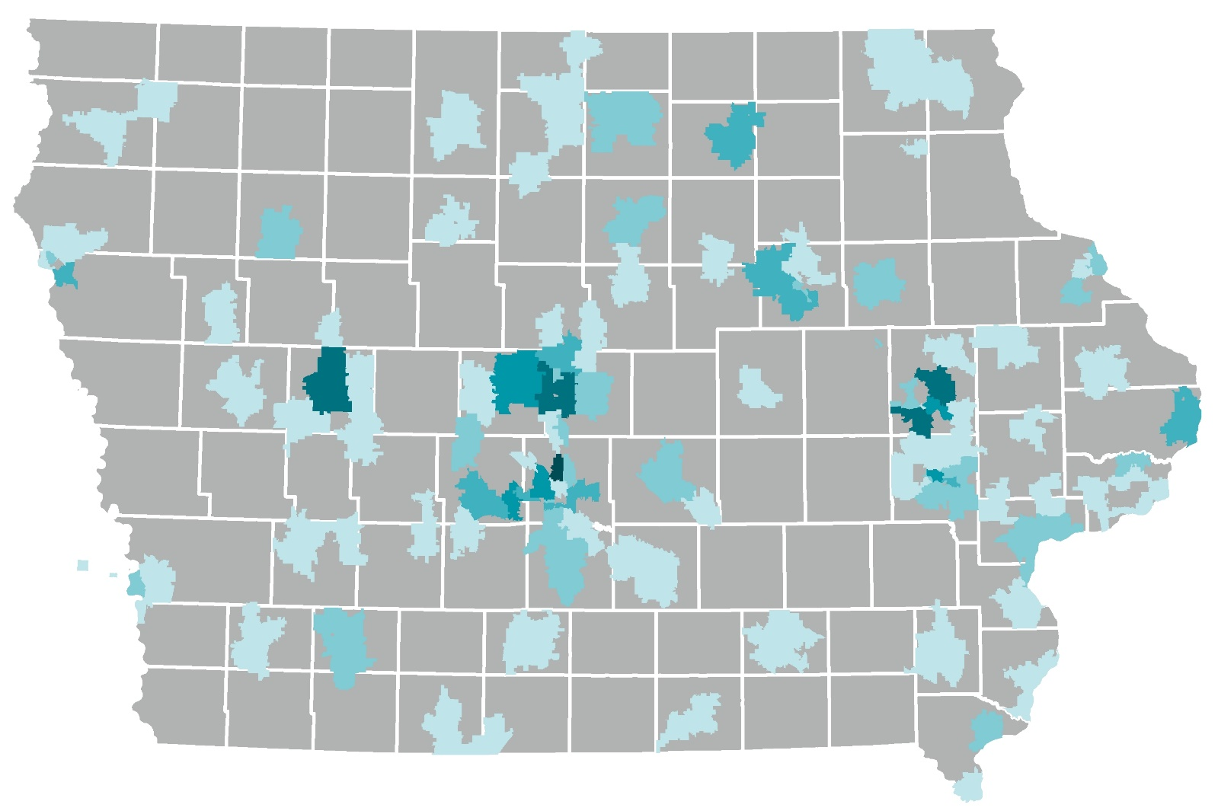
Responses by zip code

Slide 6
COVID-19 impacts
Changes in travel modes
Increase in home deliveries
Increase in working from home
Notes:
Changes in travel modes
People were asked how their usage of transportation modes change from before the pandemic to during the pandemic.
Regarding post pandemic travel, overall the results suggest respondents believe they will use personal travel modes – such as walking, riding a bike, driving – more often than they did pre-pandemic, and use shared modes such as public transit, taxis, and intercity bus less often.
Increase in home deliveries; responses suggest this trend will likely continue beyond the pandemic, with 17% of people saying they will order more online in the future than they did pre-pandemic.
Changes in working from home

Slide 7
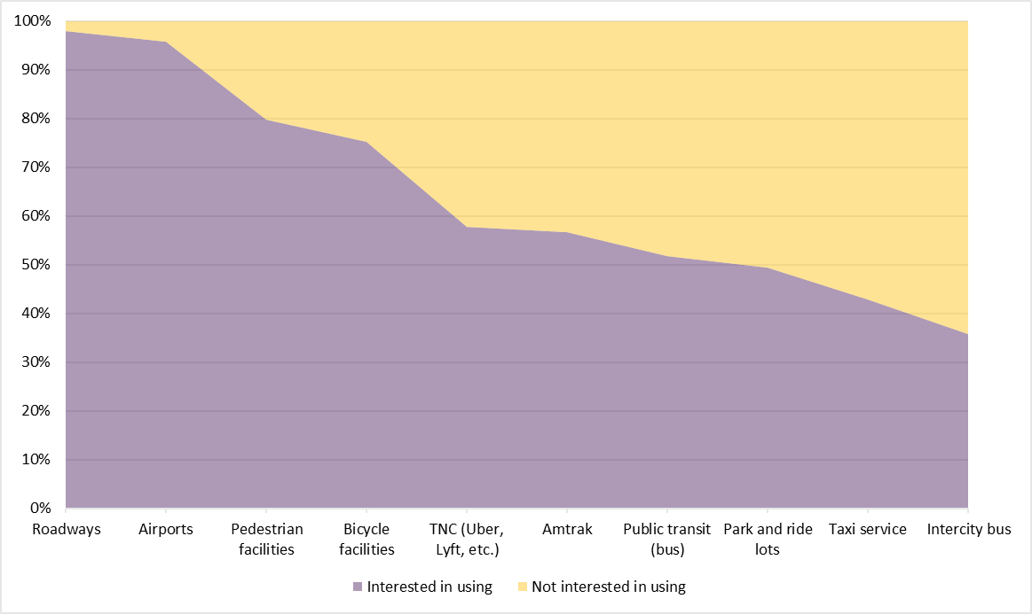
Level of interest in using mode/infrastructure
Notes:
These results are from the system objective questions, but they correlate very well to the results from the questions about travel before/during/after the pandemic- interest in personal modes, less interest in shared modes.

Slide 8
System objectives insights
Modes/infrastructure ranked by percent of positive responses
 | Safety | Condition | Accessibility | Delay | Average
Airports | 1 | 1 | 2 | 7 | 2.75
Pedestrian facilities | 3 | 4 | 3 | 1 | 2.75
Bicycle facilities | 4 | 2 | 4 | 2 | 3
Roadways | 2 | 8 | 1 | 3 | 3.5
TNC (Uber, Lyft, etc.) | 8 | 3 | 5 | 5 | 5.25
Public transit (bus) | 6 | 5 | 7 | 6 | 6
Park and ride lots | 7 | 6 | 8 | 4 | 6.25
Amtrak | 5 | 7 | 10 | 10 | 8
Taxi service | 10 | 9 | 6 | 9 | 8.5
Intercity bus | 9 | 10 | 9 | 8 | 9
Notes:
Looking at how the modes and infrastructure rank for each system objective provides some interesting results.
The rankings are based on the percent of positive responses for each objective and they are ordered by the average ranking in the far-right column.
These rankings correlate to level of interest in using the mode as well as post-pandemic travel preferences.
Interesting to note some of the outliers in the higher ranking facilities – roadways were ranked 8th overall for condition, and airports 7th overall for delay.

Slide 9
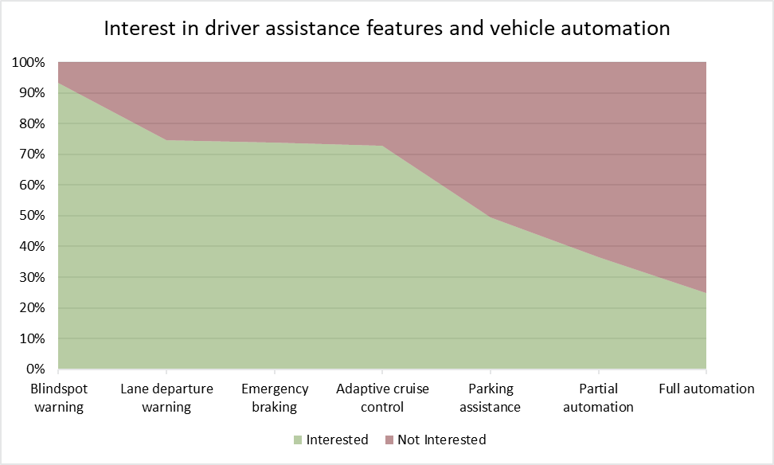
Future technology options
Notes:
We asked about people’s interest levels in various driver assistance features and automation features.
The majority of respondents who drive are interested in driver assistance features such as blindspot warnings, lane departure warnings, emergency braking, and adaptive cruise control; also, over half of respondents reported having some of these features in their current vehicle.
Less than 40 percent are interested in partial automation features, and less than 25 percent are interested in fully automated vehicles.
These results are very consistent with the 2017 long-range plan survey, which asked a similar question

Slide 10
Rightsizing Policy
Commission Workshop
July 13, 2021

Slide 11
Rightsizing “sweet spot”

Slide 12
Approach
Avoid temptation to gravitate to project development immediately
Initial focus on policy, adopted into SLRTP
Use initial policy to evaluate project development
Identify gaps and develop action items

Slide 13
Policy: Rightsizing definition
In summary…
Rightsizing means seeking an appropriate level and type of investment, and
leveraging existing assets and limited resources to maximize the returns for users.

Slide 14
Policy statements by topic
Defined need
Consideration of comprehensive needs
Stewardship priority
Stratification of the system
Addressing equity
Addressing resiliency
Addressing congestion or operational issues
Consideration of emerging technologies
Speculative development
Interchange access – under development

Slide 15
Needs Analyses
Commission Workshop
July 13, 2021

Slide 16
Critical analyses timeline
Infrastructure condition analysis (ICE) – complete
Operations analysis (ICE-OPS) – complete
Bottlenecks analysis (INRIX) – complete
Freight network updates – complete
Capacity analysis (iTRAM) – in review
Resiliency analysis – in review
Safety analysis – late summer
Modal systems analysis – ongoing
Accessibility/equity analysis – TBD

Slide 17
Infrastructure condition analysis (ICE)
Objective: Provides a composite rating based on the most recent infrastructure condition and performance data for the Primary Highway System
ICE Criteria | Percent of ICE Score
Pavement Condition Index | 25%
Bridge Condition Index | 25%
International Roughness Index | 15%
Combination Truck AADT | 15%
Single-Unit Truck AADT | 5%
Passenger AADT | 5%
Congestion Index (V/C) | 10%

Slide 18
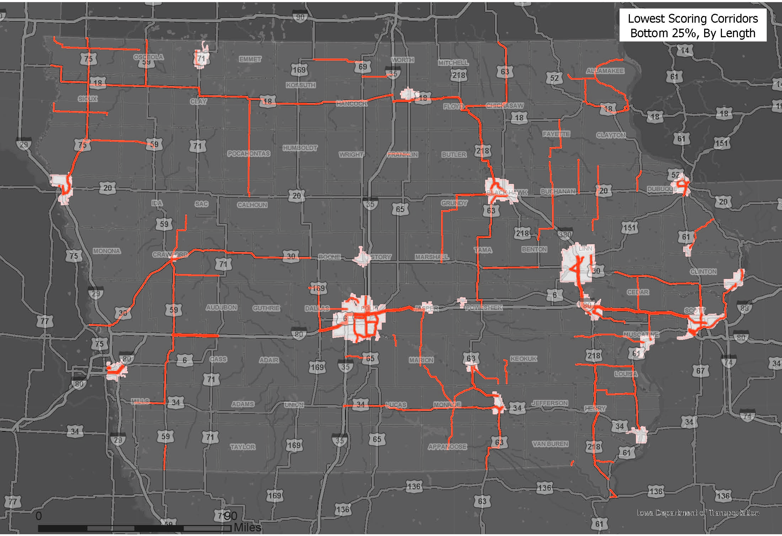
Notes:
This is the initial output for bottom 25% of the system.
Keep in mind that it is 2019 data.
We are considering how to display the data in the plan. The 2017 plan included a map like this – the bottom 25% was identified, but no additional detail was provided. We are considering categorizing the corridors by their standard deviation from the mean to help provide some additional context.

Slide 19
Operations analysis – ICE-OPS
Objective: Primary Highway System screening that quantifies the relative risk to safe and reliable operations
ICE-OPS Criteria | Percent of ICE-OPS Score
AADT | 20%
Annual Bottleneck Duration | 15%
Incident Density | 15%
Crash Rate | 15%
Buffer Time Index | 10%
Event Center Proximity | 5%
Flood Event Density | 5%
Winter Weather Sensitive Mileage | 5%
Freight Network Mileage | 5%
ICE Infrastructure Score | 5%
Notes:
The analysis helps identify corridors where strategies related to improving the operation of the system may be most beneficial.

Slide 20
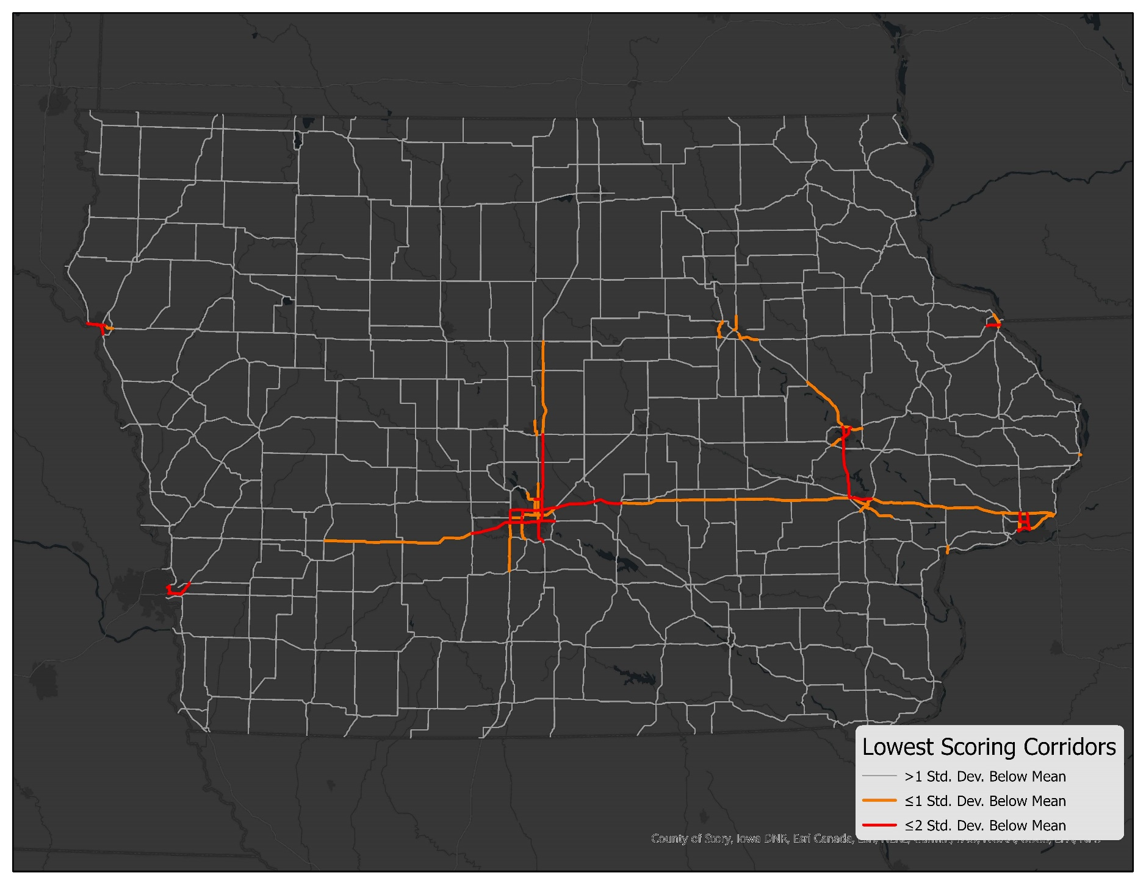
Notes:
The ICE-OPS update uses 2018 data.
This is example output that we could use, where the worst performing corridors are identified as those that are one or more standard deviation below the mean.

Slide 21
Bottlenecks analysis (INRIX)
Objective: Primary Highway System screening to identify locations that experience recurring traffic slow-downs
Refined methodology:
Identify segments that meet bottleneck definition
Calculate annual bottleneck duration per segment
Calculate bottleneck duration per mile
Isolate most severe bottlenecks
Next step: apply filters (e.g., freight, commuter, etc.)

Slide 22
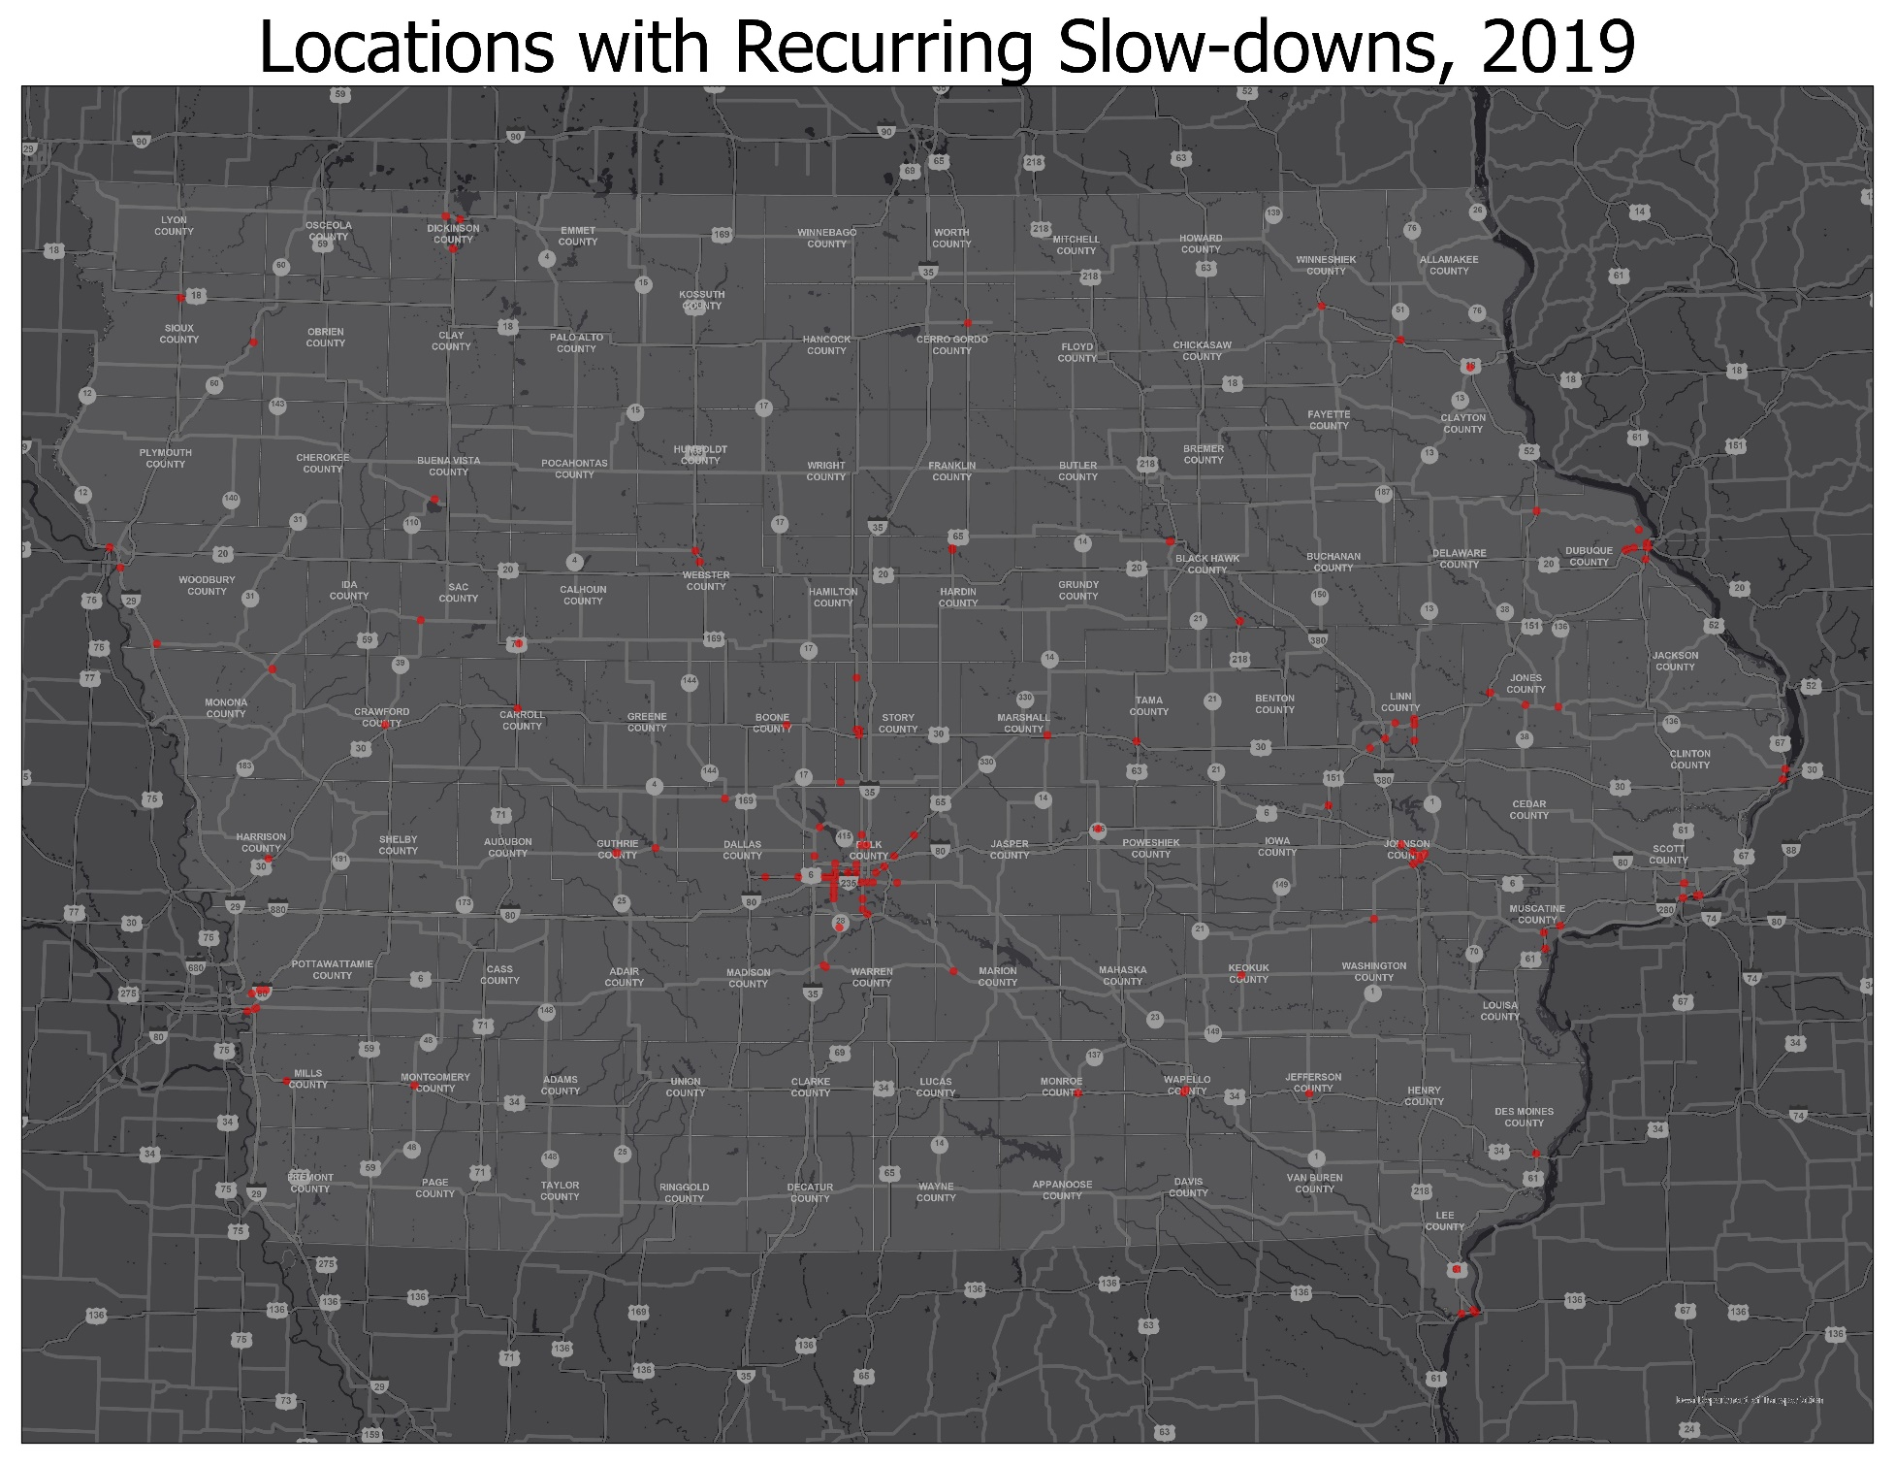

Slide 23
Freight network updates
Objective: Designate freight network locations to protect and enhance for improved freight mobility.
Methodology:
Air: major cargo airports
Highway: 30% truck traffic or 1000 truck AADT or 1000 oversize/overweight permits annually
Rail: 5 million tons per mile
Water: marine highways

Slide 24
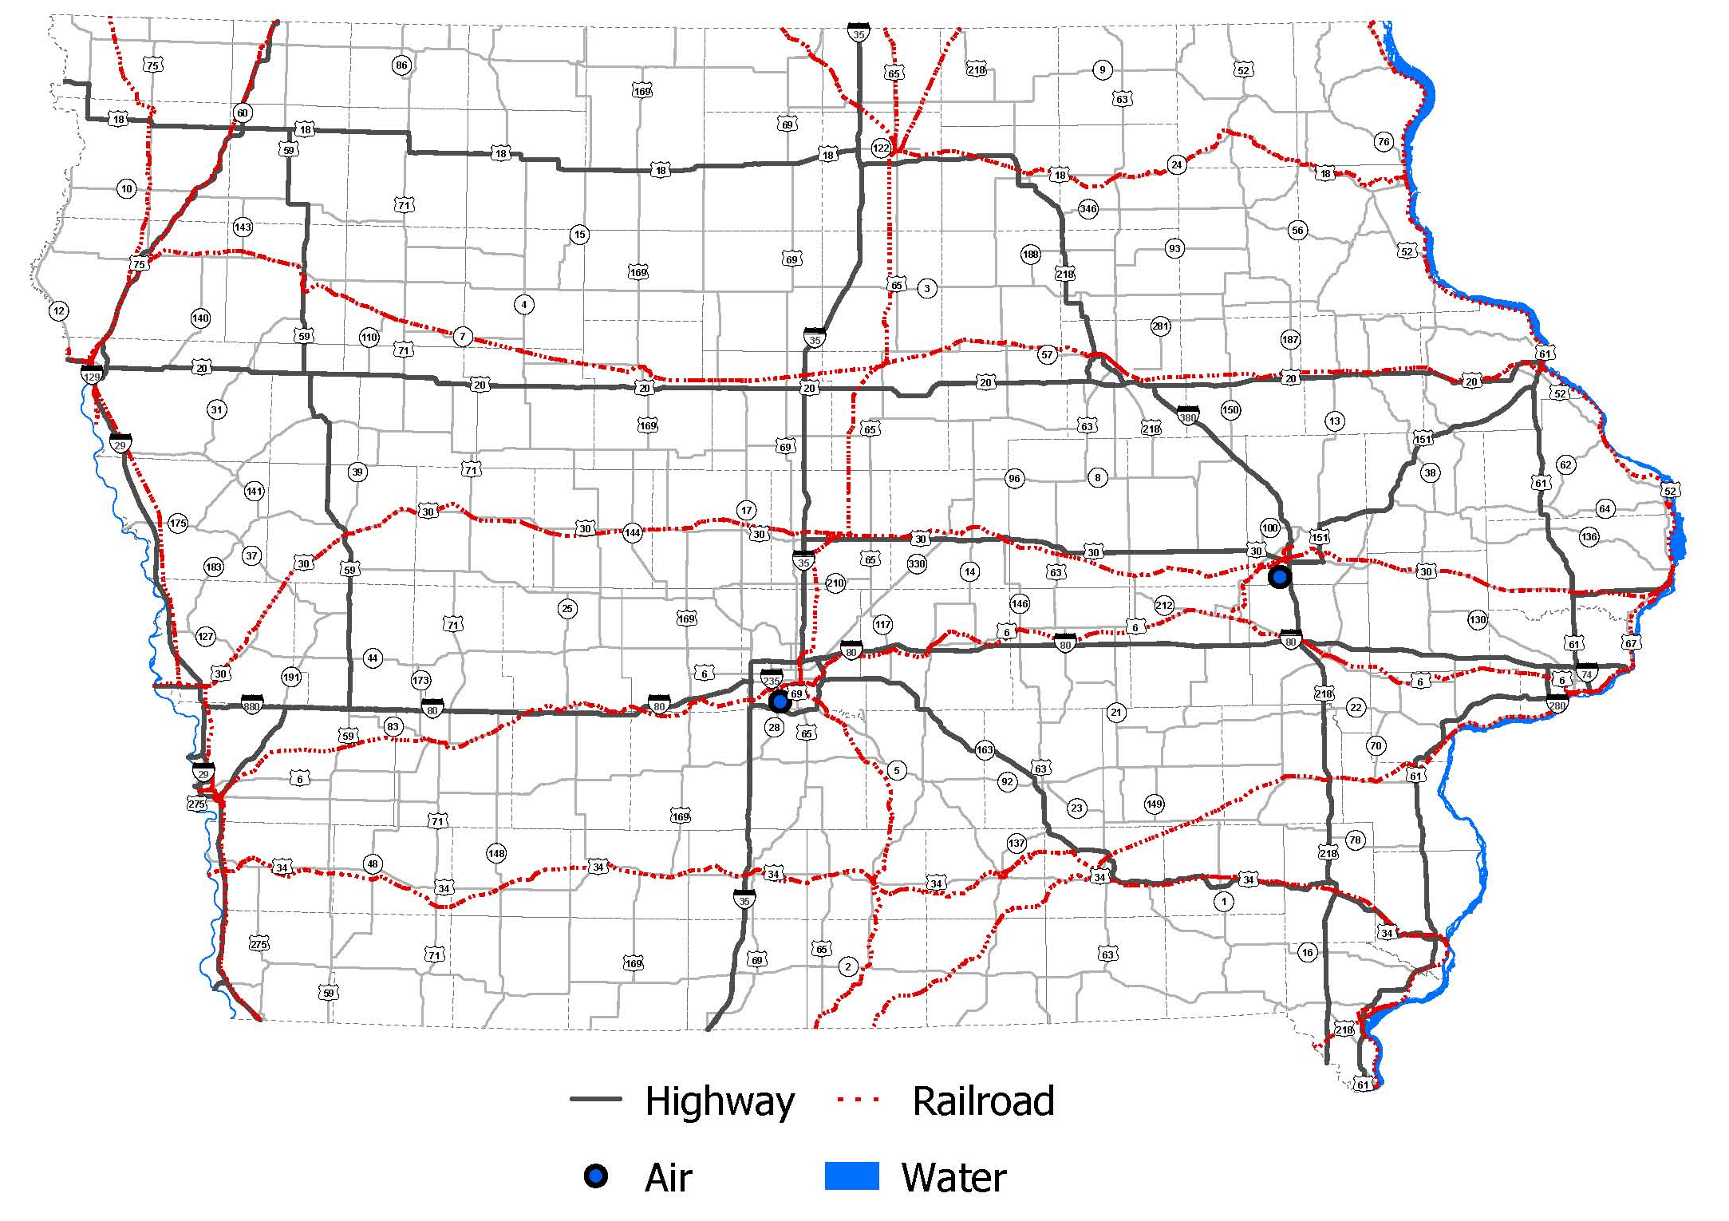

Slide 25
Wrap Up
Critical next step:
Complete needs analyses
Next Commission workshop discussion:
Remainder of needs analyses
Transition into strategies and actions

Slide 26
QUESTIONS?
Garrett.Pedersen@iowadot.us
Samuel.Hiscocks@iowadot.us
Andrea.White@iowadot.us

