Slide 1
Revitalize Iowa’s Sound Economy Program
Iowa Transportation Commission Business Meeting
July 12, 2022

Slide 2
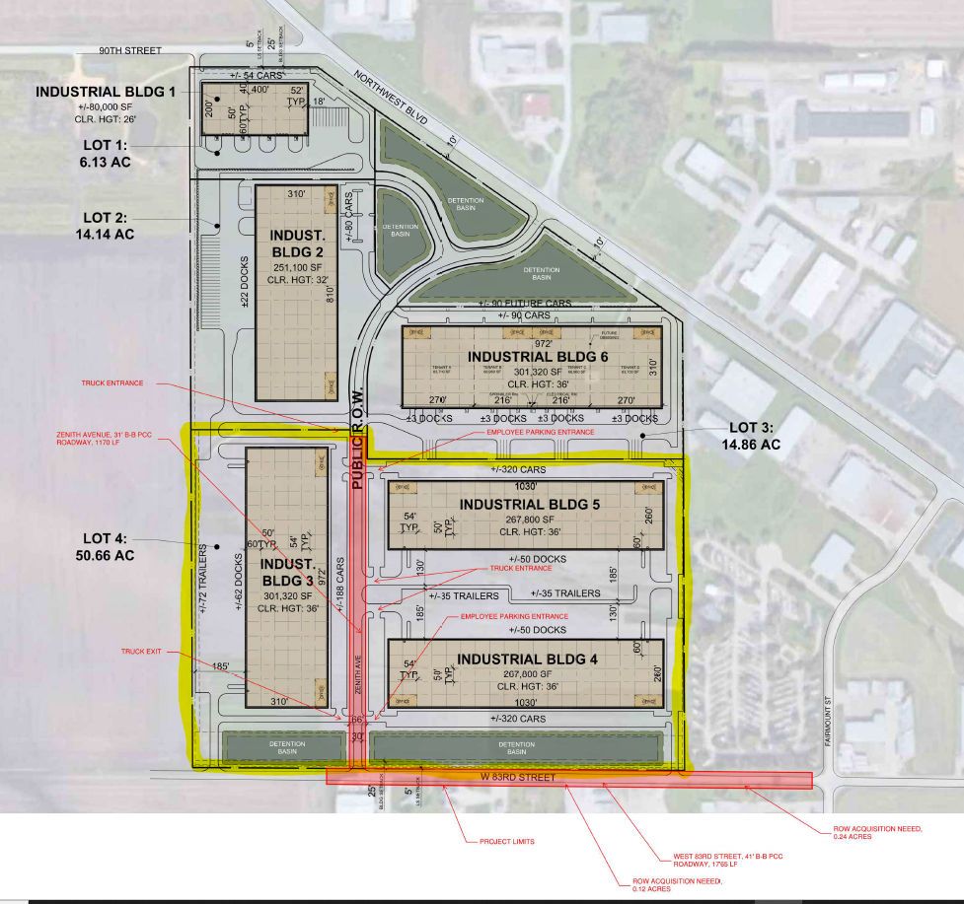
List of Local Development Applications Recommended
PROJECT NAME
SPONSOR
SCORE
TOTAL PROJECT COST
PERCENT PARTICIPATION
RECOMMENDED AMOUNT
Construction of approximately 1,170 feet of Zenith Avenue and reconstruction of approximately 1,765 feet of West 83rd Street. | Davenport | 50 | $1,884,147 | 50% | $942,074

