Slide 1
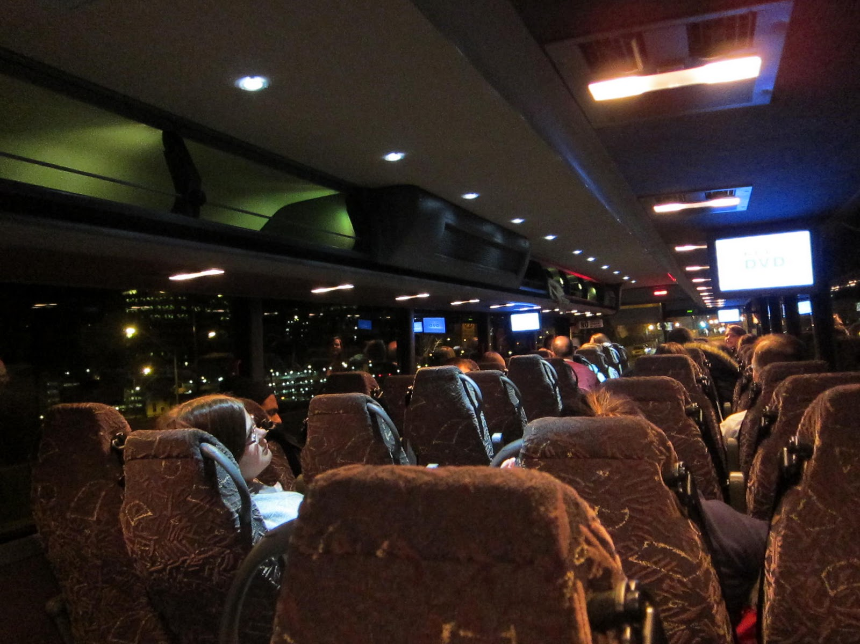

CY 22 Intercity Bus Program Amendment
July 12, 2022

Slide 2

Intercity Bus Program
CY22 Intercity Bus Program
Purpose: Support intercity bus services that includes stops at non-urbanized locations and makes meaningful connections to nationwide network
Available to private intercity bus companies, companies wishing to start bus service, public transit agencies either operating of proposing to operate bus service, and local communities wishing to support intercity connections to their community
Available Funding Source:15% of federal non-urbanized (FTA Section 5311) transit funding
Notes:
The intercity bus assistance program is a federally funded grant program that provides financial assistance to support intercity bus services that includes stops at non-urbanized locations and makes meaningful connections to nationwide network. Funding is available for private bus companies, public transit agencies, and local communities wishing to support intercity connections to their community to maintain the viability of intercity bus service in Iowa.

Slide 3
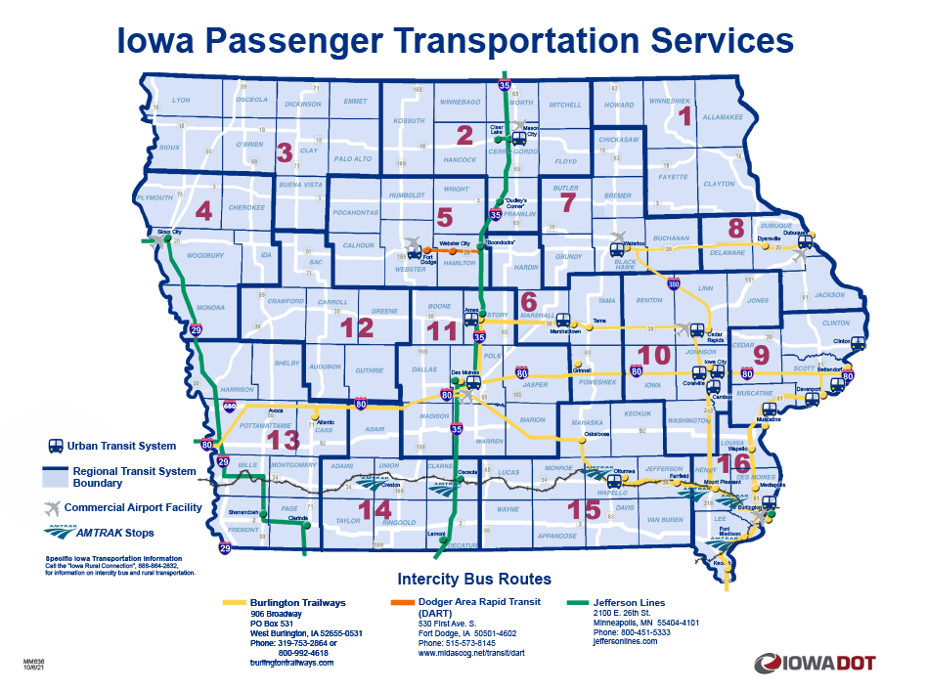
Intercity Bus Map
CY22 Intercity Bus Program
Notes:
This map provides the most recent and accurate Intercity Bus program transportation services.

Slide 4
Intercity Bus Program
CY22 Intercity Bus Program
In December 2021, the Calendar Year 2022 Intercity Bus Funding recommendations were presented to the Commission
Two of the Calendar Year 2022 intercity bus funding recipients, Jefferson Lines and Burlington Trailways, were awarded $0.20 per revenue mile operating assistance
Due to the COVID relief funding available to the intercity bus providers for continued operations, Burlington Trailways and Jefferson Lines are requesting the reprogramming of their CY22 operating dollars to capital, in an amount totaling $350,664

Slide 5
Available Funding Summary
CY22 Intercity Bus Program
Available Funding
Intercity Bus Funds being reprogrammed for CY22: $350,664 from operating assistance
Due to previous stimulus funding (CARES) that was awarded, and new funding being available (ARP), additional operating assistance has not and will not been used.
Additional contingency/underruns available from previous operating assistance: $651,591
Total amount of Intercity Bus Funding to be reallocated: $1,002,255

Slide 6
Funding and Application Proposal
CY22 Intercity Bus Program
Revised Proposal of Funding
Burlington Trailways requests an additional $496,932 for the purchase of an additional OTR Motor Coach. This estimated per motor coach cost is the same as the CY 22 requested amount of a Motor Coach.
Jefferson Lines requests as additional $450,500 for the purchase of an additional OTR Motor Coach. This estimated per motor coach cost is the same as the CY 22 requested awarded amount of a Motor Coach.
These requests total $947,432 and will leave an additional $54,823 in contingency/underruns to use for CY23 funding cycle.

Slide 7
CY22 Intercity Bus Program
CY22 Program Amendment Recommendation
PROJECT NAME | SPONSOR | TOTAL PROJECT COST | REQUESTED AMOUNT (% of Total Project Cost) | RECOMMENDED AMOUNT (% of Total Project Cost)
Operational Assistance | Burlington Trailways | $1,000,000 | $196,110 (19.6%) | $196,110 (19.6%)
OTR Motor Coach | Burlington Trailways | $584,627 | $496,932 (85%) | $496,932 (85%)
Burlington Trailways is requesting a change to the project. Funding for this additional cost comes from reprogrammed operating assistance.

Slide 8
CY22 Intercity Bus Program
CY22 Program Amendment Recommendation
PROJECT NAME | SPONSOR | TOTAL PROJECT COST | REQUESTED AMOUNT (% of Total Project Cost) | RECOMMENDED AMOUNT (% of Total Project Cost)
Operational Assistance | Jefferson Lines | $3,094,558 | $154,554 (4.99%) | $154,554 (4.99%)
OTR Motor Coach | Jefferson Lines | $530,000 | $450,500 (85%) | $450,500 (85%)
Jefferson Lines is requesting a change to the project. Funding for this additional cost comes from reprogrammed operating assistance.

Slide 9

QUESTIONS?
For more information on Iowa’s public transit and intercity bus programs, visit
www.iowadot.gov/transit
Notes:
Any questions?

