Slide 1
Infrastructure Investment and Jobs Act (IIJA) Implementation Recommendations
Transportation Commission Workshop
July 12, 2022

Slide 2
Implementation Steps
Passage of Infrastructure Bill: Nov. 15, 2021
Iowa DOT review and assessment
Iowa DOT overview to Commission: October 11, 2021
Initial stakeholder input
  City/County/RPA/MPO Committee
    Initial meeting: Feb. 2, 2022
    Second meeting: March 16, 2022
    Third meeting: May 13, 2022
  All stakeholders
    Initial communication: Nov. 30, 2021
    Summary of committee discussions: June 8, 2022
Summary of input/recommendations to Commission: June 13, 2022
Stakeholder input on recommendations: After June 13, 2022
Commission action: July 2022

Slide 3
Infrastructure Bill Overview
Infrastructure Investment and Jobs Act (IIJA)
Includes reauthorization of surface transportation programs for FFY 2022 to FFY 2026.
Includes $550 billion in new funding with half going to transportation
Core programs remain, and several new programs created

Slide 4
Highway Formula Programs (millions)
Program | 2021 (actual) | 2022 | 2023 | 2024 | 2025 | 2026
National Highway Performance | 307.4 | 365.8 | 373.1 | 380.6 | 388.2 | 395.9
Surface Transportation Block | 157.2 | 177.9 | 181.5 | 185.1 | 188.8 | 192.6
Highway Safety Improvement | 28.1 | 35.8 | 36.6 | 37.5 | 38.3 | 39.2
Rail-Highway Crossings | 5.7 | 5.7 | 5.7 | 5.7 | 5.7 | 5.7
Congestion Mitigation/Air Qual. | 11.8 | 12.3 | 12.6 | 12.8 | 13.1 | 13.3
National Highway Freight | 18.2 | 17.0 | 17.4 | 17.7 | 18.1 | 18.4
Metro Planning | 2.1 | 2.6 | 2.7 | 2.7 | 2.8 | 2.8
State Planning and Research | 10.6
Highway Infra/Bridge (through appropriation, not authorized) | 43.6 | 37.9
Bridge Formula Program |  | 93.4 | 93.4 | 93.4 | 93.4 | 93.4
Carbon Reduction |  | 15.9 | 16.2 | 16.5 | 16.8 | 17.2
PROTECT |  | 18.0 | 18.4 | 18.8 | 19.1 | 19.5
Total | 584.7 | 782.4 | 757.5 | 770.8 | 784.4 | 798.2
National EV Charging |  | 10.3 | 10.3 | 10.3 | 10.3 | 10.3

Slide 5
Commission Implementation Decisions
Distribution of Surface Transportation Block Grant Program funding
Distribution of Bridge Formula Program funding
Allocation of FFY 2022 Bridge Funding (unrelated to IIJA)
Use of Highway Safety Improvement Program funding
Use of National Highway Freight Program funding
Distribution/Use of Transportation Alternatives program funding
Use of Congestion Mitigation and Air Quality program funding
Distribution/Use of Carbon Reduction funding
Use of PROTECT funding
Information Only – National Electric Vehicle Infrastructure

Slide 6
Commission Decision – Distribution of Surface Transportation Block Grant and Bridge Formula Funding
STBG is an existing program - ~$185 million per year
Bridge is a new program - $93.4 million per year
These two programs are the primary source of city/county/MPO/RPA federal revenue
Challenges:
  Significant funding in a new program requires significant changes to allocation recommendations
  Historically, DOT/local allocation of federal funds is 69 percent/31 percent.
  Transportation Alternatives Funding (off-the-top of STBG) increased more than all other programs in IIJA – this resulted in a relatively larger increase in local – non-highway/bridge allocations thus causing an imbalance to local – highway/bridge allocations
  Increase in federal funding results in significant reduction of swap

Slide 7
Commission Decision – Distribution of Surface Transportation Block Grant and Bridge Formula Funding
Input:
Provide for consistent growth of highway/bridge funding for both DOT and local
Allocate a portion of STBG funds that can continue to be swapped to provide matching fund support for county highway projects.
Allocate a portion of STBG funds for city/county “off-system” bridges (required by IIJA) and funding that can be swapped to provide match.
Allow HSIP-Local and STBG allocations to cities under 50,000 population to continue to be swapped

Slide 8
Commission Decision – Distribution of Surface Transportation Block Grant and Bridge Formula Funding
Recommendation for STBG Allocation
55 percent to RPAs/MPOs
45 percent to other allocations
  54.3 percent for local distribution*
    11.6 percent for Farm-to-Market supplement
    32.3 percent for off-system local bridges
    56.1 percent to RPAs/MPOs
  45.7 percent to DOT (includes funding to support local project development initiatives)*
MPOs allocation from RPA/MPO category is based on their share of total state population. Remaining is allocated to RPAs based on:
  50 percent share of rural population
  50 percent: share of Farm-to-Market factors
When programmed for highway/bridge projects, can only be utilized for construction activities.
* Percentages recalculated annually to provide equal growth in funding to DOT and local governments

Slide 10
Commission Decision – Distribution of Surface Transportation Block Grant and Bridge Formula Funding
Recommendation for Bridge Formula Funding Allocation
$25,986,436 to Iowa DOT
$67,423,744 to cities/counties

Slide 11
Commission Decision – Distribution of Surface Transportation Block Grant and Bridge Formula Funding
Recommendation for Swap eligibility
Allocate a portion of STBG funds that can continue to be swapped to provide matching fund support for county highway projects.
Allocate a portion of STBG funds for city/county “off-system” bridges (required by IIJA) and funding that can be swapped to provide match for city/county bridge programs.
Allow HSIP-Local and STBG allocations to cities under 50,000 population to continue to be swapped
Utilize for construction activities only

Slide 12
Appropriations Bill – Additional Bridge Funding
  FFY 2020: $42.8 million
    Allocated 50 percent Iowa DOT and 50 percent local jurisdiction
  FFY 2021: $35.6 million
    Allocated 47.8 percent Iowa DOT and 52.2 percent local (based on share of bridge deck area)
      Iowa DOT: $17.1 million
      Local jurisdictions: $18.5 million
  FFY 2022: $37.9 million
    Recommend allocating 48.5 percent Iowa DOT and 51.5 percent local (based on share of bridge deck area)
      Iowa DOT: $18.4 million
      Local jurisdictions: $19.5 million

Slide 13
Commission Decision - Use of Highway Safety Improvement Program Funding
Funding level – approximately $37 million per year
Current policy: Allocate $2 million per year for HSIP – Secondary Program
Input: Increase allocation to $5 million per year and broaden program to include city projects
Recommendation:
  Allocate $5 million per year for HSIP – Local
  Remaining funds used in Iowa DOT Highway Program

Slide 14
Commission Decision - Use of National Highway Freight Program Funding
Funding level – approximately $17 million per year
Current policy: Allocate 10 percent for freight intermodal or freight rail projects (LIFTS Program)
Input: Support continuing to set aside 10 percent (IIJA allows up to 30 percent)
Recommendation:
  Allocate 10 percent of annual apportionment for freight intermodal or freight rail projects.
  Commission award through an annual application - LIFTS Program
  Remaining funds used in Iowa DOT Highway Program

Slide 15
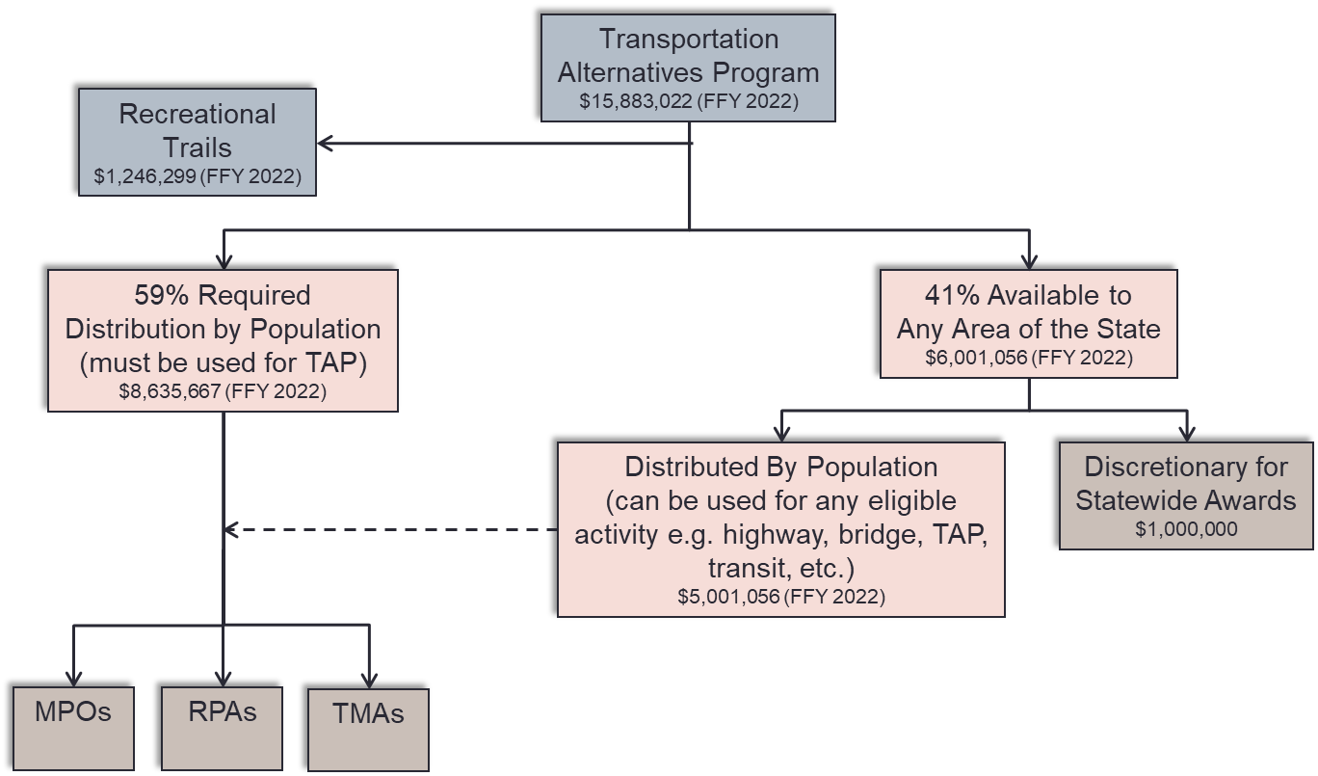
Commission Decision - Distribution/Use of Transportation Alternatives Program Funding

Slide 16
Commission Decision - Distribution/Use of Transportation Alternatives Program Funding
Retain status quo TAP funding process?
  Maintain $1,000,000 for statewide awards by Commission
  Maintain remainder of funding for TMAs, MPOs and RPAs
Continue and/or modify the matching fund incentive for Byway Projects and Safe Routes to School Projects?
Continue the Federal Recreational Trails program set-aside?
Establish a minimum project size?
Limit use of funding for just construction?

Slide 17
Commission Decision - Distribution/Use of Transportation Alternatives Program Funding
Input:
With increase in TAP funding, increase statewide set-aside to help fund larger trail projects
Continue the Federal Recreational Trails program set-aside
Do not establish a minimum project size so that important regional and metropolitan projects can be funded.
Do not limit use of funding for just construction as often these types of projects need design and engineering support that can be difficult to otherwise fund

Slide 18
Commission Decision - Distribution/Use of Transportation Alternatives Program Funding
Recommendation:
Increase the statewide TAP funding from $1,000,000 to $5,000,000 for statewide awards by Transportation Commission for larger trail projects.
Allow Safe Routes to School and Byway projects to apply for statewide funding instead of providing 30% incentive for MPO/RPA projects funded at 50%.
Provide remainder of funding for MPOs and RPAs – this will provide approximately $1,000,000 more for their targets.
TAP flex eliminated due to IIJA restrictions
No minimum MPO/RPA project threshold.
Continue allowing use of TAP funding for PE/CE/ROW.

Slide 19
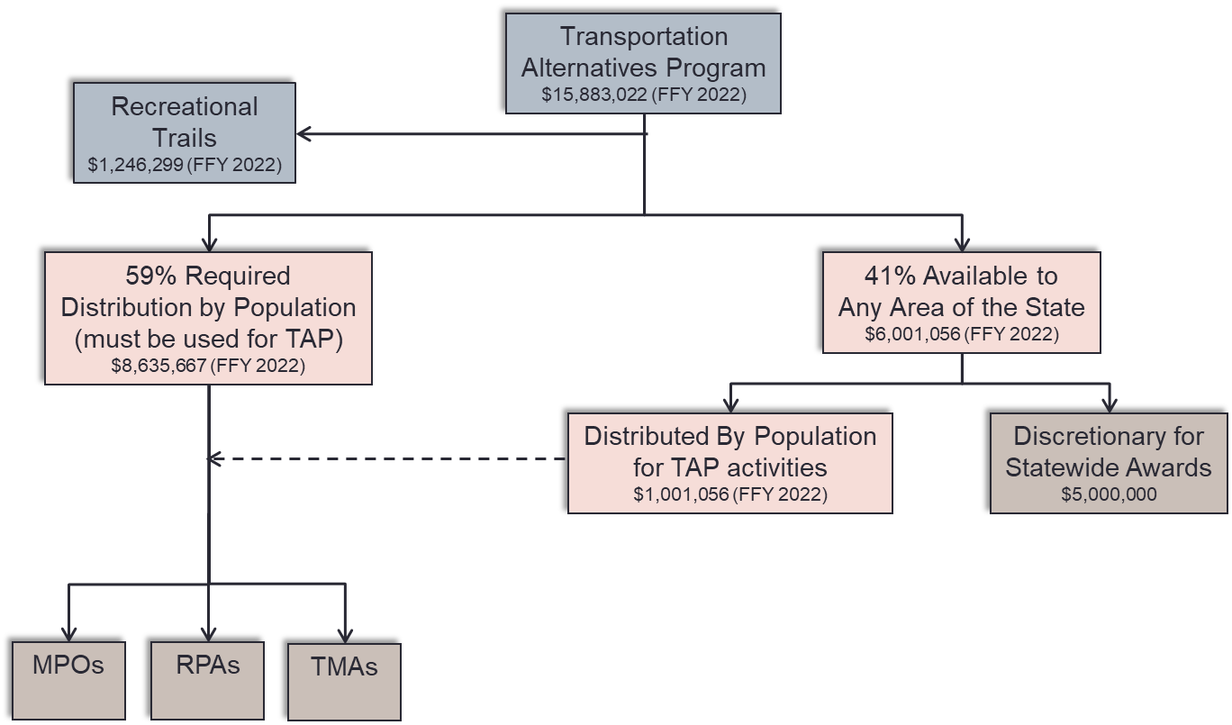
Commission Decision - Distribution/Use of Transportation Alternatives Program Funding

Slide 20
Commission Decision - Use of Congestion Mitigation and Air Quality (CMAQ) Funding
Funding level – approximately $12 million per year
Current policy:
  Allocate $4 million per year for Iowa’s Clean Air Attainment Program (ICAAP)
  Allocate $3 million per year for bus replacement
Input: Continue with current allocations
Recommendation:
  Allocate $4 million per year for Iowa’s Clean Air Attainment Program (ICAAP)*
  Allocate $3 million per year for bus replacement*
  Remaining funds used in Iowa DOT Highway Program
* Allocations may come from CMAQ or Carbon Reduction program funding

Slide 21
Commission Decision – Distribution/Use of Carbon Reduction Funding
New core program – about $16 m per year
Allocation
  65 percent suballocated by population
    Over 200,000 population: $2.2 million
    50,000 to 200,000 population: $2.1 million
    5,000 to 50,000 population: $1.9 million
    < 5,000 population: $4.1 million
  35 percent to any area: $5.6 million
Projects to reduce emissions
  Traffic monitoring facilities/programs
  Public transit
  Trails
  Congestion management
  Advanced technologies
Each state required to develop carbon reduction strategy, in consultation with MPOs by Nov. 2023

Slide 22
Commission Decision – Distribution/Use of Carbon Reduction Funding
Input:
Allocate to MPOs based on suballocation requirements
Allocate to RPAs based on suballocation levels
Recommendation:
  Allocate the IIJA suballocations to Iowa’s nine MPOs based on their share of population
  Do not allocate to RPAs due to the small amount of funding per RPA and administrative challenges
  Allow these funds to be used instead of CMAQ funds for all or part of the $3 million allocation for bus replacement and/or the $4 million allocation for ICAAP
  Remaining funds used in Iowa DOT Highway Program

Slide 23
Commission Decision – Distribution/Use of PROTECT Funding
“Promoting Resilient Operations for Transformative, Efficient, and Cost saving Transportation”
New core program – about $18 m per year
Projects to improve resiliency of transportation infrastructure
  Resilience improvement grants
  Community resiliency
  Evacuation routes
Lower match if state develops resiliency improvement plan and/or incorporates within state transportation plan
Input: Given the lack of program guidance and the preference for more flexible STBG funding, allocate these funds to Iowa DOT
Recommendation: Use funds in Iowa DOT Highway Program

Slide 24
National Electric Vehicle Infrastructure
New US DOT program from the Infrastructure Bill
Iowa allocated $51 million over FFY 2022-2026 – approximately $10.3 m per year
FFY 2022 allocation: $7.6 m (after off-the-tops)
Infrastructure within one mile of Alternative Fuel Corridor Routes
Opportunity to add routes (apps were due May 13) – Iowa did not seek additional routes to maximize flexibility

Slide 25
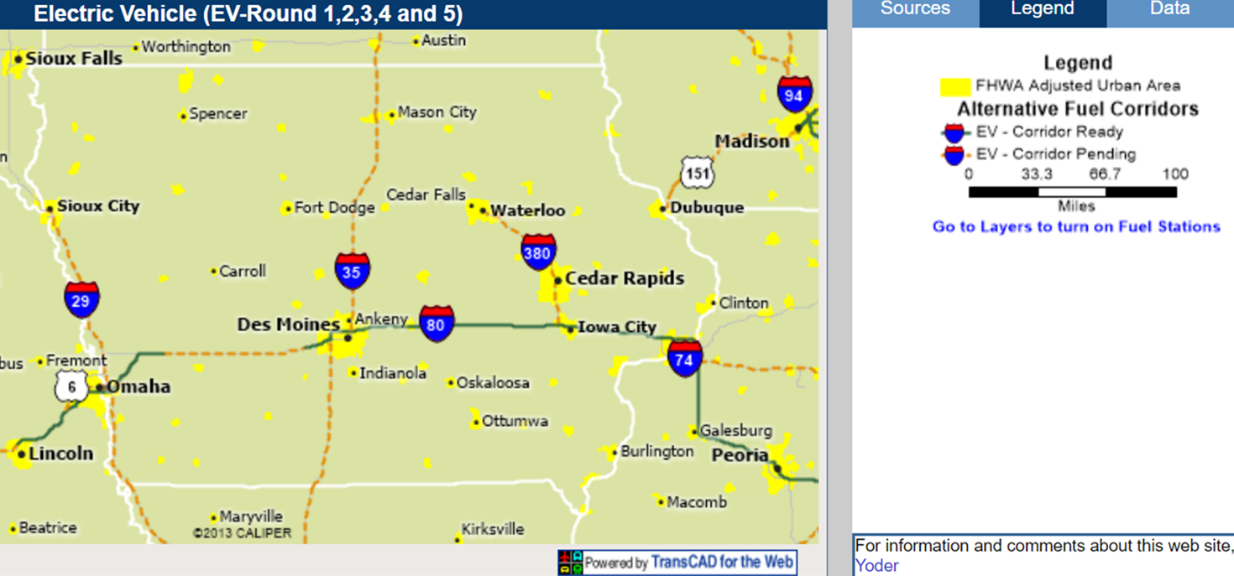
National Electric Vehicle Infrastructure

Slide 26
National Electric Vehicle Infrastructure
State Deployment Plan
  Due August 1, 2022
  Approved by September 30, 2022
  Approval required to access funds
Iowa DOT and Iowa Economic Development Authority are coordinating and developing plan.

Slide 27
Questions?

