Slide 1
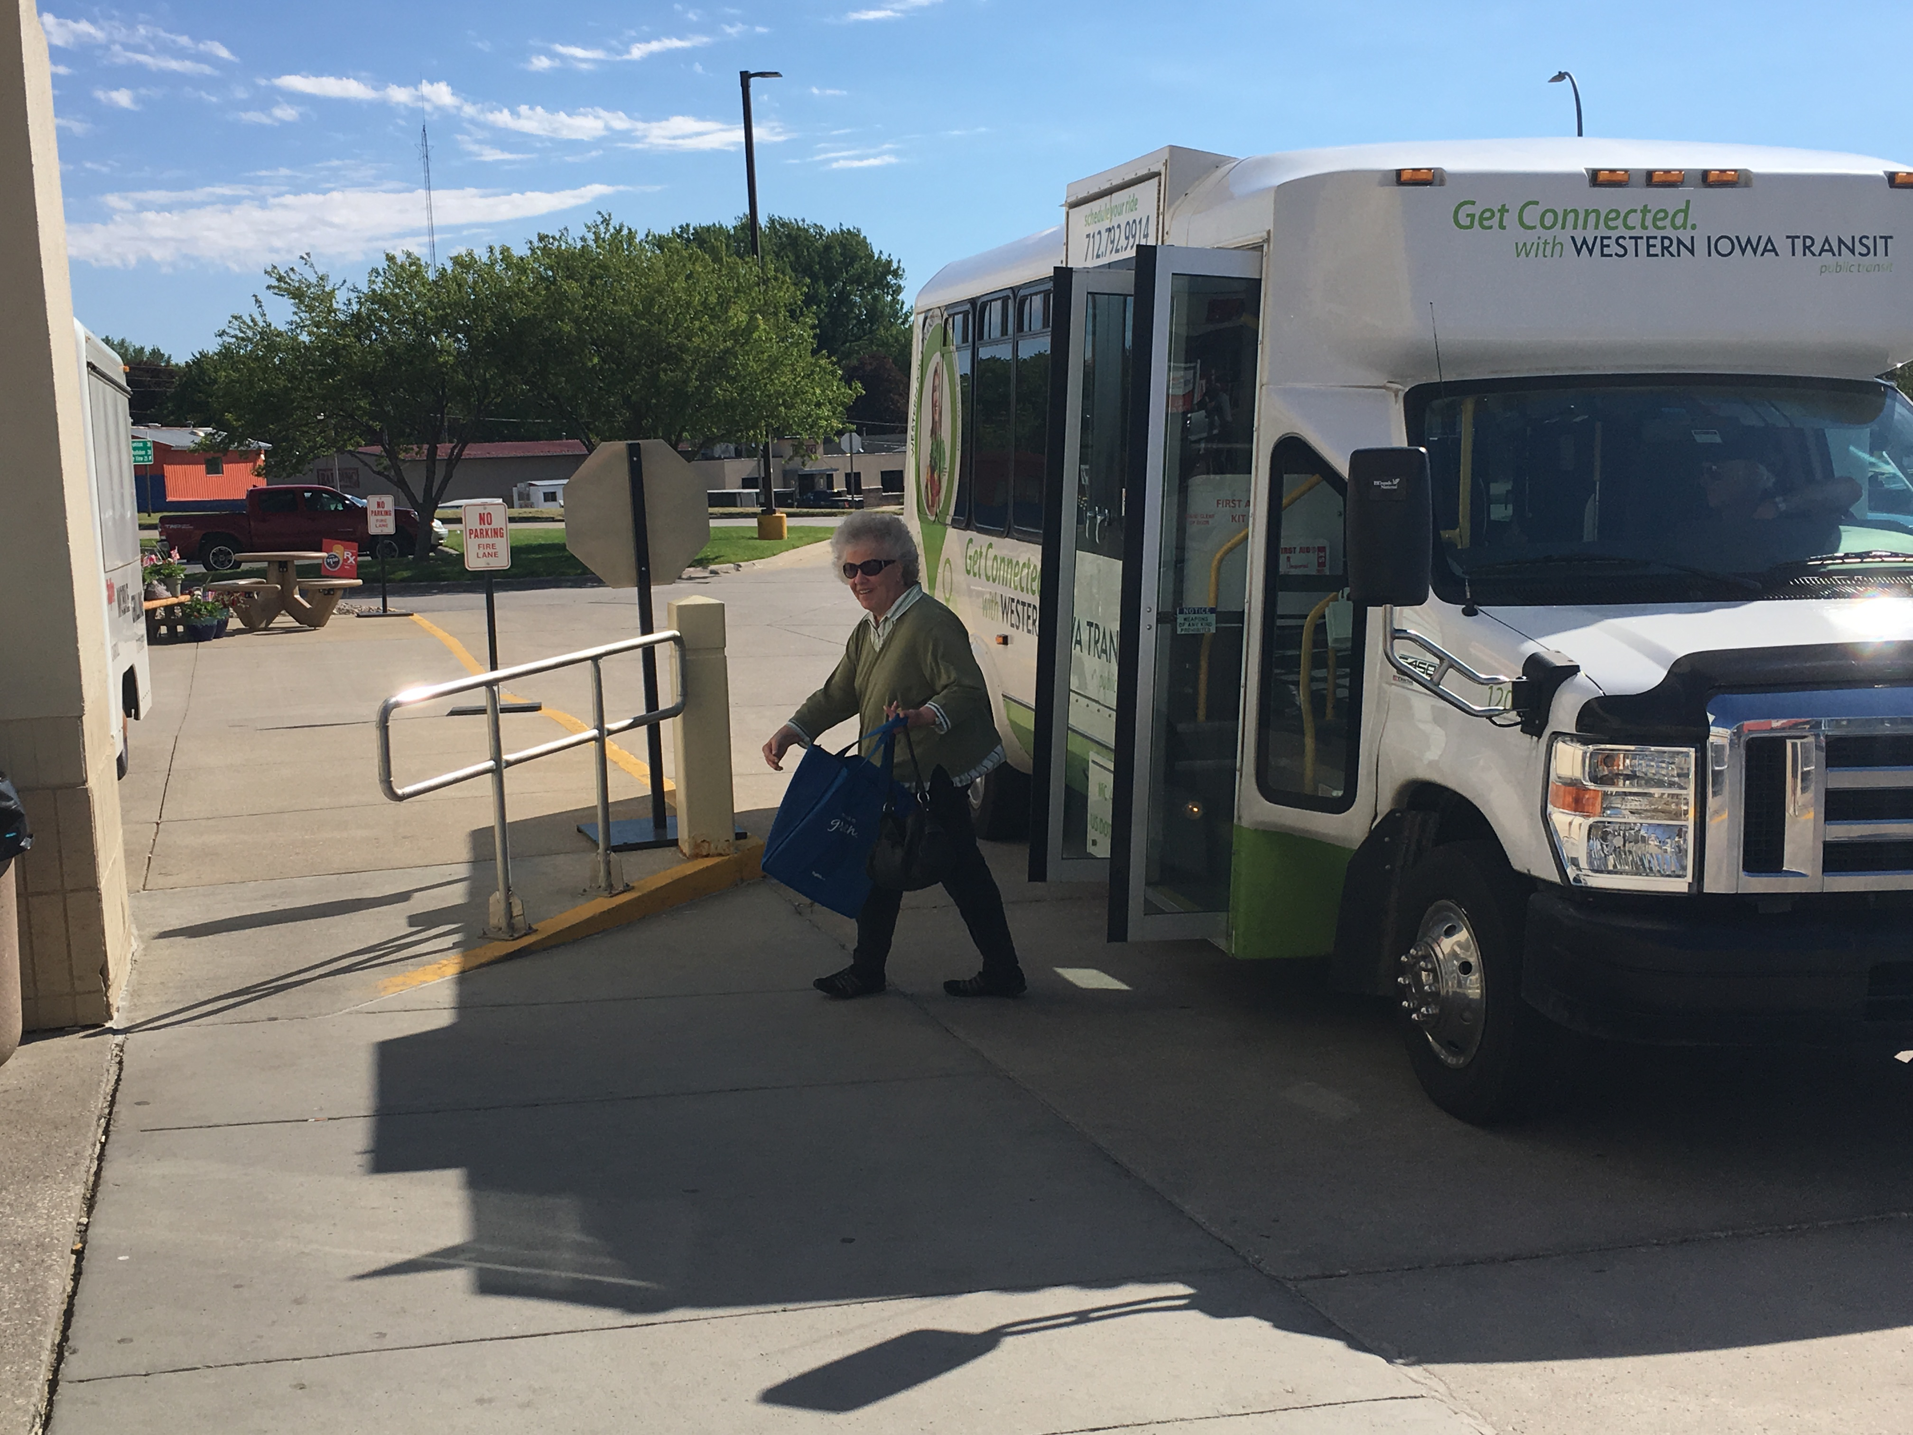

FY 2023 Public Transit Infrastructure Grant Program
July 12, 2022

Slide 2

Public Transit Infrastructure Grant Program
Program created by 2006 General Assembly
Funds vertical infrastructure projects for public transit
All 35 public transit systems are eligible

Slide 3
Project Evaluation Criteria
No more than 40-percent of the appropriation can be awarded to an individual transit system
Structural integrity of existing facilities
Safety enhancements to existing facilities
New facilities that enhance the life of the transit fleet or optimize transit service
Projects should be “shovel ready” and capable of completion in 18 months
Notes:
This program includes new construction, reconstruction/major renovation and relocation of facilities. Projects may include facilities for the administration of public transit operations, facilities for servicing, maintenance or storage of public transit vehicles, transit vehicle fueling facilities, passenger waiting facilities, and reconstruction/major renovations or relocation of existing administrative or maintenance facilities to correct violations of safety or design standards. State share is up to 80 percent with a maximum of 40 percent of the total state appropriation. Projects must be obligated within 6 months of contract execution and completed in 18 months

Slide 4
Available Funding and Application Summary
Available Funding:
  Annual appropriation: $1,500,000
  Underrun/withdrawals: $0
  Funds available: $1,500,000
Application Summary:
  Total number of projects: 7
  Total project costs: $7,067,000
  Total amount requested: $5,653,600
Notes:
We have an annual appropriation of $1.5 million. We do not have any underrun/contingency funding this year to add to the annual appropriation. We received seven applications totaling $7,067,000 (seven million, sixty-seven thousand) in project costs. The total amount requested totaled $5,653,600 (five million, six hundred fifty-three thousand, six hundred).

Slide 5
List of Applications Recommended
PROJECT NAME | SPONSOR | TOTAL PROJECT COST | REQUESTED AMOUNT (% of Total Project Cost) | RECOMMENDED AMOUNT (% of Total Project Cost)
New Automated Bus Wash | Siouxland Regional Transit System | $298,042 | $238,434 (80%) | $238,434 (80%)
Rehabilitate Shop Area in the Maintenance Facility | Ames (CyRide) | $750,000 | $600,000 (80%) | $581,566 (77%)
Replacement of insulation and vapor barrier for transit facility storage and maintenance area | North Iowa Area Council of Governments | $250,000 | $200,000 (80%) | $200,000 (80%)
Renovation of Existing Facility, Phase 1 | Southeast Iowa Regional Planning Commission | $600,000 | $480,000 (80%) | $480,000 (80%)
Jump to applications not recommended for funding
Notes:
We were able to award four projects with our allocated amount. The first one, a new automated bus wash for Siouxland regional transit system in Sioux City. They have a total project cost of $298,042, with a requested amount of $238,434 or 80% of the total project costs. The second, Ames Transit (CyRide) for a rehabilitation of the shop area in the maintenance facility. They have a total project cost of $750,000, with a requested amount of $600,000 of which we are recommending $581,566 or 77% of the total project costs. Third, we have North Iowa Area Council of Governments in Mason City for the replacement of insulation and vapor barrier for the transit facility storage and maintenance area. They have a total project cost of $250,000 and a requested and recommended amount of $200,000 or 80% of the total project costs. Last, we have Southeast Iowa Regional Planning Commission in Region 16 for the renovation of an existing facility, phase 1. The total project costs is $600,000 and they are requesting 80% in funding, or up to $480,000.

Slide 6
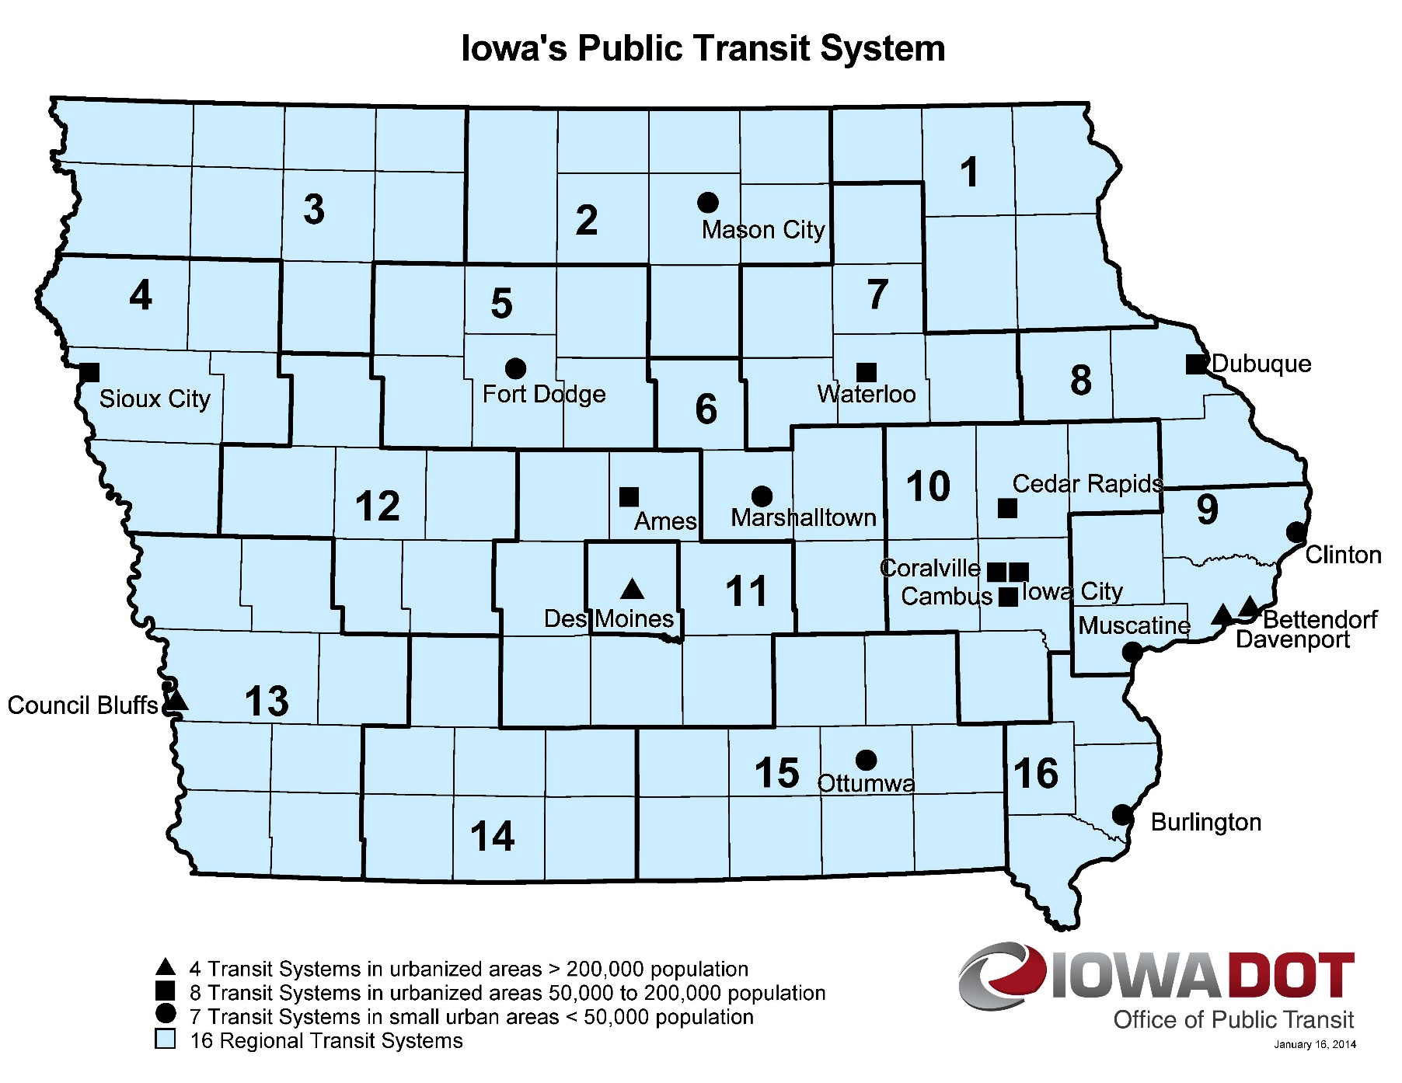
Map of Applications Received
Application received
Application recommended for funding
Notes:
Here is a map showing the Transit Systems we have in Iowa. The stars show where we received applications from (two from Sioux City area, Mason City, Waterloo, West Burlington, Ames, HIRTA) and the circles around the star show the applications we are recommending for funding.

Slide 7

QUESTIONS?
For more information on Iowa’s public transit and intercity bus programs, visit
www.iowadot.gov/transit

Slide 8
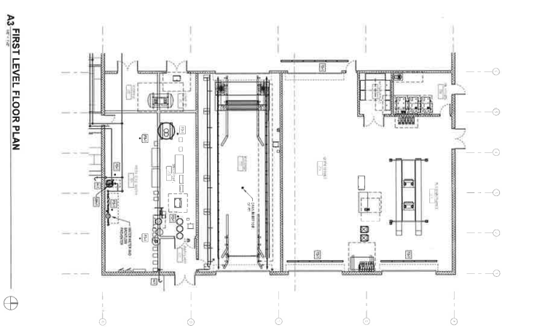
Siouxland Regional Transit System New Automated Bus Wash Project
This project will provide a new automated bus wash to maintain fleet on the property of the new building and create additional opportunities for fleet management expansion.
Total Cost: $298,042
Recommended: $238,434 (80%)
Return to List of Applications Recommended

Slide 9
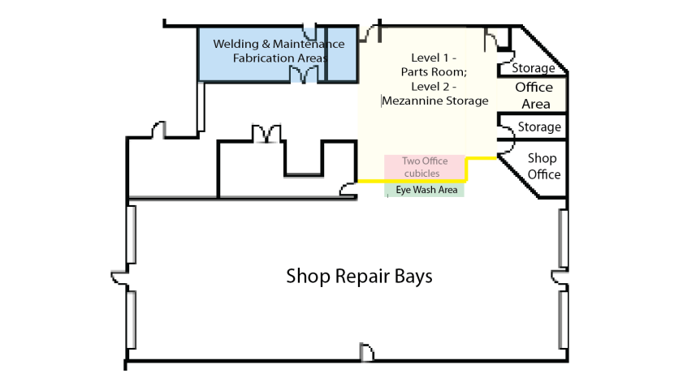
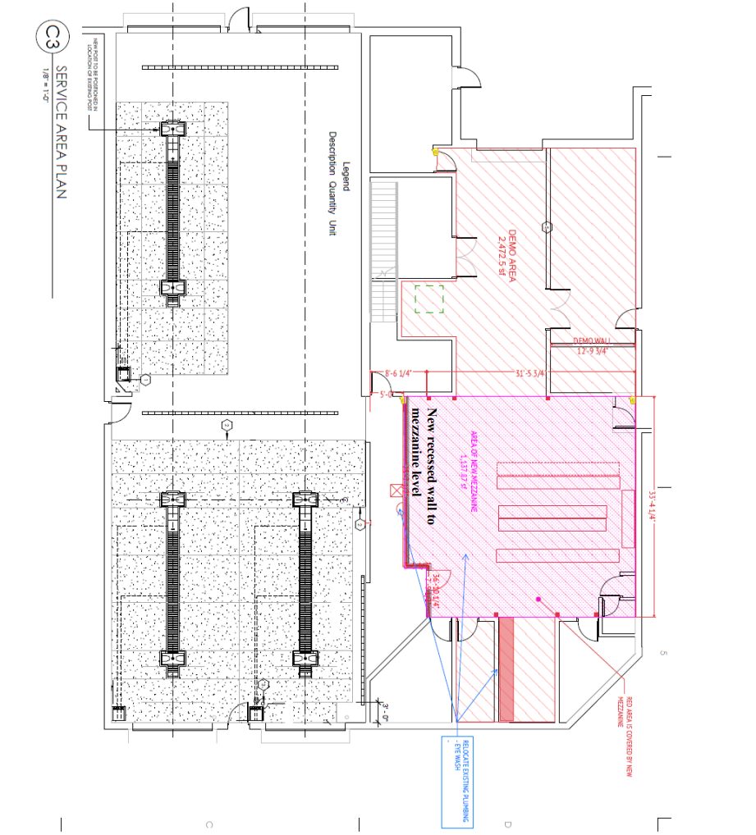
Ames – (CyRide) Rehabilitate Shop area in the Maintenance Facility Project
The area in pink where the east and west maintenance mezzanines will connect across the shop area. A ceiling will be created for the current shop administrative area while also provide new storage for the shop mechanics on the second-floor. This will provide CyRide with additional storage, accommodate staff better for administrative functions and provide safer areas to weld and fabricate metal.
Total Cost: $750,000
Recommended: $581,566 (77%)
Return to List of Applications Recommended

Slide 10
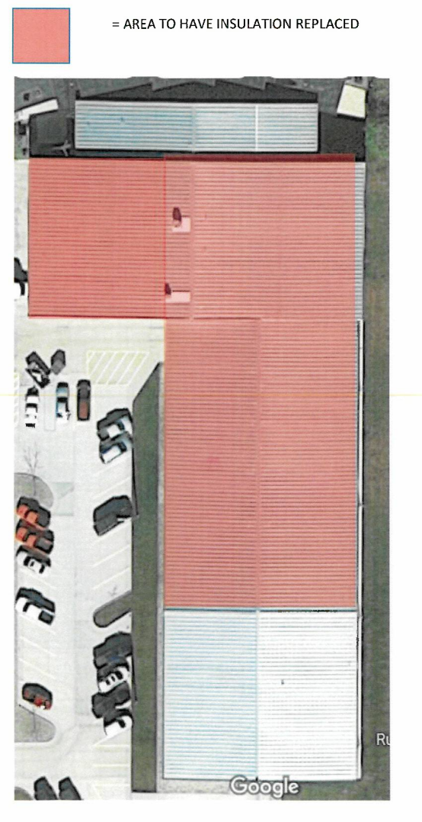
North Iowa Area Council of Governments
Replacement of Insulation and Vapor Barrier for Transit Facility Storage and Maintenance Area Project
This project will replace insulation and vapor barrier in the transit storage and maintenance area. The condition of the existing insulation and vapor barrier is showing deterioration and water intrusion. Several areas where vinyl facing on the vapor barrier are peeling off and evidence throughout these areas of water intrusion by either sagging of the insulation and/or separation of the vapor barrier due to the added weight of the water.
Total Cost: $250,000
Recommended: $200,000 (80%)
Return to List of Applications Recommended

Slide 11
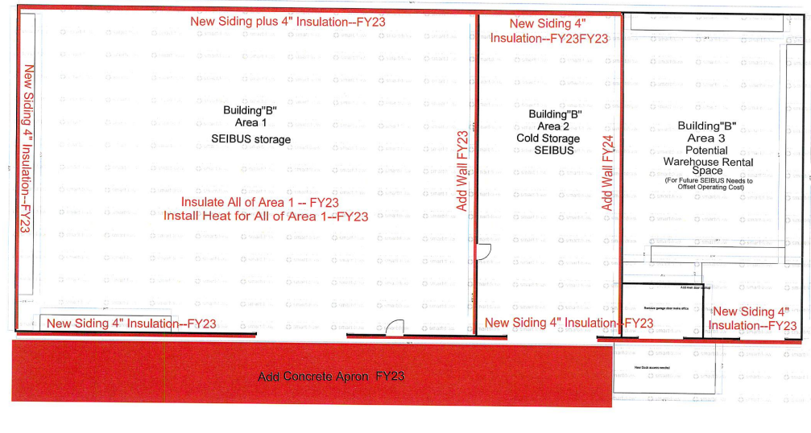
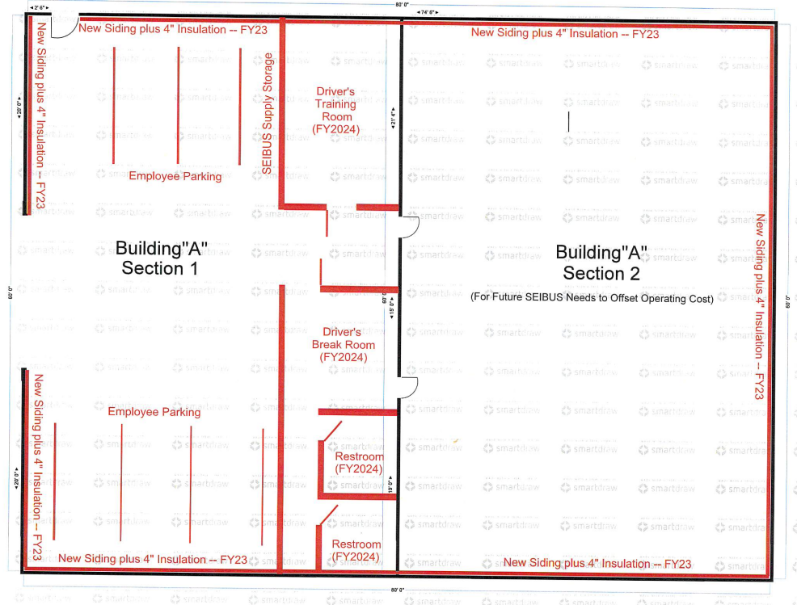
Southeast Iowa Regional Planning Commission Renovation of Existing Facility, Phase 1
This project is for a major renovation of an existing facility in Mt. Pleasant. This property consists of two buildings: an 8600 sq ft steel warehouse and 3200 sq ft steel front office/storage facility. Renovation of this facility is to make it ready for use as a vehicle storage facility for vehicles used in Henry County. Renovation includes roof repair and insulation, siding, adding walls, constructing a concrete apron, installation of security cameras and installation of a furnace.
Total Cost: $600,000
Recommended: $480,000 (80%)
Return to List of Applications Recommended

Slide 12
List of Applications
Not Recommended for Award
PROJECT NAME | SPONSOR | TOTAL PROJECT COST | REQUESTED AMOUNT (% of Total Project Cost) | RECOMMENDED AMOUNT (% of Total Project Cost)
Replace existing cooling tower | City of Sioux City | $162,000 | $129,600 (80%) | $0
Remodel structure/building to match existing buildings | 10-15 Regional Transit Agency | $500,000 | $400,000 (80%) | $0
Construction of new transit facility | Heart of Iowa Regional Transit Agency | $4,200,000 | $3,360,000 (80%) | $0
Return to List of Applications Recommended
Notes:
There were three applications that are not being recommended for funding. The City of Sioux City for replacement of a cooling tower, 10-15 regional transit agency for the remodel of a building to match existing buildings and HIRTA for construction of a new transit facility.

