Slide 1
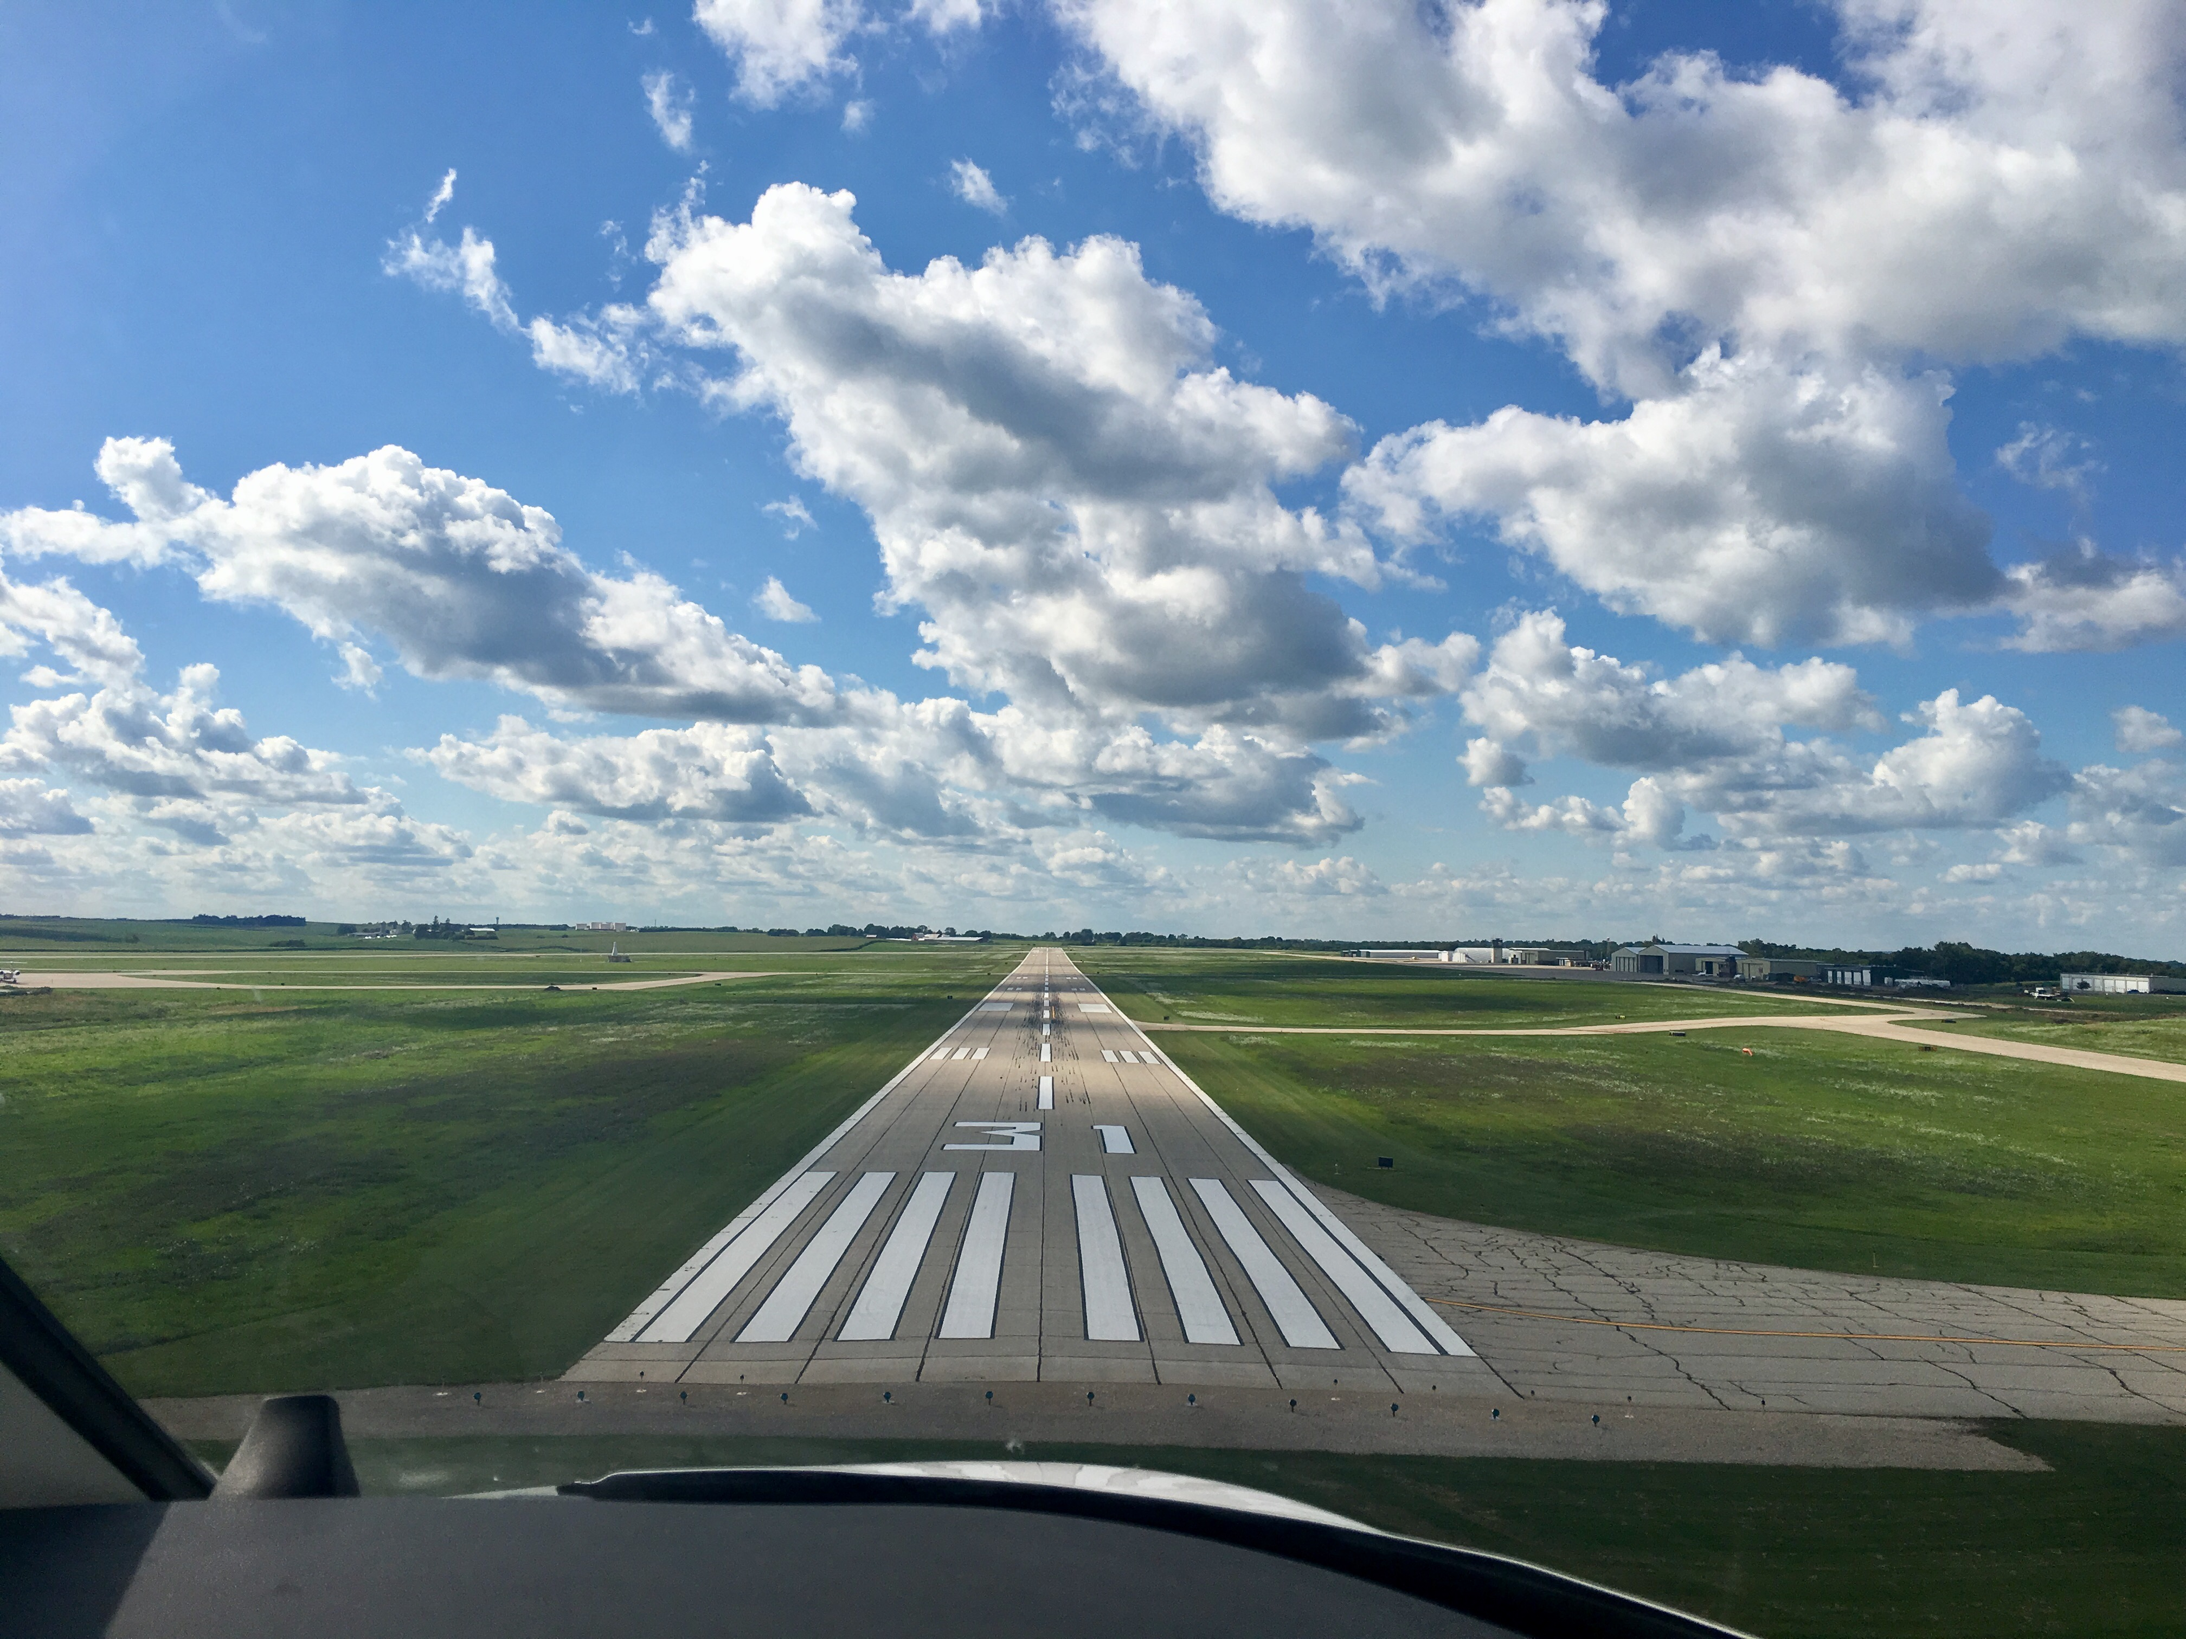

FY23 State Aviation Program
Funding Recommendation

Slide 2
State Aviation Programs - Overview
Three state programs for review
Airport Improvement Program (AIP)
Funded through Aviation Fuel Taxes and Aircraft Registration fees deposited into the State Aviation Fund
General Aviation Vertical Infrastructure (GAVI)
Funded through Rebuild Iowa Infrastructure (RIIF) appropriation
Commercial Service Vertical Infrastructure (CSVI)
Funded through Rebuild Iowa Infrastructure (RIIF) appropriation
Commission Role
The commission is responsible for approving the projects to be funded in all three of these programs
Process
Projects are presented for review at the July meeting and commission action will be requested at the August meeting

Slide 3

State Aviation Program - AIP
Includes Airport Improvement Program (AIP)
Public-owned airport sponsors may apply for grants to assist in the preservation and development of the airfield and related infrastructure.
Eligible projects are funded up to 85% and generally include planning and improvements related to enhancing airport safety, capacity, security and environmental concerns.

Slide 4
Project Evaluation Criteria
Airport Role (5-20 Points)
Local participation (5-30 Points)
Multi-jurisdictional support (0-10 Points)
Type of project (5-30 Points)
Justification (5-20 Points)

Slide 5
Available Funding and Application Summary
Available Funding:
FY23 Funds Available: $ 5,388,345
Aviation Safety Programs: $ (509,622)
Aviation Development Programs: $ (468,000)
Funds available for projects: $ 4,410,723
Application Summary:
Total number of applications: 36
Total project costs: $16,297,474
Total amount requested: $7,839,965

Slide 6
List of Applications Recommended
PROJECT NAME | SPONSOR | SCORE | TOTAL PROJECT COST | REQUESTED AMOUNT (% of Total Project Cost) | RECOMMENDED AMOUNT (% of Total Project Cost)
Runway Visual Aid Relocation | Des Moines International Airport | 95 | 7,888,791 | 400,000(5%) | 400,000(5%)
Box Hangar Site Work and Utilities | Ankeny Regional Airport | 80 | 442,000 | 265,200(60%) | 265,200(60%)
Aviation Fuel Underground Storage Tank Removal | Council Bluffs Municipal Airport | 80 | 60,000 | 27,000(45%) | 27,000(45%)
North Ramp Taxilane Overlay | Sioux Gateway Airport | 80 | 300,000 | 150,000(50%) | 150,000(50%)
Fuel System Improvements | Spencer Municipal Airport | 80 | 240,000 | 144,000(60%) | 144,000(60%)
Northwest T-Hangar Taxiway Replacement | The Eastern Iowa Airport | 80 | 871,000 | 435,500(50%) | 400,000(45%)
Reconstruct Taxilane | Mason City Municipal Airport | 75 | 310,000 | 217,000(70%) | 217,000(70%)
Fuel System Improvements - Phase 2 | Sheldon Regional Airport | 75 | 86,000 | 39,900(46%) | 39,900(46%)
Fuel System Improvements | Shenandoah Regional Airport | 75 | 70,000 | 35,000(50%) | 35,000(50%)
Reconstruct Taxilane - Phase 2 | Clinton Municipal Airport | 70 | 243,504 | 204,543(84%) | 204,543(84%)
Reconstruct South Apron | Davenport Municipal Airport | 70 | 619,579 | 495,663(80%) | 400,000(64%)
Widen Taxiway A | Fort Dodge Regional Airport | 70 | 651,100 | 455,770(70%) | 400,000(61%)
New Fuel System | Muscatine Municipal Airport | 70 | 500,000 | 385,000(80%) | 385,000(80%)
Reconstruct Row D (South Side) Taxilane | Southeast Iowa Regional Airport | 70 | 130,070 | 109,258(84%) | 109,258(84%)
Taxiway and Apron Rehabilitation | Grinnell Regional Airport | 65 | 460,000 | 368,000(80%) | 368,000(80%)
Reconstruct South T-Hangar Taxilane | Waverly Municipal Airport | 65 | 328,750 | 213,687(65%) | 213,687(65%)
Extend Taxilane for New Hangar | Denison Municipal Airport | 60 | 147,600 | 125,460(85%) | 125,460(85%)
Apron and Taxiway Reconstruction | Estherville Municipal Airport | 60 | 300,000 | 255,000(85%) | 255,000(85%)
Monument Sign | Iowa City Municipal Airport | 60 | 15,000 | 7,500(50%) | 7,500(50%)
Construct Taxiway | Lamoni Municipal Airport | 60 | 275,000 | 234,175(85%) | 234,175(85%)
Airport Entrance Sign | Sioux County Regional Airport | 60 | 63,500 | 30,000(47%) | 30,000(47%)
Jump to applications not recommended for funding

Slide 7
State Aviation Program - GAVI
General Aviation Vertical Infrastructure(GAVI)
Public owned general aviation airport sponsors may apply for projects that include landside development and renovation of airport terminals, hangars, maintenance buildings, and fuel facilities.
Eligible projects are funded up to 85%
Funds are subject to annual appropriation

Slide 8
Project Evaluation Criteria
Airport Role (5-20 Points)
Local participation (5-30 Points)
Multi-jurisdictional support (0-10 Points)
Type of project (10-30 Points)
Justification (5-20 Points)

Slide 9
Available Funding and Application Summary
Available Funding:
FY23 Funds Appropriated: $1,000,000
Underrun: $21,450
Funds available for projects $1,021,450
Application Summary:
Total number of applications: 20
Total project costs: $4,433,076
Total amount requested: $2,972,511

Slide 10
List of GAVI Applications Recommended
PROJECT NAME | SPONSOR | SCORE | TOTAL PROJECT COST | REQUESTED AMOUNT (% of Total Project Cost) | RECOMMENDED AMOUNT (% of Total Project Cost)
Construct Two Box Hangars | Ankeny Regional Airport | 90 | 685,000 | 300,000 (44%) | 300,000 (44%)
Corporate Hangar with Attached Terminal Building | Decorah Municipal Airport | 80 | 418,286 | 300,000 (72%) | 300,000 (72%)
Construct Box Hangar | Denison Municipal Airport | 80 | 633,500 | 300,000(47%) | 300,000(47%)
Corporate Hangar Improvements | Cherokee County Regional Airport | 75 | 90,000 | 63,000(70%) | 63,000(70%)
Box Hangar Door Replacement | Mount Pleasant Municipal Airport | 75 | 58,000 | 40,600(70%) | 40,600(70%)
Terminal Building Improvements | Iowa City Municipal Airport | 70 | 21,000 | 17,850(85%) | 17,850(85%)
Jump to applications not recommended for funding

Slide 11
State Aviation Program - CSVI
The Commercial Service Vertical Infrastructure (CSVI) program provides funding for landside development and renovation of terminals, hangars, maintenance buildings, and fuel facilities at commercial service airports.
Appropriated funds are distributed to the commercial service airports formula with no local match required.
50% evenly split between the airports
40% based on enplanements
10% based on cargo activity

Slide 12
Available Funding and Application Summary
Available Funding:
FY23 Funds Appropriated: $1,900,000
Funds available for projects: $1,900,000
Application Summary:
Total number of projects: 8
Total project costs: $8,475,515
Total amount requested: $1,900,000

Slide 13
List of CSVI Applications Recommended
PROJECT NAME | SPONSOR | SCORE | TOTAL PROJECT COST | REQUESTED AMOUNT (% of Total Project Cost) | RECOMMENDED AMOUNT (% of Total Project Cost)
Building 9 Improvements, Terminal Design | Des Moines International Airport | N/A | 710,748 | 710,748 | 710,748
Airfield Equipment Storage and Hangar | Dubuque Regional Airport | N/A | 127,603 | 127,603 | 127,603
Construct West FBO Facility | Eastern Iowa Airport | N/A | 7,009,622 | 441,749 | 441,749
Construct Hangar and Maintenance Building Renovation | Fort Dodge Regional Airport | N/A | 125,000 | 121,599 | 121,599
Equipment Storage Building - Design and Construct | Mason City Municipal Airport | N/A | 121,446 | 121,446 | 121,446
Rehabilitate and Build Hangars | Sioux Gateway Airport | N/A | 131,896 | 131,896 | 131,896
Corporate Community Hangar | Southeast Iowa Regional Airport | N/A | 125,000 | 120,813 | 120,813
Hangar Rehabilitation | Waterloo Regional Airport | N/A | 124,200 | 124,145 | 124,145

Slide 15

QUESTIONS?
Shane Wright Aviation Program Manager Shane.Wright@iowadot.us

Slide 16
List of AIP Applications Not Recommended
PROJECT NAME | SPONSOR | SCORE | TOTAL PROJECT COST | REQUESTED AMOUNT (% of Total Project Cost) | RECOMMENDED AMOUNT (% of Total Project Cost)
Airfield Fencing | Sioux Gateway Airport | 65 | 200,000 | 160,000 (80%) | 0
Taxiway Island Shoulder Pavement Replacement | Sioux Gateway Airport | 65 | 540,000 | 351,000 (65%) | 0
Fuel System Improvements | Fort Dodge Regional Airport | 65 | 50,000 | 42,500 (85%) | 0
Repair Perimeter Fencing & Automatic Gates | Southeast Iowa Regional Airport | 65 | 83,600 | 70,224 (84%) | 0
Nested T Hangar Apron Construction | Atlantic Municipal Airport | 60 | 455,980 | 387,500 (85%) | 0
Taxilane to New Hangar Area | Le Mars Municipal Airport | 60 | 470,000 | 400,000 (85%) | 0
Bury Overhead Power Lines - RW17 Approach & RPZ | Marion Municipal Airport | 60 | 251,400 | 213,690 (85%) | 0
Security Gate Improvements | Northeast Iowa Regional Airport | 60 | 150,000 | 120,000 (80%) | 0
Runway Improvements | Cresco Municipal Airport | 55 | 170,000 | 144,500 (85%) | 0
Fuel System Improvements - Jet A | Jefferson Municipal Airport | 55 | 490,000 | 416,500 (85%) | 0
Hangar Approach Paving | Jefferson Municipal Airport | 55 | 310,000 | 263,500 (85%) | 0
New 3,000 GAL AV-Gas Fuel Facility | Manchester Municipal Airport | 55 | 270,000 | 229,500 (85%) | 0
Install Runway Visual Aids | Marion Municipal Airport | 55 | 228,700 | 194,395 (85%) | 0
Fuel Facility Improvements | Guthrie County Regional Airport | 55 | 124,500 | 99,600 (80%) | 0
Parking Lot Expansion | Knoxville Municipal Airport | 50 | 192,000 | 134,400 (70%) | 0
Jump to applications recommended for funding

Slide 17
List of GAVI Applications Not Recommended
PROJECT NAME | SPONSOR | SCORE | TOTAL PROJECT COST | REQUESTED AMOUNT (% of Total Project Cost) | RECOMMENDED AMOUNT (% of Total Project Cost)
Corporate Hangar Improvements | Webster City Municipal Airport | 75 | 60,000 | 30,000(50%)
North Hangar Exterior Renovation | Sheldon Regional Airport | 75 | 135,900 | 101,925(75%)
Hangar Roof Replacement | Mount Pleasant Municipal Airport | 75 | 132,000 | 92,000(70%)
Rehabilitate Airport Maintenance Hangar | Estherville Municipal Airport | 75 | 175,000 | 125,000(71%)
Replace Hangar Doors - Phase 2 | Iowa City Municipal Airport | 75 | 158,000 | 125,000(79%)
T-Hangar Roof Replacement | Muscatine Municipal Airport | 70 | 107,000 | 90,950(85%)
Replace Hangar Doors | Harlan Municipal Airport | 70 | 150,000 | 125,000(83%)
Construct New Box Hangar | Sibley Municipal Airport | 65 | 380,000 | 300,000(79%)
Hangar Door Replacement | Atlantic Municipal Airport | 65 | 89,700 | 76,200(85%)
Repair block hangar, which is the first hangar building at the Chariton Airport. | Chariton Municipal Airport | 65 | 75,000 | 63,750(85%)
Hangar Improvements | Boone Municipal Airport | 65 | 135,000 | 114,750(85%)
Construct Box Hangar | Lamoni Municipal Airport | 60 | 154,690 | 131,486(85%)
Box Hangar Foundations and Floor | Jefferson Municipal Airport | 60 | 375,000 | 300,000(80%)
Replace Equipment Storage Building | Sac City Municipal Airport | 55 | 400,000 | 275,000(69%)
Jump to applications recommended for funding

