Slide 1
Transportation Trends Update
Transportation Commission Workshop
July 12, 2022

Slide 2
Overview
Economic Recovery Index
Travel trends
  US total rail carloads
  Commercial air service passenger counts
  Vehicular traffic

Slide 3
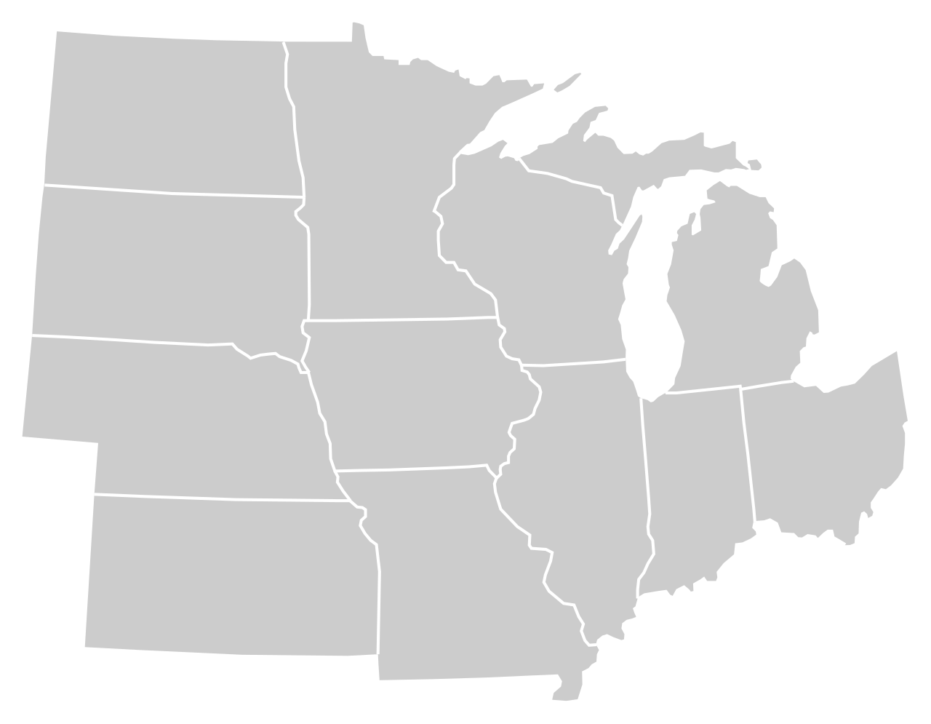
Moody’s/CNN Recovery Index - Midwest
(Pre-Pandemic = 100) As of 7/1/2022
91%
93%
110%
96%
96%
100%
(97% last month)
102%
96%
88%
96%
93%
93%
Nation is at 93% (93% last month)

Slide 5
Monthly Passenger Counts at Iowa’s Eight Commercial Service Airports
(through May 2022)

Slide 6
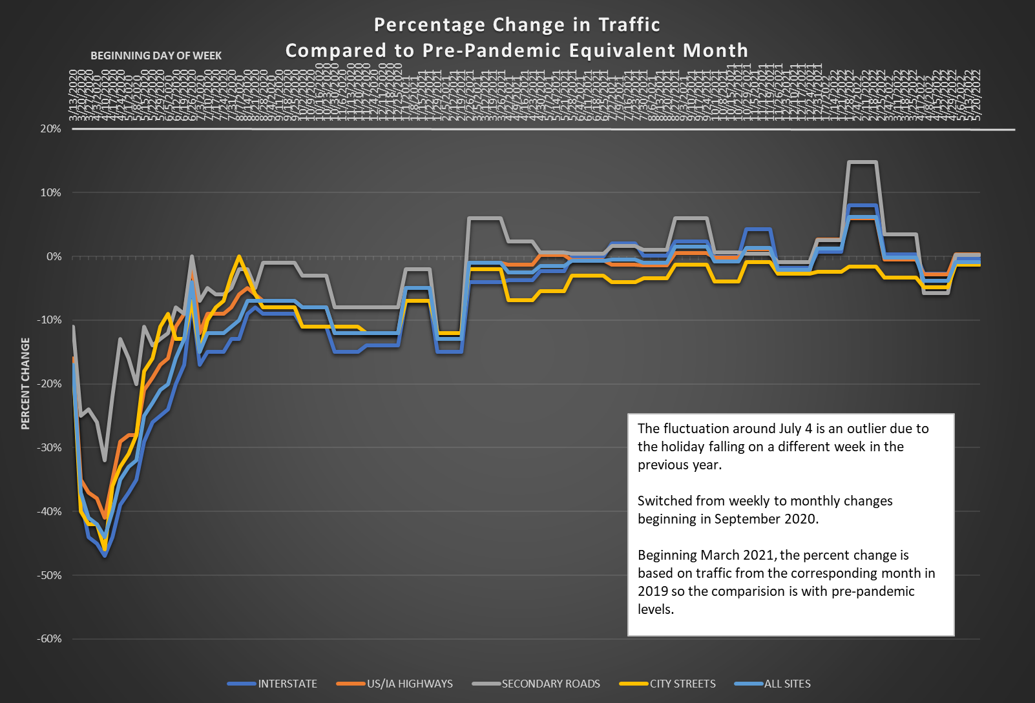

Slide 7
Questions?

