Slide 1
Corridor Preservation
US 20 from Sundown Rd. to Cottingham Rd (Peosta)
US 151 from Wendling Rd. past Springville
Transportation Commission Workshop
July 12, 2022

Slide 2
Past Steps – 1 to 4 (for both CPZs):
Sought initial guidance from Commission for new US 20 and US 151 Corridor Preservation Zone (CPZ): March 8, 2022
Mailed initial written notices to the affected city or county and property owners: March 2021
Affected cities or counties and property owners were given the opportunity to comment: March – May
After expiration of the 60-day comment period, we are presenting the proposed CPZ to the Commission today at the June workshop: June 13, 2022
The proposed CPZ will be presented to the Commission for formal action at the next monthly business meeting: July, 12, 2022
If approved DOT will send a final notice to affected property owners

Slide 3
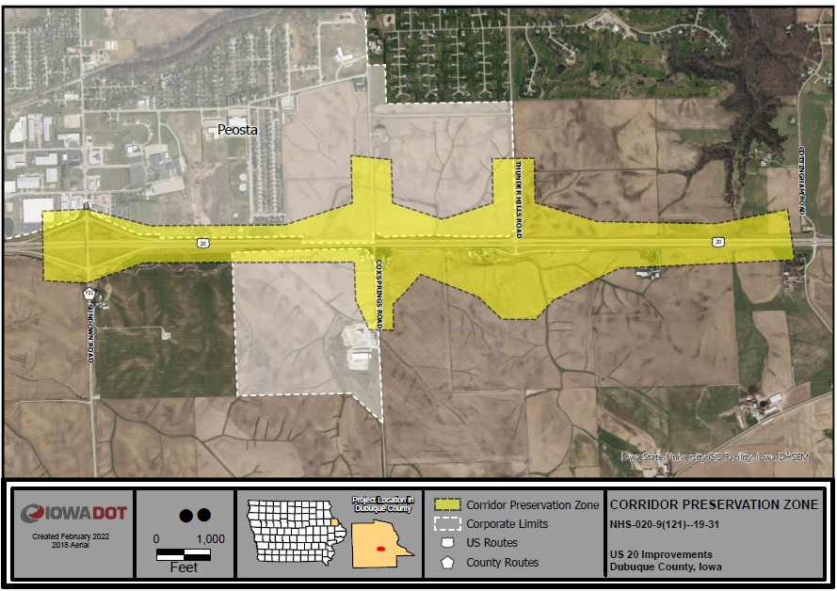
US 20 near Peosta
West of the Swiss Valley Interchange project (Completed)
Continued growth in this corridor is expected
Possible interchange at Thunder Hills Rd. in the future

Slide 4
Comments US 20 near Peosta:
2 total comments received
Summary of comments:
One wanting to know if their property will be impacted
With the further explanation they had no concerns with the CPZ.
The other comment was focused on the burden the property owners face when the DOT prolongs the construction of projects, suggested timely project completion should be a priority.

Slide 5
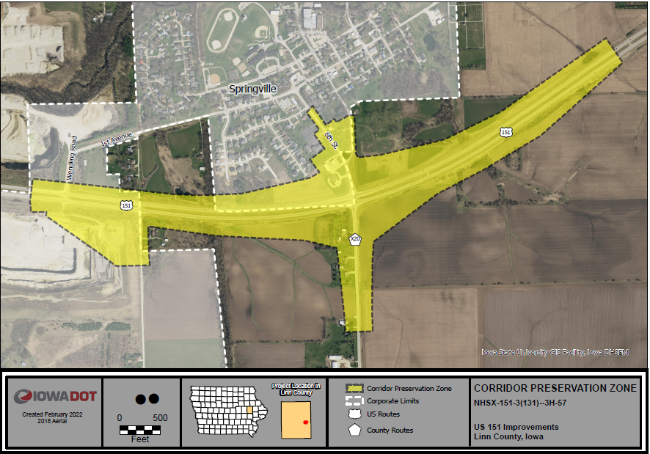
US 151 near Springville future interchange

Slide 6
Comments US 151 near Springville:
Nine total comments
Summary of comments:
Majority wanting to know if their property will be impacted
Explained that CPZ is a tool that allows us to make decisions prior to an area being rezoned or for a structure being built over $25,000 in value.
With the further explanation there were no real concerns with the CPZ for this majority.
Casey’s General Store did express concern about the possibility of losing one of two entrances with the selected alternative.

Slide 7
Comments US 151 near Springville:
The notifications for the CPZ led to several meetings with stakeholders to address the CPZ and chosen alternative, including Wendling Quarry and Security State Bank and an informal meeting with some Springville City staff.
The Quarry and City representatives were in favor of the CPZ and the project.
The representatives for the bank are not in favor of any alternative that significantly impacts the bank (NW quadrant) or their developable property (NE quadrant).

Slide 8
Next Steps - 5 & 6 (for both CPZs):
Sought initial guidance from Commission for new US20 and US 151 Corridor Preservation Zone (CPZ): March 8, 2022
Mailed initial written notices to the affected city or county and property owners: March 2021
Affected cities or counties and property owners were given the opportunity to comment: March –May
After expiration of the 60 day comment period, we present the proposed CPZ to the Commission today at the monthly workshop: June 13, 2022
The proposed CPZ is presented to the Commission for formal action at the next monthly business meeting: July 12, 2022
If approved DOT will send a final notice to affected property owners

Slide 9
Questions?
Thank You
Bryan Bradley
Location and Environment Bureau
bryan.bradley@iowadot.us
(515) 239-1787

