Slide 1
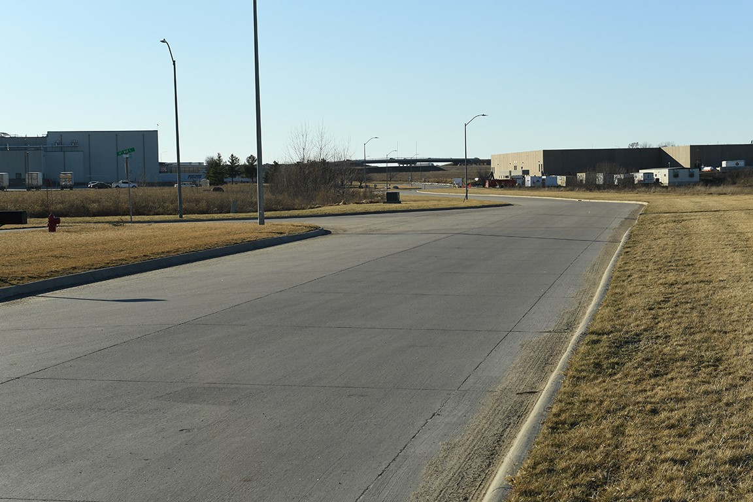
Revitalize Iowa’s Sound Economy Program
Iowa Transportation Commission Workshop
July 12, 2022

Slide 2
Revitalize Iowa’s Sound Economy Program
Created in 1985
Purpose: To promote economic development through roadway improvements.
Eligible development shall have value-adding activities that feed new dollars into the economy
Available to cities and counties through an application program

Slide 3
Available Funding and Application Summary
Available Funding
  Funded annually with dedicated state motor fuel and special fuel tax revenues
Application Summary for SFY2023
  Total number of projects awarded: 0
  Total project costs: $0
  Total amount awarded: $0
 | CITY | COUNTY
Average funding generated monthly | $905,101 | $452,550
SFY 2023 estimated Road Use Tax Revenue for July 2022 | $905,101 | $452,550
Current Unobligated Balance (as of 3/31/2022) | $3,827,169.72 | $0

Slide 4
Local Development Project Evaluation Criteria
Development Potential (35 points)
Economic impact and Cost Effectiveness (20 points)
Local Commitment and Initiative (33 points)
Transportation Need and Justification (4 points)
Local Economic Need (6 points)

Slide 5
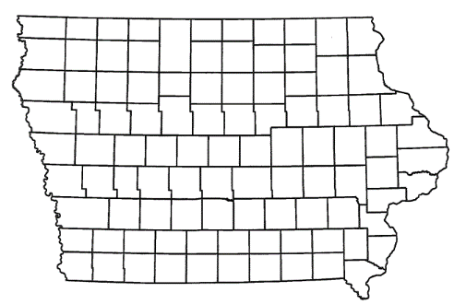
List of Local Development Applications Recommended
PROJECT NAME
SPONSOR
SCORE
TOTAL PROJECT COST
PERCENT PARTICIPATION
RECOMMENDED AMOUNT
Construction of approximately 1,170 feet of Zenith Avenue and reconstruction of approximately 1,765 feet of West 83rd Street. | Davenport | 50 | $1,884,147 | 50% | $942,074

Slide 6
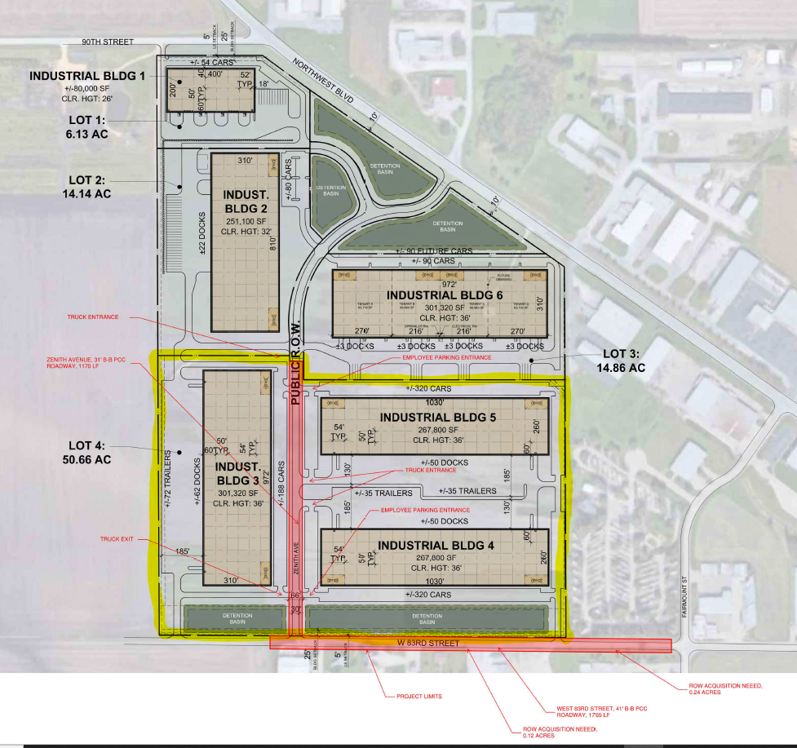
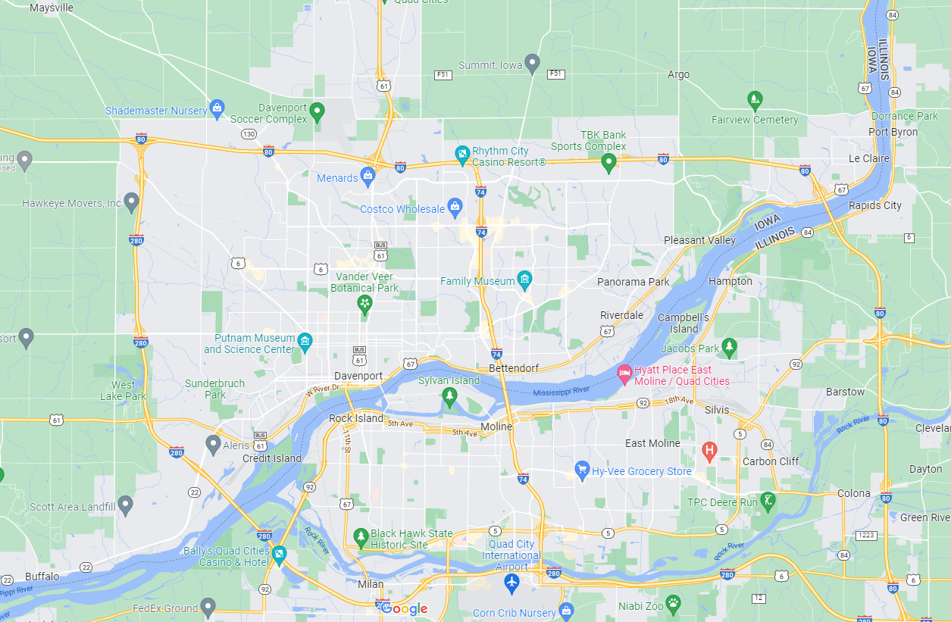
Davenport
(Local Development)
Construction of approximately 1,170 feet of Zenith Avenue and reconstruction of approximately 1,765 feet of West 83rd Street located on the northwest side of town. This project will provide access to 50 acres for light industrial purposes.
Total Cost: $1,884,147
Requested: $942,074 (50%)

Slide 7

QUESTIONS?
Craig Markley, Systems Planning Bureau
craig.markley@iowadot.us
515-239-1027

