Slide 1
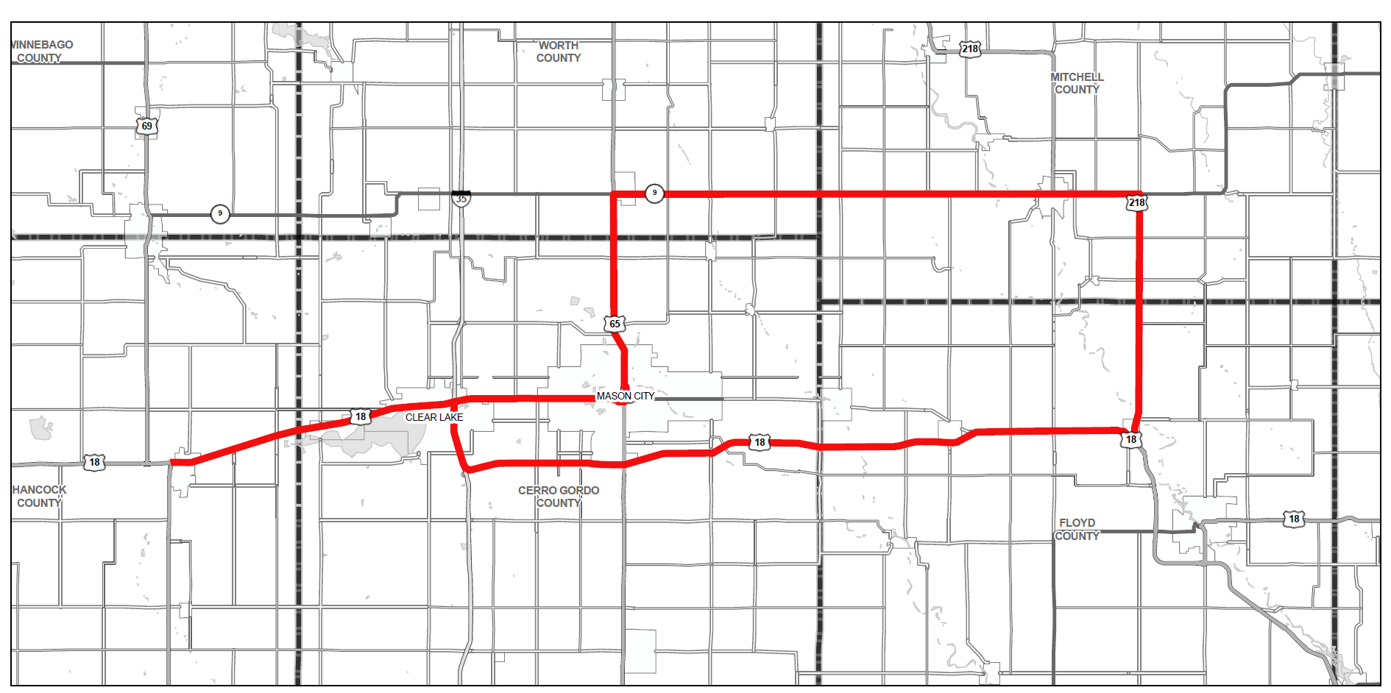
Iowa Transportation Commission Tour
North Central Iowa
August 7, 2023

