Slide 1
FY 2024 Public Transit Infrastructure Grant Program
July 11, 2023

Slide 2
Public Transit Infrastructure Grant Program
Program created by 2006 General Assembly
Funds vertical infrastructure projects for public transit
All 35 public transit systems are eligible

Slide 3
Project Evaluation Criteria
No more than 40-percent of the appropriation can be awarded to an individual transit system
Structural integrity of existing facilities
Safety enhancements to existing facilities
New facilities that enhance the life of the transit fleet or optimize transit service
Projects should be “shovel ready” and capable of completion in 18 months
Notes:
This program includes new construction, reconstruction/major renovation and relocation of facilities. Projects may include facilities for the administration of public transit operations, facilities for servicing, maintenance or storage of public transit vehicles, transit vehicle fueling facilities, passenger waiting facilities, and reconstruction/major renovations or relocation of existing administrative or maintenance facilities to correct violations of safety or design standards. State share is up to 80 percent with a maximum of 40 percent of the total state appropriation. Projects must be obligated within 6 months of contract execution and completed in 18 months.

Slide 4
Available Funding and Application Summary
Available Funding:
Annual appropriation: $1,000,000
Underrun/withdrawals: $0
Funds available: $1,000,000
Application Summary:
Total number of projects: 8
Total project costs: $38,652,056
Total amount requested: $2,700,000
Notes:
We have an annual appropriation of $1 million. We do not have any underrun/contingency funding this year to add to the annual appropriation. We received eight applications totaling $38,652,056 in federal, state, and local project costs. The total amount of PTIG requested was $2,700,000.

Slide 5
List of Applications Recommended
PROJECT NAME | SPONSOR | TOTAL PROJECT COST | REQUESTED AMOUNT (% of Total Project Cost) | RECOMMENDED AMOUNT (% of Total Project Cost)
Automated Bus Wash | Siouxland Regional Transit System | $300,000 | $240,000 (80%) | $240,000 (80%)
Bus Wash Facility | City of Muscatine | $1,631,700 | $600,000 (36.77%) | $400,000 (24.51%)
Boiler/Heat Pump Replacement | City of Sioux City | $150,656 | $120,000 (79.65%) | $120,000 (79.65%)
Renovation of Facility | Southeast Iowa Regional Planning Commission | $300,000 | $240,000 (80%) | $240,000 (80%)
Jump to applications not recommended for funding
Notes:
We were able to award four projects with our allocated amount. The first one, an automated bus wash for Siouxland regional transit system in Sioux City. They have a total project cost of $300,000, with a requested and recommended amount of $240,000 or 80% of the total project costs. The second, a bus wash facility for the City of Muscatine. The total project cost is $1,631,700. The requested amount was $600,000 and the recommended amount is $400,000. PTIG projects can be awarded up to a maximum of 40% of the total appropriation, which means for FY24 the largest single award can be up to $400,000. Third, we have the City of Sioux City for replacement of a Boiler/Heat Pump at their Martin Luther King Jr. Transportation Center. The total project cost is $150,656, with a requested and recommended amount of $120,000. Last, we have Southeast Iowa Regional Planning Commission for the renovation of an existing facility. The total project costs is $300,000 with a requested and recommended amount of $240,000 or 80% of the total project costs

Slide 6
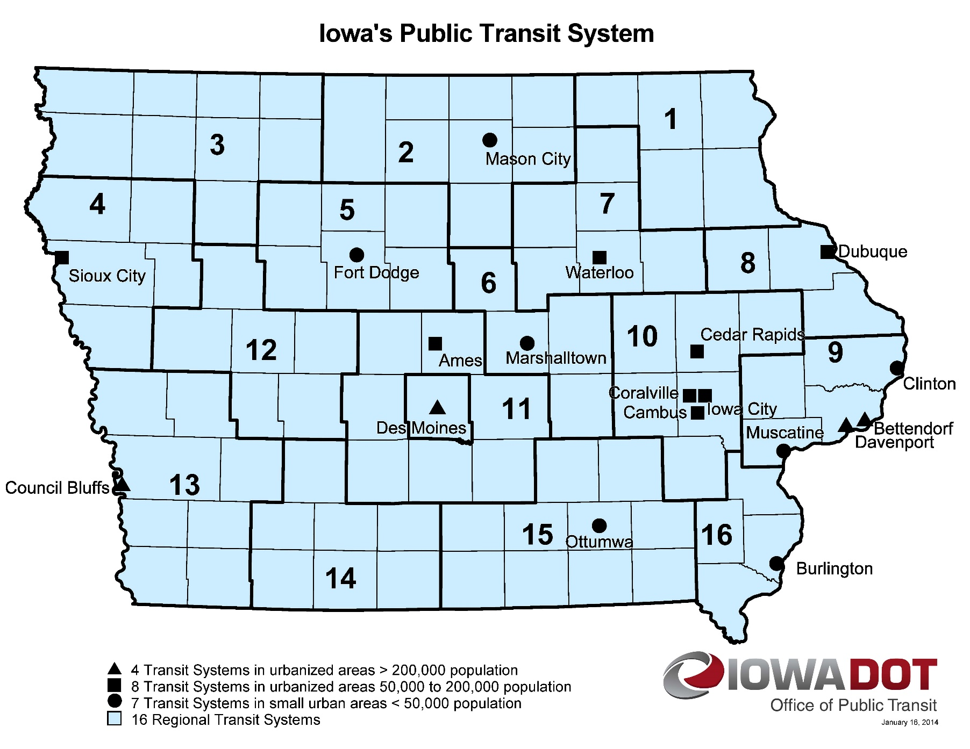
Map of Applications Received
Application received
Application recommended for funding
Notes:
Here is a map showing the Transit Systems we have in Iowa. The stars show where we received applications from (two from Sioux City area, Forest City, Ames, Des Moines (DART), HIRTA, Mount Pleasant and Muscatine) and the circles around the star show the applications we are recommending for funding.

Slide 7
QUESTIONS?
For more information on Iowa’s public transit and intercity bus programs, visit
www.iowadot.gov/transit

Slide 8
Siouxland Regional Transit Automated Bus Wash
This project will provide a new automated bus wash to maintain fleet on the property of the new building and create additional opportunities for fleet management expansion.
Total Cost: $300,000
Recommended: $240,000 (80%)
Return to List of Applications Recommended

Slide 9
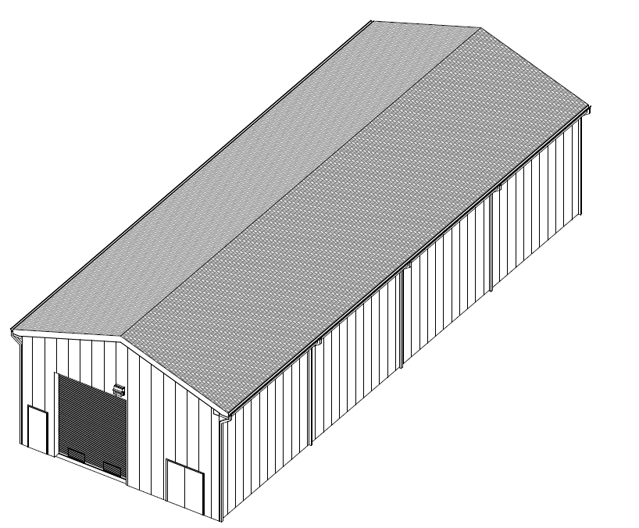
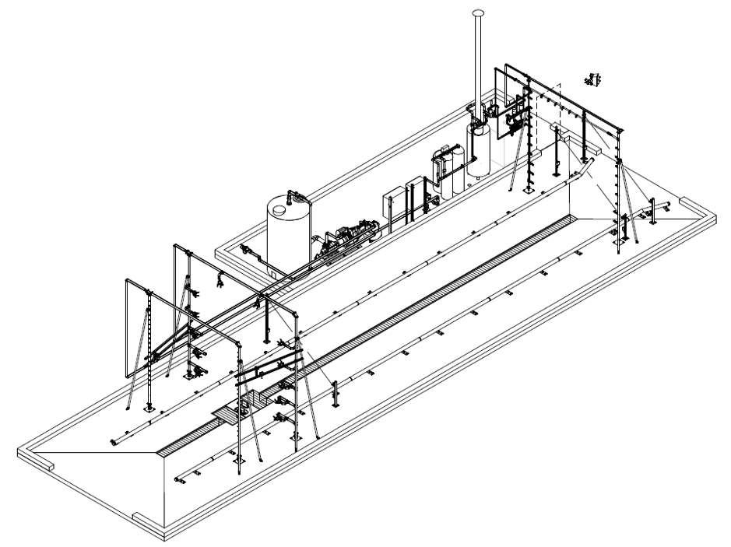
City of Muscatine – Bus Wash Facility
This project will construct an automatic drive through wash bay that includes an automatic high-pressure wash system with water reclamation and manual
pressure washer.
Total Cost: $1,631,700
Recommended: $400,000 (24%)
Return to List of Applications Recommended

Slide 10
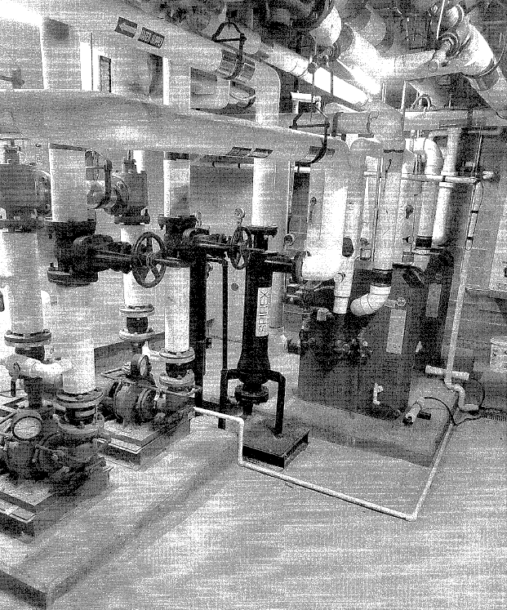
City of Sioux City – Boiler/Heat Pump Replacement
This project will replace two heating water boilers and associated piping serving the Martin Luther King Jr. Transportation Center
Total Cost: $150,650
Recommended: $120,000 (79.65%)
Return to List of Applications Recommended

Slide 11
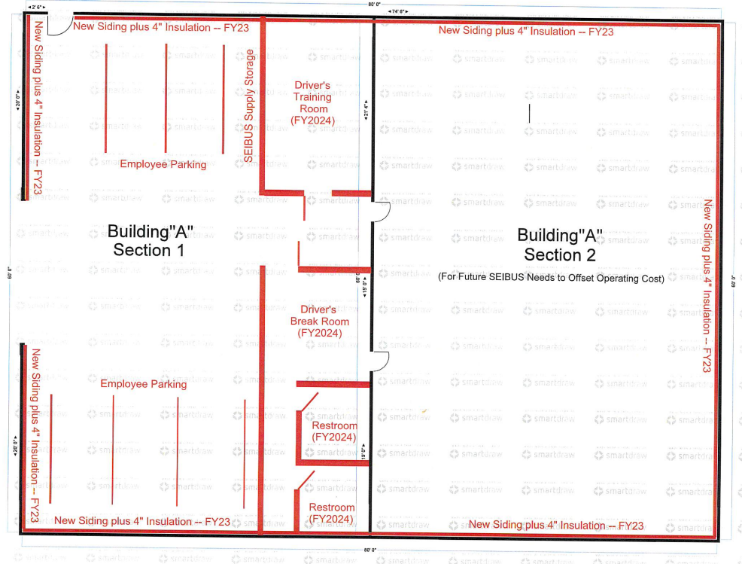
Southeast Iowa Regional Planning Commission - Renovation of Facility
This project is for a major renovation of an existing facility in Mt. Pleasant. This property consists of two buildings: an 8600 sq ft steel warehouse and 3200 sq ft steel front office/storage facility. Renovation of this facility is to make it ready for use as a vehicle storage facility for vehicles used in Henry County. Renovation includes roof repair and insulation, siding, adding walls, constructing a concrete apron, installation of security cameras and installation of a furnace.
Total Cost: $300,000
Recommended: $240,000 (80%)
Return to List of Applications Recommended

Slide 12
List of Applications Not Recommended for Award
PROJECT NAME | SPONSOR | TOTAL PROJECT COST | REQUESTED AMOUNT (% of Total Project Cost) | RECOMMENDED AMOUNT (% of Total Project Cost)
Fire Mitigation Building Improvements | Ames (CyRide) | $500,000 | $400,000 (80%) | $0
Operations and Maintenance Facility | Des Moines Area Regional Transit Authority | $34,789,700 | $400,000 (1.15%) | $0
Parking Garage | North Iowa Area Council of Governments | $500,000 | $300,000 (60%) | $0
Vehicle Storage Facility | Heart of Iowa Regional Transit Agency | $480,000 | $400,000 (83.33%) | $0
Return to List of Applications Recommended
Notes:
There were four applications that are not being recommended for funding. The Ames (CyRide) for Fire Mitigation Building Improvements, Des Moines Area Regional Transit Authority for an Operations and Maintenance Facility, North Iowa Area Council of Governments for a Parking Garage, and Heart of Iowa Regional Transit Agency for a vehicle storage facility.

