Slide 1
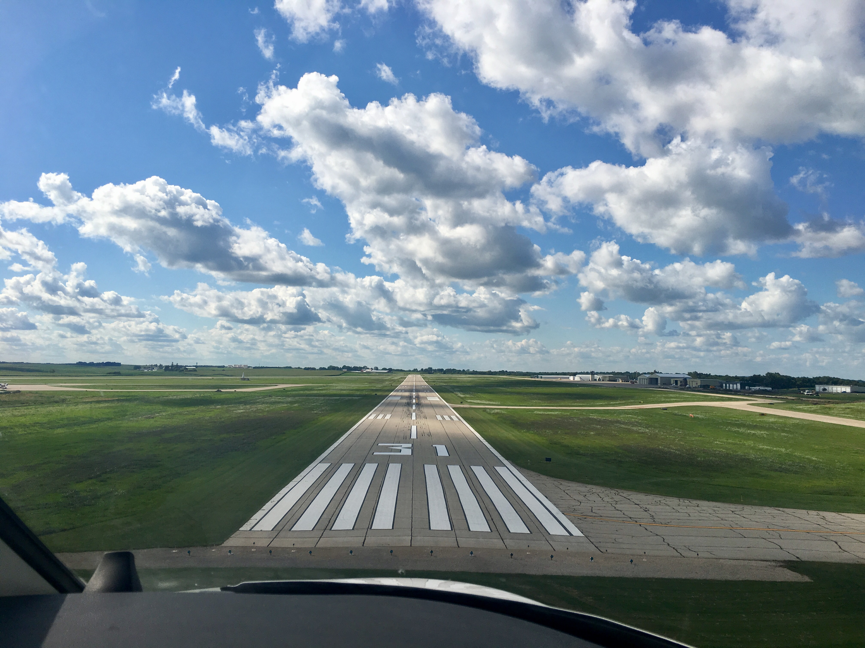

FY24 State Aviation Program
Funding Recommendation

Slide 2

State Aviation Programs - Overview
Three state programs for review
  Airport Improvement Program (AIP)
    Funded through Aviation Fuel Taxes and Aircraft Registration fees deposited into the State Aviation Fund
  General Aviation Vertical Infrastructure (GAVI)
    Funded through Rebuild Iowa Infrastructure (RIIF) appropriation
  Commercial Service Vertical Infrastructure (CSVI)
    Funded through Rebuild Iowa Infrastructure (RIIF) appropriation
Commission Role
  The commission is responsible for approving the projects to be funded in all three of these programs
Process
  Projects are presented for review at the July meeting and commission action will be requested at the August meeting
  Commercial Service Airport Terminal Program – new appropriation for FY2024 that will be discussed at a future meeting

Slide 3

State Aviation Program - AIP
Includes Airport Improvement Program (AIP)
Public-owned airport sponsors may apply for grants to assist in the preservation and development of the airfield and related infrastructure.
Eligible projects are funded up to 85% and generally include planning and improvements related to enhancing airport safety, capacity, security and environmental concerns.

Slide 4

Project Evaluation Criteria
Airport Role (5-20 Points)
Local participation (5-30 Points)
Multi-jurisdictional support (0-10 Points)
Type of project (5-30 Points)
Justification (5-20 Points)

Slide 5
Available Funding and Application Summary
Available Funding:
  FY24 Funds Available: $ 5,329,262
  Aviation Safety Programs: $ (360,000)
  Aviation Development Programs: $ (473,000)
  Funds available for projects: $ 4,496,262
Application Summary:
  Total number of applications: 36
  Total project costs: $12,350,580
  Total amount requested: $8,619,632

Slide 6
List of Applications Recommended
PROJECT NAME | SPONSOR | SCORE | TOTAL PROJECT COST | REQUESTED AMOUNT (% of Total Project Cost) | RECOMMENDED AMOUNT (% of Total Project Cost)
Taxiway D Apron and Access Roadway Paving- Phase 4 | Ankeny Regional Airport | 85 | 1,038,100 | 467,145(45%) | 400,000(38%)
General Aviation Apron Pavement Repair | Des Moines International Airport | 85 | 866,694 | 390,000(45%) | 390,000(45%)
Rehabilitate General Aviation Taxilane | Mason City Municipal Airport | 75 | 410,000 | 287,000(70%) | 287,000(70%)
South Apron Expansion Grading | Sioux County Regional Airport | 75 | 641,000 | 400,000(62%) | 400,000(62%)
Apron Pavement Rehabilitation | Centerville Municipal Airport | 70 | 224,000 | 168,000(75%) | 168,000(75%)
Reconstruct North Apron - Phase 2 | Clinton Municipal Airport | 70 | 476,700 | 400,428(84%) | 400,000(83%)
Construct Hangar Site Development Area | Council Bluffs Municipal Airport | 70 | 668,000 | 267,200(40%) | 267,200(40%)
Obstruction Analysis and Mitigation Plan | Creston Municipal Airport | 70 | 10,000 | 8,000(80%) | 8,000(80%)
General Aviation Apron Reconstruction | Dubuque Regional Airport | 70 | 500,000 | 400,000(80%) | 400,000(80%)
Obstruction Removal | Emmetsburg Municipal Airport | 70 | 430,000 | 344,000(80%) | 344,000(80%)
Fuel System Improvements | Fort Dodge Regional Airport | 70 | 100,000 | 80,000(80%) | 80,000(80%)
Expand Apron | Knoxville Municipal Airport | 70 | 88,661 | 62,062(70%) | 62,062(70%)
New Jet A Fuel System | Muscatine Municipal Airport | 70 | 500,000 | 400,000(80%) | 400,000(80%)
Reconstruct Taxiway and Apron Pavement | Southeast Iowa Regional Airport | 70 | 476,190 | 400,000(84%) | 400,000(84%)
Landside Paving, Lighting, and Gate Improvements | Ames Municipal Airport | 70 | 250,000 | 200,000(80%) | 200,000(80%)
Hangar Building Site Improvements | Jefferson Municipal Airport | 65 | 350,000 | 262,500(75%) | 262,500(75%)
Airport Entrance Sign | Estherville Municipal Airport | 55 | 55,000 | 27,500(50%) | 27,500(50%)
Jump to applications not recommended for funding

Slide 7
State Aviation Program - GAVI
General Aviation Vertical Infrastructure(GAVI)
Public owned general aviation airport sponsors may apply for projects that include landside development and renovation of airport terminals, hangars, maintenance buildings, and fuel facilities.
Eligible projects are funded up to 85%
Funds are subject to annual appropriation

Slide 8
Project Evaluation Criteria
Airport Role (5-20 Points)
Local participation (5-30 Points)
Multi-jurisdictional support (0-10 Points)
Type of project (10-30 Points)
Justification (5-20 Points)

Slide 9
Available Funding and Application Summary
Available Funding:
  FY24 Funds Appropriated: $1,000,000
  Project Cancellations and Underrun: $550,698
  Funds available for projects $1,550,698
Application Summary:
  Total number of applications: 13
  Total project costs: $2,467,025
  Total amount requested: $1,778,841

Slide 10
List of GAVI Applications Recommended
PROJECT NAME | SPONSOR | SCORE | TOTAL PROJECT COST | REQUESTED AMOUNT (% of Total Project Cost) | RECOMMENDED AMOUNT (% of Total Project Cost)
Construct T-Hangar | Ottumwa Regional Airport | 85 | 546,870 | 300,000 (55%) | 300,000 (55%)
Box Hangar Improvements | Webster City Municipal Airport | 80 | 60,000 | 30,000 (50%) | 30,000 (50%)
Hangar Roof Replacement | Mount Pleasant Municipal Airport | 75 | 132,000 | 92,000 (70%) | 92,000 (70%)
North Hangar Upgrades | Sheldon Regional Airport | 75 | 108,400 | 72,900 (67%) | 72,900 (67%)
T-Hangar Door Operator Replacement | Spencer Municipal Airport | 75 | 85,000 | 68,000 (80%) | 68,000 (80%)
Install New Hangar Doors | Harlan Municipal Airport | 70 | 150,000 | 125,000 (83%) | 125,000(83%)
Construct New Hangar | Sibley Municipal Airport | 70 | 421,000 | 300,000 (71%) | 300,000 (71%)
Hangar HVAC Upgrade | Northeast Iowa Regional Airport | 70 | 40,000 | 30,000 (75%) | 30,000 (75%)
Expand Terminal Building | Perry Municipal Airport | 70 | 375,000 | 300,000 (80%) | 300,000 (80%)
Replace Hangar Exterior | Washington Municipal Airport | 65 | 135,000 | 114,750 (85%) | 114750 (85%)
Terminal Building Rehabilitation | Tipton - Mathews Memorial Airport | 55 | 138,880 | 118,048 (85%) | 118048 (85%)
Jump to applications not recommended for funding

Slide 11
State Aviation Program - CSVI
The Commercial Service Vertical Infrastructure (CSVI) program provides funding for landside development and renovation of terminals, hangars, maintenance buildings, and fuel facilities at commercial service airports.
Appropriated funds are distributed to the commercial service airports formula with no local match required.
    50% evenly split between the airports
    40% based on enplanements
    10% based on cargo activity

Slide 12
Available Funding and Application Summary
Available Funding:
  FY24 Funds Appropriated: $1,900,000
  Funds available for projects: $1,900,000
Application Summary:
  Total number of projects: 8
  Total project costs: $7,830,500
  Total amount requested: $1,900,000

Slide 13
List of CSVI Applications Recommended
PROJECT NAME | SPONSOR | SCORE | TOTAL PROJECT COST | REQUESTED AMOUNT (% of Total Project Cost) | RECOMMENDED AMOUNT (% of Total Project Cost)
Construct Consolidated Aircraft Deicing Facility* | Des Moines International Airport | N/A | 2,134,000 | $696,931 | $696,931
Construct Hangar, Airfield Equipment Storage, Airfield Generator* | Dubuque Regional Airport | N/A | 3,000,000 | $127,281 | $127,281
Construct Two Aircraft Hangars | Eastern Iowa Airport | N/A | 1,939,000 | $453,106 | $453,106
Construct Hangars. Renovate SRE Building* | Fort Dodge Regional Airport | N/A | 125,000 | $122,005 | $122,005
Construct Equipment Storage Building - Design | Mason City Municipal Airport | N/A | 250,000 | $122,250 | $122,250
Construct T-Hangars* | Sioux Gateway Airport | N/A | 132,000 | $132,812 | $132,812
Construct Hangar* | Southeast Iowa Regional Airport | N/A | 125,000 | $120,354 | $120,354
Airport Terminal Security Upgrades and Hangar Lighting Upgrade | Waterloo Regional Airport | N/A | 125,500 | $125,262 | $125,262
* Airports requesting to use prior years unutilized funds on FY24 project

Slide 15

QUESTIONS?
Shane Wright
Aviation Program Manager
Shane.Wright@iowadot.us

Slide 16
List of AIP Applications Not Recommended
PROJECT NAME | SPONSOR | SCORE | TOTAL PROJECT COST | REQUESTED AMOUNT (% of Total Project Cost) | RECOMMENDED AMOUNT (% of Total Project Cost)
Remove Underground Fuel System | Denison Municipal Airport | 65 | 102,000 | 85,680(84%) | 0
Fuel System Improvements | Iowa City Municipal Airport | 65 | 470,000 | 399,500(85%) | 0
Bury Overhead Power Lines - Runway 17 Approach | Marion Municipal Airport | 65 | 264,600 | 224,910(85%) | 0
Taxilane Expansion and Widening | Perry Municipal Airport | 65 | 280,000 | 224,000(80%) | 0
Airfield Fencing | Sioux Gateway Airport | 65 | 200,000 | 160,000(80%) | 0
Repair Fencing and Gate Operators | Southeast Iowa Regional Airport | 65 | 133,300 | 111,972(84%) | 0
Demolish Armory Facility and Site Restoration | The Eastern Iowa Airport | 65 | 838,000 | 419,000(50%) | 0
East Taxilane Extension | Atlantic Municipal Airport | 60 | 105,000 | 89,250(85%) | 0
Runway 15/33 Overlay | Cresco Municipal Airport | 60 | 500,000 | 400,000(80%) | 0
Construct Terminal Area Fencing | Denison Municipal Airport | 60 | 113,500 | 95,340(84%) | 0
Security Gate Improvements | Northeast Iowa Regional Airport | 60 | 120,000 | 96,000(80%) | 0
Replace Runway Lighting | Rock Rapids Municipal Airport | 60 | 510,000 | 433,500(85%) | 0
Hangar Development Area Sitework | Le Mars Municipal Airport | 55 | 440,000 | 330,000(75%) | 0
Runway Lighting Rehabilitation | Eagle Grove Municipal Airport | 55 | 353,000 | 300,050(85%) | 0
Apron Reconstruction | Eagle Grove Municipal Airport | 55 | 260,000 | 208,000(80%) | 0
Install Precision Approach Path Indicator | Marion Municipal Airport | 55 | 255,700 | 217,345(85%) | 0
Install Fuel System | New Hampton Municipal Airport | 55 | 50,000 | 37,500(75%) | 0
Expand Apron and Rehabilitation | Pocahontas Municipal Airport | 55 | 204,135 | 173,500(85%) | 0
Pave Parking Lot | Shenandoah Regional Airport | 50 | 67,000 | $50,250(75%) | 0
Jump to applications recommended for funding

Slide 17
List of GAVI Applications Not Recommended
PROJECT NAME | SPONSOR | SCORE | TOTAL PROJECT COST | REQUESTED AMOUNT (% of Total Project Cost) | RECOMMENDED AMOUNT (% of Total Project Cost)
Rehabilitate Terminal Building | Perry Municipal Airport | 65 | 110,000 | 88,000(80%) | 0
Construct New Box Hangar | Lamoni Municipal Airport | 55 | 164,875 | 140,143(85%) | 0
Jump to applications recommended for funding

