Slide 1
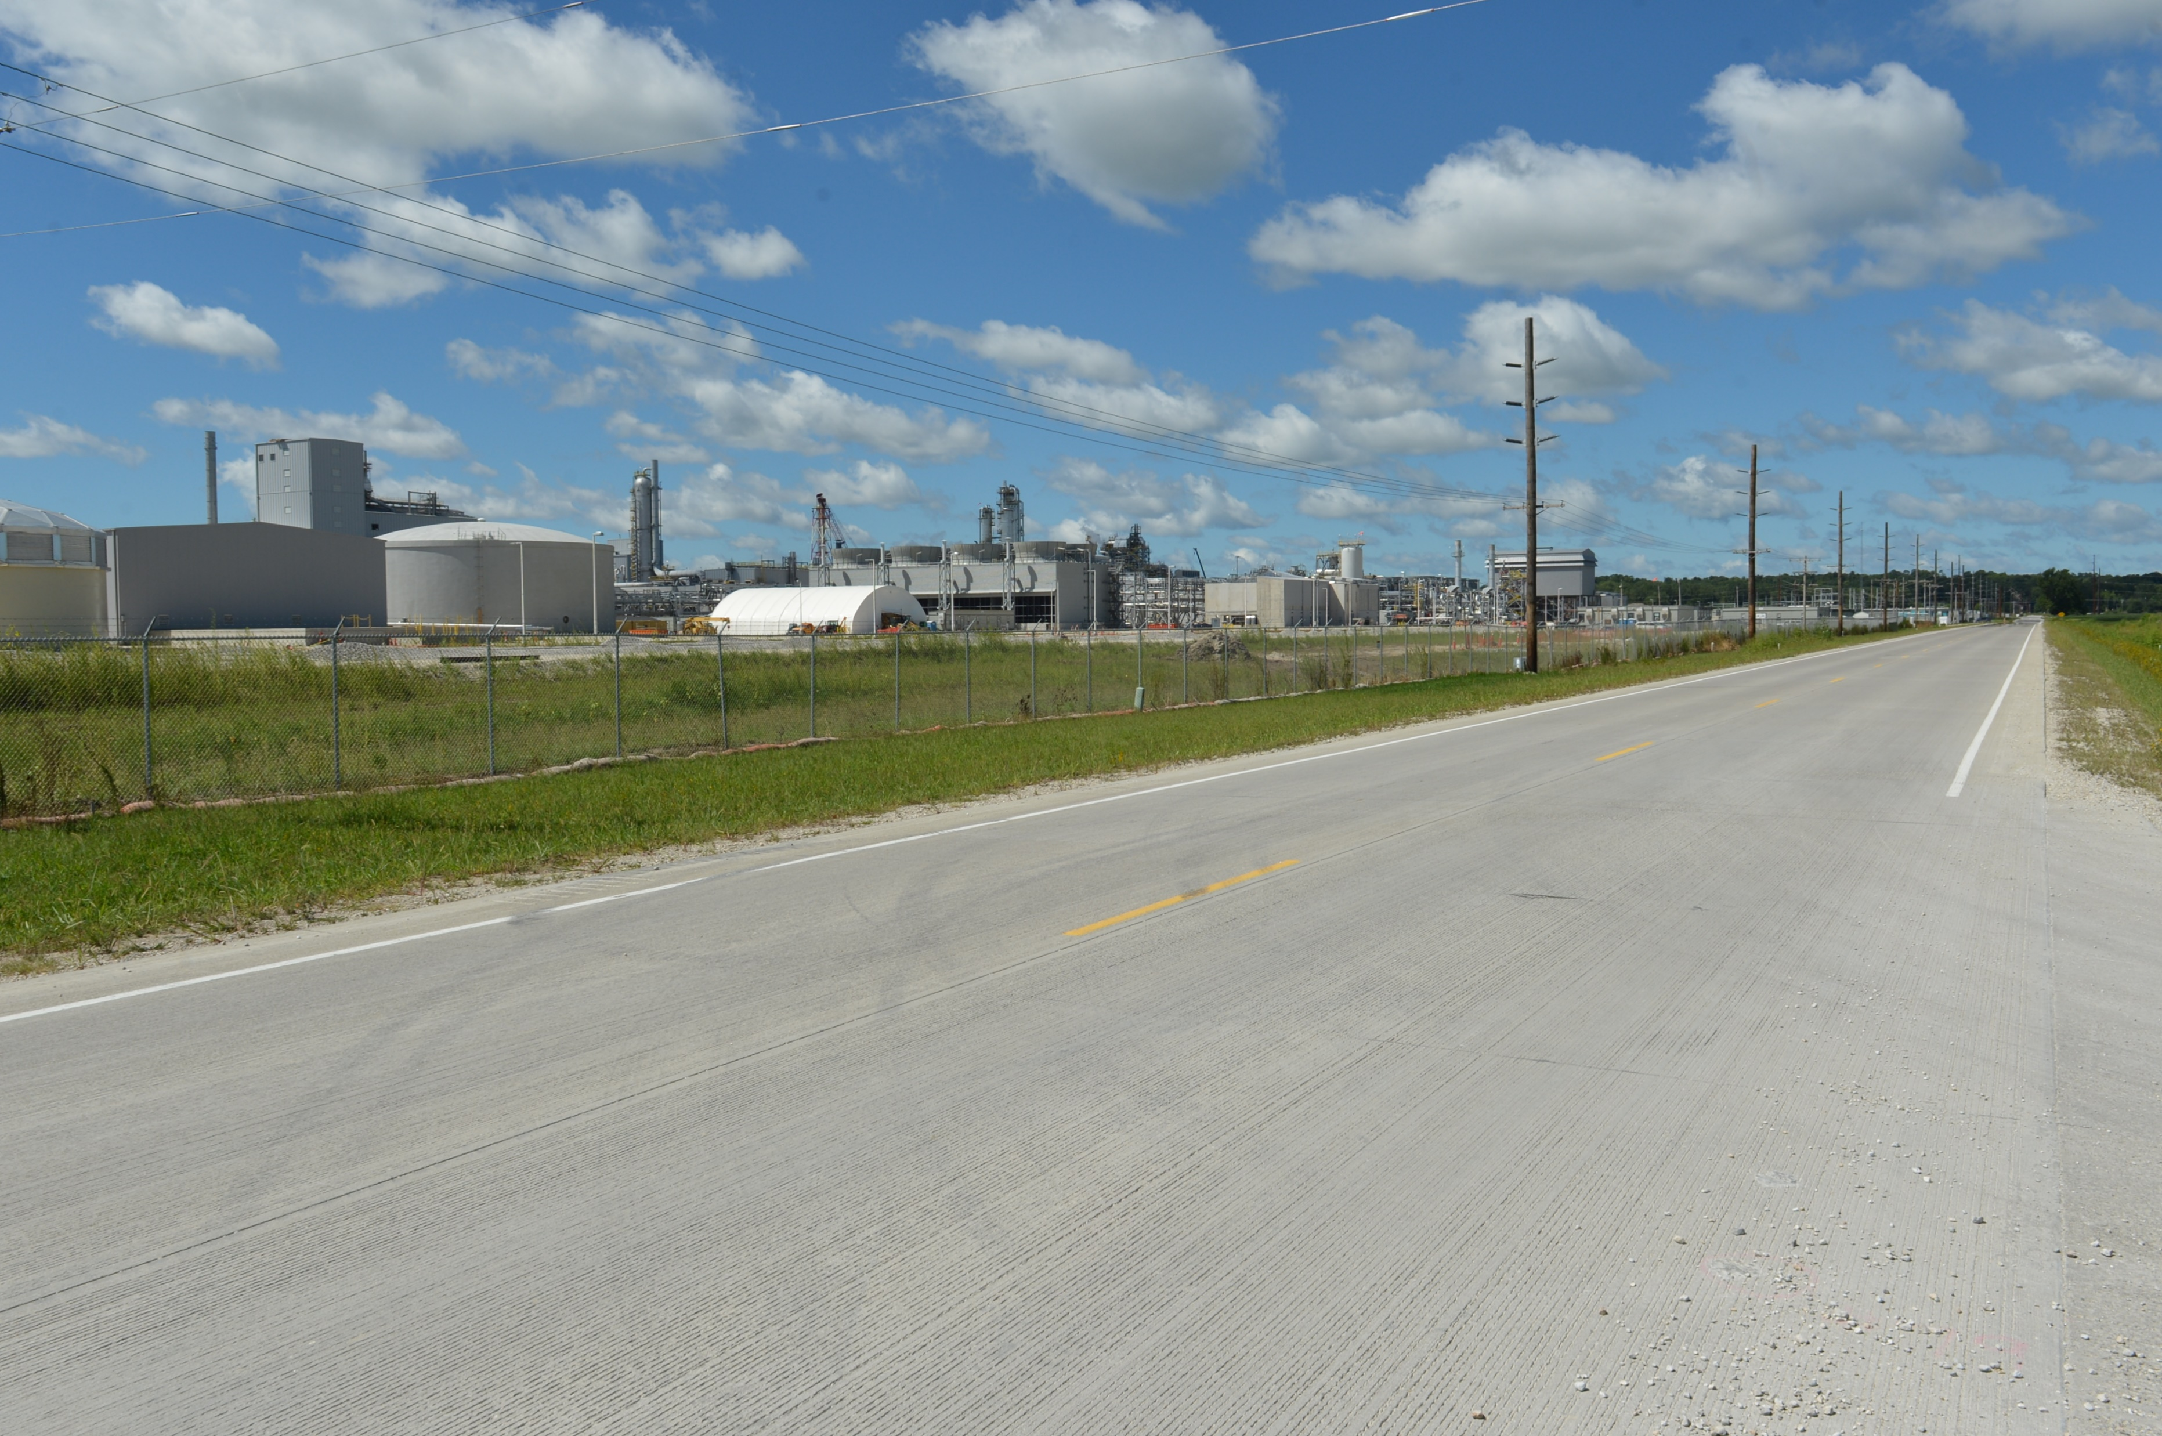
Revitalize Iowa’s Sound Economy Program
Funding Recommendation
Debra Arp
Grant Program Administration Team Lead
7/9/2024

Slide 2
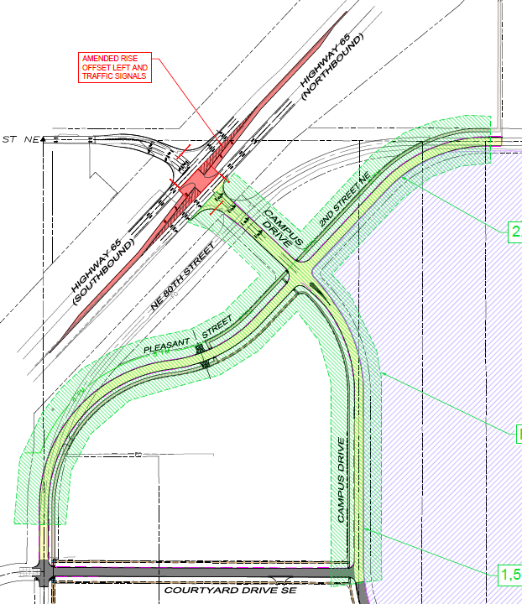
Local Development Recommendation
PROJECT NAME | SPONSOR | SCORE | TOTAL PROJECT COST | PERCENT PARTICIPATION | RECOMMENDED AMOUNT
Construction of offset left turn lanes and traffic signalization on U.S. 65 at Campus Drive on the east side of town (Certified Site Amendment) | Bondurant | 60 | $1,159,625 | 60% | $695,775
2
2

Slide 3
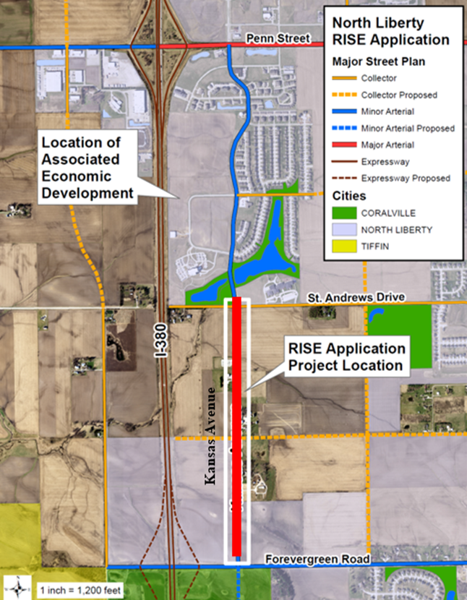
Project Settlement Recommendation
PROJECT BACKGROUND | SPONSOR | RISE FUNDS AWARDED | TOTAL ELIGIBLE PROJECT COSTS | RISE FUNDS REIMBURSED | RECOMMENDED SETTLEMENT
Awarded $3,070,000 on August 8, 2017, for the reconstruction of approximately 5,220 feet of Kansas Avenue and a roundabout at Kansas Avenue and St. Andrews Drive contingent on the creation of 307 new jobs. The roadway was opened to traffic on September 25, 2019. No jobs were created. | North Liberty | $3,070,000 | $3,985,264 | $3,070,000 | $1,077,368
3
3

