Slide 1



Transportation Trends Update
July 9, 2024
3/2/2023

Slide 2
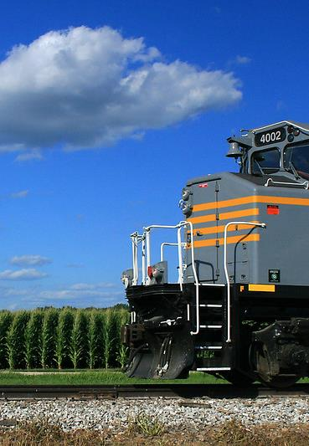

Agenda
US total rail carloads
Commercial air service passenger counts
Vehicular traffic
Mississippi River and Panama Canal

Slide 4
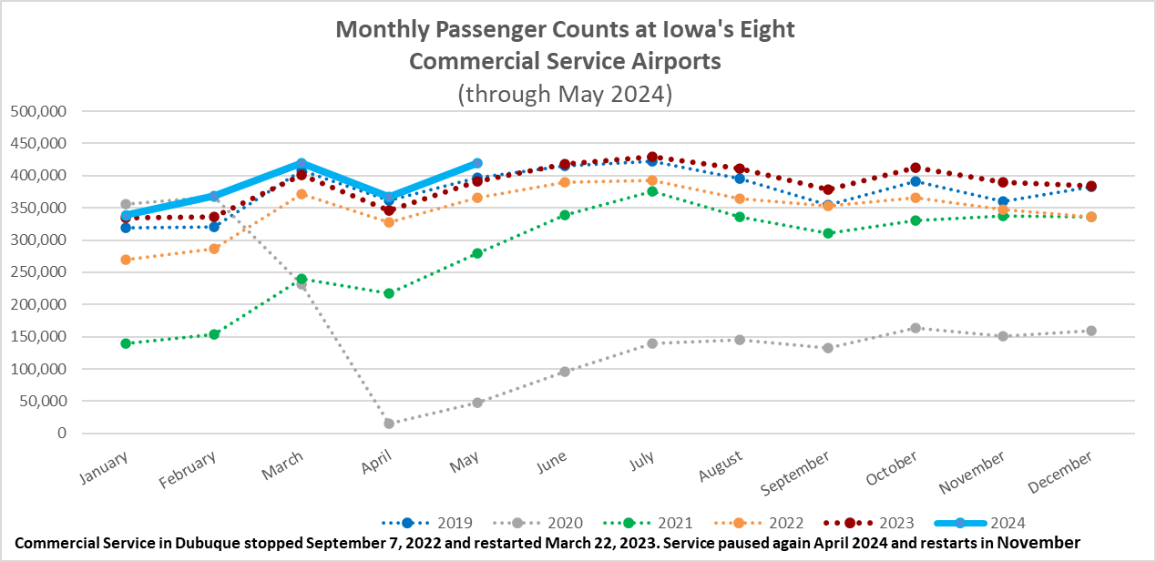

Slide 5
Monthly State Vehicle Miles of Travel
(through May 2024)

Slide 6
Water Transportation
Mississippi River
As of early February, the Corps of Engineers announced the end of drought conditions impacting the Mississippi River that began September 2022.
Flooding conditions now exist on some stretches of the river.
Some locks on the Upper Mississippi are closed or will close for at least several days in early July due to flooding..
Panama Canal
Drought has reduced the amount of freshwater available to use for the lock system. Drought was most likely caused by El Nino.
Rainy season has arrived as hoped and Gatun Lake level is at the average level for June.
Daily transits are at 32 and scheduled to increase to 35 by August 5. Normal levels - 36 to 38 ships per day.
Has been operating with draft limitations but that’s improving.
Forty percent of all US container traffic travels through the Panama Canal

Slide 7
Questions?

