Slide 1


August Commission Tour Preview
July 9, 2024
3/2/2023

Slide 2
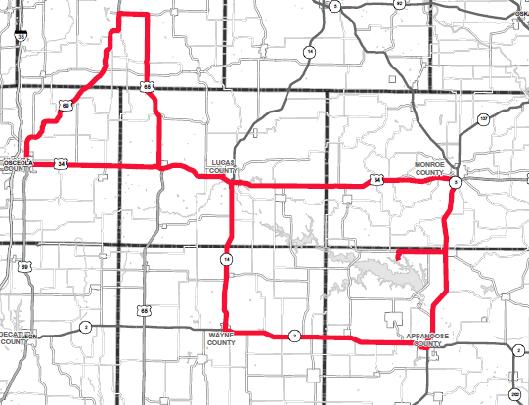
August Commission Tour Preview
Honey Creek Resort

Slide 3
August Commission Tour Preview
Begin tour at Honey Creek Resort
US 34 Corridor
  Super 2 Recommendations from Albia to Osceola
  Bridge Replacements and Improvements along corridor
US 69 FY-2025 3R Project
  South of Clarke Co. Rd. R35 to N of Warren Co Line
US 65 Bridge Replacement
  Otter Creek 1.6 mi south of Warren Co. Rd. G58
Tour and Lunch at Hy Vee Distribution Center (Chariton)
IA 14, IA 2, and IA 5 previous 3R improvements
  District 5 3R Funding Overview
End tour at Honey Creek Resort

Slide 4
August Commission Tour Preview
Questions?
Shawn Majors
Shawn.majors@iowadot.gov​
iowadot.gov

