Slide 1
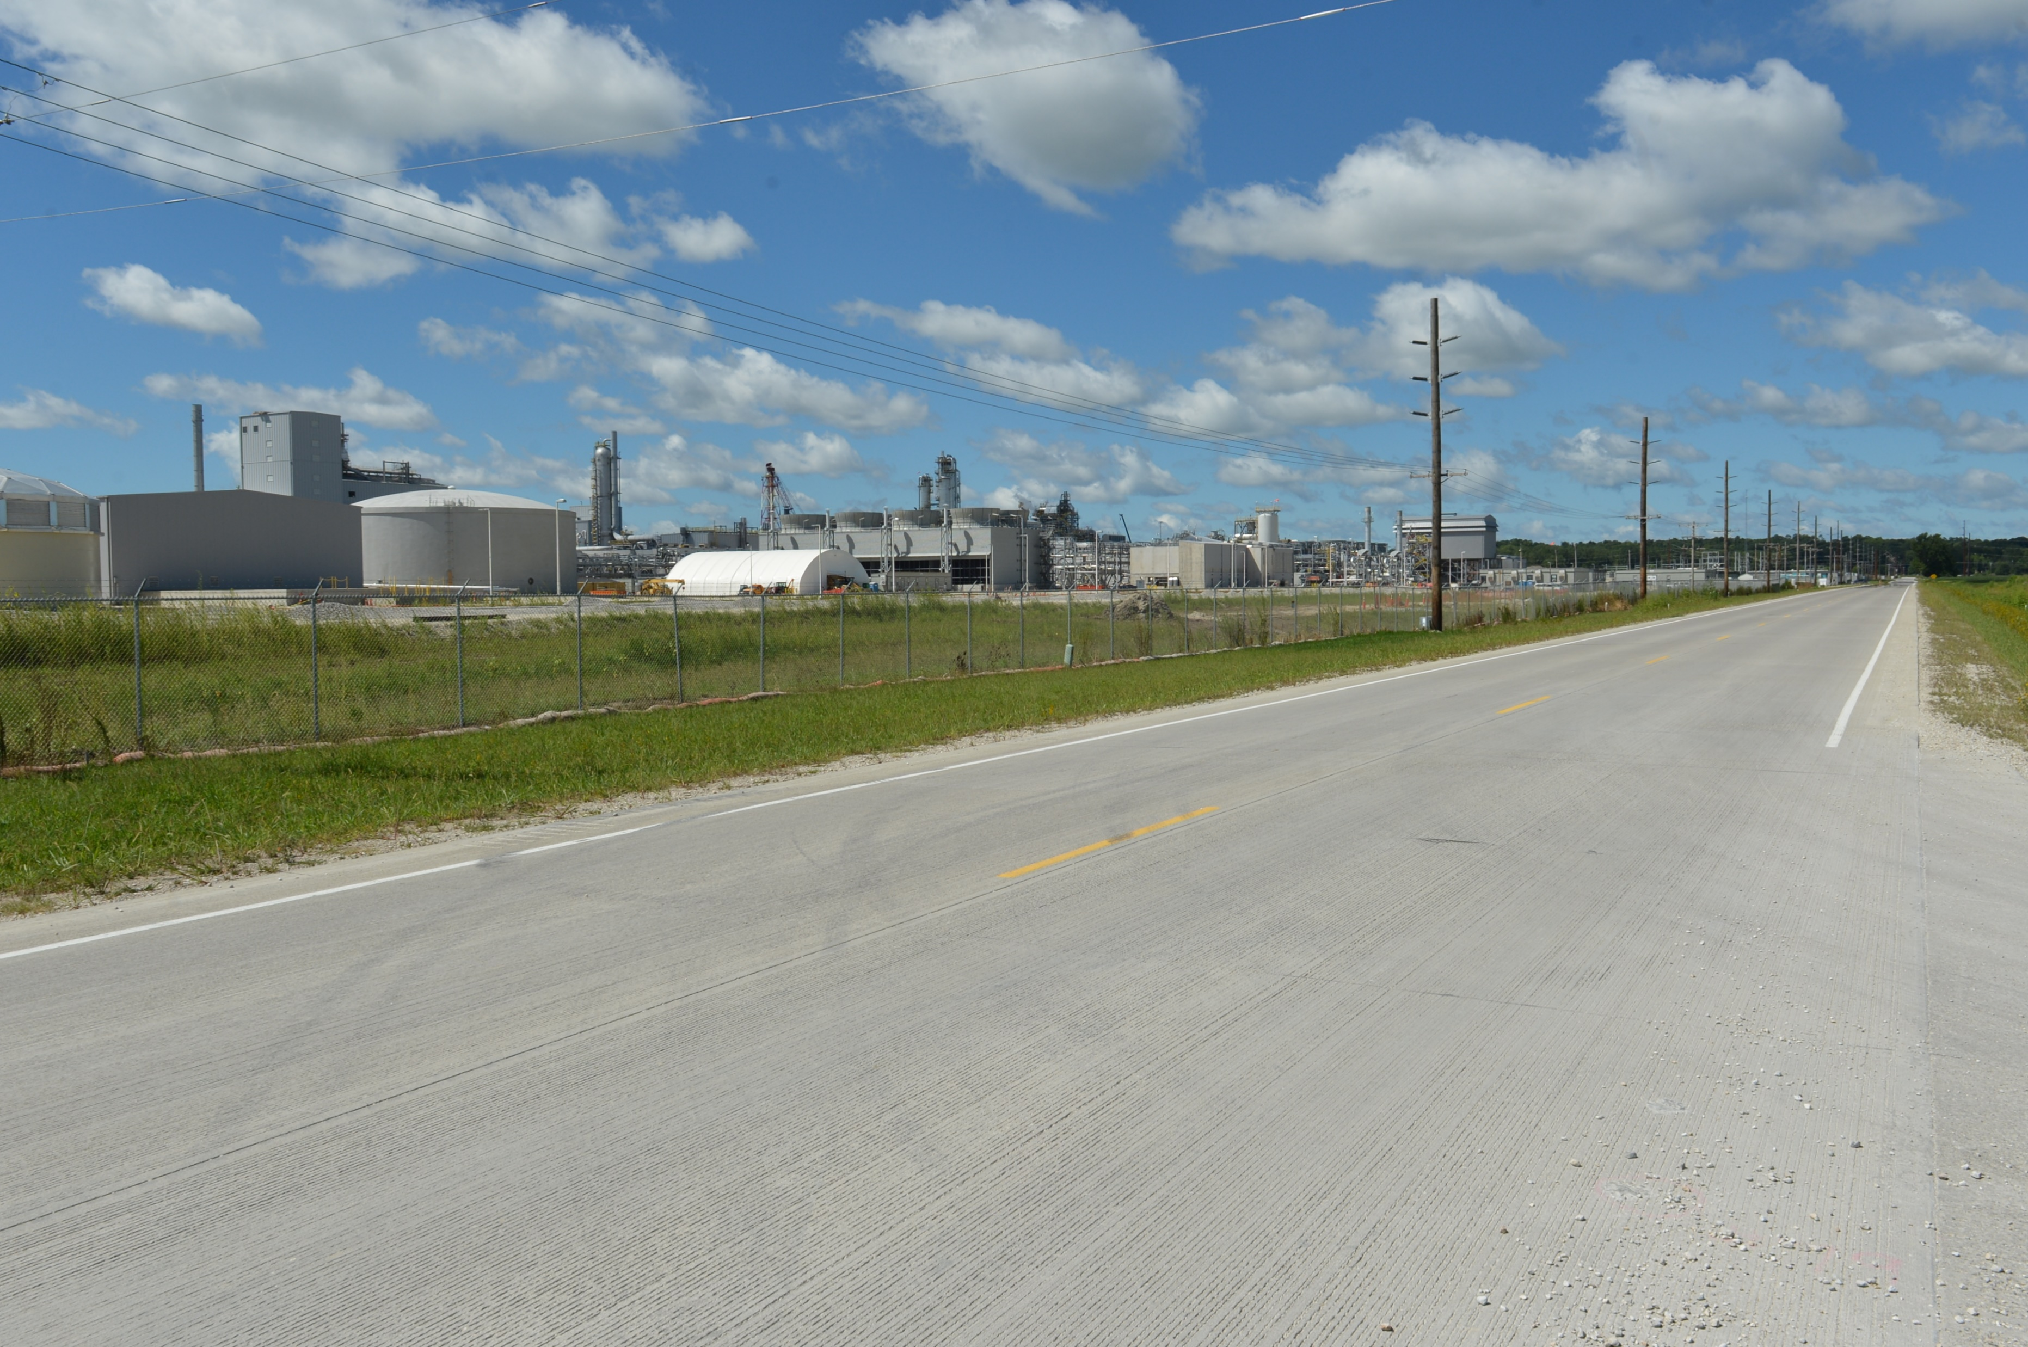
Revitalize Iowa’s Sound Economy Program
Funding Recommendation
Debra Arp
Grant Program Administration Team Lead
7/9/2024

Slide 2
Revitalize Iowa’s Sound Economy Program
Created in 1985
Purpose: To promote economic development through roadway improvements
Eligible development shall have value-adding activities that feed new dollars into the economy
Available to cities and counties through an application program
2
2

Slide 3
Monthly Program Financial Report
Funded annually with dedicated state motor fuel and special fuel tax revenues
 | City RISE Fund | County RISE Fund
FY2024 Projected Total RISE Road Use Tax Fund (RUTF) Revenue ¹ | $11,759,666 | $5,879,833
Actual RISE Revenue Received as of 5/31/2024 ² (% of FY2024 Projected Revenue) | $10,951,765 (93.1%) | $5,326,759 (90.6%)
FY2024 RISE Funds Awarded as of 5/31/2024 (% of Projected Total RUTF committed) | $8,932,847 (76.0%) | $0 (0%)
Fund Balance as of 5/31/2024 | $53,735,431 | $20,451,872
Outstanding Commitments as of 5/31/2024³ | ($40,816,789) | ($17,160,520)
Uncommitted Balance as of 5/31/2024 | $12,918,642 | $3,291,353
¹ Calculation based on FY2023 average monthly RISE RUTF revenue of $979,972 to the city RISE fund and $489,986 to the county RISE fund. As of 5/31/2024, FY2024 is 91.7% complete.
² Actual RISE revenue includes RUTF revenue, loan repayments, and project settlements. These revenue sources are variable and are not included in projections.
³ Award of $344,450 to Fort Dodge in June 2024 is not reflected in the outstanding commitments of 5/31/2024.
3
3

Slide 4
Local Development Project Evaluation Criteria
Criteria | Points
Development Potential | 35
Economic Impact and Cost Effectiveness | 20
Local Commitment and Initiative | 33
Transportation Need and Justification | 4
Local Economic Need | 6
4
4

Slide 5
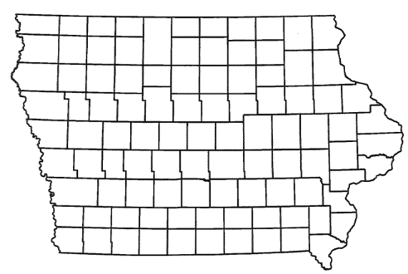
Local Development Recommendations
PROJECT NAME | SPONSOR | SCORE | TOTAL PROJECT COST | PERCENT PARTICIPATION | RECOMMENDED AMOUNT
Construction of offset left turn lanes and traffic signalization on U.S. 65 at Campus Drive on the east side of town (Certified Site Amendment) | Bondurant | 60 | $1,159,625 | 60% | $695,775
5
5

Slide 6
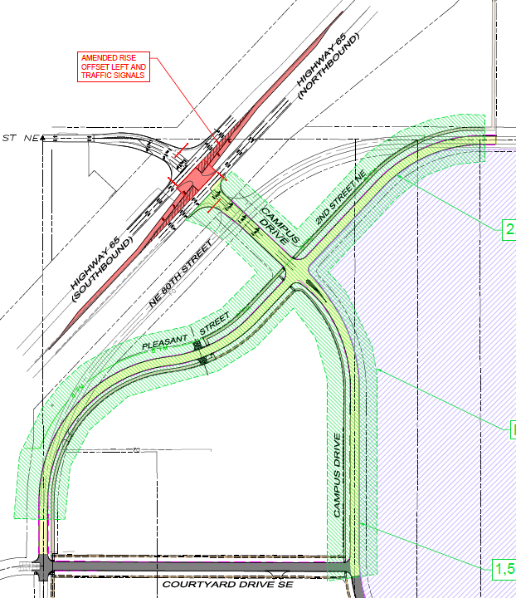
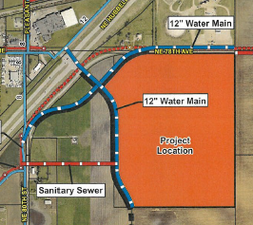
Bondurant
Certified Site
Local Development
Amendment
An amendment to the scope and grant award was requested to construct offset left turn lanes and traffic signals on U.S 65 at Campus Drive.
Awarded August 2023
Total Cost: $3,675,594
RISE Award: $2,205,356 (60%)
Added Total Cost: $1,159,625
RISE Request: $695,775 (60%)
6

Slide 7
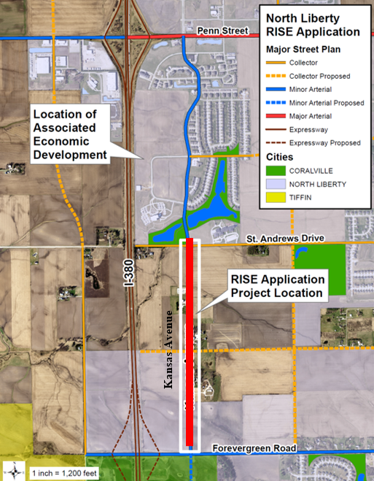
Project Settlement
North Liberty
Immediate Opportunity
Awarded $3,070,000 on August 8, 2017, for the reconstruction of approximately 5,220 feet of Kansas Avenue and a roundabout at Kansas Avenue and St. Andrews Drive contingent on the creation of 307 new jobs. The roadway was opened to traffic on September 25, 2019. No jobs were created.
RISE Funds Reimbursed: $3,070,000
Recommended
Settlement: $1,077,368
7

Slide 8
Questions?
jennifer.kolacia@iowadot.us
515-239-1738

