Slide 1
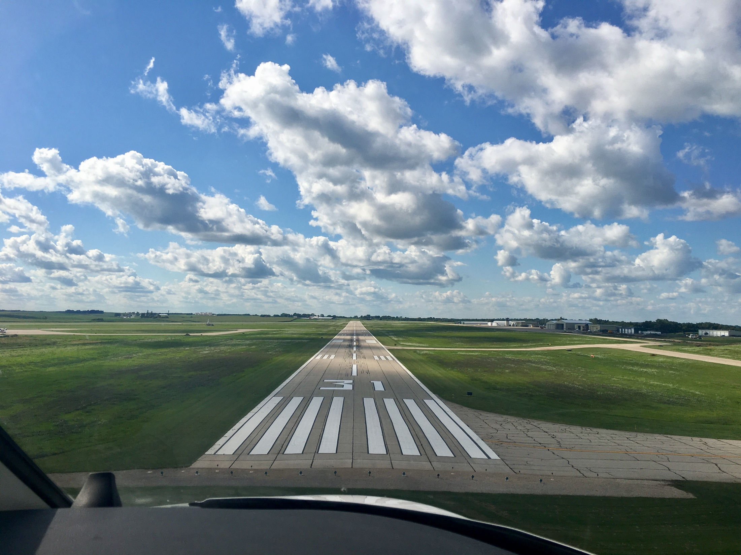

FY2025 State Aviation Program
Funding Recommendation
Shane Wright
Aviation Program Manager
7/9/2024

Slide 2
State Aviation Programs - Overview
Three state programs for review
Airport Improvement Program (AIP)
Funded through Aviation Fuel Taxes and Aircraft Registration fees deposited into the State Aviation Fund
General Aviation Vertical Infrastructure (GAVI)
Funded through Rebuild Iowa Infrastructure (RIIF) appropriation
Commercial Service Vertical Infrastructure (CSVI)
Funded through Rebuild Iowa Infrastructure (RIIF) appropriation
Commission Role
The commission is responsible for approving the projects to be funded in all three of these programs
Process
Projects are presented for review at the July meeting and commission action will be requested at the August meeting

Slide 3
State Aviation Program - AIP
Includes Airport Improvement Program (AIP)
Public-owned airport sponsors may apply for grants to assist in the preservation and development of the airfield and related infrastructure.
Eligible projects are funded up to 85% and generally include planning and improvements related to enhancing airport safety, capacity, security and environmental concerns.

Slide 4
Project Evaluation Criteria
Airport Role (5-20 Points)
Local participation (5-30 Points)
Multi-jurisdictional support (0-10 Points)
Type of project (5-30 Points)
Justification (5-20 Points)

Slide 5
Available Funding and Application Summary
Available Funding:
FY25 Funds Available: $ 6,322,042
Aviation Safety Programs: $ (515,000)
Aviation Development Programs: $ (473,000)
Funds available for projects: $ 5,334,042
Application Summary:
Total number of applications: 33
Total project costs: $11,437,318
Total amount requested: $8,095,215

Slide 6
List of Applications Recommended
PROJECT NAME | SPONSOR | SCORE | TOTAL PROJECT COST | REQUESTED AMOUNT (% of Total Project Cost) | RECOMMENDED AMOUNT (% of Total Project Cost)
North GA Apron Reconstruction | Des Moines International Airport | 85 | 850,770 | 382,846(45%) | 382,846(45%)
Taxiway Repair | Carroll Arthur N Neu Airport | 75 | 17,988 | 13,491(75%) | 13,491(75%)
Remove Underground Storage Tanks | Denison Municipal Airport | 75 | 67,000 | 33,500(50%) | 33,500(50%)
South Apron Reconstruction | Sioux Gateway Airport | 75 | 600,000 | 400,000(67%) | 400,000(67%)
Fuel System Improvements | Spencer Municipal Airport | 75 | 185,500 | 139,125(75%) | 139,125(75%)
Construct Hangar Development Taxilane | Mason City Municipal Airport | 75 | 546,800 | 382,760(70%) | 382,760(70%)
South Apron Utility Expansion | Sioux County Regional Airport | 75 | 117,500 | 88,125(75%) | 88,125(75%)
Construct Taxilane, Apron, and Demo Armory | The Eastern Iowa Airport | 70 | 1,201,000 | 605,000(50%) | 400,000(33%)
T-Hangar Approach and Taxilane Extension | Boone Municipal Airport | 70 | 500,000 | 375,000(75%) | 375,000(75%)
Obstruction Mitigation | Creston Municipal Airport | 70 | 65,000 | 55,250(85%) | 55,250(85%)
Taxilane Extension, Apron Expansion, and Site Improvements | Le Mars Municipal Airport | 70 | 500,000 | 350,000(70%) | 350,000(70%)
Construct Taxiway/Aprons for Hangar | Mount Pleasant Municipal Airport | 70 | 370,000 | 292,300(70%) | 292,300(70%)
Apron Expansion | Newton Municipal Airport | 70 | 400,000 | 340,000(79%) | 340,000(79%)
Airfield Lighting Replacement | Rock Rapids Municipal Airport | 70 | 570,000 | 400,000(85%) | 400,000(85%)
Runway 34 Obstruction Mitigation | Vinton Veterans Memorial | 70 | 200,000 | 170,000(70%) | 170,000(70%)
Runway Markings Improvement | Dubuque Regional Airport | 70 | 412,000 | 329,600(85%) | 329,600(85%)
Terminal Area Utility Improvements | Knoxville Municipal Airport | 70 | 250,000 | 200,000(80%) | 200,000(80%)
Construct Taxilane | Northeast Iowa Regional Airport | 70 | 583,870 | 400,000(69%) | 400,000(69%)
Construct Hangar Aprons | Ankeny Regional Airport | 70 | 222,850 | 111,425(50%) | 111,425(50%)
Hangar Apron and Site Improvement | Washington Municipal Airport | 70 | 300,000 | 225,000(75%) | 225,000(75%)
Terminal Area Access and Taxiway | Milford Municipal Airport | 65 | 76,600 | 38,300(50%) | 38,300(50%)
Airport Layout Plan and Narrative | Osage Municipal Airport | 65 | 67,900 | 54,320(80%) | 54,320(80%)
Runway 31 Obstruction Mitigation | Rockwell City Municipal Airport | 60 | 180,000 | 153,000(85%) | 153,000(85%)
Jump to applications not recommended for funding

Slide 7
State Aviation Program - GAVI
General Aviation Vertical Infrastructure(GAVI)
Public owned general aviation airport sponsors may apply for projects that include landside development and renovation of airport terminals, hangars, maintenance buildings, and fuel facilities.
Eligible projects are funded up to 85%
Funds are subject to annual appropriation

Slide 8
Project Evaluation Criteria
Airport Role (5-20 Points)
Local participation (5-30 Points)
Multi-jurisdictional support (0-10 Points)
Type of project (10-30 Points)
Justification (5-20 Points)

Slide 9
Available Funding and Application Summary
Available Funding:
FY25 Funds Appropriated: $1,000,000
Project Cancellations and Underrun: $58,350
Funds available for projects $1,058,350
Application Summary:
Total number of applications: 9
Total project costs: $3,153,667
Total amount requested: $1,783,350

Slide 10
List of GAVI Applications Recommended
PROJECT NAME | SPONSOR | SCORE | TOTAL PROJECT COST | REQUESTED AMOUNT (% of Total Project Cost) | RECOMMENDED AMOUNT (% of Total Project Cost)
Construct Box Hangars | Ankeny Regional Airport | 90 | 985,000 | 300,000(30%) | 300,000(30%)
Construct T-Hangar | Boone Municipal Airport | 85 | 720,000 | 300,000(42%) | 300,000(42%)
Construct T-Hangar | Northeast Iowa Regional Airport | 80 | 300,000 | 300,000(56%) | 300,000(56%)
Hangar Structural Improvement | Mount Pleasant Municipal Airport | 75 | 66,000 | 45,600(69%) | 45,600(69%)
Hangar Roof Replacement and Rehab | Keokuk Municipal Airport | 75 | 101,000 | 80,750(80%) | 80,750(80%)
Hangar HVAC and Restroom Improvements | Knoxville Municipal Airport | 70 | 40,000 | 32,000(80%) | 32,000(80%)
Jump to applications not recommended for funding

Slide 11
State Aviation Program - CSVI
The Commercial Service Vertical Infrastructure (CSVI) program provides funding for landside development and renovation of terminals, hangars, maintenance buildings, and fuel facilities at commercial service airports.
Appropriated funds are distributed to the commercial service airports formula with no local match required.
50% evenly split between the airports
40% based on enplanements
10% based on cargo activity

Slide 12
Available Funding and Application Summary
Available Funding:
FY25 Funds Appropriated: $1,900,000
Funds available for projects: $1,900,000
Application Summary:
Total number of projects: 8
Total project costs: $43,321,817
Total amount requested: $1,900,000

Slide 13
List of CSVI Applications Recommended
PROJECT NAME | SPONSOR | SCORE | TOTAL PROJECT COST | REQUESTED AMOUNT (% of Total Project Cost) | RECOMMENDED AMOUNT (% of Total Project Cost)
Consolidated Aircraft Deicing Facility | Des Moines International Airport | N/A | 2,873,787 | $724,575 | $724,575
Terminal Exit Lane, Airport Fuel Farm, Airport Hangar, Airfield Storage | Dubuque Regional Airport | N/A | 3,425,000 | $124,553 | $124,553
Construct Snow Removal Equipment Facility | Eastern Iowa Airport | N/A | 36,219,000 | $435,599 | $435,599
Renovate Quonset Hangar/GA Restroom/Renovate Terminal Awning | Fort Dodge Regional Airport | N/A | 333,000 | $120,798 | $120,798
Terminal Site Improvements, Demo, Site Restoration | Mason City Municipal Airport | N/A | 217,700 | $121,158 | $121,158
Terminal Roof Replacement | Sioux Gateway Airport | N/A | 128,330 | $128,330 | $128,330
Community Hangar and Covered Walkway | Southeast Iowa Regional Airport | N/A | 125,000 | $120,085 | $120,085
Hangar Improvements and Terminal Interior Upgrades | Waterloo Regional Airport | N/A | 124,902 | $124,902 | $124,902

Slide 15


Questions?
shane.wright@iowadot.us
515-239-1048

Slide 16
List of AIP Applications Not Recommended
PROJECT NAME | SPONSOR | SCORE | TOTAL PROJECT COST | REQUESTED AMOUNT (% of Total Project Cost) | RECOMMENDED AMOUNT (% of Total Project Cost)
Rehabilitate Taxiway D | Fort Dodge Regional Airport | 70 | 535,200 | 428,160(80%) | 0
Reconstruct Apron Pavement | Southeast Iowa Regional Airport | 70 | 476,190 | 400,000(84%) | 0
Expand AvGas Fuel System | Estherville Municipal Airport | 65 | 300,000 | 240,000(80%) | 0
Reconstruct Parking Apron | Grinnell Regional Airport | 65 | 375,000 | 300,000(80%) | 0
East Taxilane Extension | Atlantic Municipal Airport | 60 | 120,000 | 102,000(85%) | 0
Construct Terminal Area Fencing | Denison Municipal Airport | 60 | 113,500 | 95,340(84%) | 0
AvGas Fuel System Improvements | Jefferson Municipal Airport | 60 | 450,000 | 360,000(80%) | 0
Reconstruct North T-Hangar Taxilane | Waverly Municipal Airport | 60 | 402,650 | 330,173(82%) | 0
Fuel Facility Improvement | Guthrie County Regional Airport | 55 | 310,000 | 248,000(80%) | 0
Avgas Fuel System | New Hampton Municipal Airport | 55 | 70,000 | 52,500(75%) | 0
 |  |  |  |  | 0
 |  |  |  |  | 0
 |  |  |  |  | 0
 |  |  |  |  | 0
 |  |  |  |  | 0
 |  |  |  |  | 0
 |  |  |  |  | 0
 |  |  |  |  | 0
 |  |  |  |  | 0
Jump to applications recommended for funding

Slide 17
List of GAVI Applications Not Recommended
PROJECT NAME | SPONSOR | SCORE | TOTAL PROJECT COST | REQUESTED AMOUNT (% of Total Project Cost) | RECOMMENDED AMOUNT (% of Total Project Cost)
Construct Hangar and Terminal | Decorah Municipal Airport | 75 | 416,667 | 300,000(72%) | 0
Install New Hangar Doors | Harlan Municipal Airport | 70 | 150,000 | 125,000(83%) | 0
Construct T-Hangar | Mount Pleasant Municipal Airport | 70 | 375,000 | 300,000(80%) | 0
Jump to applications recommended for funding

