Slide 1
County Road Fund Distribution
Iowa Transportation Commission – July 9, 2024
Stuart Anderson

Slide 2
Agenda
State Road Fund Distribution
County Road Fund Distribution History
Secondary Road Fund Distribution Committee and Current Methodology
Boards and Commissions Changes
Recommendations
Next Steps
2

Slide 3
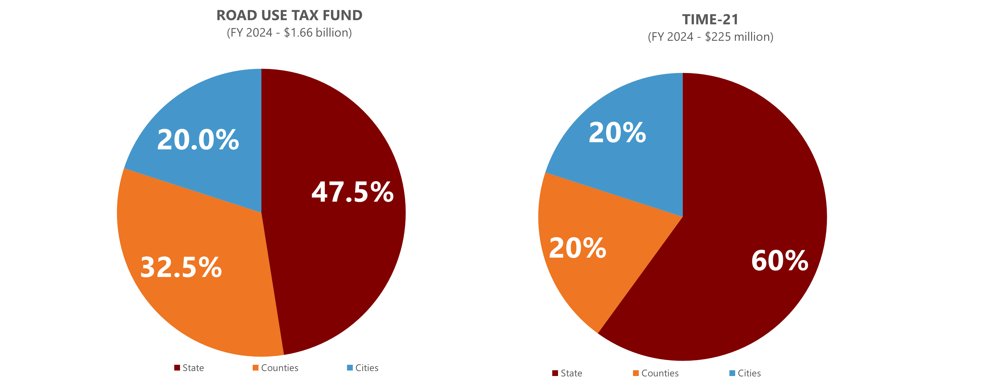
State Road Fund Distribution

Slide 4
Road Use Tax Fund Distribution
DOT: Primary Road Fund (47.5 percent)
Cities: Street Construction Fund (20 percent)
Allocated to individual cities based on each city’s share of total state municipal population.
Counties (32.5 percent):
Secondary Road Fund (24.5 percent)
Allocated to individual counties based on a formula
Farm-to-Market Fund (8 percent)
Allocated to individual counties based on a formula

Slide 5
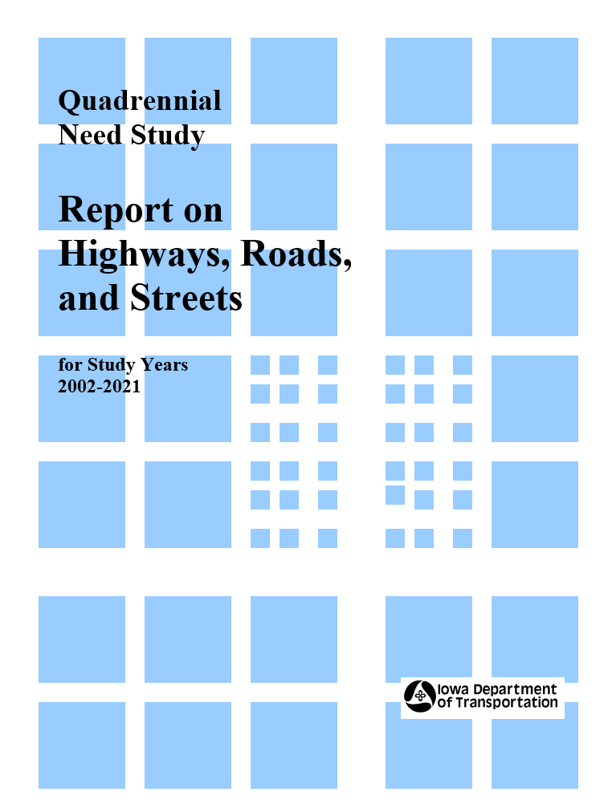
County Road Fund Distribution History
Prior to FY 2007, both county funds were largely allocated based on each county’s share of “needs.”
Needs were determined through a legislatively-mandated Iowa DOT study conducted every four years to estimate 20-years of bridge and pavement needs
Secondary Road Fund
70 percent based on each county’s share of total statewide secondary system “needs”
30 percent based on each county’s share of total statewide area
Farm-to-Market Road Fund
70 percent based on each county’s share of total statewide Farm-to-Market system “needs”
30 percent based on each county’s share of total statewide area

Slide 6
County Road Fund Distribution History
Challenges with needs-based allocation
Large swings in needs for individual counties from study-to-study led to unpredictable and highly variable funding allocations every four years
Perceived to reward under-maintenance of roads resulting in increased needs leading to greater allocation of formula funding
Difficult to understand and explain the process
Solution
Legislature established a Secondary Road Fund Distribution Advisory Committee (SRFDAC) in 2002 to consider new methodologies for fund distribution among counties and make recommendations to the general assembly
Committee met extensively from 2002 through 2004
Assessed options to improve the need study process
Reviewed past studies
Reviewed other state methodologies

Slide 7
SRFDAC Recommendation
Utilize a formula based on objective data that are related to a county’s transportation system
Factors in the formula
County area
Rural population
Total vehicle miles of travel
Miles of earth/dirt roads (Secondary Road Fund only)
Miles of granular roads
Miles of paved roads
Length of bridges
Benefits of methodology
Easy to explain/calculate
Stable in the short-term yet accommodates long-term changes
Phase-in formula over five years (FY 2007 to FY 2011)

Slide 8
SRFDAC Recommendation (continued)
Iowa Code retain the Secondary Road Fund Distribution Advisory Committee and authorize them to define the formula and methodology for county road fund allocation in administrative rules.
Administrative rules would also
Define the process for calculating the distribution factors each year
Define the process for making considering and approving changes to the distribution formula

Slide 9
New Methodology Implementation
SRFDAC Recommendation submitted to the general assembly in January 2005
Legislature passed House File 674 in the 2005 Session
Renamed the Secondary Road Fund Distribution Advisory Committee to the Secondary Road Fund Distribution Committee (SRFDC)
Empowered SRFDC to determine the formula for distributing county road funds
Directed SRFDC to adopt rules to govern the determination and modification of the formula for distribution of county road funds.
Directed new methodology be phased-in over five-years beginning July 1, 2006 (FY 2007)

Slide 10
Current Administrative Rule Process
Iowa County Engineers Association Service Bureau annually calculates Secondary Road Fund and Farm-to-Market Fund distribution allocations using data from Iowa DOT.
Factor | Secondary Road Fund Weighting | Farm-to-Market Road Fund Weighting | Factor explanation
Area | 30% | 30% | Total area of each county, including urban areas – serves as measure of system size and extent
Pop | 10% | 15% | Rural population living outside incorporated areas
VMT | 12.5% | 10% | "Vehicle Miles of Travel per day" -- a measure of total traffic
Dirt | 0.5% | 0% | Miles of un-surfaced roads
Granular | 20% | 9% | Miles of granular surfaced roads
Paved | 13% | 23% | Miles of paved, seal-coated or otherwise weatherproofed roads
-LFBD- | 14% | 13% | Total lineal feet of bridge deck of all structures included in National Bridge Inventory [Span >= 20 ft]
 | 100% | 100%

Slide 11
Current Administrative Rule Process
Secondary Road Fund Distribution Committee
Membership (twelve members)
Six county engineers appointed by Iowa County Engineers Association
Six county supervisors appointed by the Iowa State Association of County Supervisors
Equal distribution of members from large, medium, and small counties with geographic diversity and no county having more than one member.
Six-year staggered terms
Meetings - at least once a year
Resolution to propose a new or modified formula requires 10 affirmative votes
Resolution to adopt, amend, or rescind administrative rules requires 10 affirmative votes

Slide 12
Current Administrative Rule Process
Changes to the distribution formula
Can be proposed by committee or executive board of Iowa County Engineers Association or Iowa State Association of County Supervisors
With a new proposal, committee will establish a work plan and schedule to complete a report within 18 months of request
Report provided to all county engineers and supervisors for comment.
After receipt of comment, the committee may adopt a resolution that formally proposes a distribution formula (10 affirmative votes)
Both executive boards shall consider a request to endorse.
With executive boards endorsement, each county considers and adopts a resolution in favor or in opposition.
If at least 66 counties adopt resolutions in support, the new distribution formula is adopted.

Slide 13
Boards and Commissions Changes
Senate File 2385 – Passed in the 2024 Session
Eliminates SRFDC from Iowa Code
Requires Transportation Commission to adopt county road fund distribution formulas through administrative rules
Transportation Commission empowered to establish and utilize ad hoc advisory committees

Slide 14
Recommendation
Rescind Chapter 102 – Secondary Road Fund Distribution Committee
Adopt new Chapter 103 – Secondary Road Fund Distribution Methodology
Establish and utilize SRFDC as an ad hoc advisory committee to the Transportation Commission
Retain current distribution formula
Retain current process for considering changes to the formula and requirements for executive boards and counties to approve, with final consideration and approval by the Transportation Commission.

Slide 15
Next Steps
Commission feedback
Develop and adopt administrative rules in a future meeting

Slide 16
Questions?
stuart.anderson@iowadot.us
515-239-1661

