Slide 1
FY 2020 Public Transit Infrastructure Grant Program

Slide 2
Public Transit Infrastructure Grant Program
Program created by 2006 General Assembly
Funds vertical infrastructure projects for public transit
All 35 public transit systems are eligible

Slide 3
Project Evaluation Criteria
No more than 40-percent of the appropriation can be awarded to an individual transit system
Structural integrity of existing facilities
Safety enhancements to existing facilities
New facilities
Projects should be “shovel ready” and capable of completion in 18 months

Slide 4
Available Funding and Application Summary
Available Funding:
Annual appropriation: $1,500,000
Underrun/withdrawals: $ 92,500
Funds available: $1,592,000
Application Summary:
Total number of projects: 6
Total project costs: $2,624,807
Total amount requested: $2,099,845

Slide 5
List of Applications Recommended
PROJECT NAME | SPONSOR | SCORE | TOTAL PROJECT COST | REQUESTED AMOUNT (% of Total Project Cost) | RECOMMENDED AMOUNT (% of Total Project Cost)
New bus storage and administrative facility – Benton County | Region 10 (Cedar Rapids) | N/A | $397,500 | $318,000 (80%) | $318,000 (80%)
New HVAC system | Ames (CyRide) | N/A | $651,373 | $521,098 (80%) | $521,098 (80%)
Phase II transfer center | Dubuque | N/A | $430,929 | $344,743 (80%) | $344,743 (80%)
Renovated transit maintenance and storage facility | Sioux City | N/A | $169,000 | $135,200 (80%) | $135,200 (80%)
New bus storage and vehicle wash facility | Region 15 (Ottumwa) | N/A | $522,750 | $418,200 (80%) | $273,459 (52%)
Jump to applications not recommended for funding

Slide 6
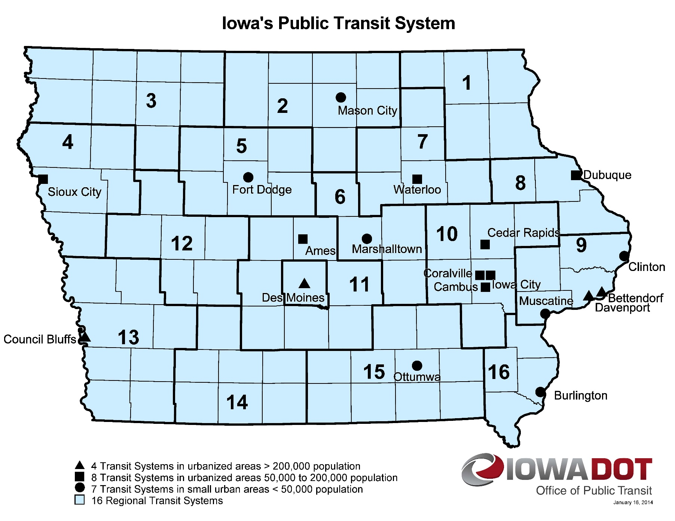
Map of Applications Received
Application received
Application recommended for funding
Notes:
18 Transit Systems

Slide 7
QUESTIONS?
For more information on Iowa’s public transit and intercity bus programs, visit
www.iowadot.gov/transit

Slide 8
New bus storage and administrative facility – Benton County – Region 10 (Cedar Rapids)
This project will allow more vehicles to be stored indoors, provide access to a wash bay that will improve the condition and lifespan of the transit vehicles, include a dedicated maintenance bay, office and storage area. The existing facility is within the floodplain of the Cedar River and had been inundated in 2008 and 2016. The proposed location is outside of the floodplain.
Total Cost: $397,500
Requested: $318,000 (80%)
Return to List of Applications Recommended

Slide 9
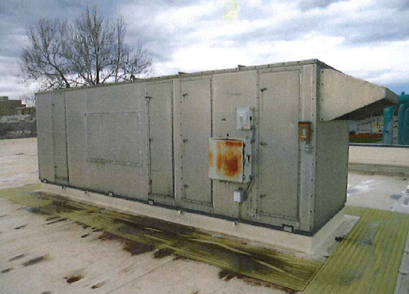
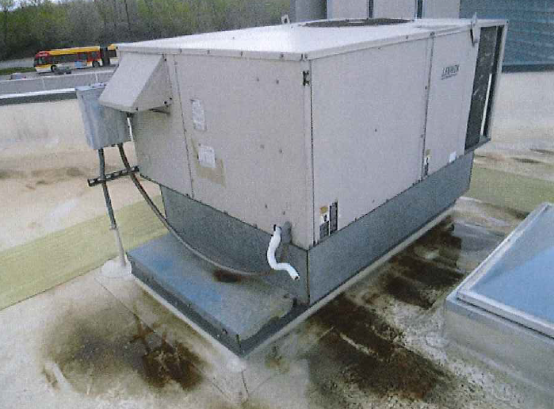
New HVAC system – Ames (CyRide)
This project will replace outdated HVAC equipment at five separate areas of the CyRide bus maintenance facility. This includes 1) 2005 Multi-Stack HVAC Unit, 2) 2002 Wash Bay HVAC System, 3) 1989 Southwest Bus Storage HVAC system, 4) 1989 Shop Area Office HVAC Improvements, 5) 1983 Restrooms/Storage Roof Top Unit Replacement
Total Cost: $651,373
Requested: $521,098 (80%)
Return to List of Applications Recommended

Slide 10
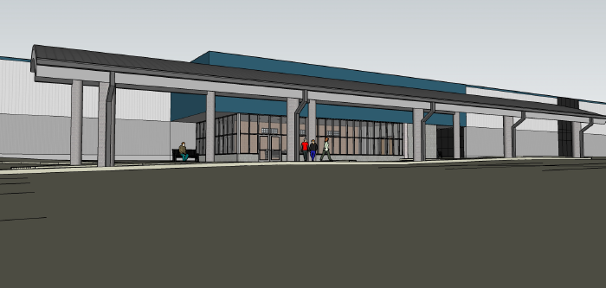
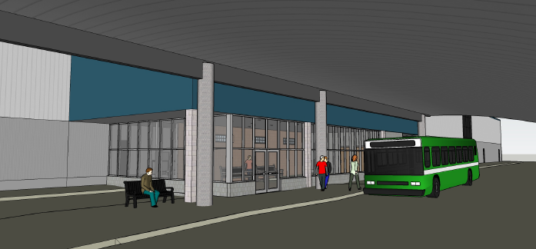
Phase II transfer center - Dubuque
This project is the second phase of the ARC Transfer Center. Phase one was completed in 2012, and provided a canopy for passengers as well as exterior seating. Phase two includes a climate controlled indoor waiting area with restrooms and a janitor’s closet. Four of The Jule’s nine routes use this location, which is the second most used stop and averages 200 trips per day.
Total Cost: $430,929
Requested: $344,743 (80%)
Return to List of Applications Recommended

Slide 11
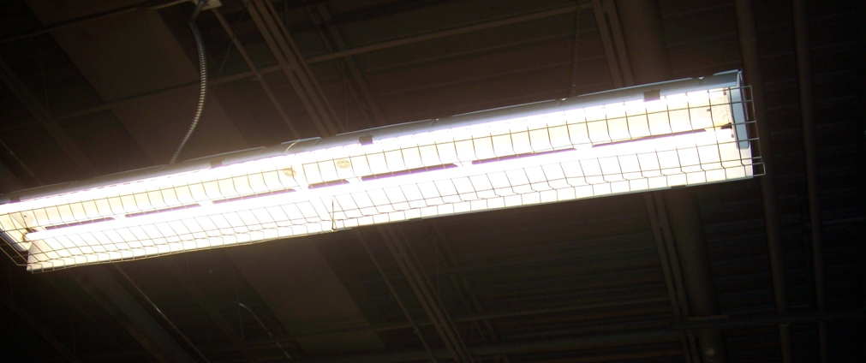
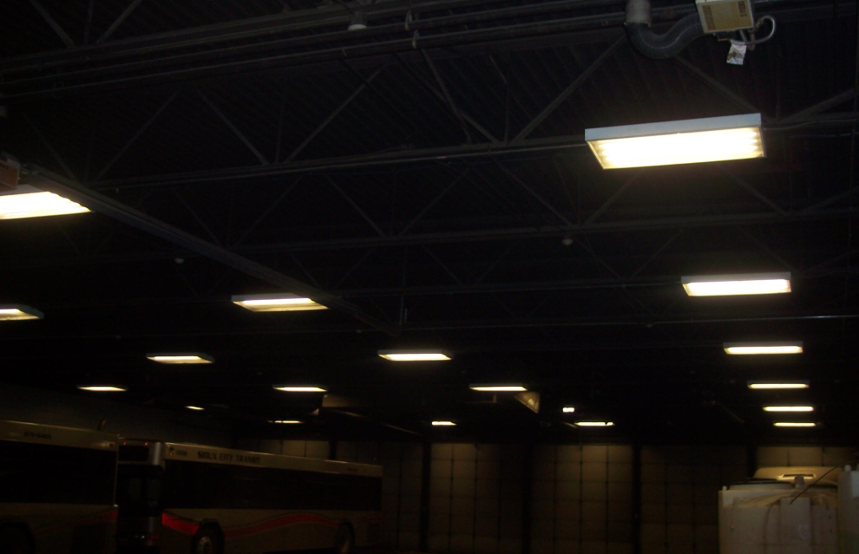
Renovated transit maintenance and storage facility – Sioux City
This project involves renovating the mechanic’s locker room area, and upgrading facility lighting. Two major energy audits have been conducted and each projected an electric utility savings of fifty percent or more could be achieved from lighting upgrades. This projects replacing 220 interior and exterior light fixtures with LED fixtures, which will improve safety, as well as electric utility costs.
Total Cost: $169,000
Requested: $135,200 (80%)
Return to List of Applications Recommended

Slide 12
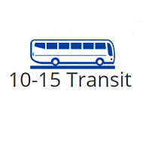
New bus storage and vehicle wash facility – Region 15
This project involves constructing a new transit vehicle storage building in Ottumwa, with an attached wash bay that will improve the condition and lifespan of the public transit vehicles.
Total Cost: $522,750
Requested: $418,200 (80%)
Return to List of Applications Recommended

Slide 13
List of Applications Not Recommended for Award
PROJECT NAME | SPONSOR | SCORE | TOTAL PROJECT COST | REQUESTED AMOUNT (% of Total Project Cost) | RECOMMENDED AMOUNT (% of Total Project Cost)
Remodeled bus storage and administrative facility – Washington County | Region 10 (Cedar Rapids) | N/A | $453,255 | $362,604 (80%) | $0
Return to List of Applications Recommended

