Slide 1
Revitalize Iowa’s Sound Economy Program

Slide 2
Revitalize Iowa’s Sound Economy Program
Created in 1985
Purpose: To promote economic development through roadway improvements.
Eligible development shall have value-adding activities that feed new dollars into the economy
Available to cities and counties through an application program

Slide 3
Available Funding and Application Summary
Available Funding
Funded annually with dedicated state motor fuel and special fuel tax revenues
Application Summary for SFY2019
Total number of projects awarded: 10
Total project costs: $11,975,265
Total amount awarded: $7,296,877
 | CITY | COUNTY
Average funding generated monthly | $997,556 | $498,778
SFY 2019 current Road Use Tax Revenue (as of 4/29/2019) | $9,886,183.65 | $4,943,091.84
Current Unobligated Balance (as of 4/29/2019) | $16,811,067.71 | $4,895,497.06

Slide 4
Immediate Opportunity Project Evaluation Criteria
Growth Potential
Average wages meet at least 100% laborshed wage
Quality of Jobs
No pattern of violations
In-state suppliers
Impact on import substitution
Few Iowa competitors
Operating expenditures spent in Iowa
Out-of-state sales
Hiring preferences to Iowa residents

Slide 5
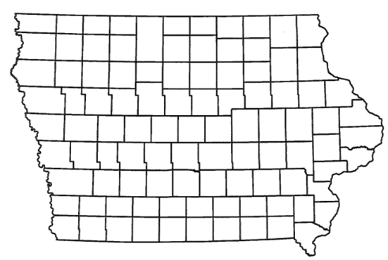
List of Immediate Opportunity Applications Recommended
PROJECT NAME
SPONSOR
JOBS
TOTAL PROJECT COST
PERCENT PARTICIPATION
RECOMMENDED AMOUNT
Construction of approximately 342 feet of South 85th Street. | West Des Moines | 24 | $350,159 | 80% | $280,127

Slide 6
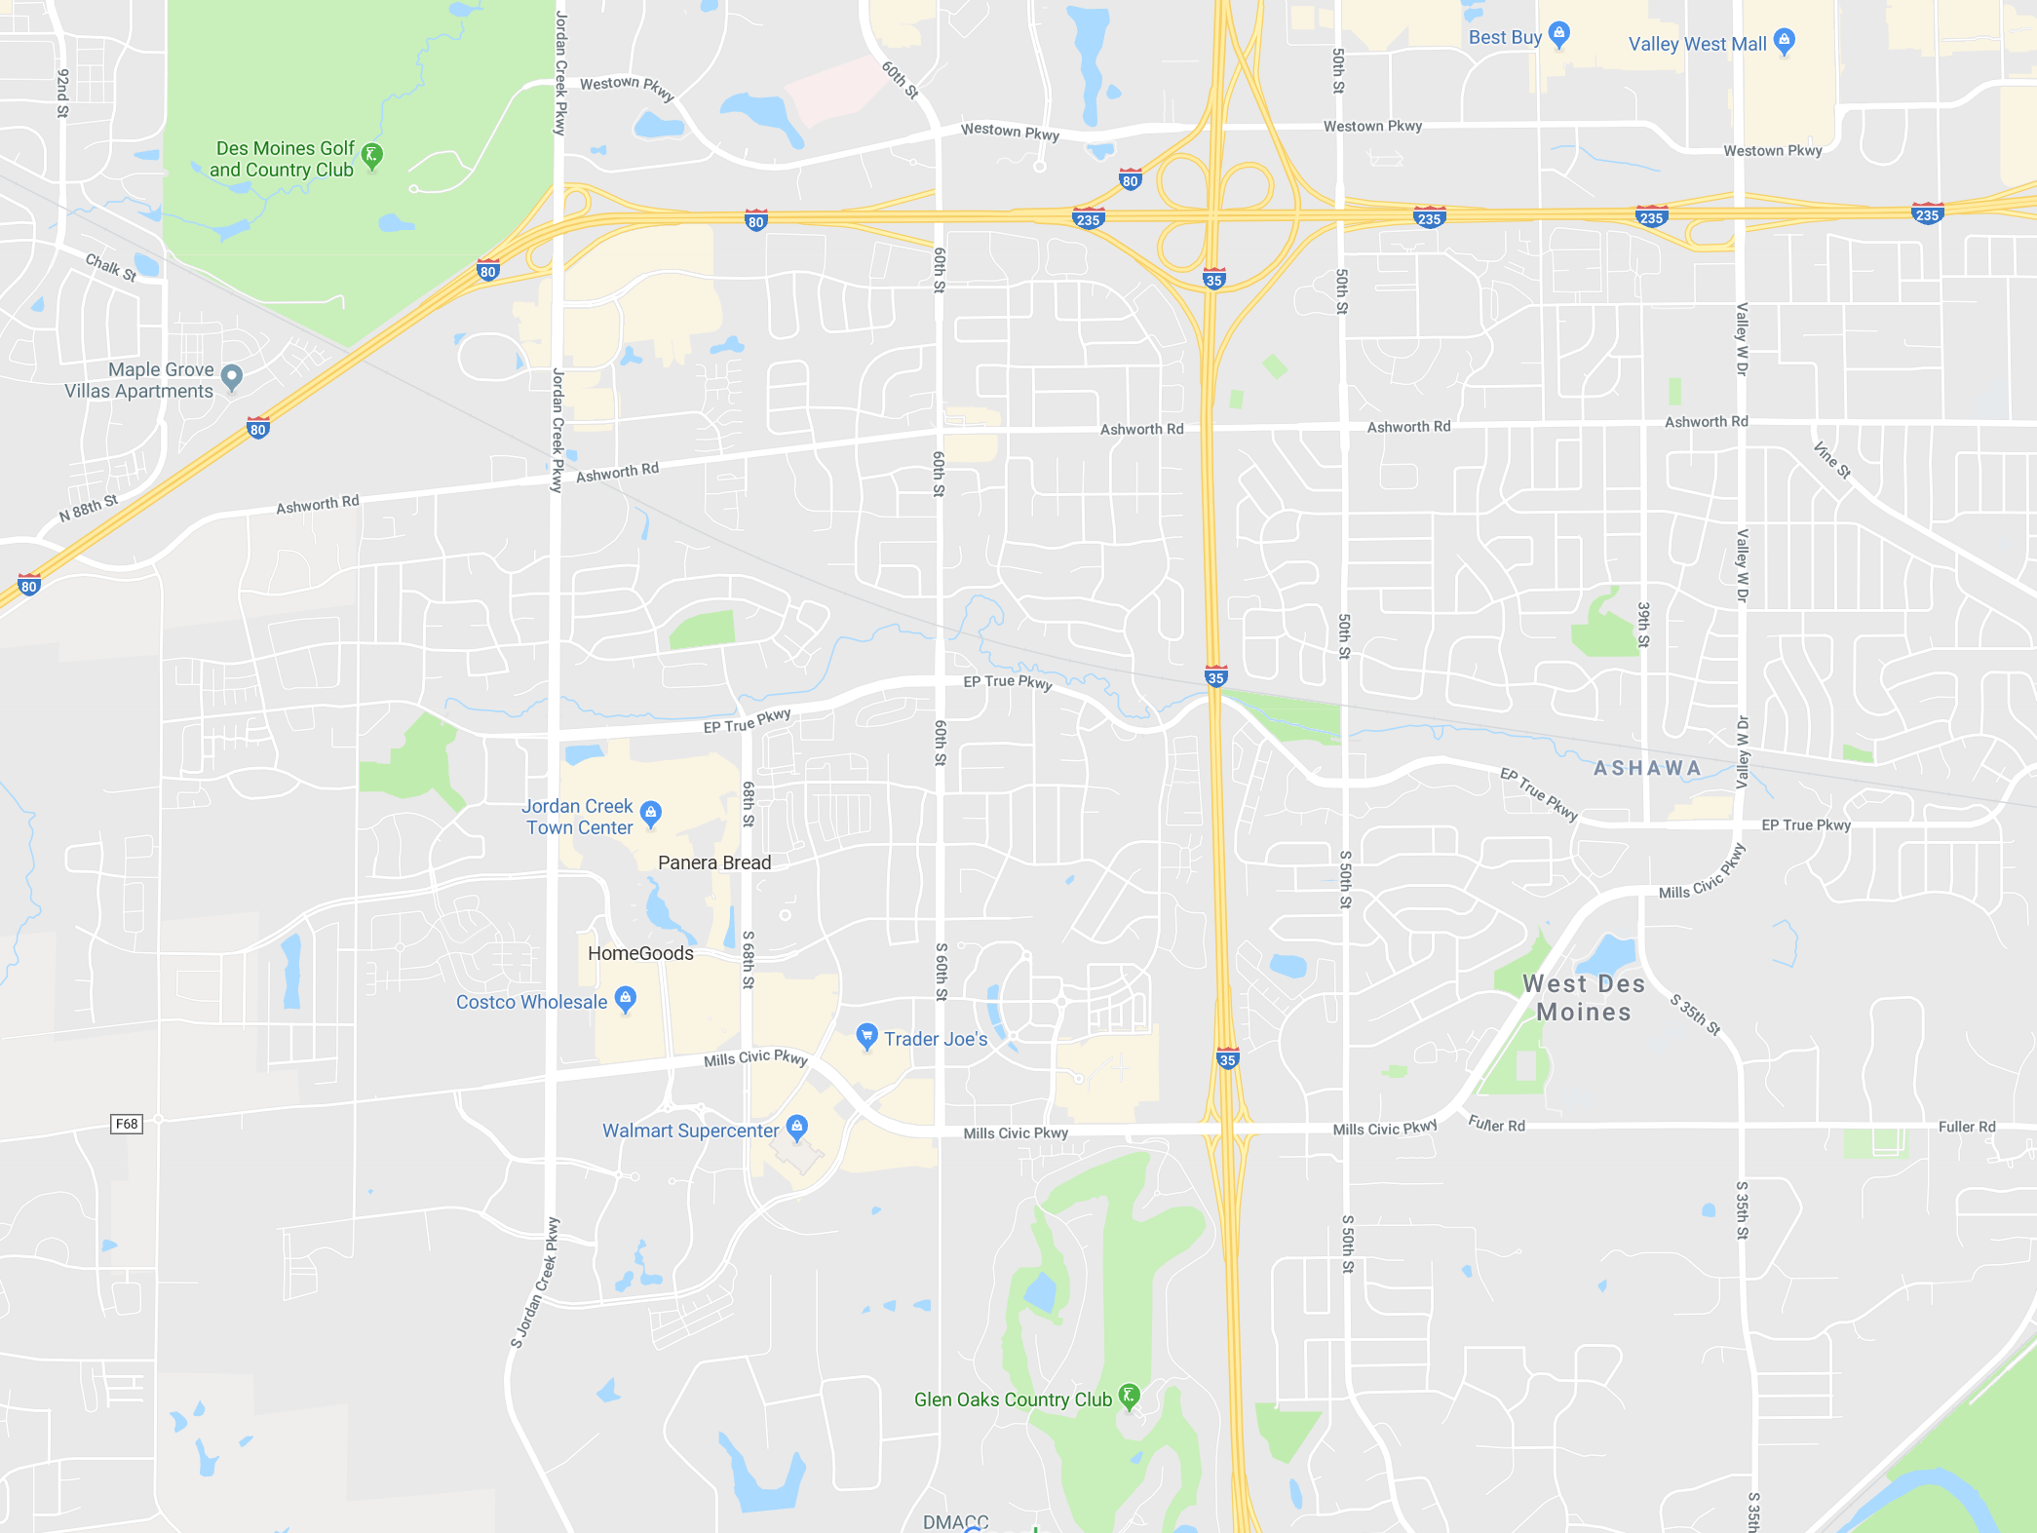
West Des Moines
(Immediate Opportunity)
Construction of approximately 342 feet of South 85th Street located on the west side of town. This project is necessary to provide improved access to the proposed expansion of Sammons Financial Group, a provider of financial products.
Total Cost: $350,159
Requested: $280,127 (80%)
Jobs Created: 24
RISE Cost/Job Assisted: $11,671.96
Capital Investment/RISE $: $232.29
Company Average Wages: $35.36
(140% of laborshed)
Mills Civic Parkway
S 81st Street
S 85th Street
Cascade Avenue

Slide 7
Local Development Project Evaluation Criteria
Development Potential (35 points)
Economic impact and Cost Effectiveness (20 points)
Local Commitment and Initiative (33 points)
Transportation Need and Justification (4 points)
Local Economic Need (6 points)

Slide 8
List of Local Development Applications Recommended
PROJECT NAME
SPONSOR
SCORE
TOTAL PROJECT COST
PERCENT PARTICIPATION
RECOMMENDED AMOUNT
Construction of approximately 1,750 feet of South Monroe Avenue. | Mason City | 74 | $1,110,156 | 50% | $555,078

Slide 9
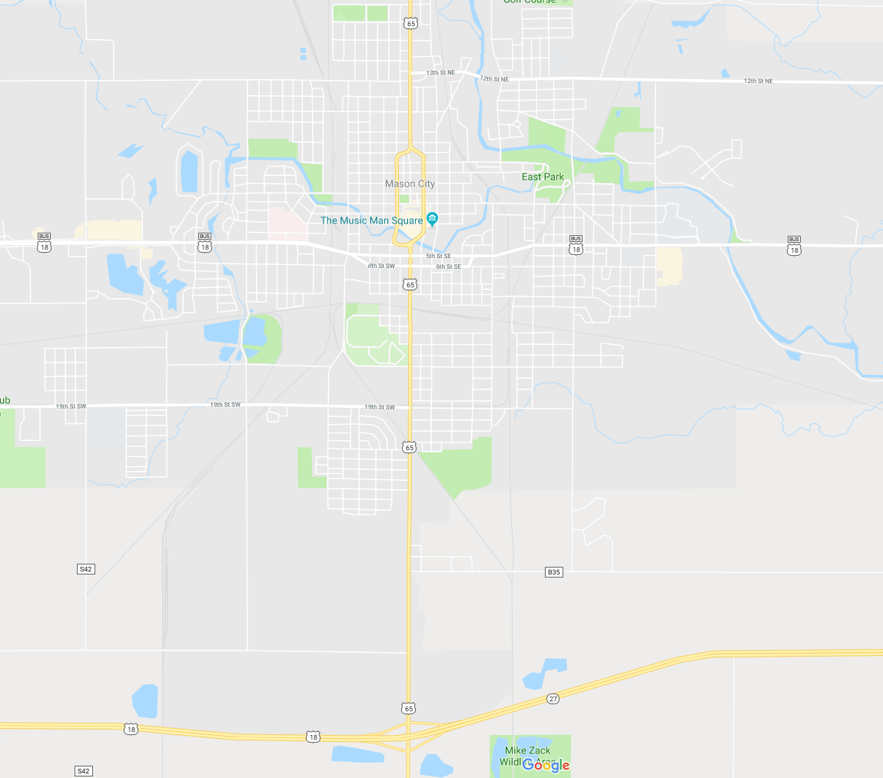
Mason City
(Local Development)
Construction of approximately 1,750 feet of South Monroe Avenue located on the south side of town. This project is necessary to provide access to more than 120 acres for industrial purposes.
Total Cost: $1,110,156
Requested: $555,078 (50%)

Slide 10
QUESTIONS?
Craig Markley, Systems Planning Bureau
craig.markley@iowadot.us
515-239-1027

