Slide 1
Revitalize Iowa’s Sound Economy Program
Iowa Transportation Commission Workshop
June 7, 2021

Slide 2
Revitalize Iowa’s Sound Economy Program
Created in 1985
Purpose: To promote economic development through roadway improvements.
Eligible development shall have value-adding activities that feed new dollars into the economy
Available to cities and counties through an application program

Slide 3
Available Funding and Application Summary
Available Funding
Funded annually with dedicated state motor fuel and special fuel tax revenues
Application Summary for SFY2021
Total number of projects awarded: 15
Total project costs: $25,463,356
Total amount awarded: $13,504,857
 | CITY | COUNTY
Average funding generated monthly | $970,179 | $485,089
SFY 2021 current Road Use Tax Revenue (as of 5/24/2021) | $9,922,162.92 | $4,961,081.46
Current Unobligated Balance (as of 5/24/2021) | $6,063,993.73 | $3,851,351.51

Slide 4
Local Development Project Evaluation Criteria
Development Potential (35 points)
Economic impact and Cost Effectiveness (20 points)
Local Commitment and Initiative (33 points)
Transportation Need and Justification (4 points)
Local Economic Need (6 points)

Slide 5
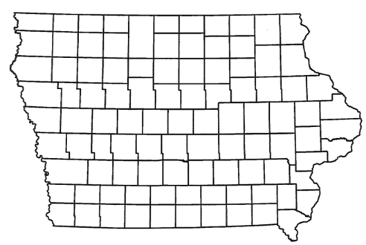
List of Local Development Applications Recommended
PROJECT NAME
SPONSOR
SCORE
TOTAL PROJECT COST
PERCENT PARTICIPATION
RECOMMENDED AMOUNT
Replacement of the 11th Street Bridge. | Waterloo | 66 | $8,923,952 | 19% | $1,723,952
Provide additional roadway improvements to relocate the expanded main Des Moines Airport terminal (Amendment). | Des Moines | 73 | $9,724,688 | 50% | $4,862,344

Slide 6
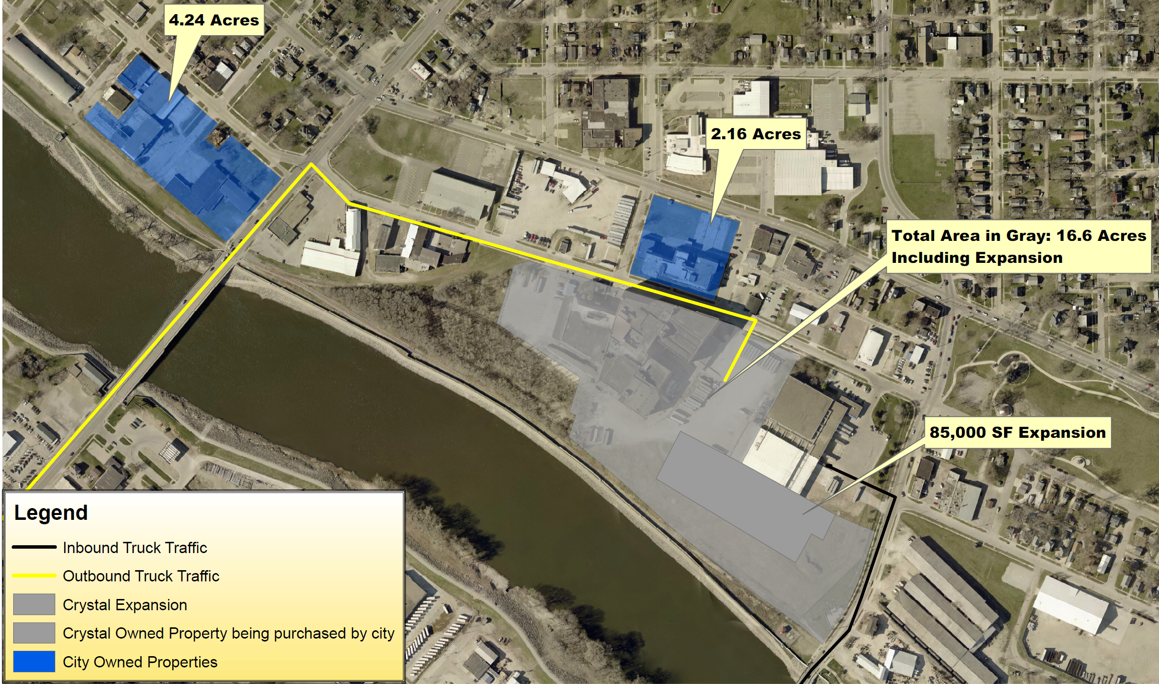
Waterloo
(Local Development)
Replacement of the 11th Street Bridge located in the center of town. This project will provide improved access to more than 23 acres for industrial purposes.
Total Cost: $8,923,952
Requested: $1,723,952 (19%)

Slide 7
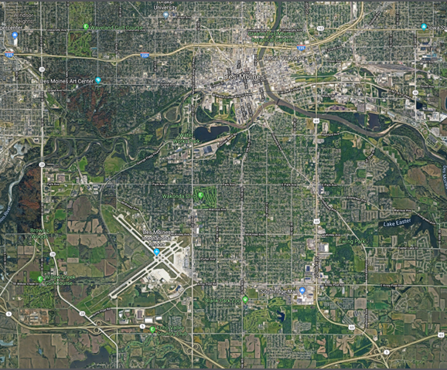
Des Moines - Amendment
(Local Development)
An amendment to the scope and grant award was requested to provide additional roadway improvements to relocate the main Des Moines Airport terminal. This amendment is necessary to provide improved access to the expanded Des Moines International Airport terminal for airport purposes.
Total Cost: $9,724,688
Requested: $4,862,344 (50%)

Slide 8
QUESTIONS?
Craig Markley, Systems Planning Bureau
craig.markley@iowadot.us
515-239-1027

