Slide 1
Corridor Preservation
I-380 from North Liberty to Cedar Rapids
I-80 at DeSoto interchange
Transportation Commission Workshop
June 8, 2021

Slide 2
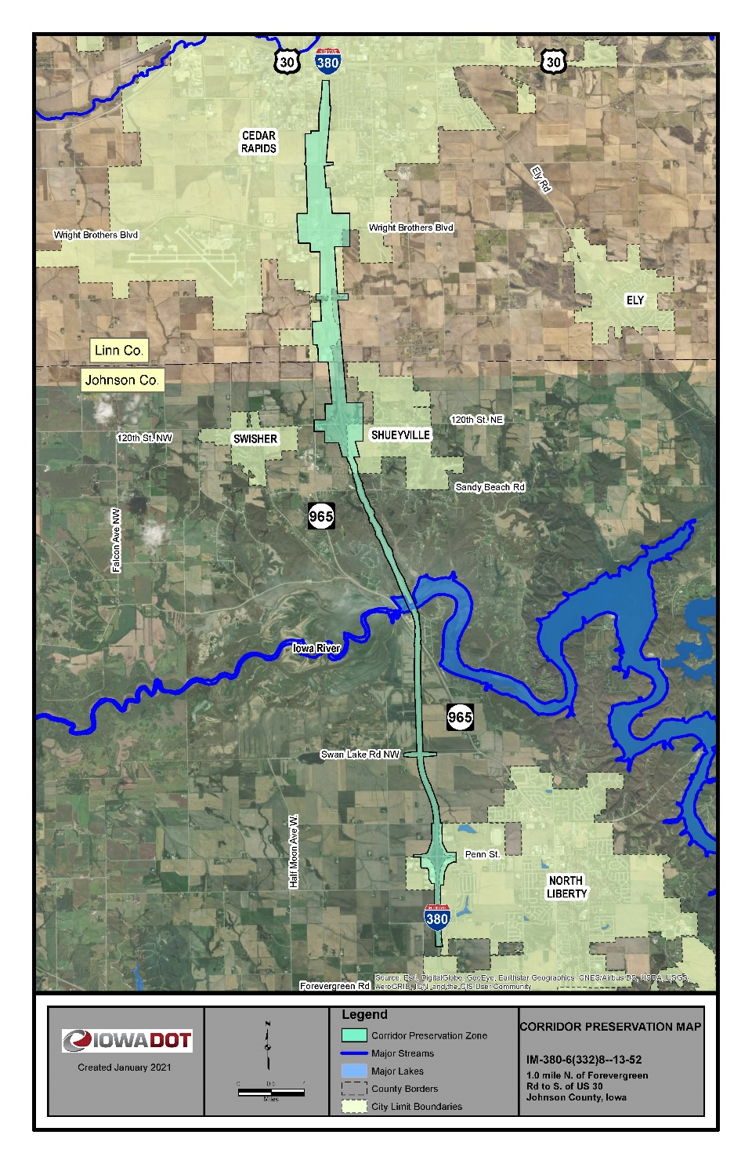
New I-380 CPZ
Approximately 12 miles long
Includes three interchanges
Expected future growth in traffic and housing/commercial development
Expansion to 6 lanes
Improve mobility, safety, and efficiency

Slide 3
Comments (I-380 Johnson/Linn):
28 total comments – including the Cities of North Liberty, Swisher and Cedar Rapids
Summary of comments:
CPZ letter and map needs more specifics
Conversations with developers and cities helped answer their questions and concerns about being able to develop their property under a CPZ
Response – overall no real concerns with the CPZ

Slide 4
NEW CPZ for I-80 in Dallas County

Slide 5
Comments (I-80 Dallas):
12 total comments – Mainly coming from businesses at the interchange and residents east of De Soto.
Summary of comments:
Wanting to know if their property will be impacted
Explained that CPZ is a tool that allows us to make decisions prior to an area being rezoned or for a structure being built over $25,000 in value.
The CPZ zone is different than right-of-way line.
Response – overall no real concerns with the CPZ

Slide 6
CPZ process improvements
First New CPZs since 2018
Public notification was added
Improve notification letters
Provide a video on the CPZ process
Beneficial to property owners
Development considerations
Does not discourage
Minimizes future costs/impacts
May result in purchase - most do not

Slide 7
Next Steps (I-380 Johnson/Linn and I-80 Dallas):
Sought initial guidance from Commission for new I-380 and I-80 Corridor Preservation Zone (CPZ) March 9, 2021
Mailed initial written notices to the affected city or county and property owners March 2021
Affected cities or counties and property owners were given the opportunity to comment March –May
After expiration of the 60 day comment period, we present the proposed CPZ to the Commission today at the monthly workshop June 8, 2021
The proposed CPZ is presented to the Commission for formal action at the next monthly business meeting July
We send a final notice to affected property owners

Slide 8
Thank You
Gary K. Harris, PE
Location and Environment Bureau

