Slide 1
Transportation Trends Update
Transportation Commission Workshop
June 13, 2022

Slide 2
Overview
Economic Recovery Index
Travel trends
US total rail carloads
Commercial air service passenger counts
Vehicular traffic

Slide 3
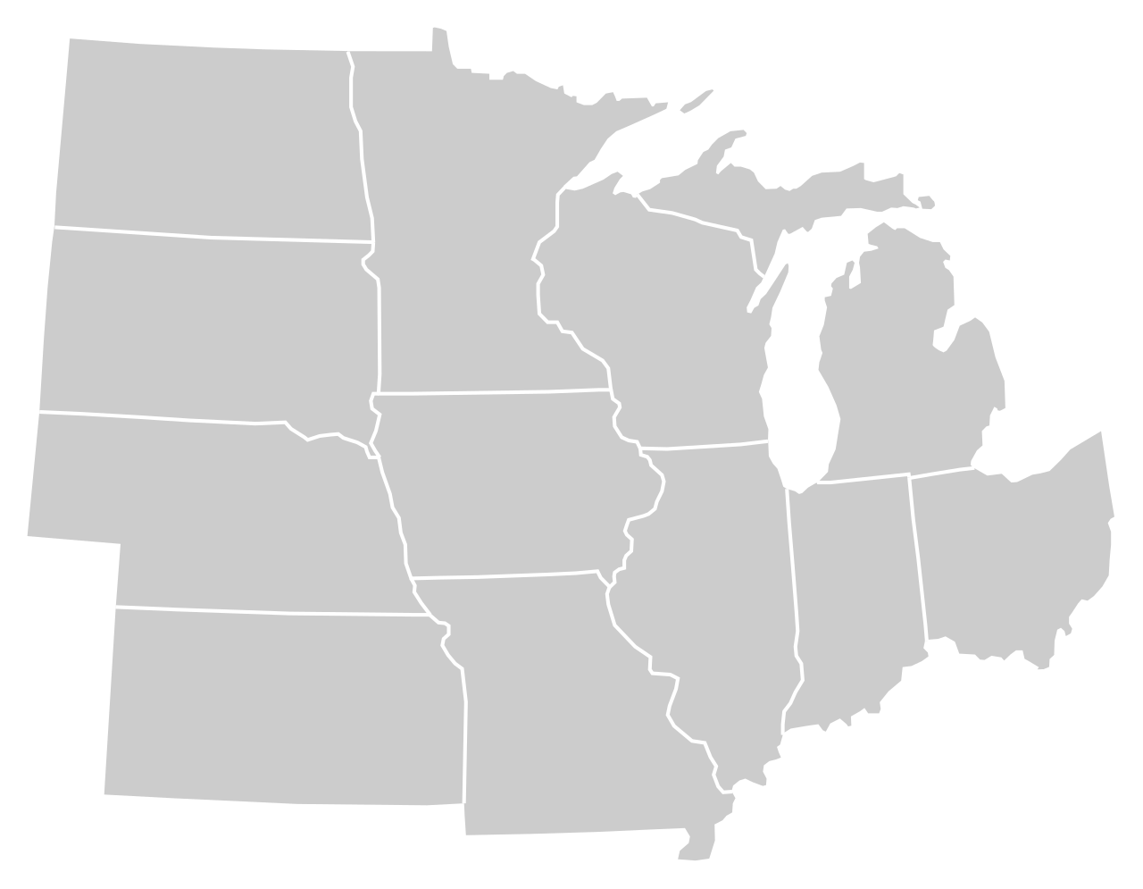
Moody’s/CNN Recovery Index - Midwest (Pre-Pandemic = 100) As of 6/3/2022
93%
90%
105%
92%
92%
97%
(95% last month)
98%
94%
87%
96%
91%
92%
Nation is at 93% (93% last month)

Slide 5
Monthly Passenger Counts at Iowa’s Eight Commercial Service Airports
(through April 2022)

Slide 7
Questions?

