Slide 1
Corridor Preservation
US 20 from Sundown Rd. to Cottingham Rd (Peosta)
US 151 from Wendling Rd. past Springville
Transportation Commission Workshop
June 13, 2022

Slide 2
Past Steps – 1 to 4 (for both CPZs):
Sought initial guidance from Commission for new US 20 and US 151 Corridor Preservation Zone (CPZ): March 8, 2022
Mailed initial written notices to the affected city or county and property owners: March 2021
Affected cities or counties and property owners were given the opportunity to comment: March – May
After expiration of the 60-day comment period, we are presenting the proposed CPZ to the Commission today at the June workshop: June 13, 2022
The proposed CPZ will be presented to the Commission for formal action at the next monthly business meeting: July, 12, 2022
If approved DOT will send a final notice to affected property owners

Slide 3
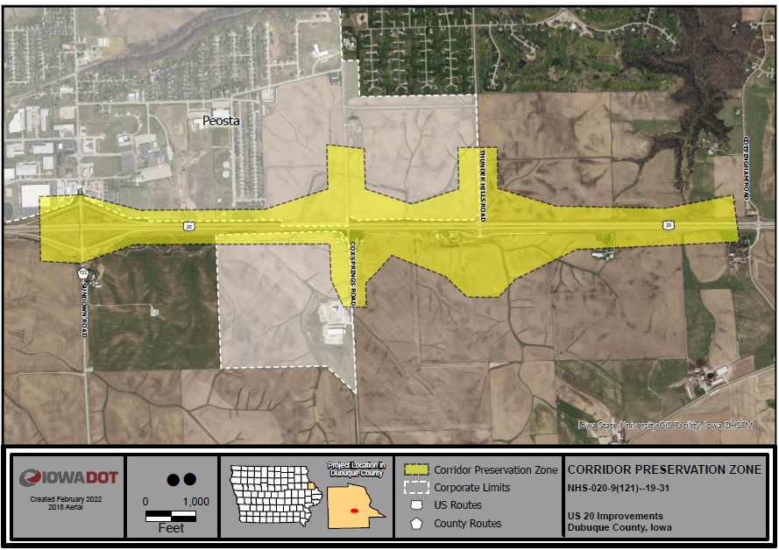
US 20 near Peosta
West of the Swiss Valley Interchange project (Completed)
Continued growth in this corridor is expected
Possible interchange at Thunder Hills Rd. in the future

Slide 4
Comments US 20 near Peosta:
2 total comments received
Summary of comments:
One wanting to know if their property will be impacted
With the further explanation they had no concerns with the CPZ.
The other comment was focused on the burden the property owners face when the DOT prolongs the construction of projects, suggested timely project completion should be a priority.

Slide 5
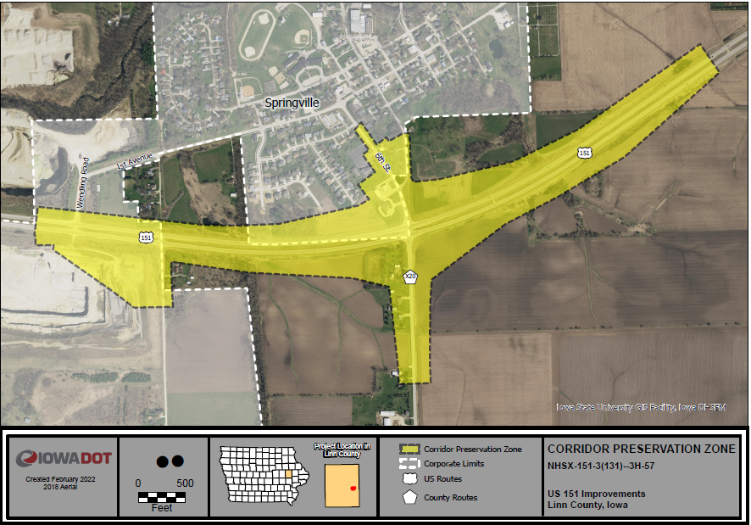
US 151 near Springville future interchange

Slide 6
Comments US 151 near Springville:
Nine total comments
Summary of comments:
Majority wanting to know if their property will be impacted
Explained that CPZ is a tool that allows us to make decisions prior to an area being rezoned or for a structure being built over $25,000 in value.
With the further explanation there were no real concerns with the CPZ for this majority.
Casey’s General Store did express concern about the possibility of losing one of two entrances with the selected alternative.

Slide 7
Comments US 151 near Springville:
The notifications for the CPZ led to several meetings with stakeholders to address the CPZ and chosen alternative, including Wendling Quarry and Security State Bank and an informal meeting with some Springville City staff.
The Quarry and City representatives were in favor of the CPZ and the project.
The representatives for the bank are not in favor of any alternative that significantly impacts the bank (NW quadrant) or their developable property (NE quadrant).

Slide 8
Next Steps - 5 & 6 (for both CPZs):
Sought initial guidance from Commission for new US20 and US 151 Corridor Preservation Zone (CPZ): March 8, 2022
Mailed initial written notices to the affected city or county and property owners: March 2021
Affected cities or counties and property owners were given the opportunity to comment: March –May
After expiration of the 60 day comment period, we present the proposed CPZ to the Commission today at the monthly workshop: June 13, 2022
The proposed CPZ is presented to the Commission for formal action at the next monthly business meeting: July 12, 2022
If approved DOT will send a final notice to affected property owners

Slide 9
Questions?
Thank You
Bryan Bradley
Location and Environment Bureau
bryan.bradley@iowadot.us
(515) 239-1787

Slide 10
What is a corridor preservation?
Corridor preservation is not a legal encumbrance on the property or an exercise of eminent domain but is instead a right of notice.
Corridor preservation avoids inconsistent development of property needed for highway right-of-way, by allowing us to receive notice of intended development of property within the proposed right-of-way and giving us the opportunity to take action to acquire it before the development occurs.

Slide 11
Legal authority for corridor preservation
The legal authority for corridor preservation comes from section 306.19(5) of the Iowa Code, which authorizes the Iowa DOT to “notify a city or county that a road under the jurisdiction or control of the department will be established, improved, relocated, or maintained and that the department may need to acquire additional right-of-way or property rights within an area described by the department.”

Slide 12
Iowa DOT process for Commission approval
We present the proposed CPZ to the Commission at a monthly workshop for initial guidance. Initial guidance is not formal action or approval, but only the opportunity to informally determine whether the Commission has interest in considering the use of CPZ for the project.
If the Commission’s initial guidance shows interest in considering the use of CPZ, we will mail an initial written notice to the affected city or county and property owners. The initial written notice is not an exercise of preservation of authority under section 306.19(5), but only notice that the Commission will consider the proposed CPZ at a workshop at least 60 days after the date the written notice was issued.

Slide 13
Iowa DOT process for Commission approval (cont.)
Affected cities or counties and property owners are given the opportunity to comment. The initial notice includes instructions for obtaining information and submitting or presenting comments to the Commission.
After expiration of the 60 day comment period, we present the proposed CPZ to the Commission at the appointed monthly workshop. The presentation would include any comments or information submitted or presented by the affected city or county and property owners.

Slide 14
Iowa DOT process for Commission approval (cont.)
The proposed CPZ is presented to the Commission for formal action at the next monthly business meeting. Any personal presentation or comments by affected cities, counties, or property owners would typically occur as part of the business meeting.
If approved, we follow the usual and required process for formal notice established by section 306.19(5), which includes written notice to the affected city or county and published notice in the newspaper. We will also continue with blog notices in conjunction with the published notice, and in addition will send a final notice to affected property owners.

Slide 15
How it works – Iowa DOT notice requirements
Section 306.19(5) requires we do the following to establish a corridor preservation zone (CPZ):
File notice with the city or county. We must give the city or county in which the property is located written notice that we may need to acquire the property for highway purposes. The notice must include a map describing the property that may need to be acquired.
Publish notice. Within seven days of filing the notice, we must publish a notice in a newspaper of public record that includes a description and map of the property that may need to be acquired, and explains that it may restrict the grant or approval of building permits, subdivision plats, or zoning changes.
Once established, a CPZ is valid for three years, and we may re-establish it every three years.

Slide 16
How it works – city or county notice requirements
Once we properly establish a CPZ, section 306.19(5) requires a city or county to give us 30 days notice of any of the following involving property within the CPZ:
An application for a building permit for construction valued at $25,000 or more.
Submission of a subdivision plat.
A proposed change in zoning.
The city or county cannot grant the application or approve the subdivision plat or zoning change until it has given us the 30 day notice and the 30 day period for action has expired without any action by us.

Slide 17
How it works – Iowa DOT options after notice from the city or county
Section 306.19(5) requires we do all of the following if we want to continue to preserve the property:
Give the city or county notice it intends to proceed with acquisition of the property. We must, before the 30 day notice period expires, give the city or county written notice that we intend to acquire all or part of the property or property rights affecting the CPZ.
Initiate acquisition of the property. Within ten days of giving the city or county notice of intent to proceed, we must begin the process of acquiring the property or property rights from the affected persons.
If we do not provide notice of intent to proceed, the city or county may grant the building permit or approve the subdivision plat or zoning change.

Slide 18
Current Iowa DOT process for Commission approval
The following outlines the procedure we currently and typically follow to establish a CPZ:
We present the proposed CPZ to the Commission at a monthly workshop.
The Commission takes formal action on the proposed CPZ at the next monthly business meeting.
If approved, we proceed with the written and published notice required by section 306.19(5). We also publish notice of the action taken through a blog release of actions taken by the Commission, and a separate blog release that repeats the published notice.
Under the current process, we do not give notice to the city or county, or to affected property owners before the Commission considers or takes action on the proposed CPZ (other than through usual public notice of agendas).

