Slide 1
City of Cedar Rapids Project Updates
Public Comment

Slide 2
Wright Brothers Boulevard
30
Legend
Commercial/Industrial
Residential
Institutional
RISE Funded Projects
Wright Brothers Boulevard Interchange

Slide 3
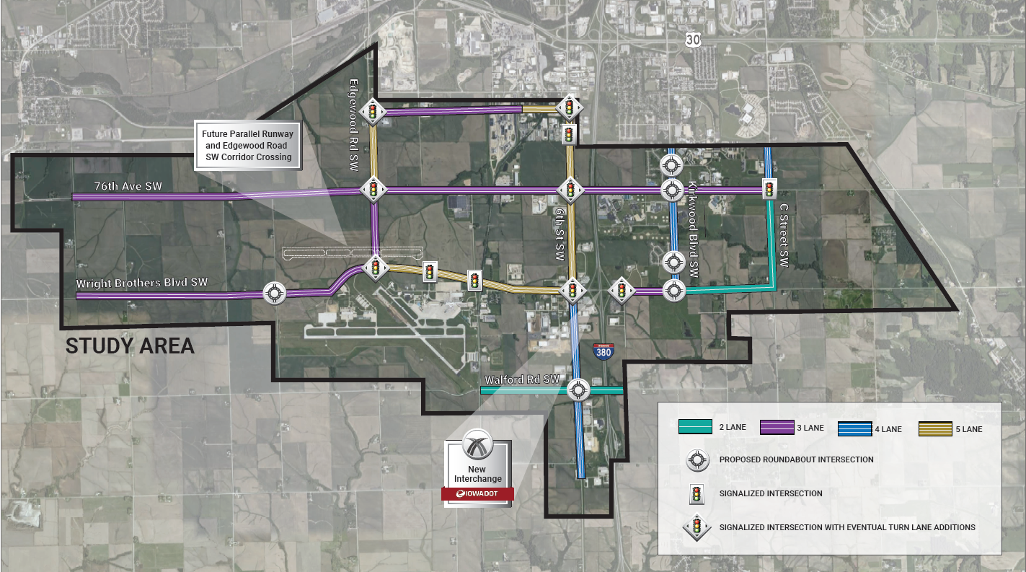
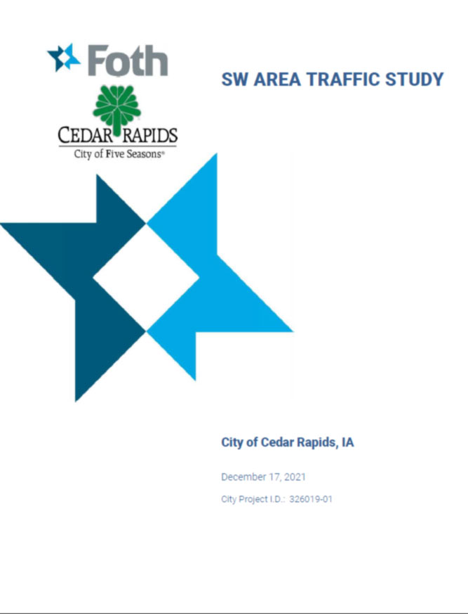
Southwest Area Traffic Study & Investments

Slide 4
Collins Road
Phase III Need
$25 M
Phase II Need
$40 M
Completed
Continues to be one of the highest volume corridors; high crash rate
Pursuing best value, long-term impacts

Slide 5
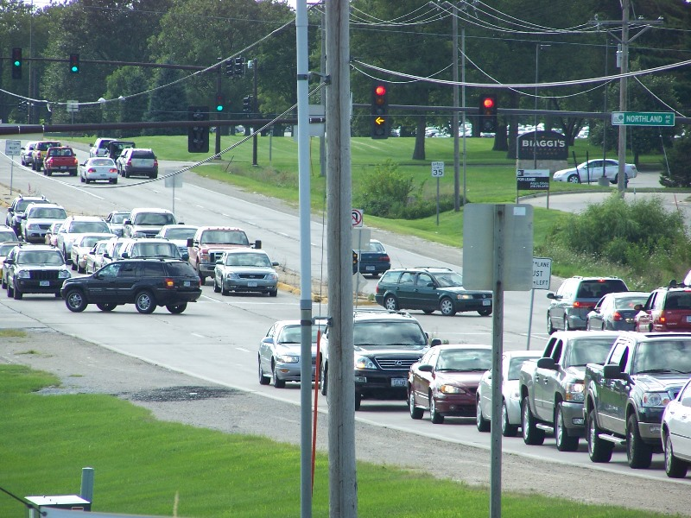
Collins Road | Next Phase

Slide 6
Thank You!

