Slide 1
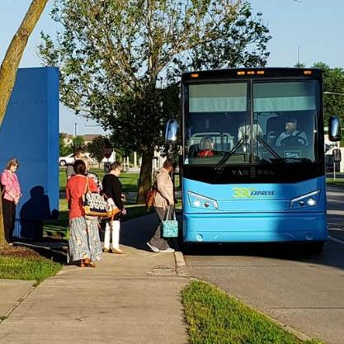
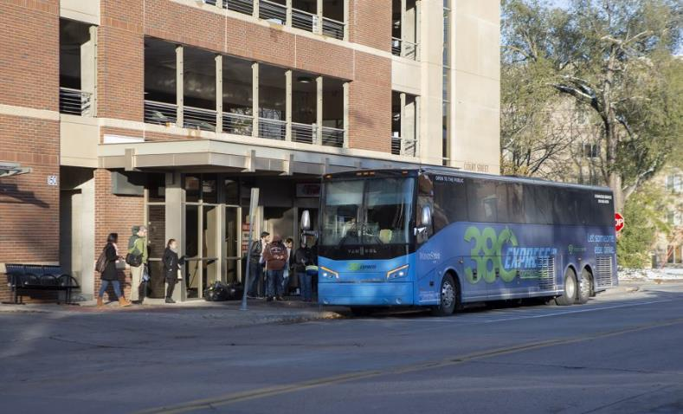
Brock Grenis
East Central Iowa Council of Governments
June 2022

Slide 2
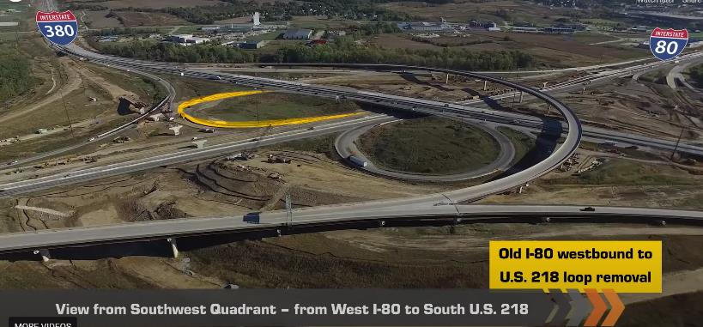
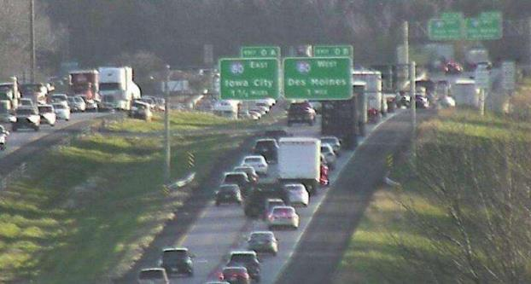
Background
Began October 2018
Funded as part of I-80/I-380 Reconstruction
Alleviate Traffic/Provide Alternative
Bus Service Supported by Plans

Slide 3
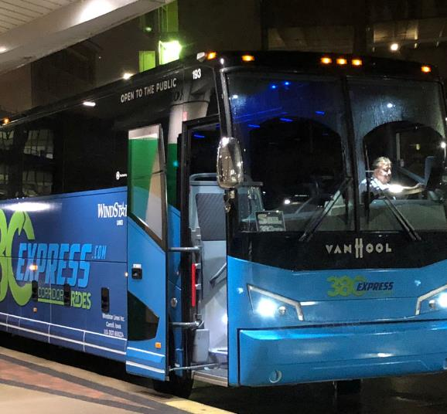
Service Set Up
Funded by Iowa DOT
ECICOG Administers Service
Windstar Lines operates day-to-day service

Slide 4
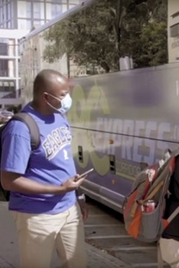
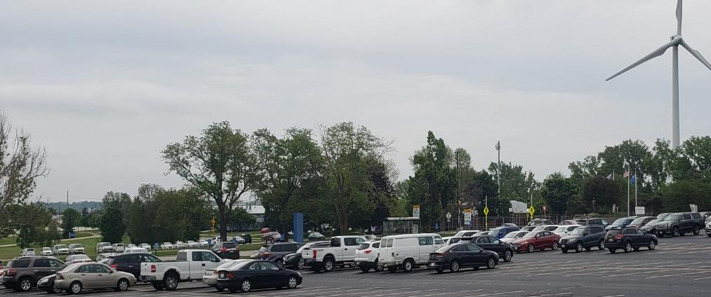
Service Details
3 Stops in CR; 3 Stops Iowa City Area
Buses run from 5:00 AM – 9:00 PM
One way cost $3.50
Mobile Payment Option

Slide 5
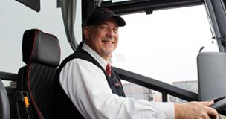
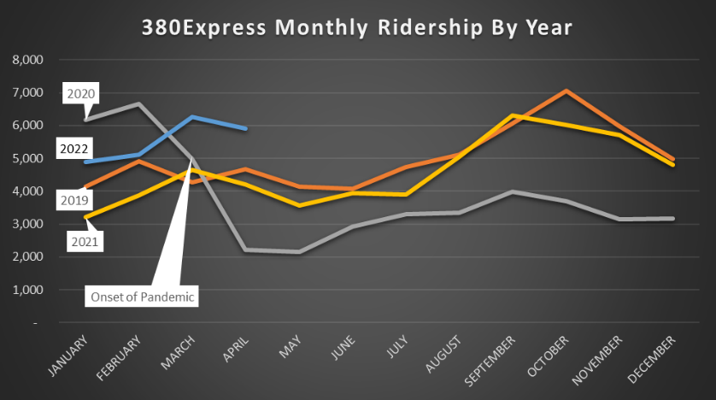
Performance
Average 300 Riders/Day
70% Travel Southbound in AM
67% Trips Work Related (12% School)

Slide 6
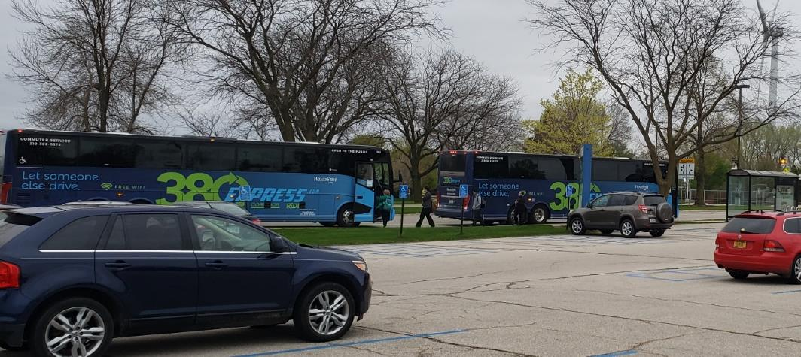
Covid-19 Impacts
60% Drop in Ridership
Suspended Fare Collection
Convoy Buses to Social Distance
>2,000 rides/month

Slide 7
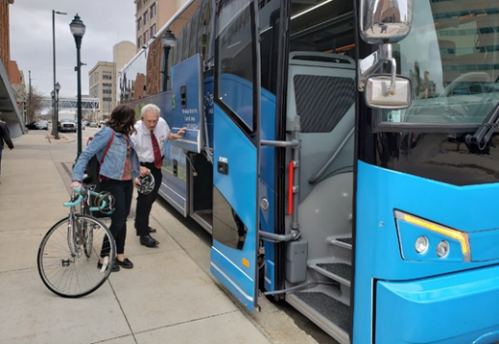
Partnerships
University of Iowa Students, Faculty, Employees get ½ Price Fares
Averaged 150 Participants
Kirkwood Provides Monthly Passes for Students
Park CR – Discounted Parking Passes

Slide 8
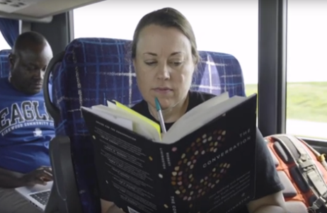
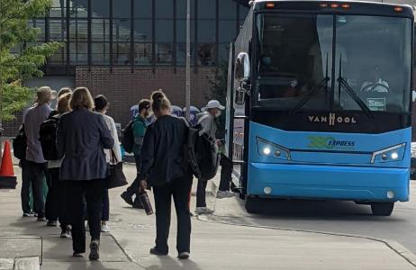
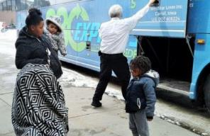
Rider Feedback
UIHC and VA Employees Cancelling Parking Passes
1st Time Transit Users
Money Savings and Stress Relief
Dialysis Patients
Worry About Service After 2023

Slide 9
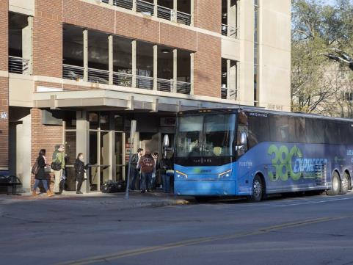
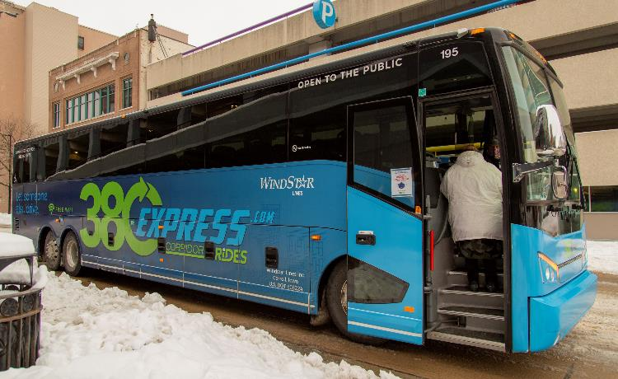
Plans for Future Years
Continued Construction on I-380
ECICOG Able to Provide Partial Funding
Passenger Revenue Increasing
Shortfall in Funds to Continue Service as-is
Request DOT to Consider Funding Service

Slide 10
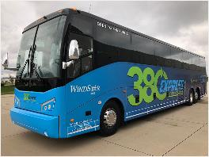
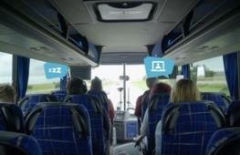
Thanks to you and all DOT staff who have been part of the 380Express

