Slide 1
Black Hawk County Metropolitan Area Transportation Policy Board and the Iowa Northland Regional Transportation Authority Presentation to the Iowa Transportation Commission June 14, 2022 Coralville, Iowa

Slide 2
IA 58 and Greenhill Rd Single Point Interchange
The City of Cedar Falls and the MPO thank the Iowa Transportation Commission for programming $33.5 million in FY’27

Slide 3
U.S. Highway 218 – Janesville to Waverly
The INRTA, Bremer County, Black Hawk County, and City of Janesville thank the Iowa Transportation Commission for programming $43 million for this important project
Interchange at 260th St
Replacing the 7th St Bridge in Janesville
RTA planning efforts to extend bike accommodations from Janesville to Waverly
Notes:
Will improve the safety and traffic operations of the corridor.
Complete access control from Waterloo/Cedar Falls to northwest of Waverly

Slide 4
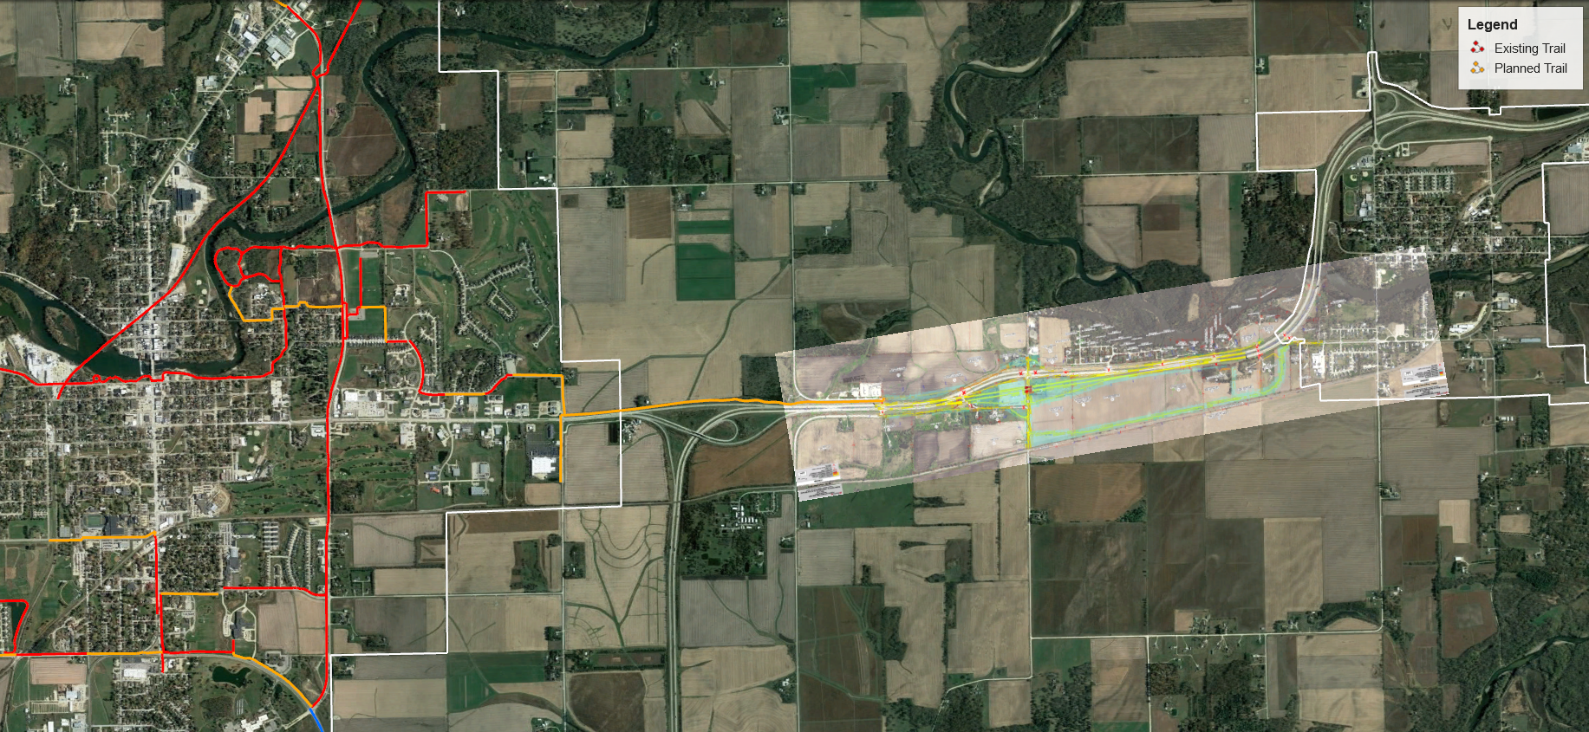
U.S. Highway 218 – Bike Planning
Waverly
Janesville
2-mile bike gap
Notes:
In conjunction with this project, INRCOG staff will be coordinating planning efforts for bicycle accommodations from Janesville to Waverly.
~ 2-mile gap from 260th St north to 29th Ave SW in Waverly

Slide 5
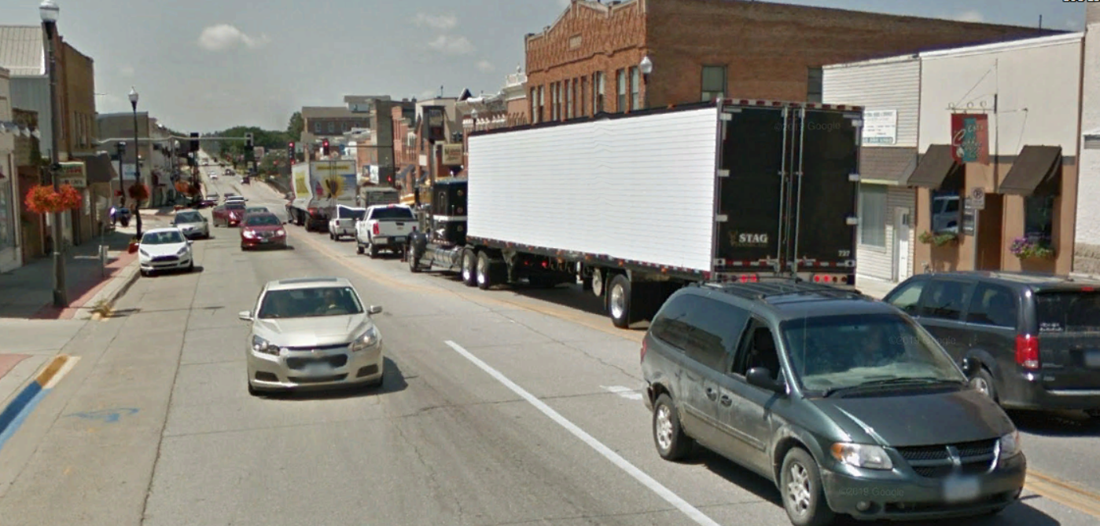
IA 150 Corridor
Planning and Environmental Linkages (PEL) Study is underway
I-380 north to Oelwein
Safety and operations issues
Exploring Super-2 Highway improvements
March 2023 completion
The INRTA, Buchanan County, and City of Independence thank the Iowa Transportation Commission for programming funds for this study

Slide 6
Northeast Industrial Access
NEPA phase scheduled for FY 2024
$ 480k in STBG programmed through MPO
Up to $60M in feasible alternatives identified
Project Goals:
Improved system and freight reliability
Improved access to industrial area
Economic development opportunities

Slide 7
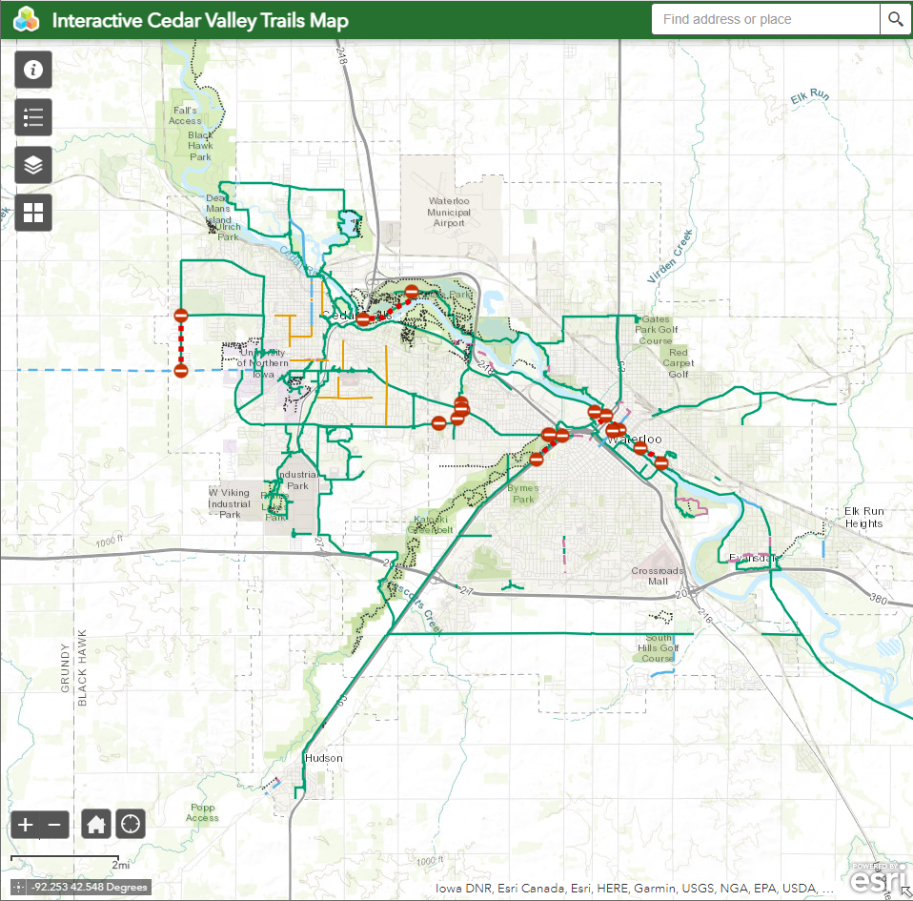
Other Transportation Planning Activities
MPO Pedestrian Master Plan (Adopted February 2022)
Interactive Cedar Valley Trails Map (Launched May 2022)
MET Transit fixed-route restructuring (Summer 2022)
MET Transit Study (FY 2023)
*Exploratory
Mobility Coordinator (FY 2023)
*Exploratory

Slide 8
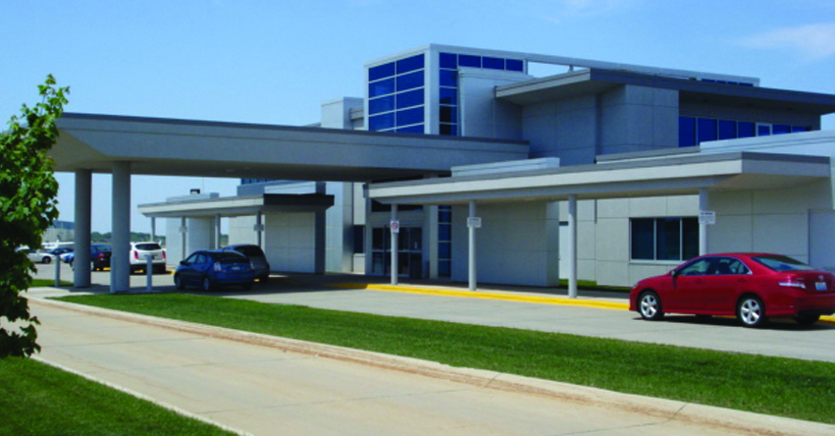
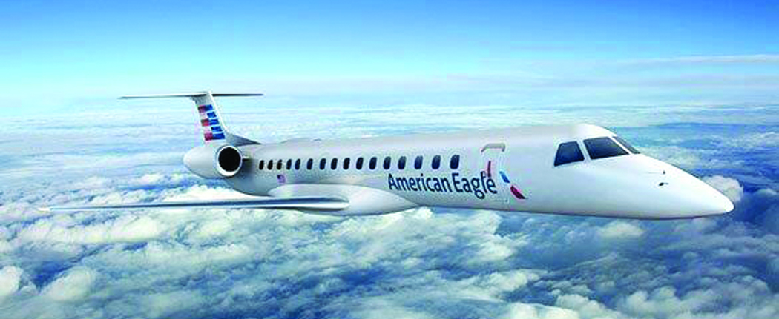
Aviation in Waterloo & The Greater Cedar Valley Region
Thank you for the strong commitment to Iowa’s Commercial Service and General Aviation Airports, with the recent completion of:
Department reorganization and hiring of State Aviation Director and Staff
Update of Iowa’s State Aviation System Plan
Airport Marketing & Air Service Sustainment Programs
Commercial Service & General Aviation Infrastructure (CSVI & GAVI) Programs
Iowa Public Airports Association (IPAA) looks forward to working with the Commission and the Aviation Bureau to implement the State Aviation System Plan and Goals
Expected signature by Governor Reynolds for the successful passage of IPAA’s legislative request for support & passage of SF-2370 for waiving the taxes from aircraft parts & labor services, and passed with significant bi-partisan support during this most recent extended legislative session

Slide 9
Continued Commitment to Iowa’s Aviation System Plan for Continued Airport Infrastructure Investment
With the recent support by Governor Reynolds of $100M for the Iowa Commercial Aviation Infrastructure Fund (CAIF), continue to support IPAA’s request with a long-term commitment for all Commercial Service & General Aviation Airports in Iowa’s Aviation System Plan for on-going State investments in aviation & airport infrastructure
Support for a long-term commitment for on-going infrastructure investments for both Commercial Service and General Aviation Airports
Expand the Runway Markings & Pavement Maintenance Programs to include smaller CSAs that enplane under 50k passengers annually
Partner with Iowa’s airports with a 5% matching share to FAA and AIP funded projects (similar to other states)
Join IPAA to become fully engaged in the challenges for small community & rural air service throughout Iowa
Pre and post pandemic challenges
Nationwide shortage of pilots for the regional airline community

Slide 10
Continued Commitment to Iowa’s Aviation System Plan for Continued Airport Infrastructure Investment
As Congress begins debate soon on the next FAA Reauthorization Bill, respectfully request to continue funding for the following:
Five (5) Year Reauthorization Bill
Airport Improvement Program
US DOT’s popular Essential Air Services (EAS) program
Full funding levels for the Federal Contract and Cost-Share Air Traffic Control Tower Program (FC-ATCT) (reference USDOT-IG Report No: AV-2013-009)
Join IPAA and oppose the diversion of aviation fuel taxes from the sale of jet fuel to the Federal Highway Trust Fund – in contrast with the Aviation Trust Fund
Support IPAA’s request for:
Increasing the Passenger Facility Charge from $4.50 to $8.50
Indexing the PFC for construction cost inflation

Slide 11
Thank you!

