Slide 1
City of Burlington
Assistant City Manager for Public Works- Nick MacGregor

Slide 2
Burlington Completed Projects
Agency Street Widening- RISE and TSIP
RISE-Hinkle Drive
ICCAP- Roosevelt Adaptive Signals

Slide 3
Agency Street

Slide 4
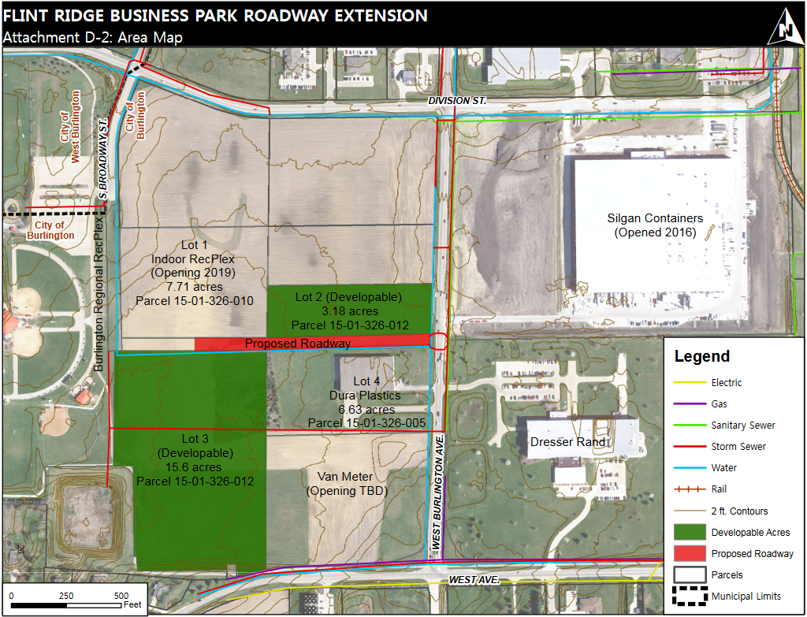
Hinkle Drive- RISE Project

Slide 5
Upcoming Projects
Washington Street
Agency Street
Summer Street
Cascade Bridge

Slide 6
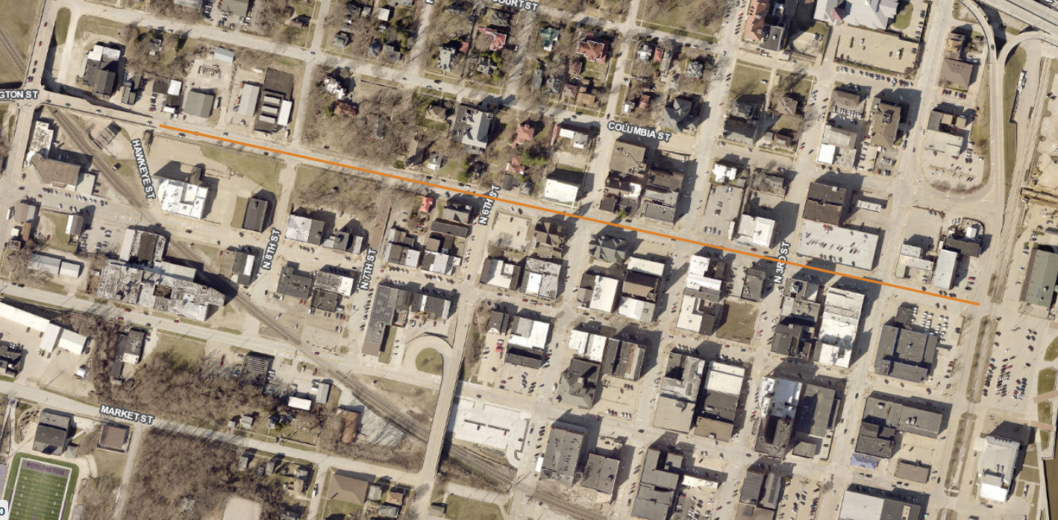
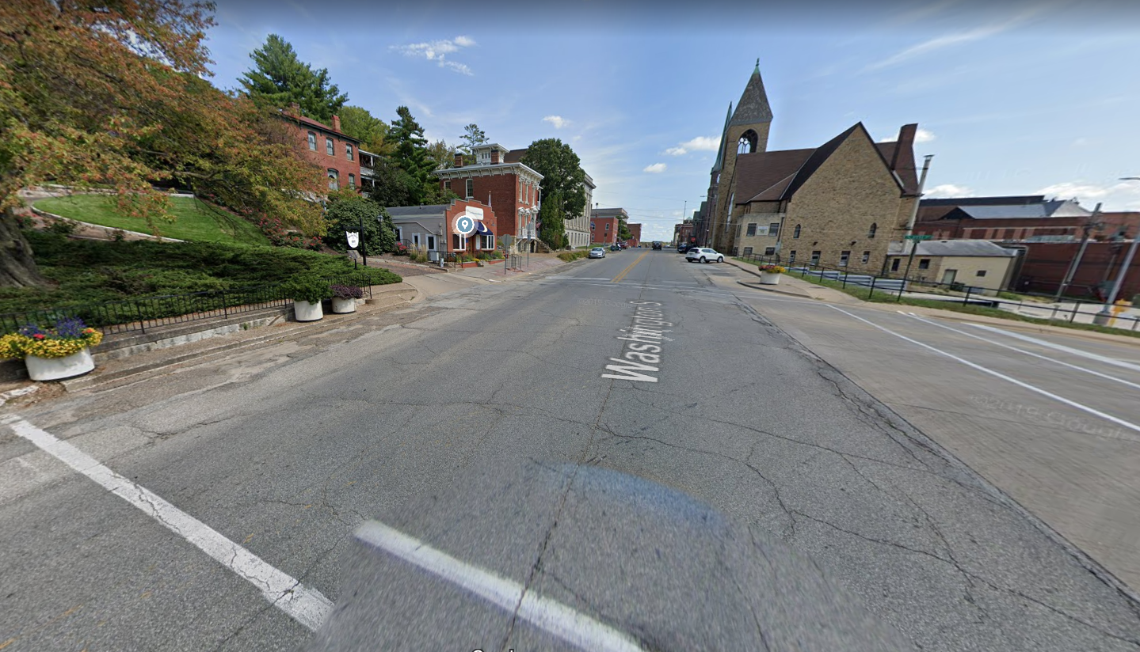
Washington Street

Slide 7
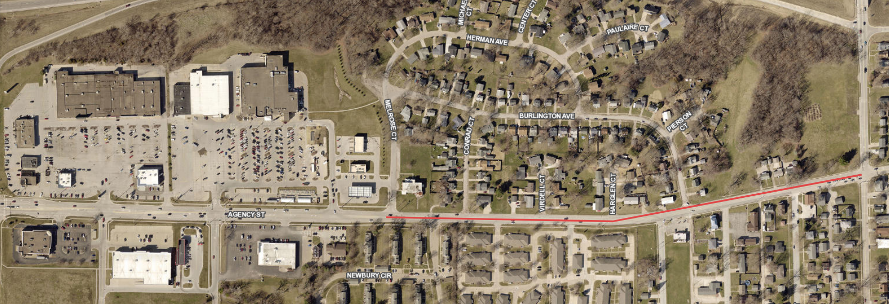
Agency Street

Slide 8
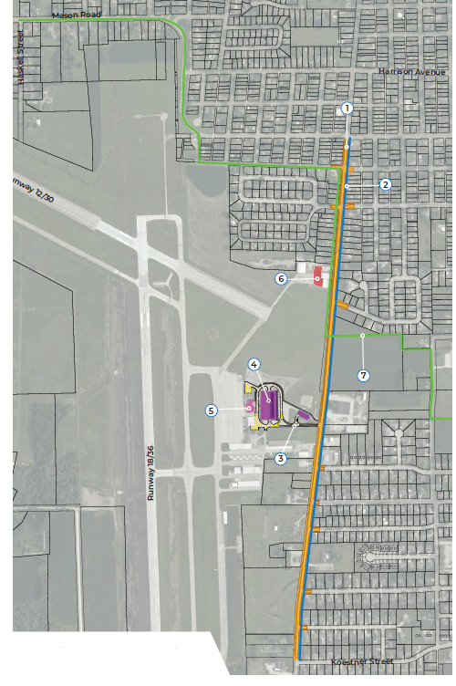
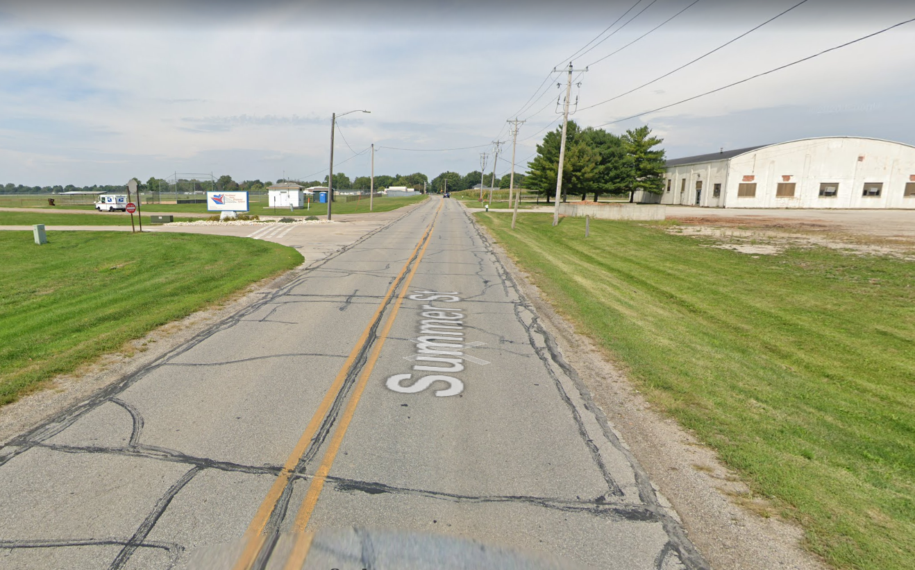
Summer Street

Slide 9
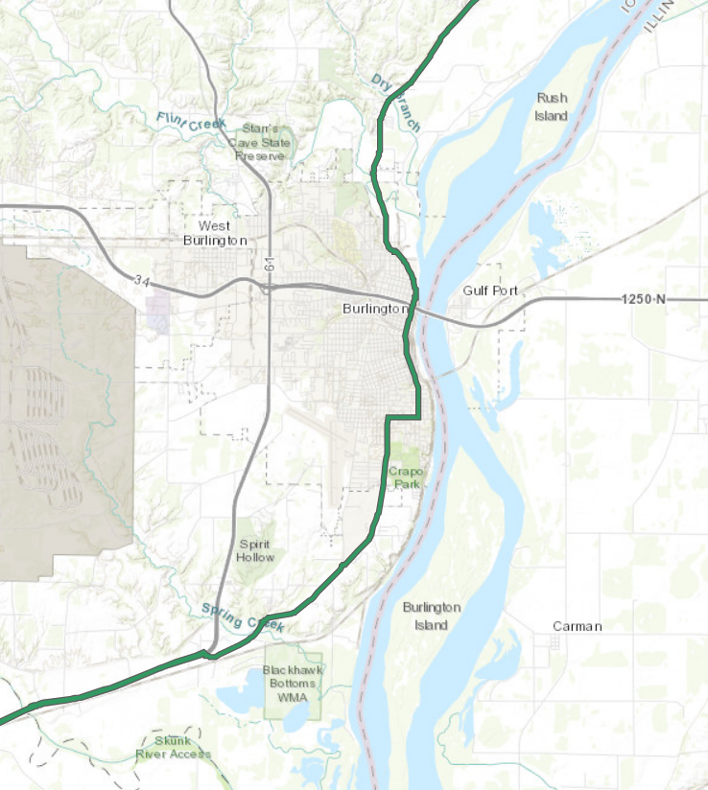
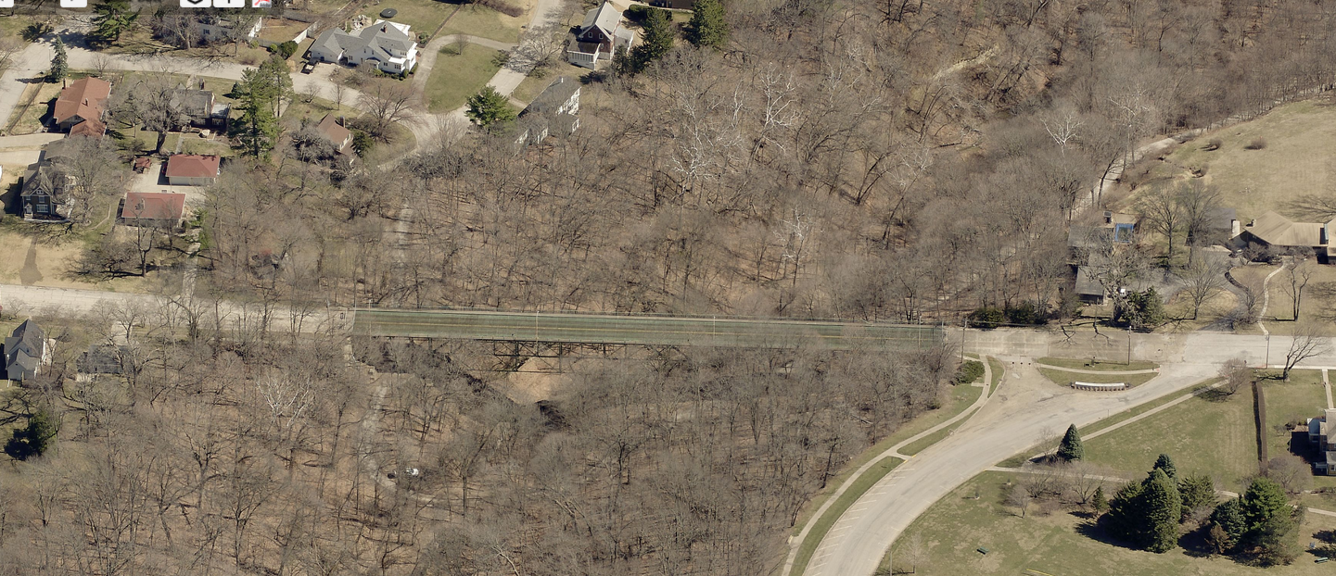
Cascade Bridge

Slide 10
Thank You!

