Slide 1
IMPACTS OF HIGHWAY 61 CORRIDOR PROJECT

Slide 2
The mission of the Highway 61 Coalition is to advocate for four-lane improvement of U.S. Highway 61 from Keokuk to Muscatine, Iowa.
Des Moines County, IA
Henry County, IA
Lee County, IA
Louisa County, IA
Muscatine County, IA
Clark County, MO

Slide 3
The Highway 61 improvements and the promise of four-lanes from Keokuk to Muscatine has allowed the SE IA region to gain more than $177 Million in private capital investment in the past 5 years More than 400 new jobs created. There are exciting projects on the horizon, and the completion of the Highway 61 Infrastructure project is critical to Southeast Iowa’s success!

Slide 4
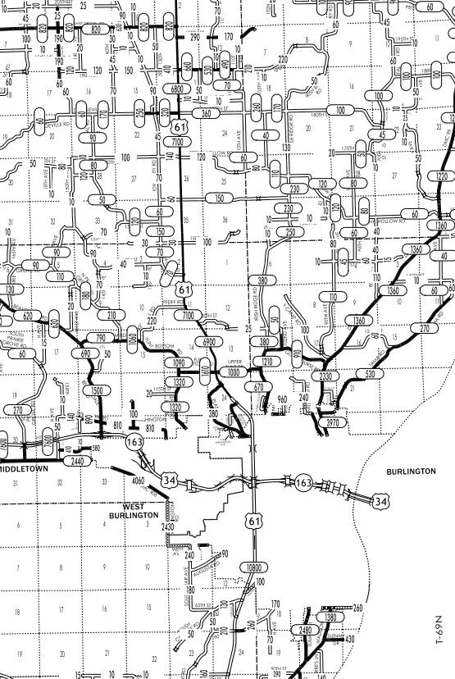
With traffic counts now reaching 7100 at last count from Burlington to the Muscatine county line, the Highway 61 four-lane project is vital for commuter and commercial operators’ safety
IDOT Traffic Flow Map of Des Moines County

Slide 5
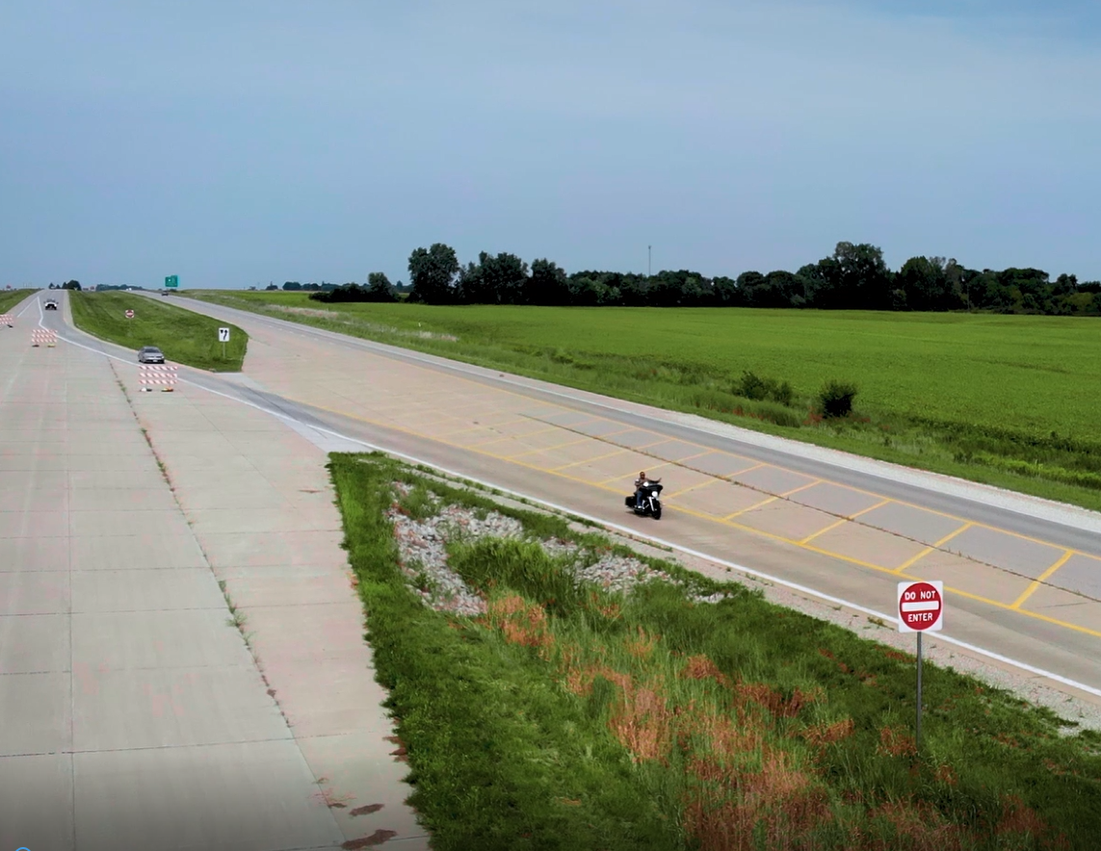

Slide 6
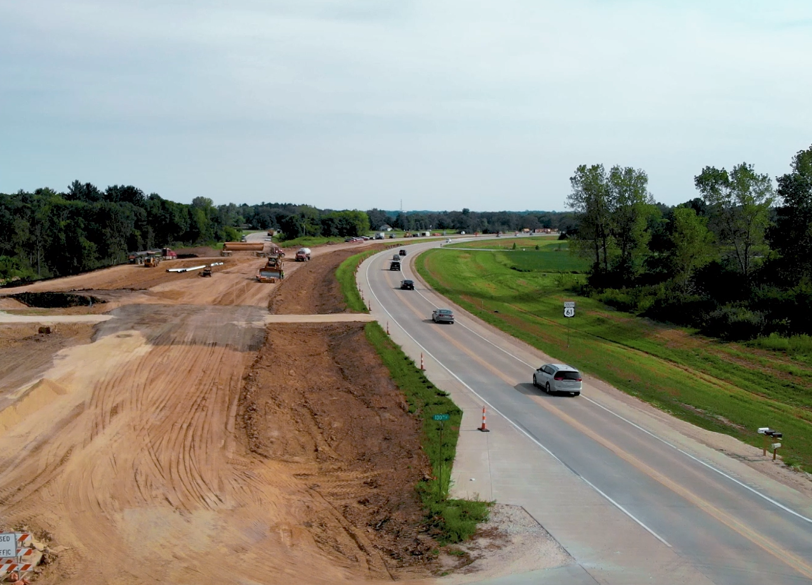

Slide 7
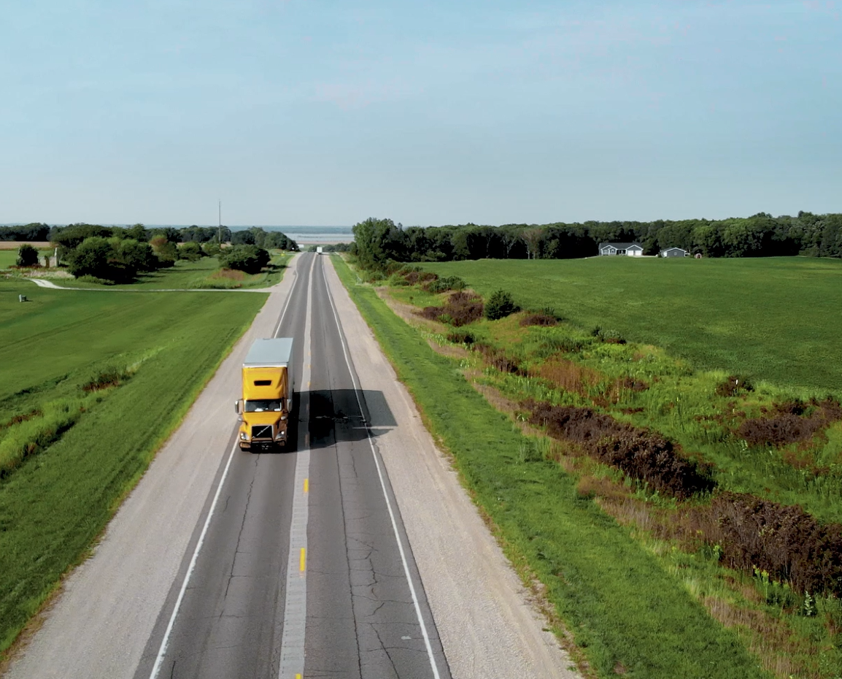

Slide 8
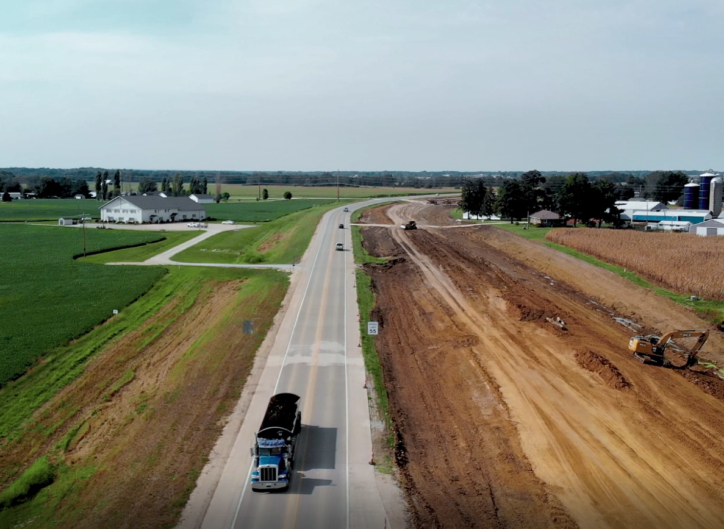

Slide 9
We ask that Highway 61 Corridor remains a top priority for the state of Iowa. Thank you for your continued support.

