Slide 1
Strengthening Southeast Iowa Since 1973
Notes:
Good Morning! My name is Zach James, Planning Directors with SEIRPC. Welcome to Southeast Iowa. I hope you have enjoyed your time touring the region and seeing all of the great projects we have going on in this part of the state.

Slide 2
ABOUT SEIRPC REGION
SEIRPC SERVICE AREA – 103,784
Des Moines County – 38,910
Henry County – 20,482
Lee County – 33,555
Louisa County – 10,837
AND THEIR MUNICIPALITIES
Burlington/West Burlington – 27,179
Fort Madison – 10,270
Keokuk – 9,900
Mount Pleasant – 9,274
Notes:
While smaller in geography, slightly more dense in terms of population.

Slide 3
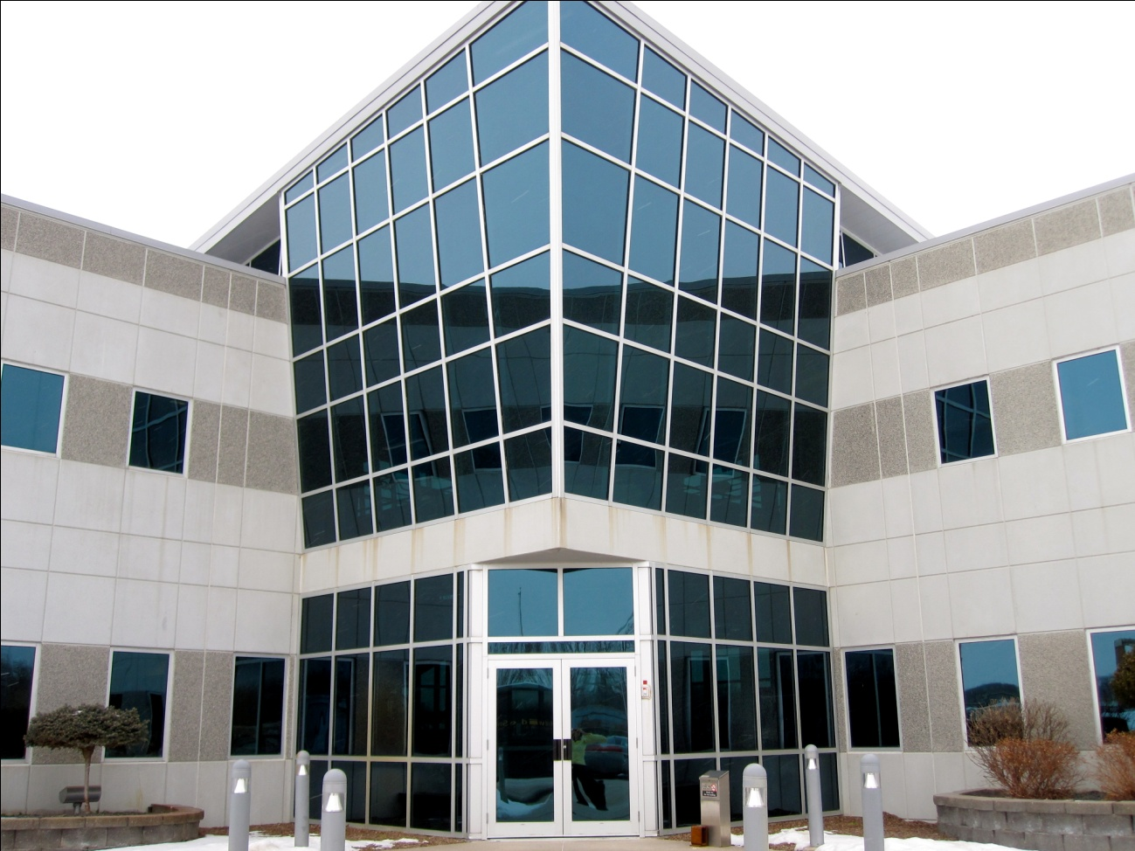
ABOUT SEIRPC
Incorporated 1973
19-member board
35 Total employees (including SEIBUS)
Budget ~$3.8 million for FY2024
Offices located in West Burlington
Notes:
Board include 4 members from each county – 1 County Rep, 2 largest city reps, and private sector rep
Employees include SEIBUS
Brief description of services to lead into transportation discussion

Slide 4
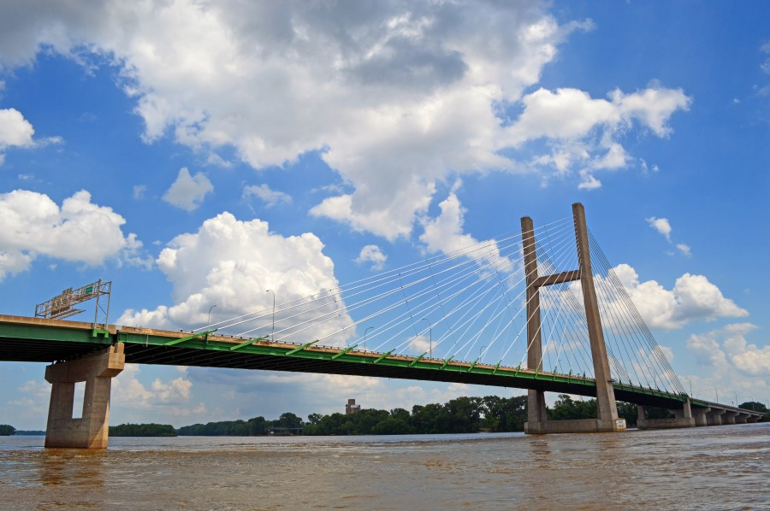
ABOUT SEIRPC AND OUR REGION
Services offered:
Community Planning and Development
Technical assistance including GIS Mapping and data collection/analysis
Housing Trust Fund administration
Economic Development Assistance
Grant writing/administration
Revolving Loan Fund administration
Public transit
Transportation Planning
Notes:
Board include 4 members from each county – 1 County Rep, 2 largest city reps, and private sector rep
Employees include SEIBUS
Brief description of services to lead into transportation discussion

Slide 5
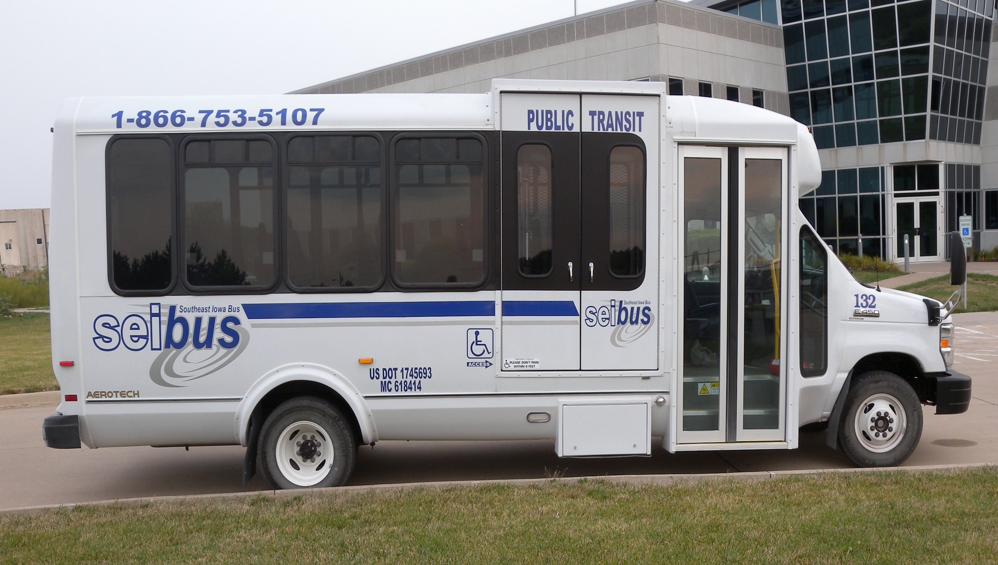
SOUTHEAST IOWA BUS (SEIBUS) OVERVIEW
Authorized regional transit provider by Des Moines, Henry, Lee, and Louisa Counties
Statistics:
 | FY2020 | FY2021 | FY2022
Total Rides | 121,846 | 53,840 | 107,576
General Public | 24,425 | 17,068 | 21,306
Medicaid | 10,363 | 6,130 | 8,005
Contracted | 87,058 | 30,642 | 78,265
Notes:
Lee County recently added
Anyone can ride – primary clientele elderly, mentally/physically disabled
Partnerships and routes with regional entities such health and human service providers, cities, counties, hospitals

Slide 6
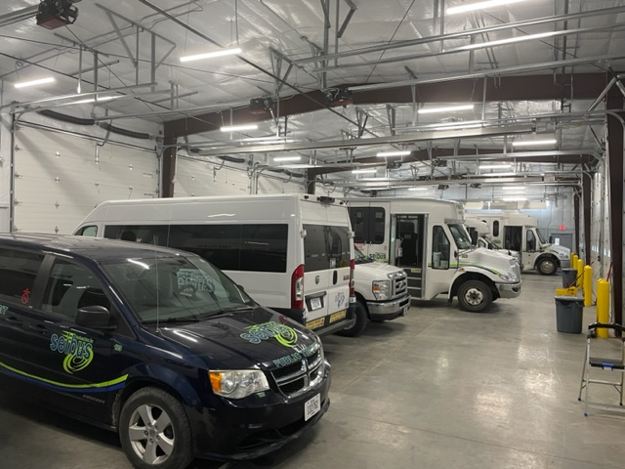
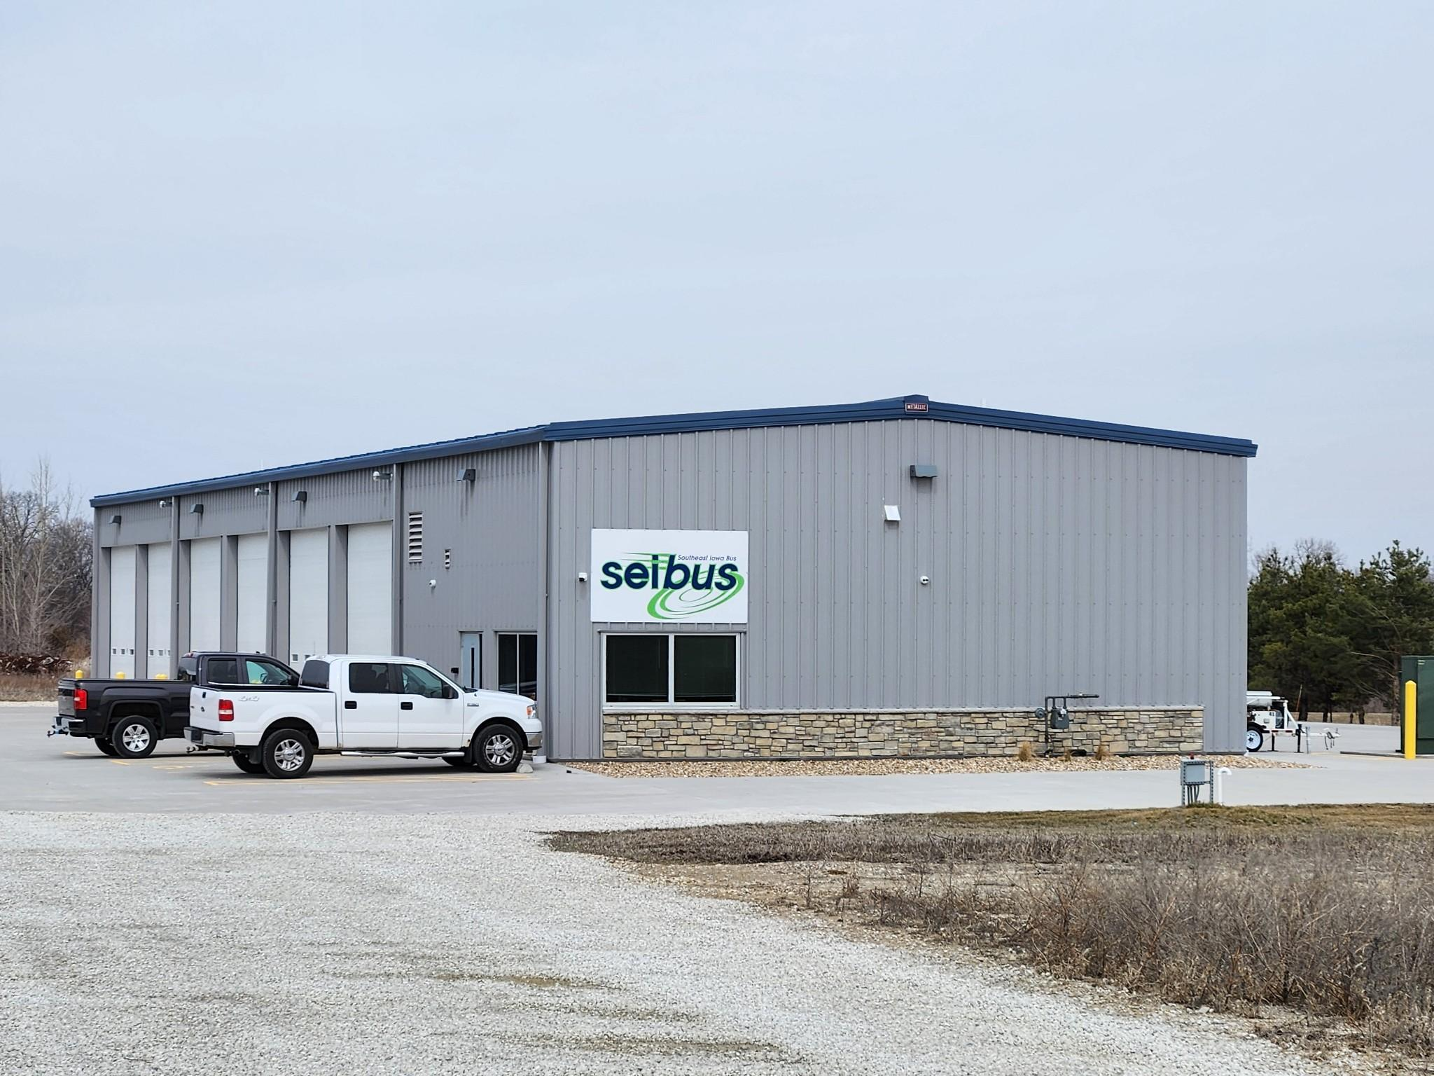
SOUTHEAST IOWA BUS (SEIBUS) OVERVIEW
New bus storage facility – West Burlington (PTIG)
Notes:
Lee County recently added
Anyone can ride – primary clientele elderly, mentally/physically disabled
Partnerships and routes with regional entities such health and human service providers, cities, counties, hospitals

Slide 7
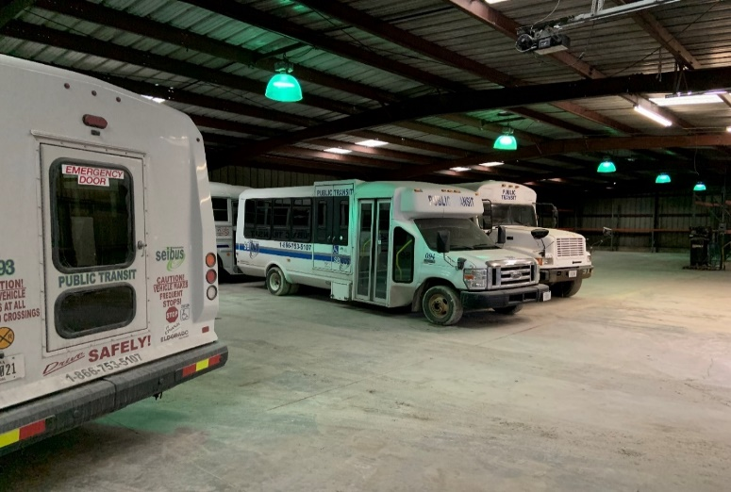
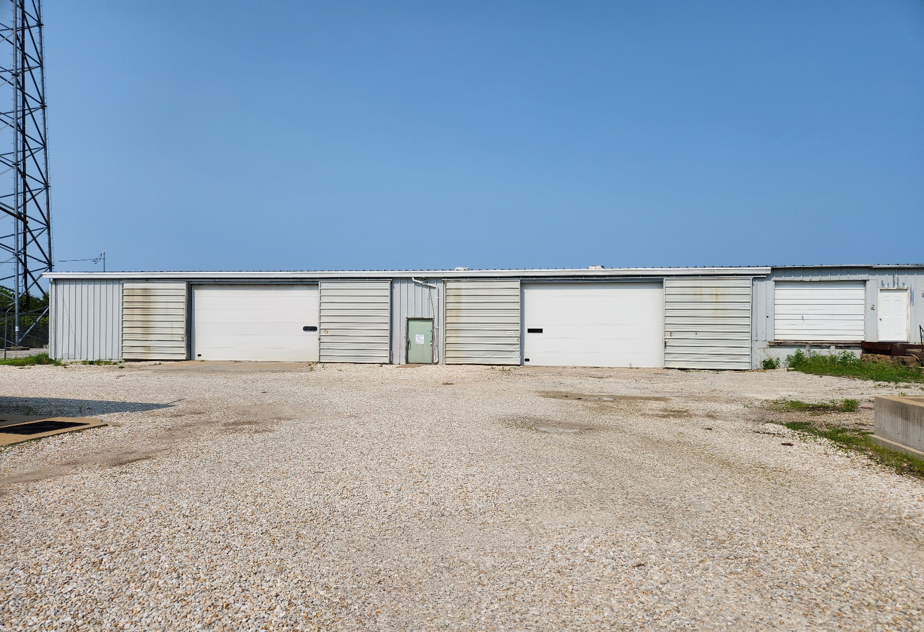
SOUTHEAST IOWA BUS (SEIBUS) OVERVIEW
New bus storage facility – Mount Pleasant (PTIG application in process)
Notes:
Lee County recently added
Anyone can ride – primary clientele elderly, mentally/physically disabled
Partnerships and routes with regional entities such health and human service providers, cities, counties, hospitals

Slide 8
SEIRPC TRANSPORTATION PLANNING
Regional Consultation Process
SEIRPC distributes STBG and TAP funds through competitive process
Competitive process and scoring encourages larger projects with regional impact and ensuring all funding to be spent
STBG and TAP Projects Awarded
 | FFY2022 | FFY2023 | FFY2024 | FFY2025 | FFY2026 | Totals
STBG Projects | 3 | 3 | 2 | 2 | 2 | 12
STBG Funding Amount | $ 2,667,710 | $ 3,115,562 | $ 3,140,306 | $ 3,203,680 | $ 3,266,680 | $15,393,938
TAP Projects | 2 | 1 | 1 | 1 | 1 | 6
TAP Funding Amount | $ 562,683 | $ 238,800 | $ 347,534 | $ 548,111 | $ 375,000 | $1,116,380
Notes:
Regional STP and TAP projects programmed last 5 years
Grants Past 5 years only – Programs include EDA, RISE, TSIP, SRTS, SRT, FRT, City Bridge Fund, Foundations
Planning Documents – this includes TIP, TPWP, PTP, LRTP, SRTS Plans, trail plans, wayfinding, parking, etc.

Slide 9
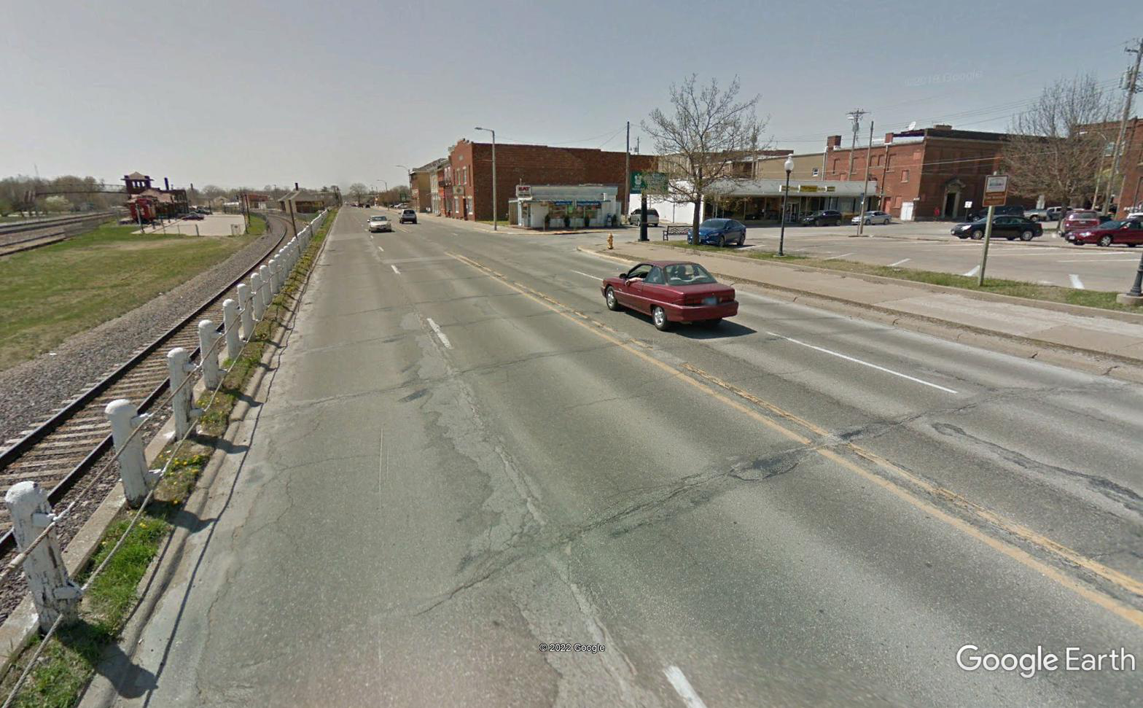
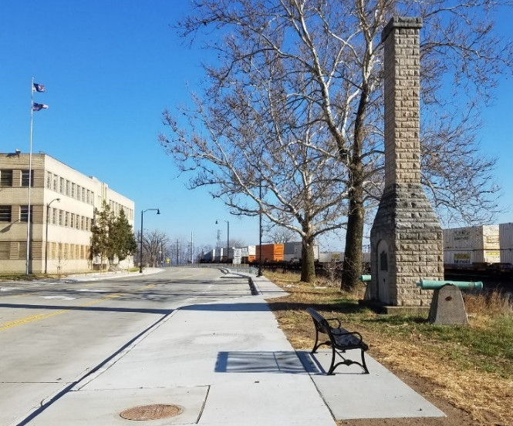
SEIRPC TRANSPORTATION PLANNING
Regional Consultation Process
Fort Madison– Avenue H/Business US Highway 61
BEFORE
AFTER
Notes:
Regional STP and TAP projects programmed last 5 years
Grants Past 5 years only – Programs include EDA, RISE, TSIP, SRTS, SRT, FRT, City Bridge Fund, Foundations
Planning Documents – this includes TIP, TPWP, PTP, LRTP, SRTS Plans, trail plans, wayfinding, parking, etc.

Slide 10
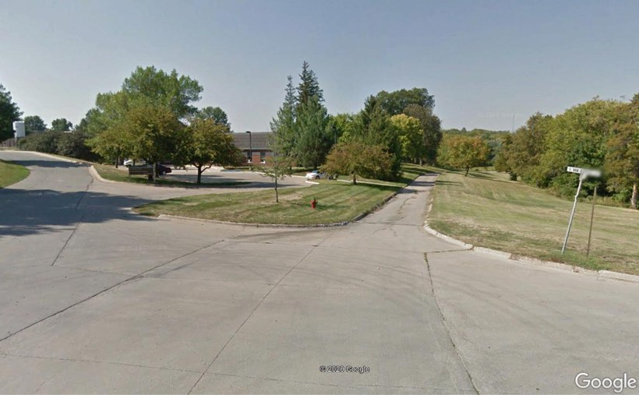
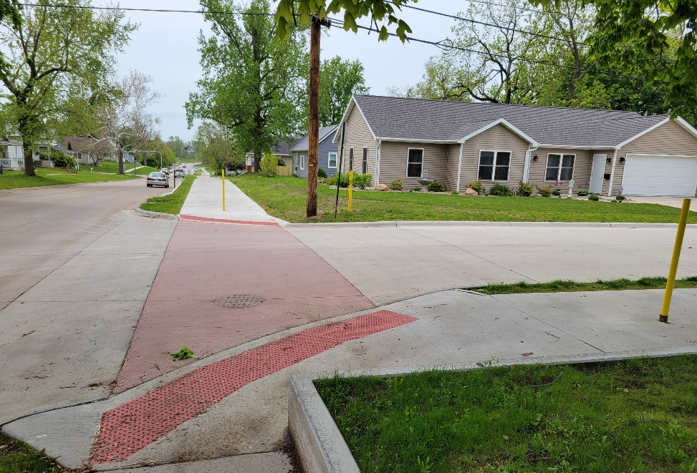
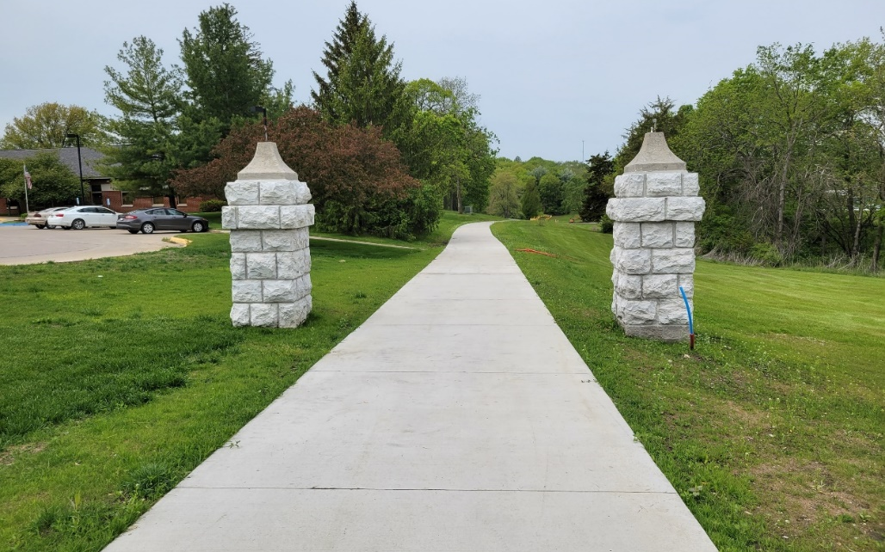
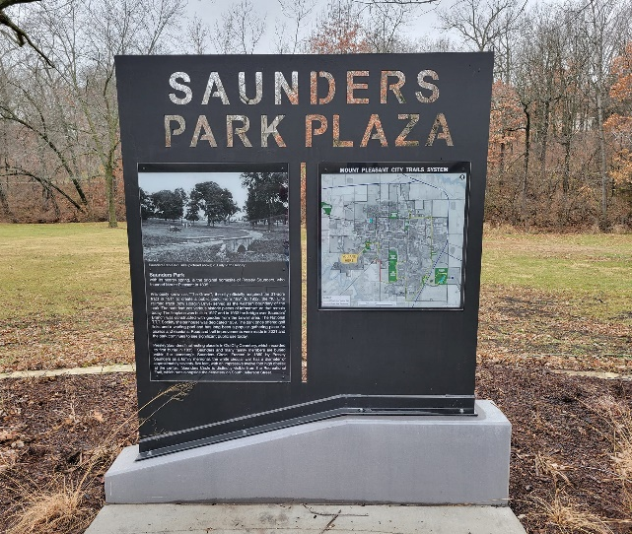
SEIRPC TRANSPORTATION PLANNING
Regional Consultation Process
Mount Pleasant Saunders Park Trail
BEFORE
AFTER
Notes:
Regional STP and TAP projects programmed last 5 years
Grants Past 5 years only – Programs include EDA, RISE, TSIP, SRTS, SRT, FRT, City Bridge Fund, Foundations
Planning Documents – this includes TIP, TPWP, PTP, LRTP, SRTS Plans, trail plans, wayfinding, parking, etc.

Slide 11
SEIRPC TRANSPORTATION PLANNING
Grant Writing
Grant Writing (FY2023)
Grants Written | Grants Funded | Total Grant Amount Awarded to Date
31 | 10 (8 under review) | ~ $6.7 Million
Transportation Grants Written | Transportation Grants Funded | Total Transportation Grant Amount Awarded to Date
17 | 6 (3 under review) | ~ $1.8 Million
Entity | Project | Program | Funding Award
West Burlington | Gear Avenue Trail Phase II | State Recreational Trails | $ 345,357
Fort Madison | Fort Madison Marina Restoration Project | Destination Iowa | $ 250,000
Donnellson | Westview Park Trail - Phase I | REAP | $ 50,000
West Point | 8th Street-South Park Connector Trail | REAP | $ 31,865
Burlington | Cascade Bridge Engineering (assisted Impact 7G on application) | Scenic Byways | $ 1,071,780
SEIRPC | Safety Action Plan | Safe Streets 4 All | $ 64,000
Notes:
Regional STP and TAP projects programmed last 5 years
Grants Past 5 years only – Programs include EDA, RISE, TSIP, SRTS, SRT, FRT, City Bridge Fund, Foundations
Planning Documents – this includes TIP, TPWP, PTP, LRTP, SRTS Plans, trail plans, wayfinding, parking, etc.

Slide 12
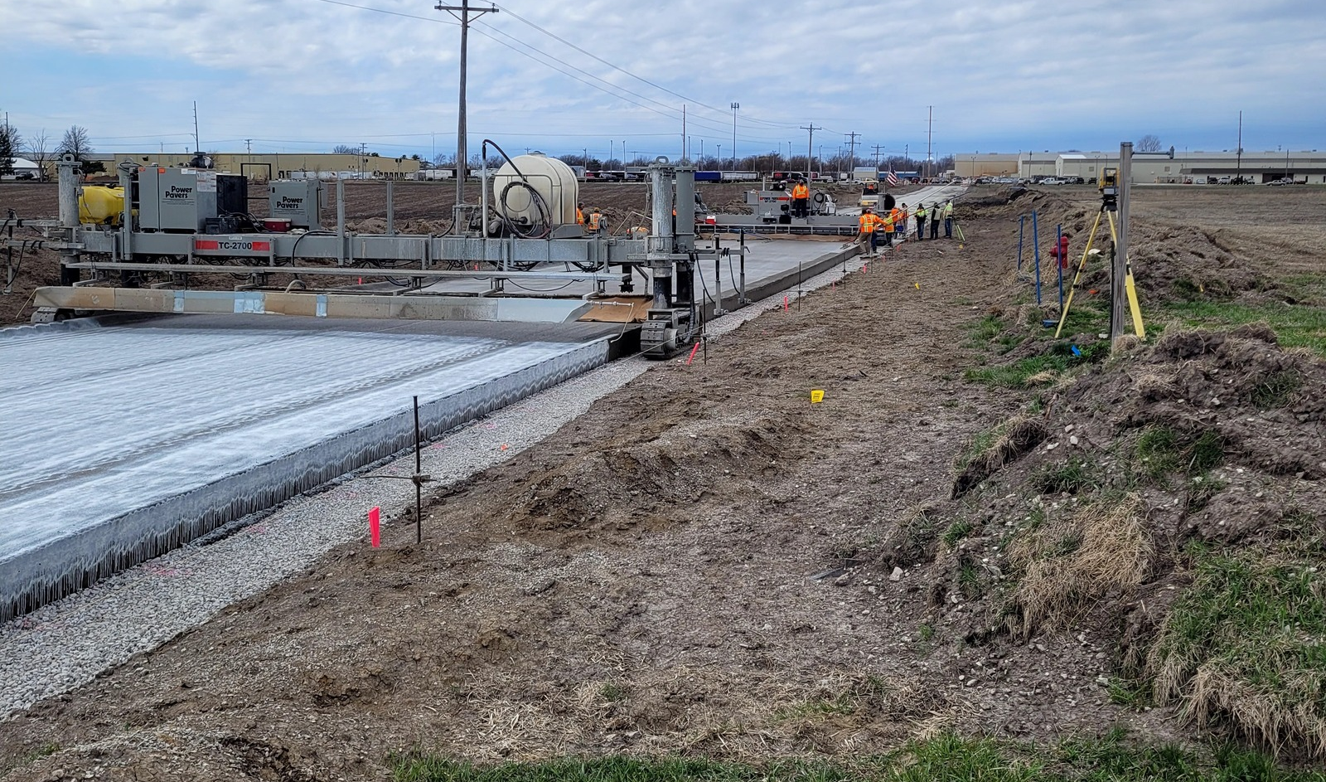
SEIRPC TRANSPORTATION ACTIVITIES
Grant Writing and Administration
Mount Pleasant – Bluegrass Road (RISE Grant)
Notes:
Local Development RISE Grant – Expansion of an existing company adjacent to the road, plus open up additional land for development

Slide 13
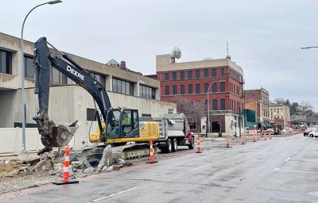
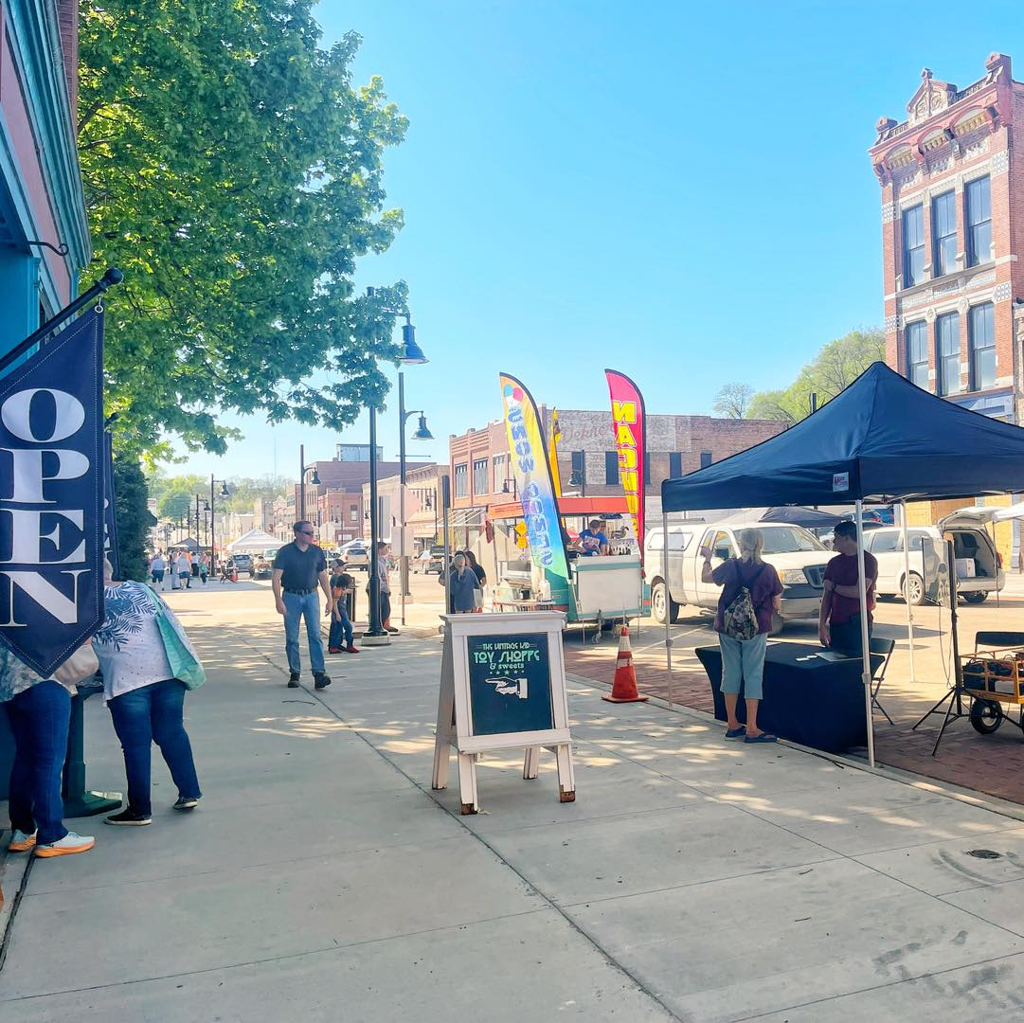
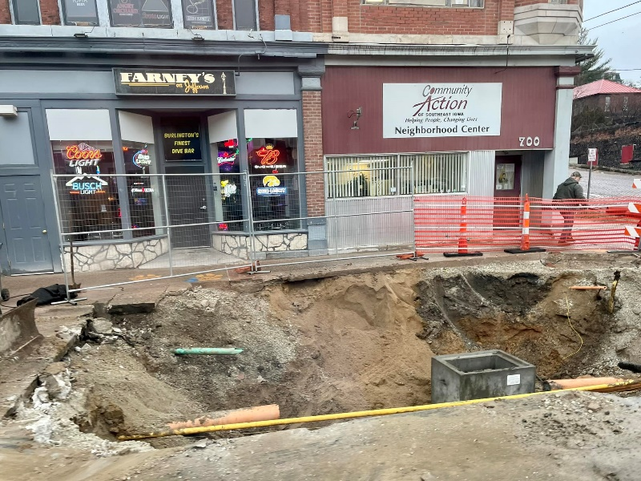
SEIRPC TRANSPORTATION ACTIVITIES
Grant Writing and Administration
Burlington – Riverfront, Jefferson Street, and Main Street (TIGER Grant)

Slide 14
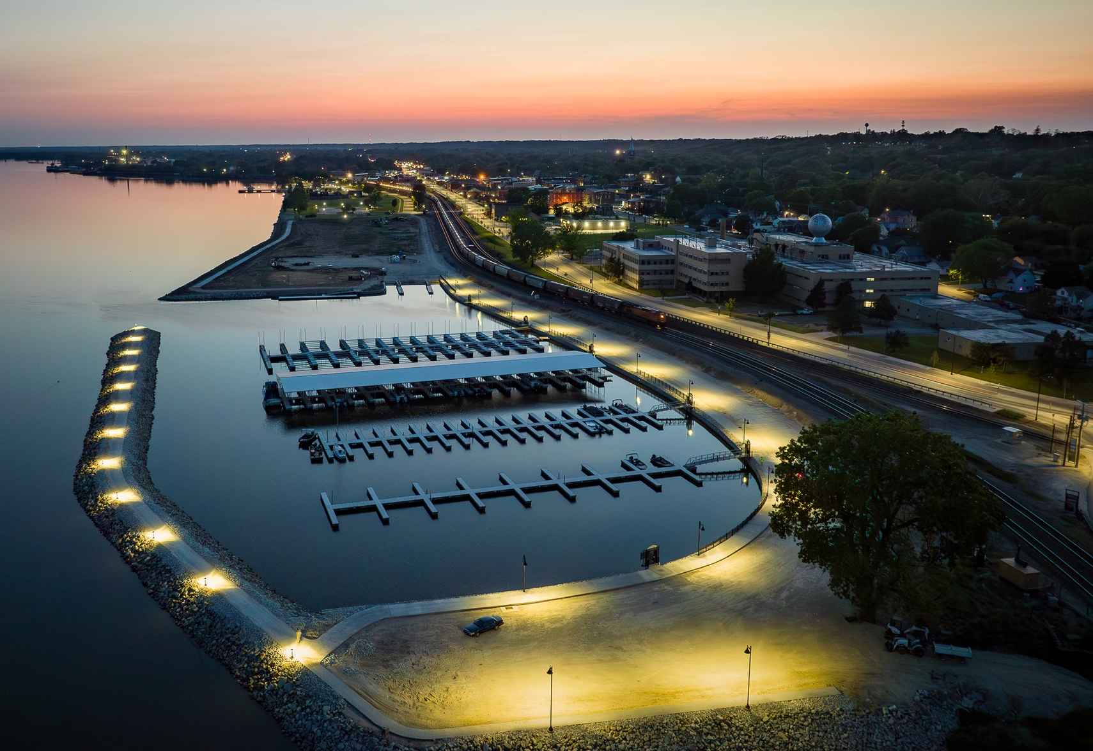
SEIRPC TRANSPORTATION ACTIVITIES
Grant Writing and Administration
Fort Madison – Marina Improvements (WRAC, CAT)
Notes:
City asked us to assist in relocating their depot from its current location to the original historic depot in Downtown Fort Madison

Slide 15
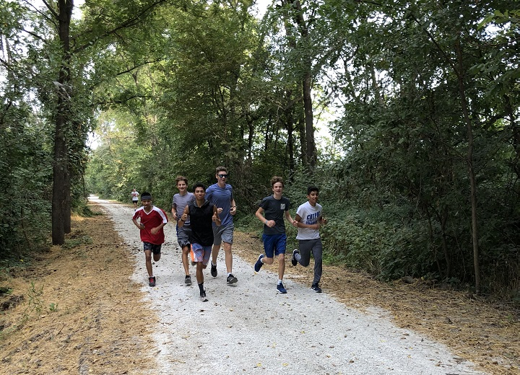
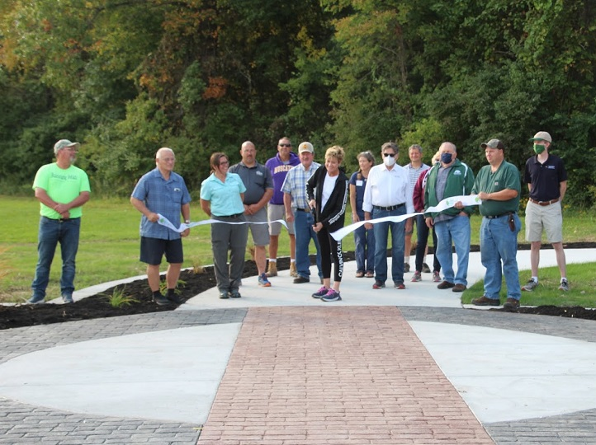
SEIRPC TRANSPORTATION ACTIVITIES
Grant Writing and Administration
Louisa County – Hoover Nature Trail (TAP, SRT)

Slide 16
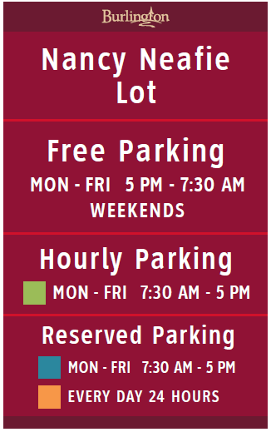
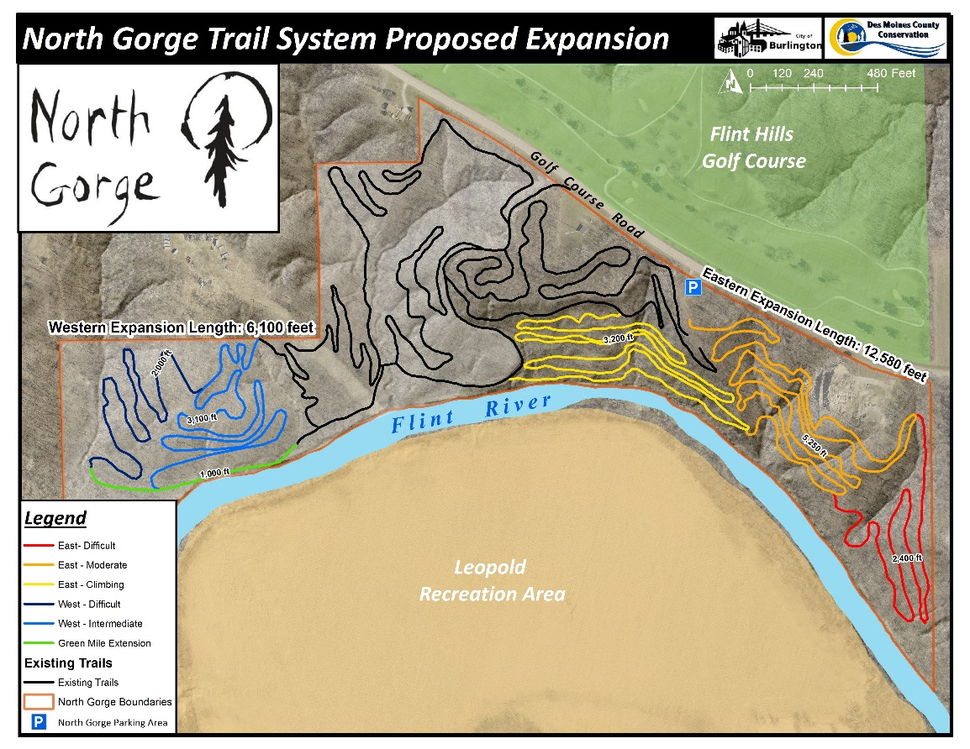
SEIRPC TRANSPORTATION ACTIVITIES
Planning
Wayfinding Signage Studies
Parking Studies
Traffic Impact Studies
Bike and Pedestrian Plans

Slide 17
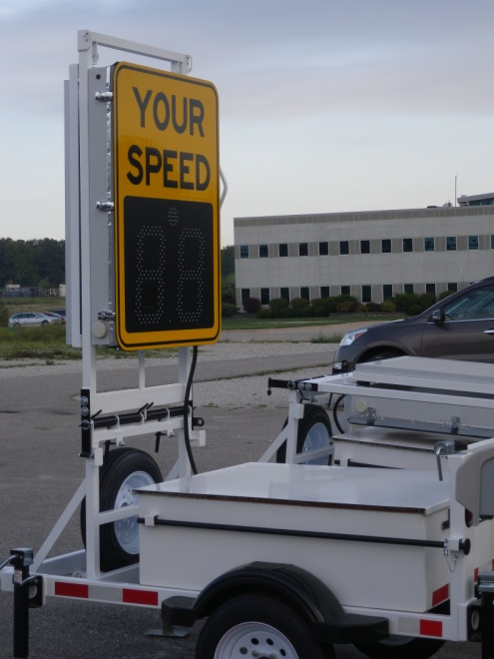
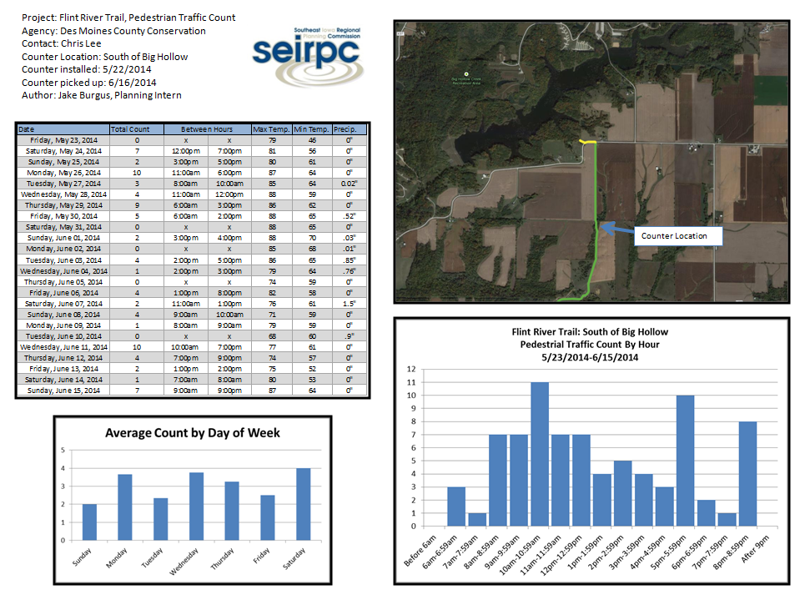
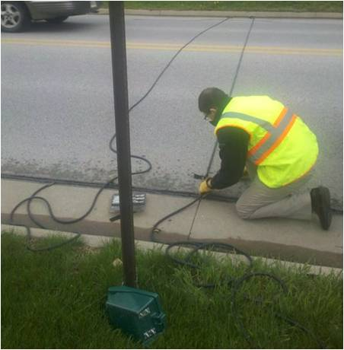
SEIRPC TRANSPORTATION ACTIVITIES
Other Services
Traffic counting
Trail counting
Speed indicators

Slide 18
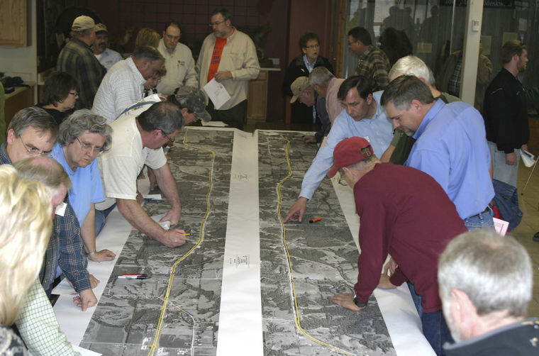
SEIRPC TRANSPORTATION ACTIVITIES
Community Engagement
Partnerships
SEIRPC Board
Transit Advisory Committee
Technical Advisory Committee
CEDS(LRTP) Steering Committee
Mid American Port Commission
Southeast Iowa Regional and Economic Port Authority
Local bike and pedestrian committees
Healthy Living Committees
National Association of Development Organizations
Other State and Federal Agencies – EDA, USDA, IEDA, EPA
Partnerships
Iowa Council of Governments (ICOG)
Iowa DOT Bicycle and Pedestrian Long-Range Plan/Advisory Committee
Iowa DOT Freight Advisory Council
Iowa DOT Federal Aid Swap Committee
Board Member Highway 34 Coalition
Board Member Highway 61 Coalition
Lee County MTSD
Chair of Great River Region Partnership
Economic Development/Chamber of Commerce Boards

Slide 19
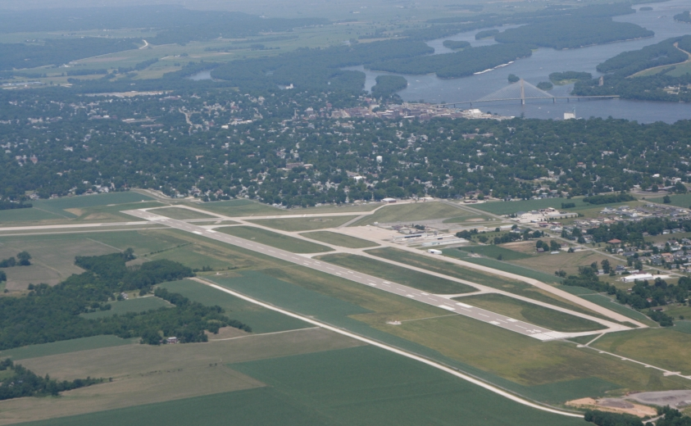
Thank you for your time today!
Please visit www.seirpc.com or www.facebook.com/seirpc for additional information about SEIRPC.
Mike Norris
Executive Director
319-753-4310
mnorris@seirpc.com
Zach James
Assistant Director
319-753-4313
zjames@seirpc.com

