Slide 1
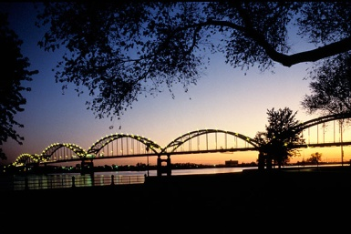
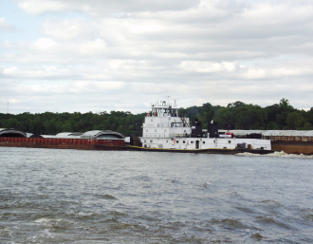
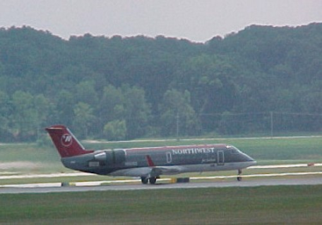
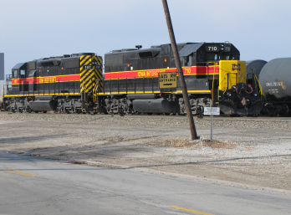
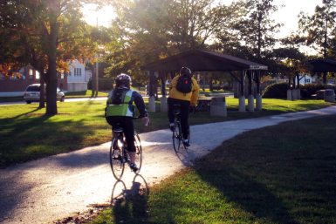
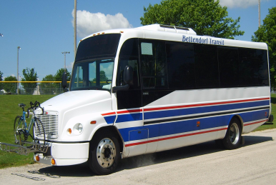
Iowa DOT Commission Presentation
June 13, 2023

Slide 2
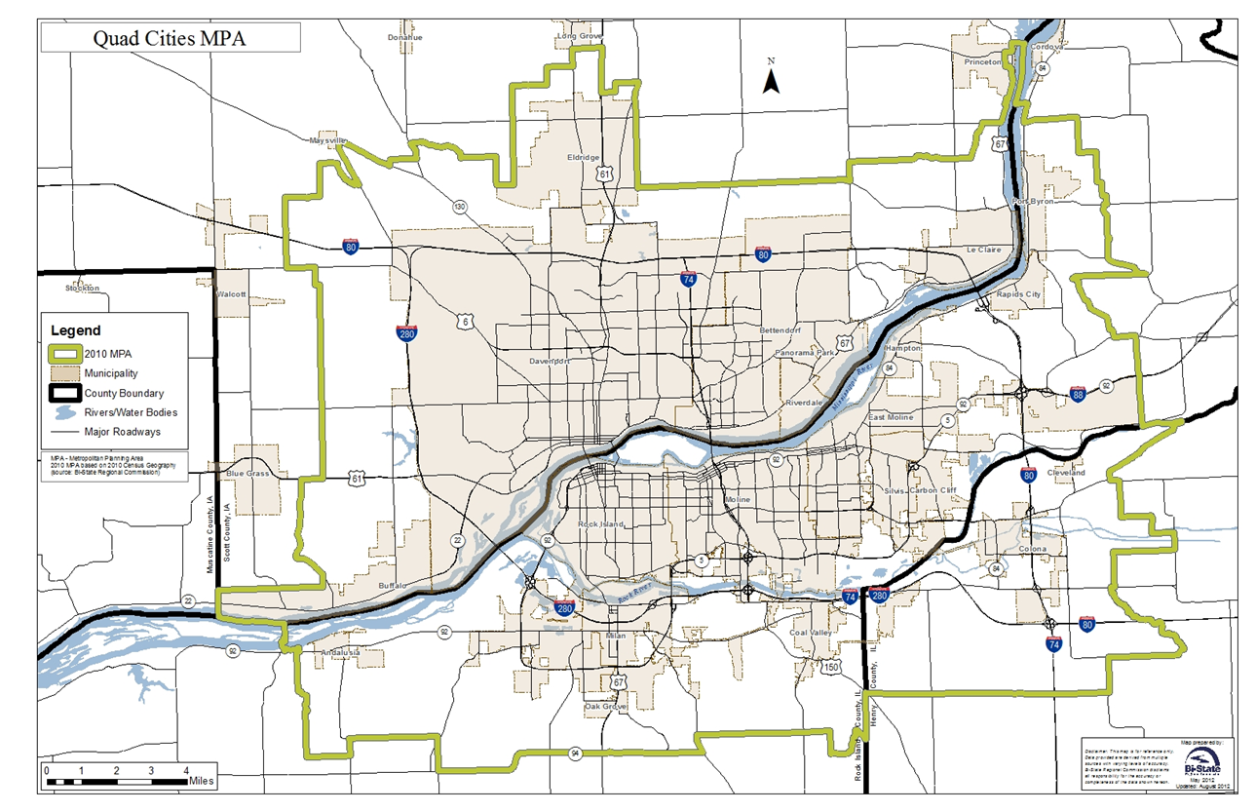

Slide 3
Six-Laning of I-80
Advocating in 4 Long Range Transportation Plans
Pre Pandemic AADT was 52,500 in Quad Cities
Some of the Highest Counts in Iowa on I-80
35% + Increase in Traffic Since 2002
One of Busiest Stretches with over 36% Trucks
Advocating Initially for Interchanges
I-80 Widening Focus on QCA with Higher Traffic
such as other Metro Areas in the State

Slide 4
Interstate 80 System Study in QCA
Studied Condition, Geometry, Operation, Safety & Six-Laning of I-80 (I-80 Bridge – I-280)
21 of 28 Ramps Rated Poor in Safety/Crashes
Crash Rates Expected to Increase
Right Shoulder Rated Poor throughout Study Area
Build Concept: 6-Laning & Removes Left-Hand Exits
Notes:
Complete I-74 Project with Kimberly Road Interchange which provides pedestrian accessibility and rehabilitates pavement and ramps which are in very poor repair. Interstate feasibility analysis which includes studying four potential changes and maybe more identified by the Department. They are six-laning of I-80 ; realigning Kimberly Road I-280 Interchange; extending a north bound lane at the I-74 and I-80 interchange; and the reconstructing I-80 Middle Road Interchange.

Slide 5
Interstate 80 Bridge
Included in Iowa and Illinois DOT TIP’s – Thank You!
Structurally Deficient Design with Poor Shoulders Drove Need
Phase I Study Nearing Completion
Construction Anticipated in 2028
Periodic Bridge Closures Required for Repairs
WB Ramps at US 67 Interchange Rated Poor for Crashes/Geometry

Slide 6
I-80 at Middle Road Interchange
Included in State TIP – Thank you!
34% Growth on 80/100% on Middle Forecasted by Network Model
TBK Sports Complex & SE Quadrant Expansion Drives Need

Slide 7
TBK Bank Indoor and Outdoor Sport Complex
$60 Million Investment, 182 Total Jobs, + $100 Million Commercial
785,000 Visitors Annually, 40 % from Six Surrounding States
Soccer/Basketball/Volleyball/Pickleball/Wrestling/Baseball/Softball

Slide 8
TBK Bank Sports Complex
TBK 100 Million Expansion
Iron Tee Golf
Multi-Sport Turf Fields
Paired with Bettendorf Forest Grove Improvement Project – Roadway/Roundabout/BikePed/Utilities

Slide 9
Interstate 80 at Interstate 74 Interchange – 62,700 Intersecting AADT
Over 60% Growth on I-80 Forecasted by Bi-State Network Model
EB & WB I-74 Bridges Over I-80 Rated Poor for Width
3 of 4 Ramps have Poor Crash Rates (136 – 316)
Growth in Davenport and Bettendorf Projected to the North

Slide 10
Interstate 80 at US 61 Interchange ~ 77,000 Intersecting AADT
Over 35% Growth on I-80 Forecasted by Network Model
Inadequate Merging Lanes Contribute to 232/HMVMT Crashes
All Ramp Loops Rated Poor Geometry – NEXT PRIORITY!

Slide 11
Interstate 80 at NW Blvd Interchange - 54,250 Intersecting AADT
Over 30% Growth on I-80 Forecasted by Bi-State Network Model
3 of 4 Ramps have Poor Crash Rates (86 – 261)
Interchange Reconfiguration to Accommodate Trucks Recommended
Additional Trucks Anticipated with Amazon and Fair Oaks Foods

Slide 12
Iowa DOT Staff Appreciated
Consistent Communication with Various Project Engineers, PIO’s, District Office Staff, Public
Open to Troubleshooting Issues when they Arise
Thank You! Questions?

Slide 13
Thank You! Questions?

