Slide 1
Revitalize Iowa’s Sound Economy Program
Iowa Transportation Commission Business Meeting
June 13, 2023

Slide 2
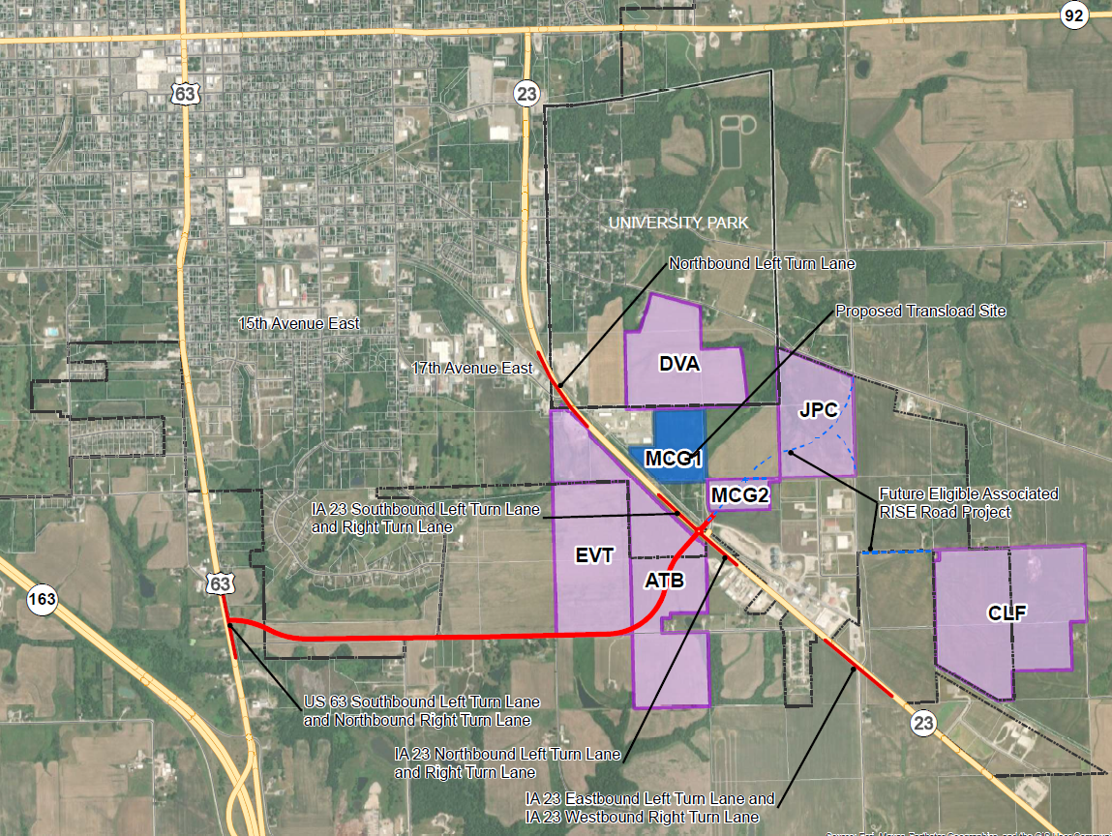
List of Local Development Applications Recommended
PROJECT NAME
SPONSOR
SCORE
TOTAL PROJECT COST
PERCENT PARTICIPATION
RECOMMENDED AMOUNT
Construction of approximately 10,000 feet of new roadway connecting Iowa 23 and US 63, turn lanes at Iowa 23 and 17th Avenue East, Iowa 23 and Osburn Avenue, Iowa 23 and proposed connector, and US 63 and proposed connector located southeast of Oskaloosa. | Mahaska County | 58 | $15,600,563 | 65% | $10,140,366

