Slide 1
Revitalize Iowa’s Sound Economy Program
Iowa Transportation Commission Workshop
June 12, 2023

Slide 2
Revitalize Iowa’s Sound Economy Program
Created in 1985
Purpose: To promote economic development through roadway improvements.
Eligible development shall have value-adding activities that feed new dollars into the economy
Available to cities and counties through an application program

Slide 3
Available Funding and Application Summary
Available Funding
Funded annually with dedicated state motor fuel and special fuel tax revenues
Application Summary for SFY2023
Total number of projects awarded: 8
Total project costs: $24,007,269
Total amount awarded: $12,914,201
 | CITY | COUNTY
Average funding generated monthly | $905,101 | $452,550
SFY 2023 current Road Use Tax Revenue (as of 4/30/2023) | $10,028,710.66 | $5,014,355.32
Current Unobligated Balance (as of 4/30/2023) | $8,615,970.21 | $593,810.32

Slide 4
Local Development Project Evaluation Criteria
Development Potential (35 points)
Economic impact and Cost Effectiveness (20 points)
Local Commitment and Initiative (33 points)
Transportation Need and Justification (4 points)
Local Economic Need (6 points)

Slide 5
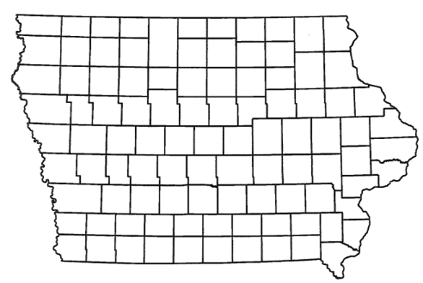
List of Local Development Applications Recommended
PROJECT NAME
SPONSOR
SCORE
TOTAL PROJECT COST
PERCENT PARTICIPATION
RECOMMENDED AMOUNT
Construction of approximately 10,000 feet of new roadway connecting Iowa 23 and US 63, turn lanes at Iowa 23 and 17th Avenue East, Iowa 23 and Osburn Avenue, Iowa 23 and proposed connector, and US 63 and proposed connector located southeast of Oskaloosa. | Mahaska County | 58 | $15,600,563 | 65% | $10,140,366

Slide 6
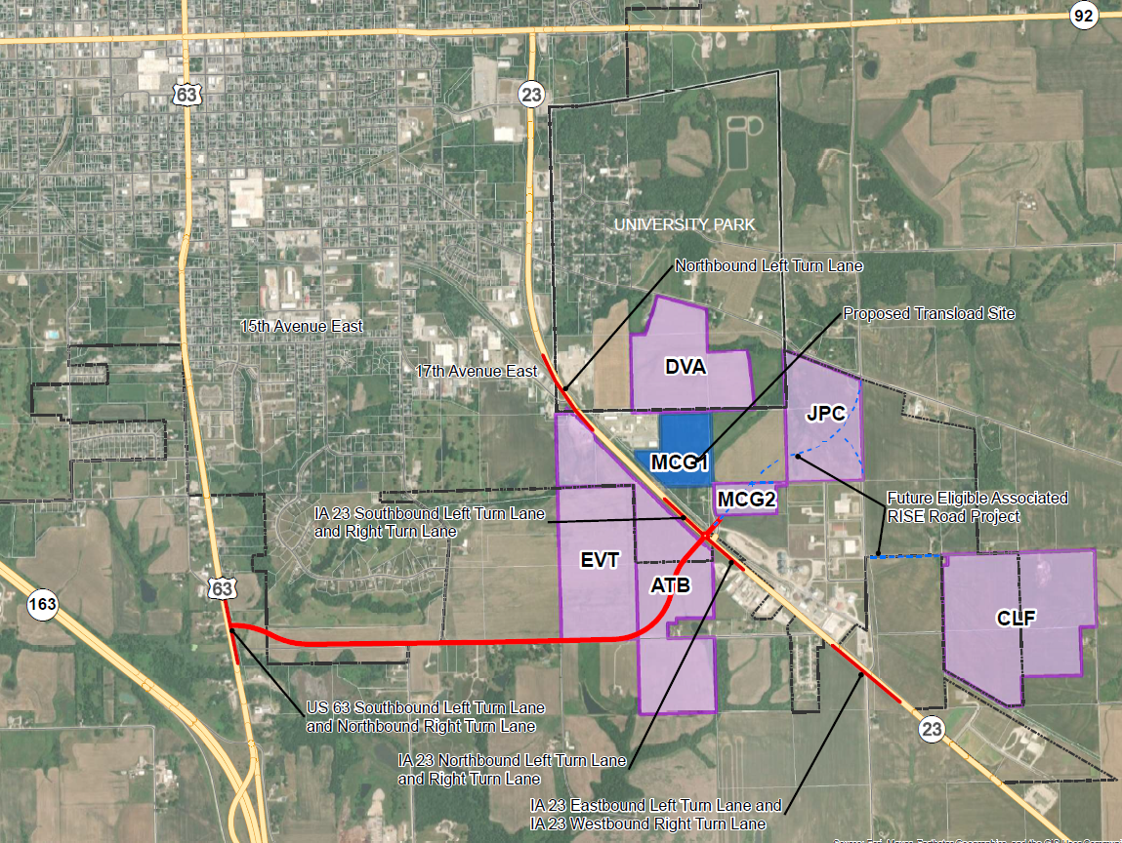
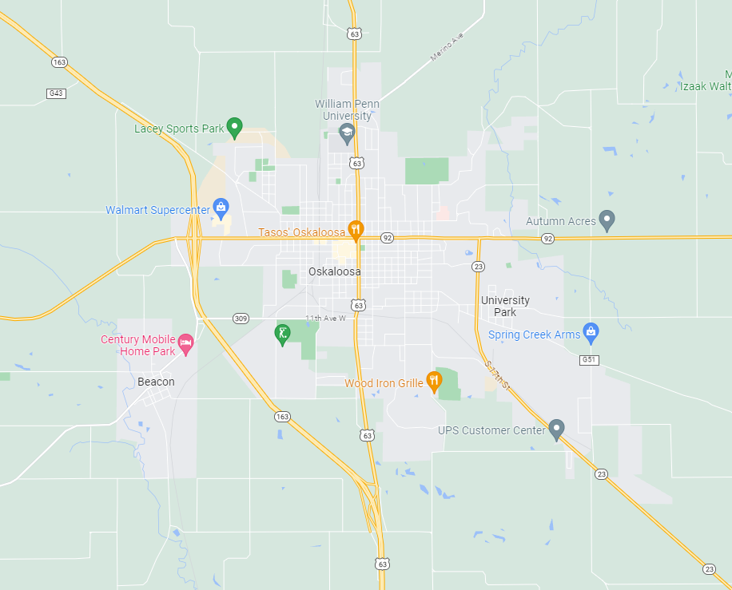
Mahaska County
(Local Development)
Construction of approximately 10,000 feet of new roadway connecting Iowa 23 and US 63, turn lanes at Iowa 23 and 17th Avenue East, Iowa 23 and Osburn Avenue, Iowa 23 and proposed connector, and US 63 and proposed connector located southeast of Oskaloosa. This project is necessary to provide improved access to more than 517 acres including Oskaloosa Innovation Park, a proposed Iowa Economic Development Authority Certified Site of approximately 490 acres, and an additional 27 acres that will be opened for RISE eligible development.
Total Cost: $15,600,563
Requested: $10,140,366 (65%)

Slide 7
QUESTIONS?
Debra Arp, Systems Planning Bureau
Debra.Arp@iowadot.us
515-239-1681

