Slide 1
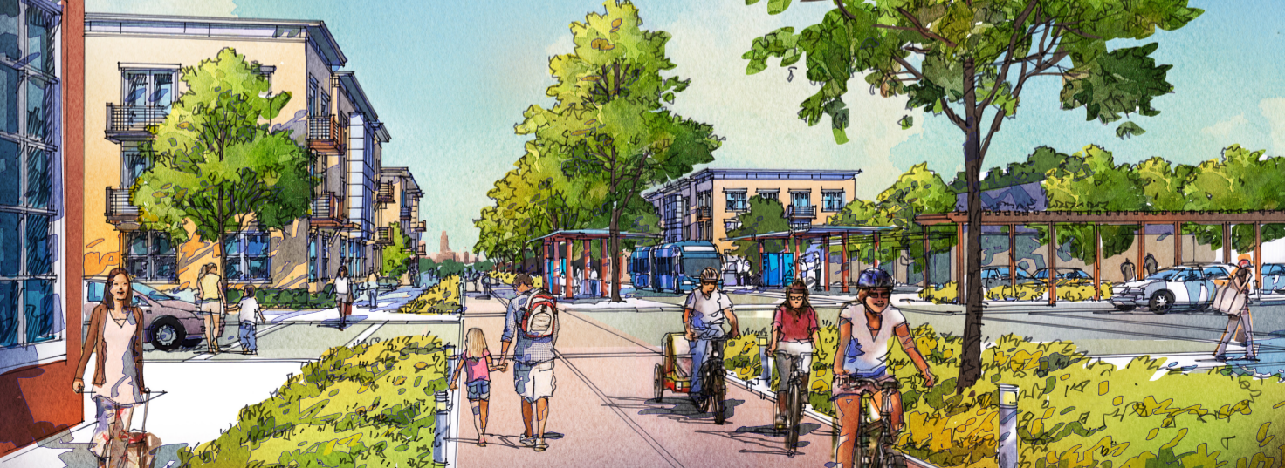
IDOT Transportation Commission
Council Bluffs
June 11, 2024

Slide 2
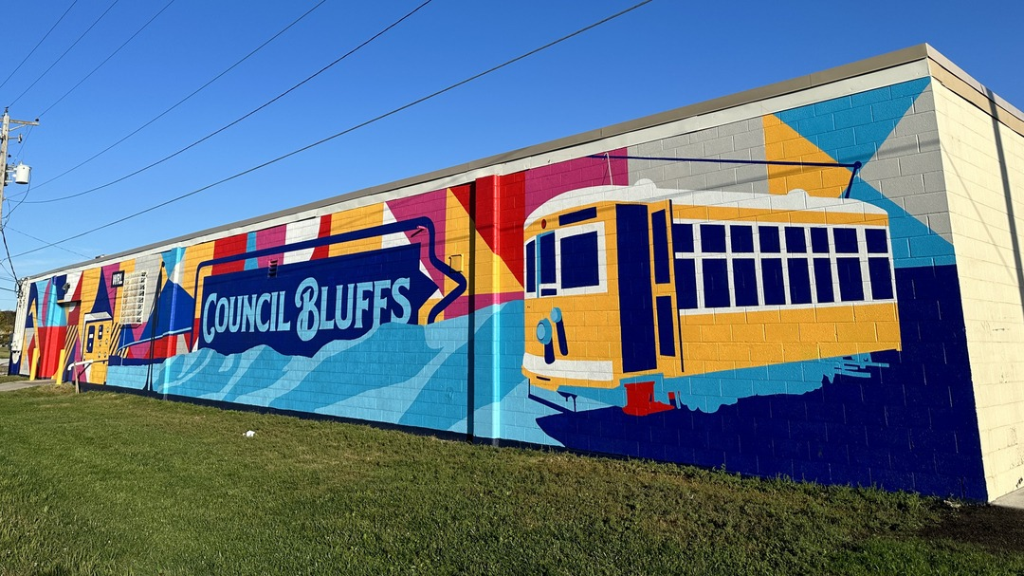
Our Mission:
To continuously improve the quality of life and attractiveness of the City of Council Bluffs.

Slide 3
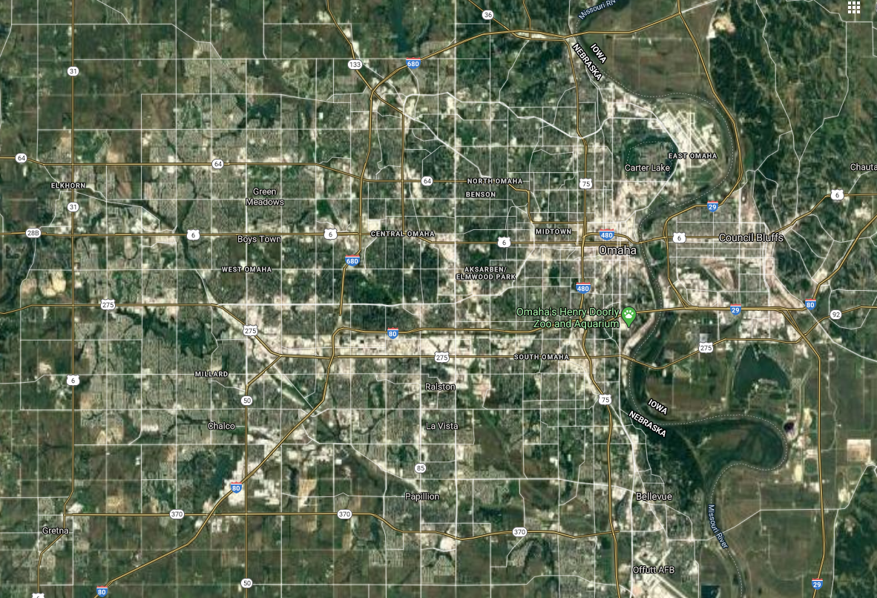
Where is Council Bluffs?

Slide 4
Where is Council Bluffs?

Slide 5
Where is Council Bluffs?
“Urban Core”

Slide 6
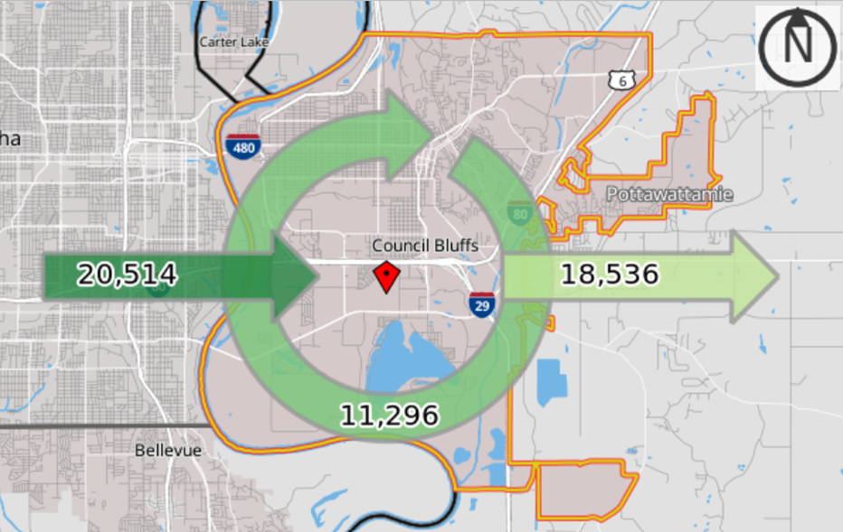
CB is Bigger than You Think

Slide 7
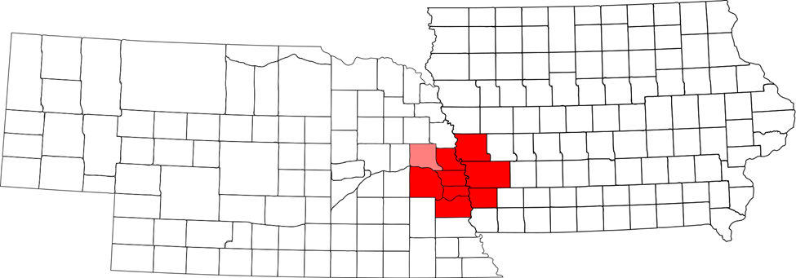
A metro over a million…

Slide 8

A metro over a million…

Slide 9
AND GROWING BY another 500,000 by 2054

Slide 10
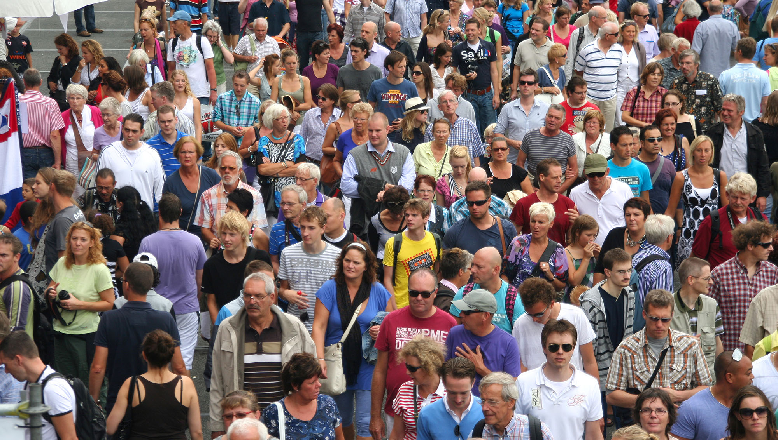
A Growing Metro
How many will come to Council Bluffs?

Slide 11

Where will they go?
There is already a housing shortage in the Omaha-Council Bluffs metro

Slide 12
Rental Housing Shortage
American Community Survey 5 year avg. estimates (US Census):
2022: 1.4%
2021: 2.1%
2020: 2.2%
2019: 2.2%
2018: 3.4%
2017: 4.0%
2016: 5.1%
2015: 8.0%

Slide 13
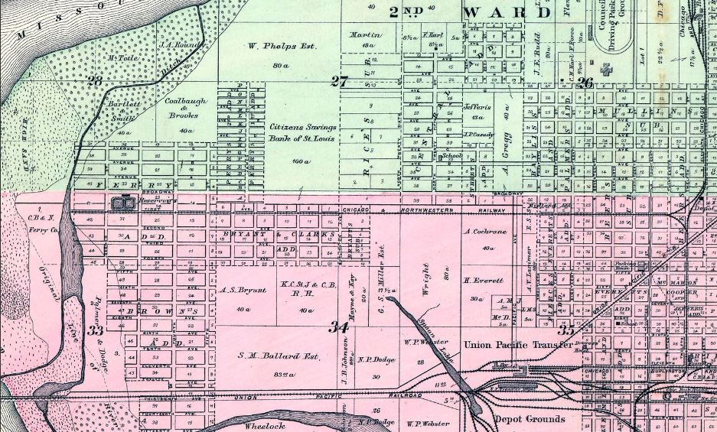
Chicago & Northwestern Railway
1885

Slide 14
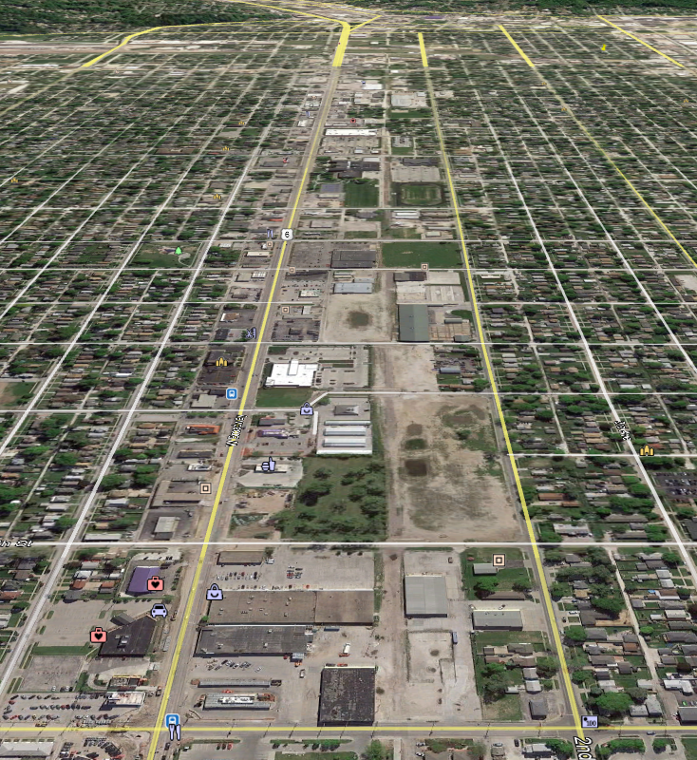
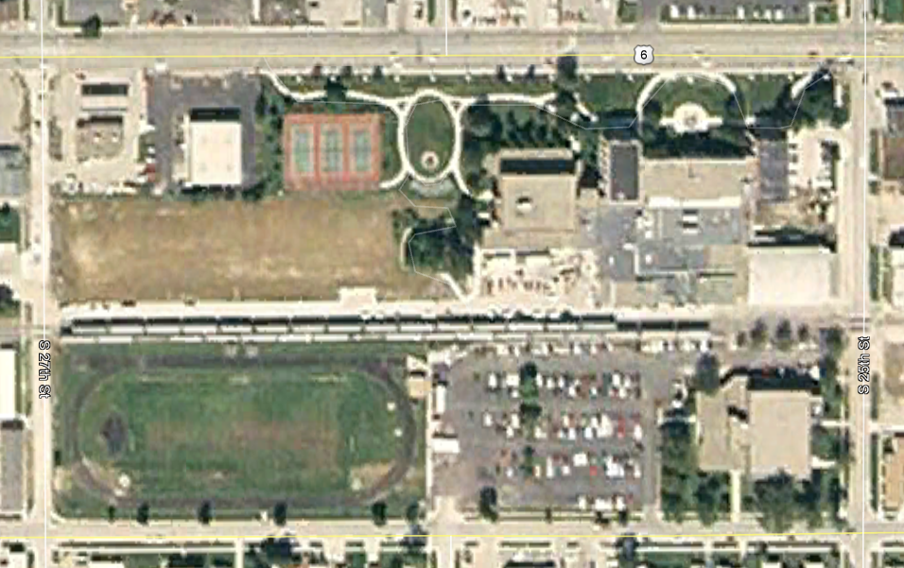
1st Avenue
Former railroad; tracks removed
1 block south of W. Broadway
66’ wide
1.8 miles from 16th to 35th
City-owned ROW
2006 Aerial

Slide 15
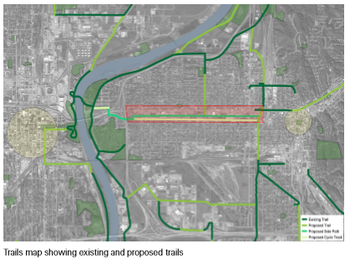
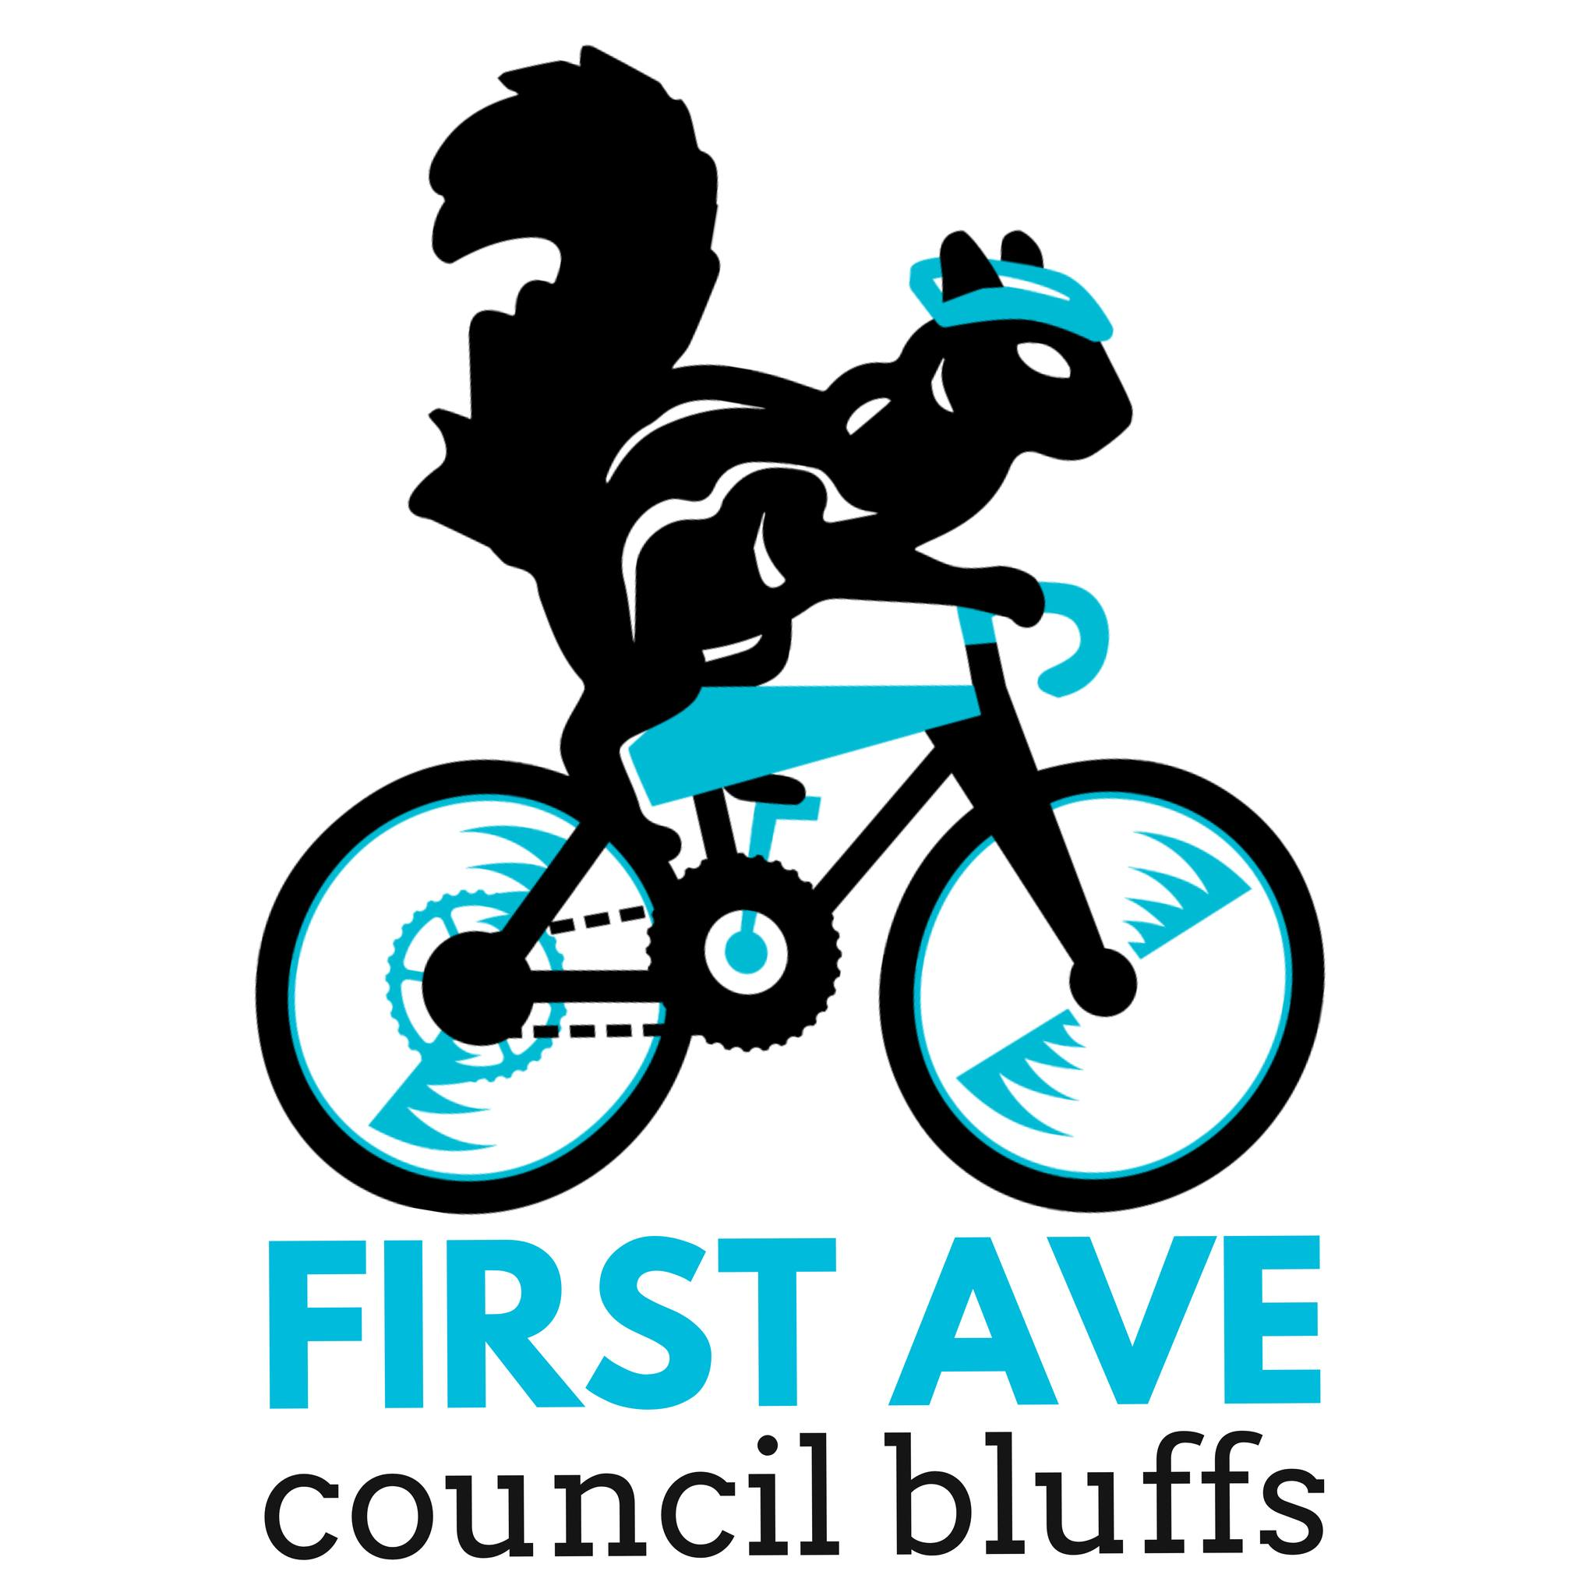
Big Picture: Connections
Bike trails
Bike lanes

Slide 16
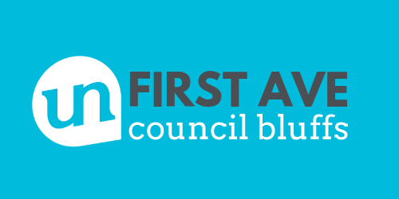
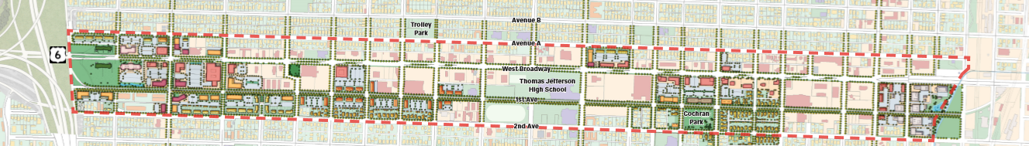
It’s more than a trail

Slide 17
Furthering
Interconnections,
Revitalization,
Streetscapes,
Transportation, and
Aesthetics for a
Vibrant
Economy

Slide 18
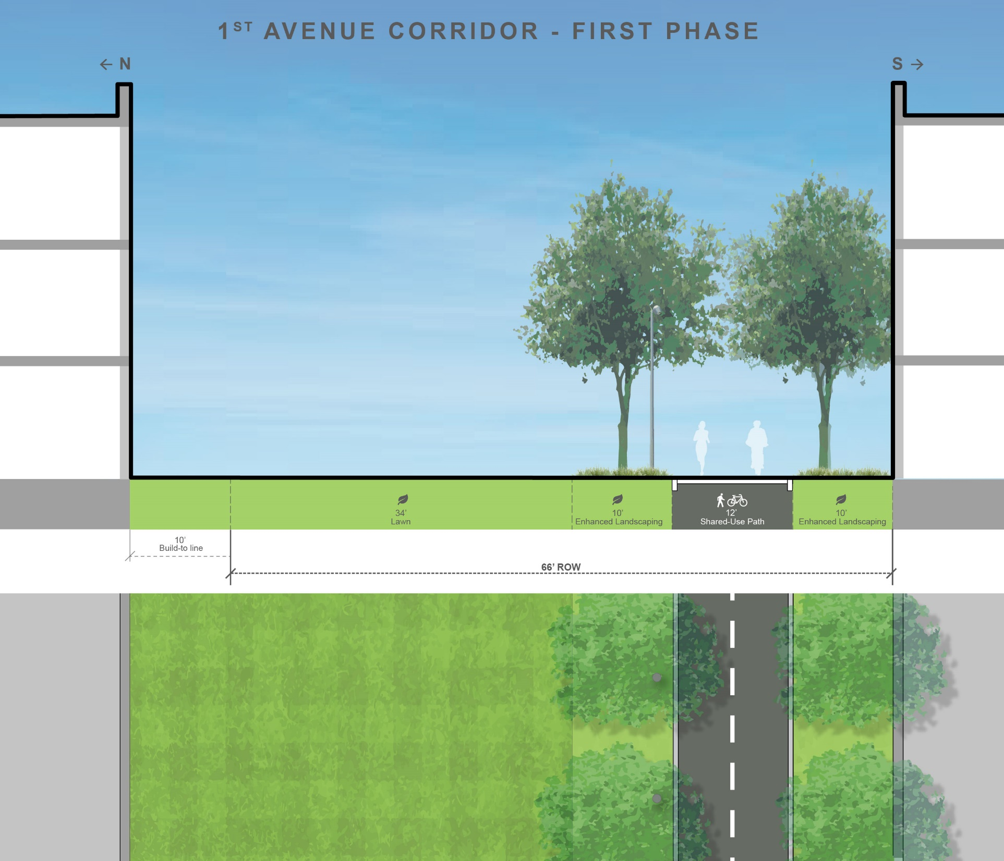
A Multi-Use Trail
Trail Concept
Offset to south side

Slide 19
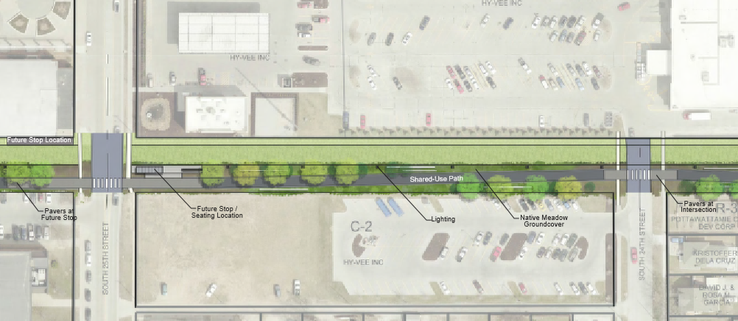
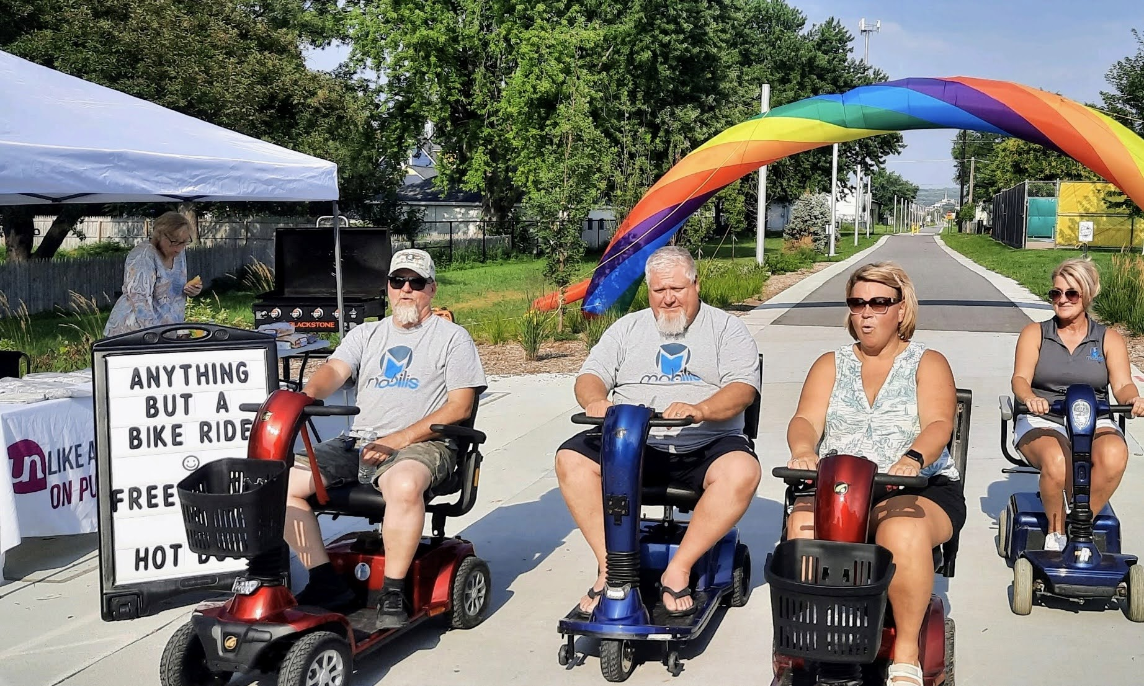
Trail Concept

Slide 20
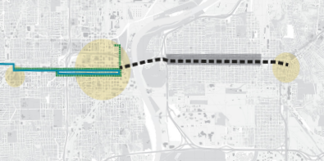
Big Picture: Connections
Bike trails
Bike lanes
Future transit?

Slide 21
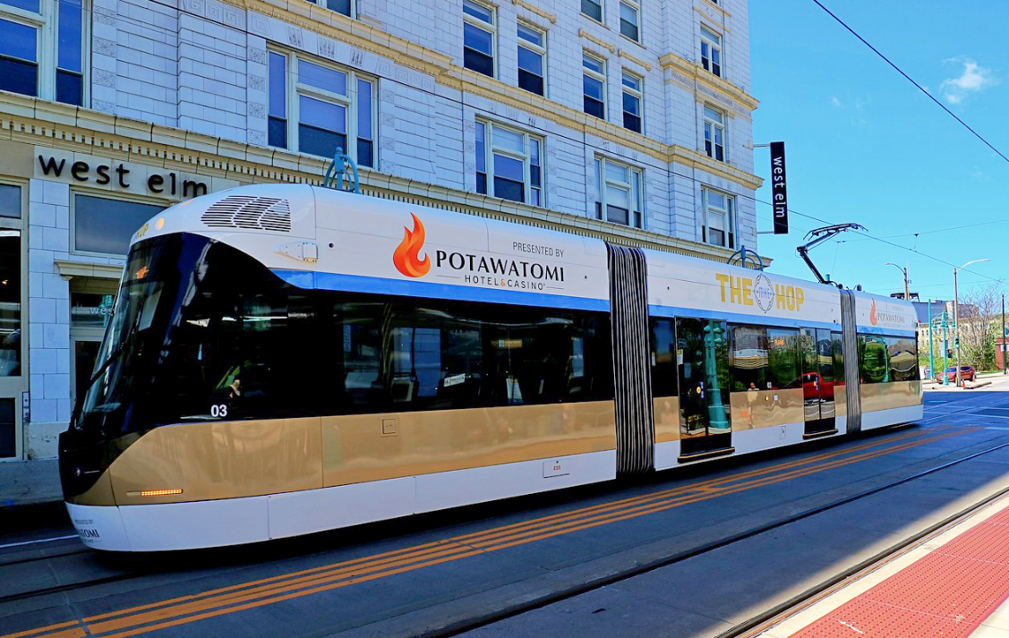
What is a Streetcar?
Modern Streetcar a.k.a. Tram
Can operate either within mixed traffic or dedicated lanes
Slower speeds, more frequent stops (about every 3-6 blocks)

Slide 22
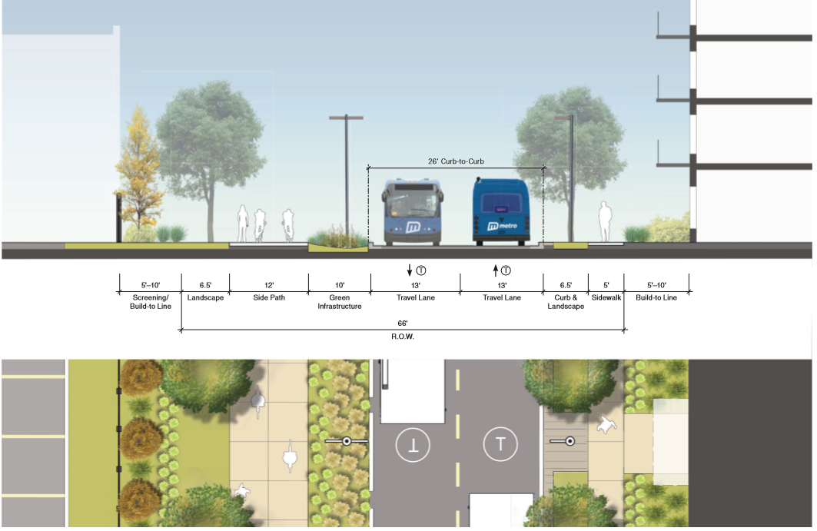
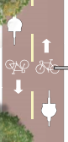
A Multi-Modal Corridor
2015 West Broadway Master Plan
1st Avenue

Slide 23
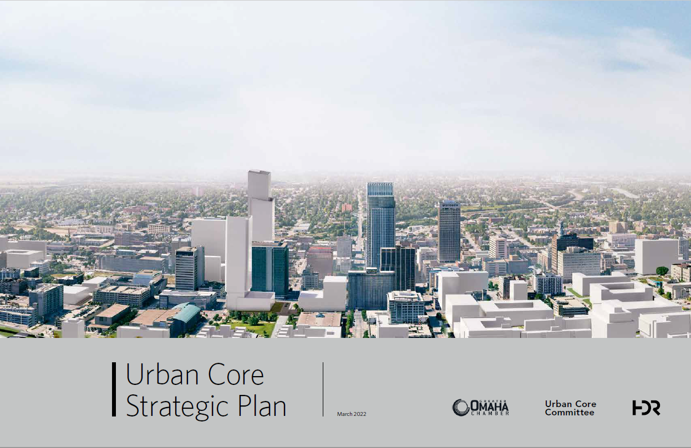
Omaha-Council Bluffs Urban Core

Slide 24
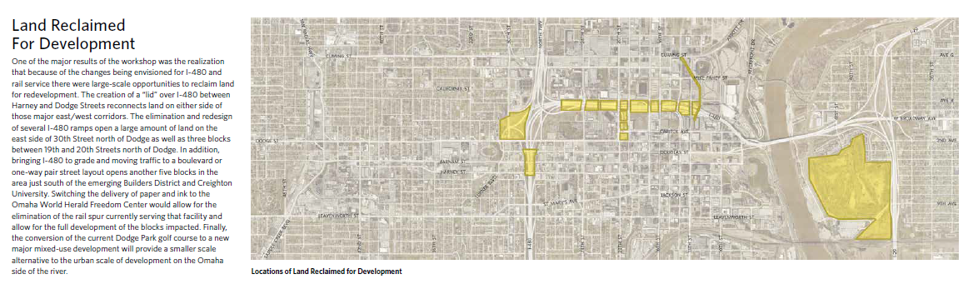
Omaha-Council Bluffs Urban Core
Dodge Park Golf Course is the single largest development opportunity in the Urban Core

Slide 25
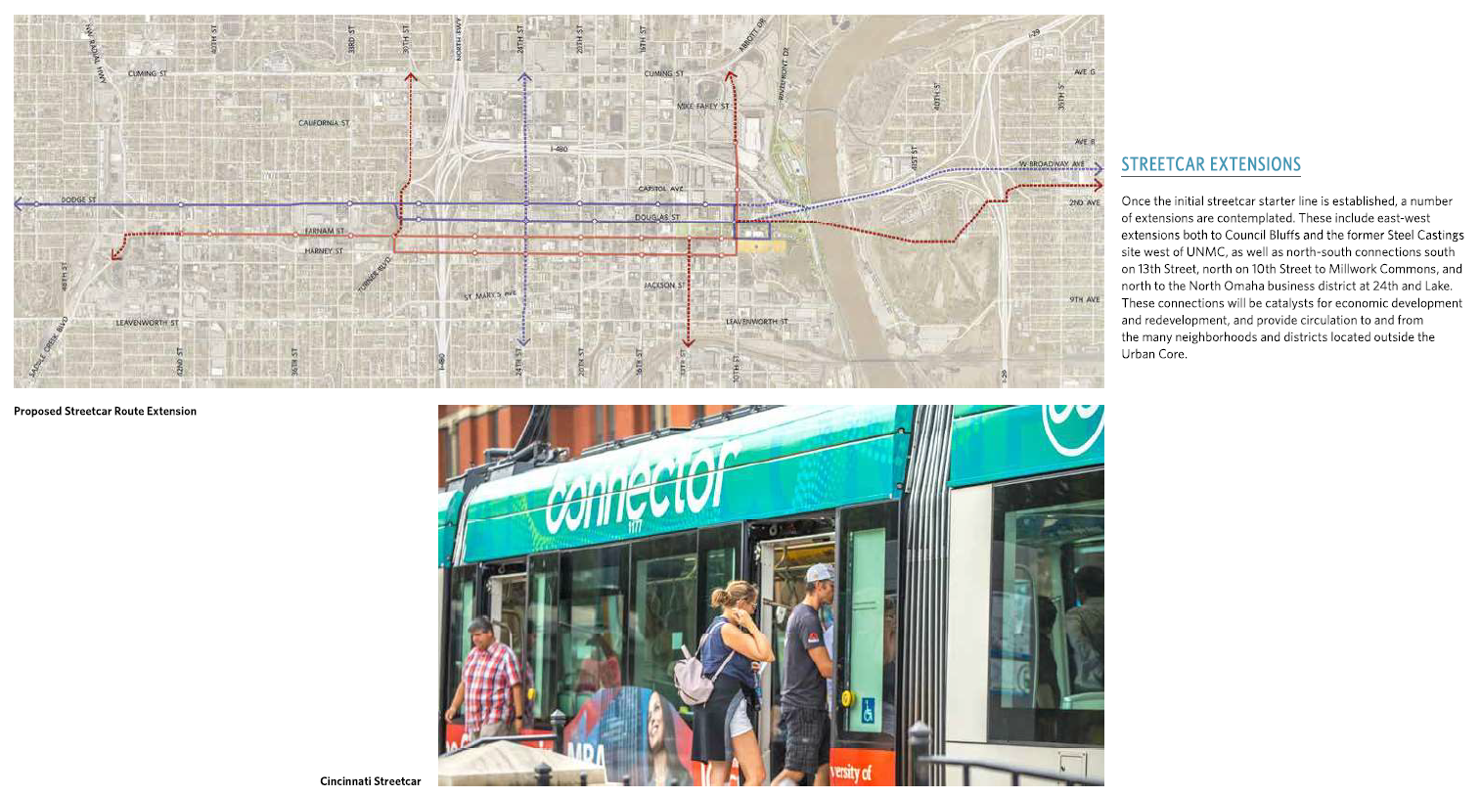
Omaha-Council Bluffs Urban Core
Modern Streetcar

Slide 26
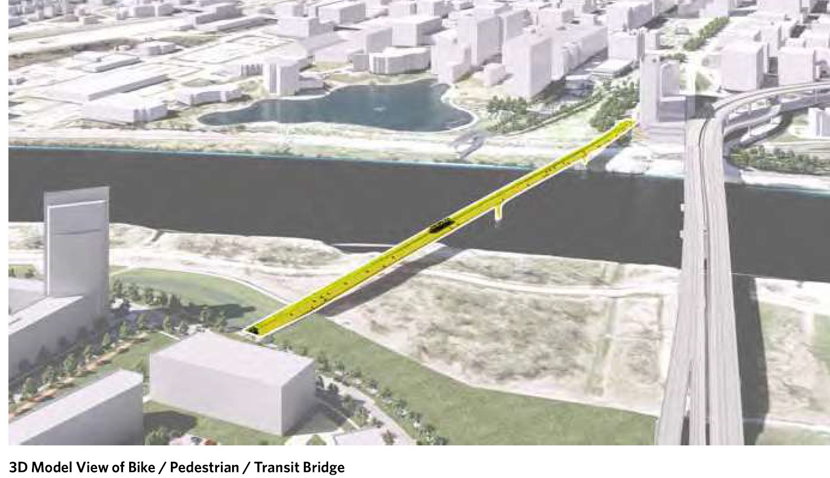
Omaha-Council Bluffs Urban Core
Multi-Modal Bridge
Looking west

Slide 27
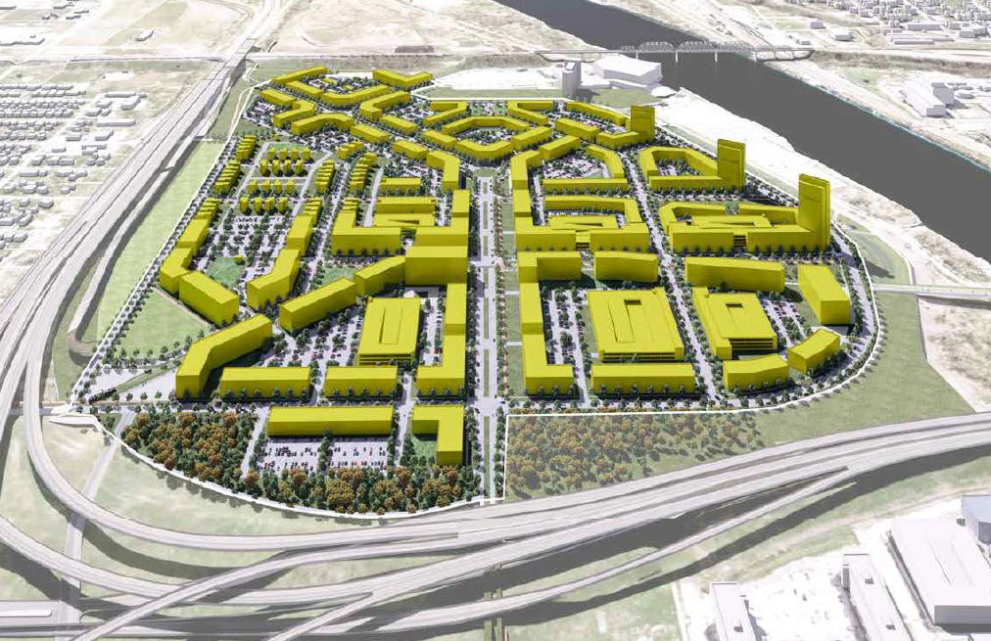
Omaha-Council Bluffs Urban Core
Dodge Park Golf Course Redevelopment
Looking south

Slide 28
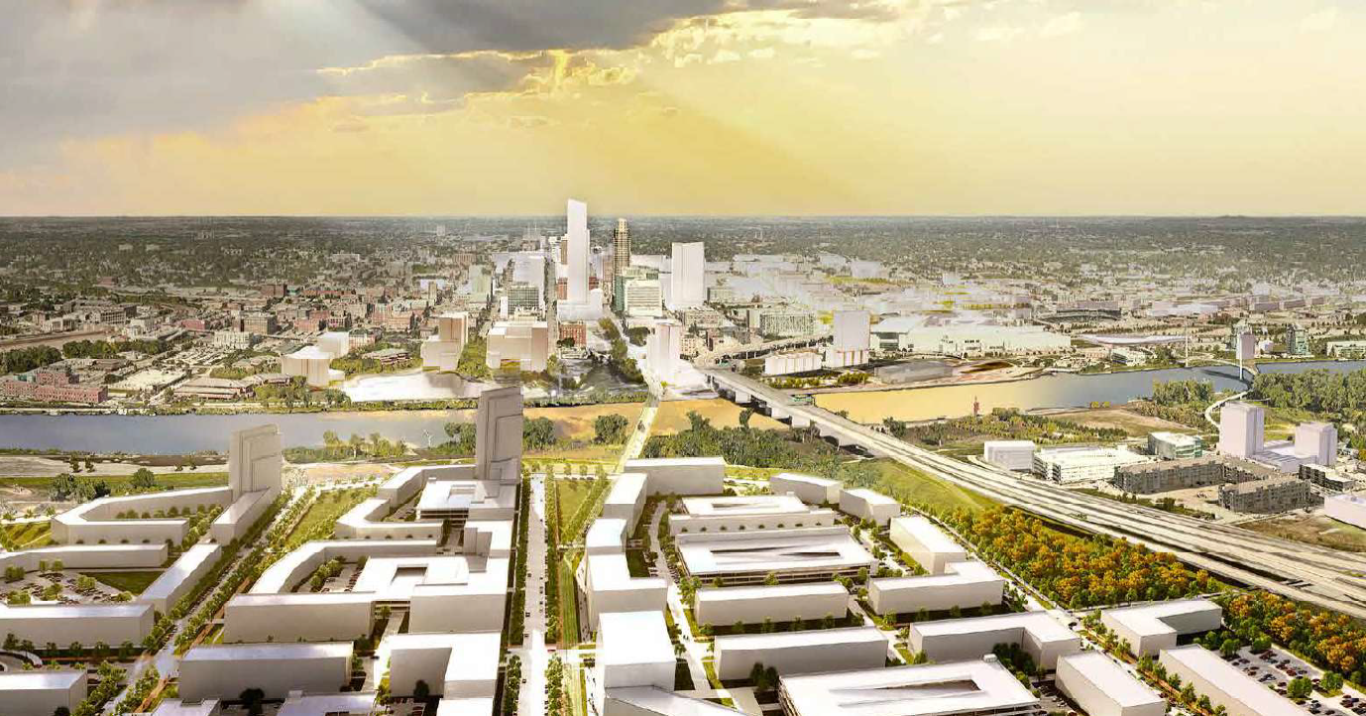
Omaha-Council Bluffs Urban Core
Dodge Park Golf Course Redevelopment
Looking west

Slide 29
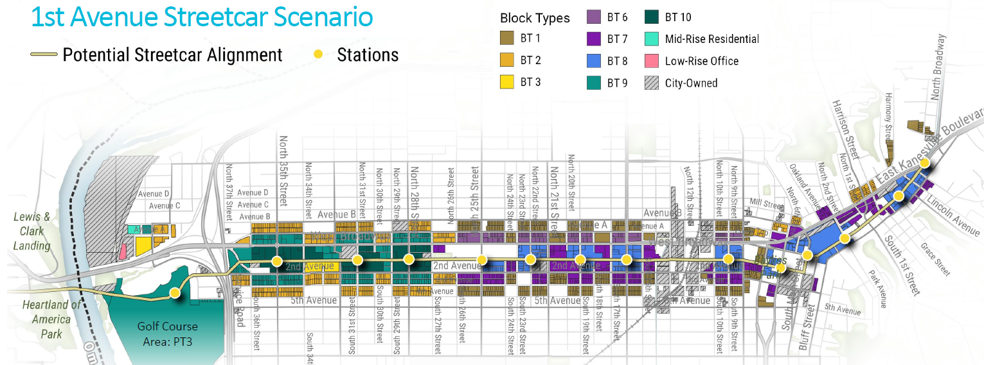
Transit Alternatives Analysis

Slide 31
A Multi-Modal Corridor
Multi-use Trail is complete

Slide 32
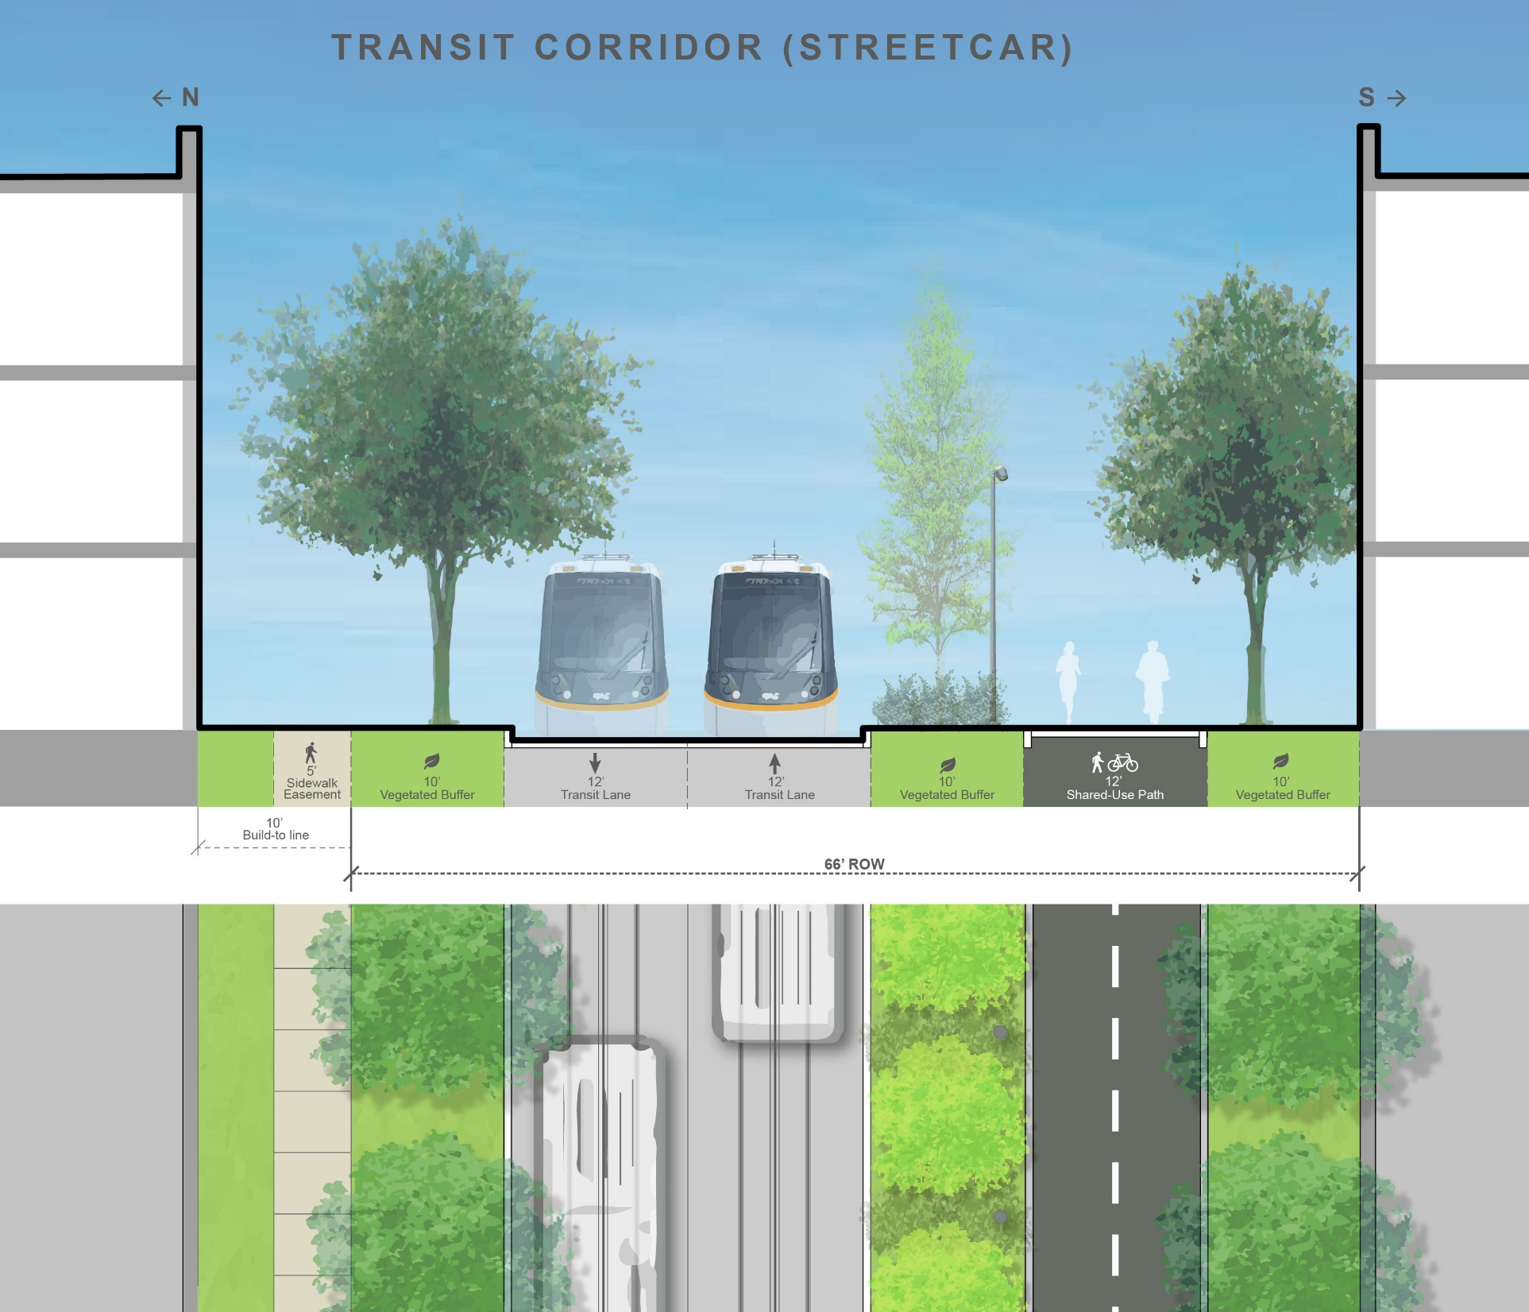
A Multi-Modal Corridor
Concept with future transit

Slide 33
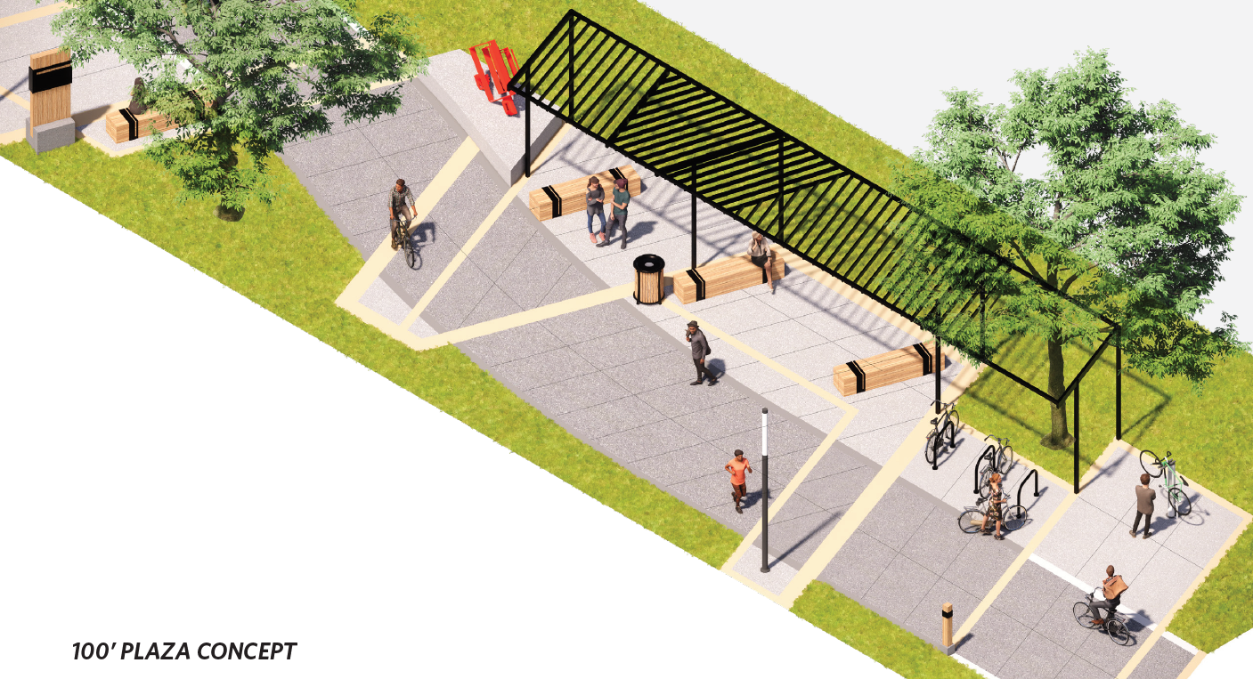
Plazas Convert to Transit Stops (every 3-4 blocks—6 total)

Slide 34
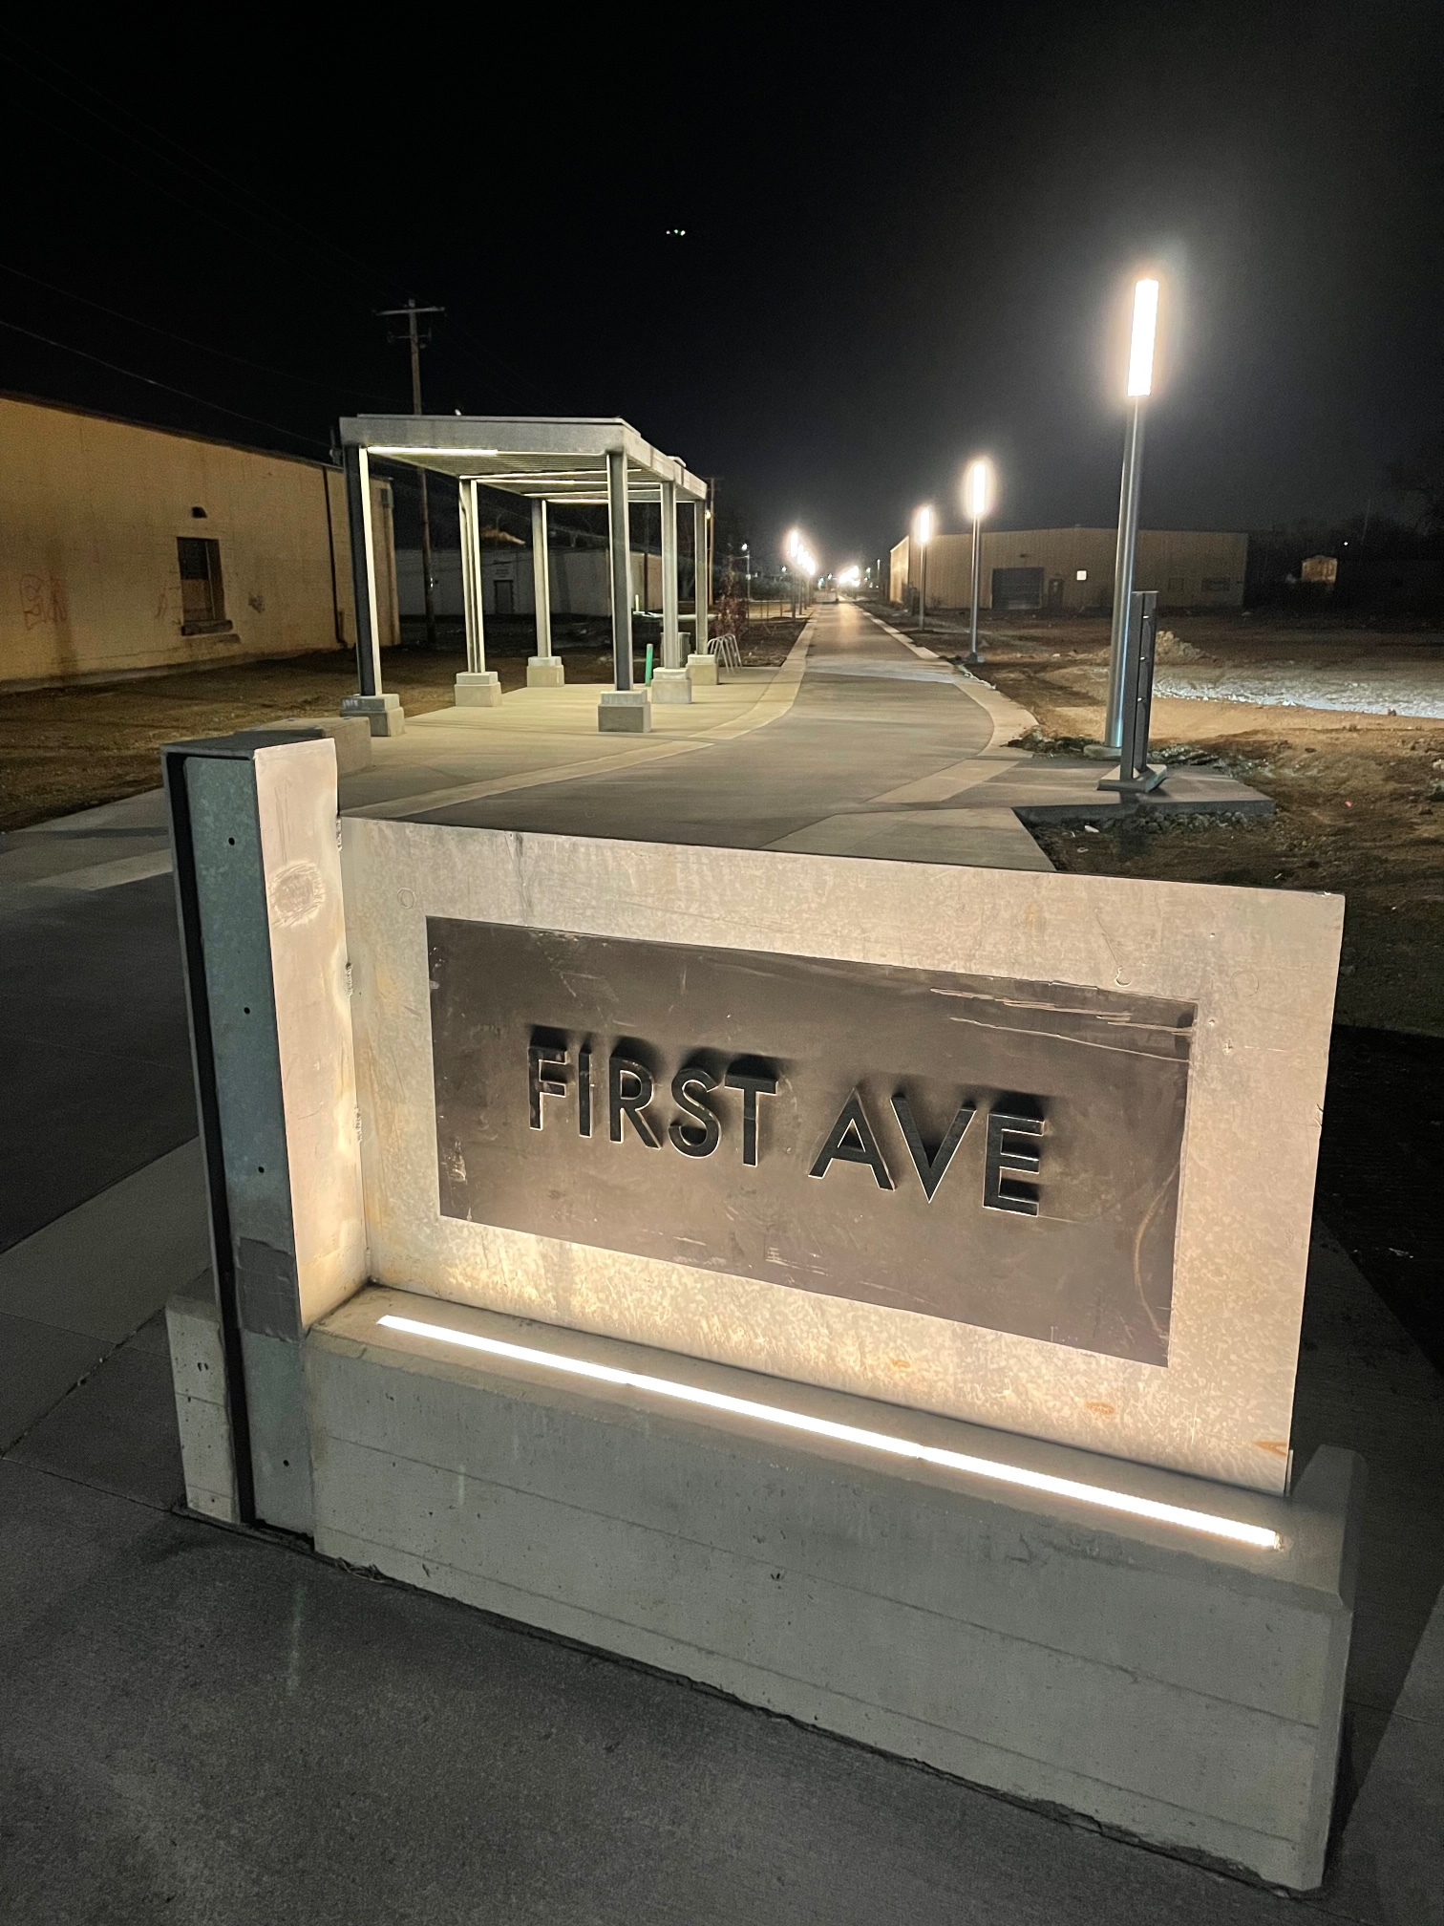
Trail Plazas Convert to Transit Stops

Slide 35
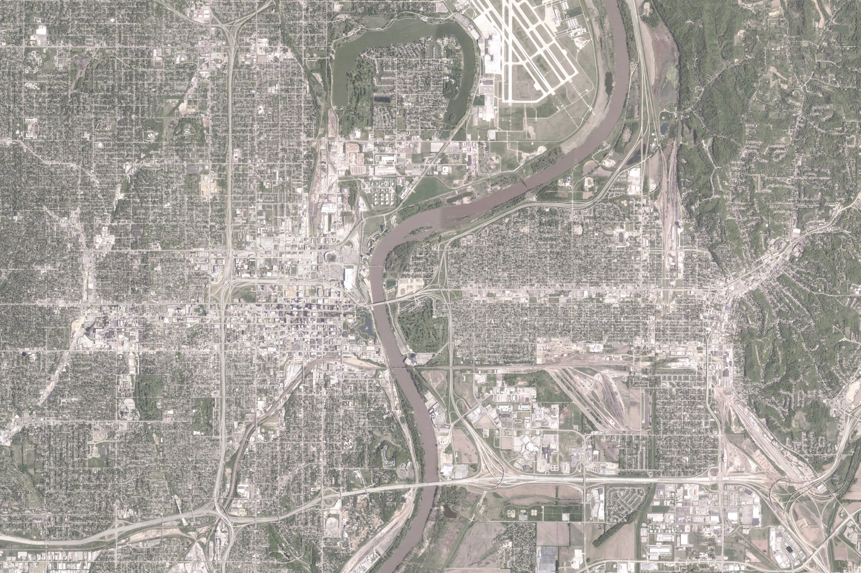
Big Picture: A Connected Metro Core

Slide 36
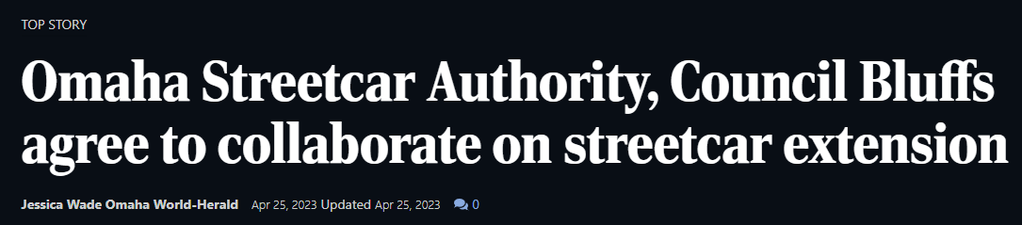
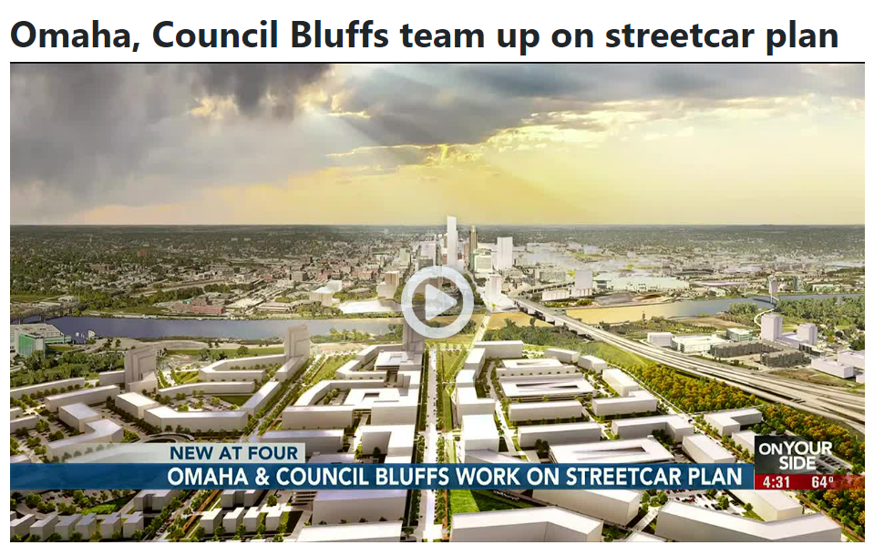
Next Steps
Quadrilateral agreement with City of Council Bluffs, City of Omaha, Metro Transit, and the Omaha Streetcar Authority-DONE!
Easement agreement with CB Community School District
A Planning & Environmental Linkages study for the FTA
Financial Plan for operations

Slide 37
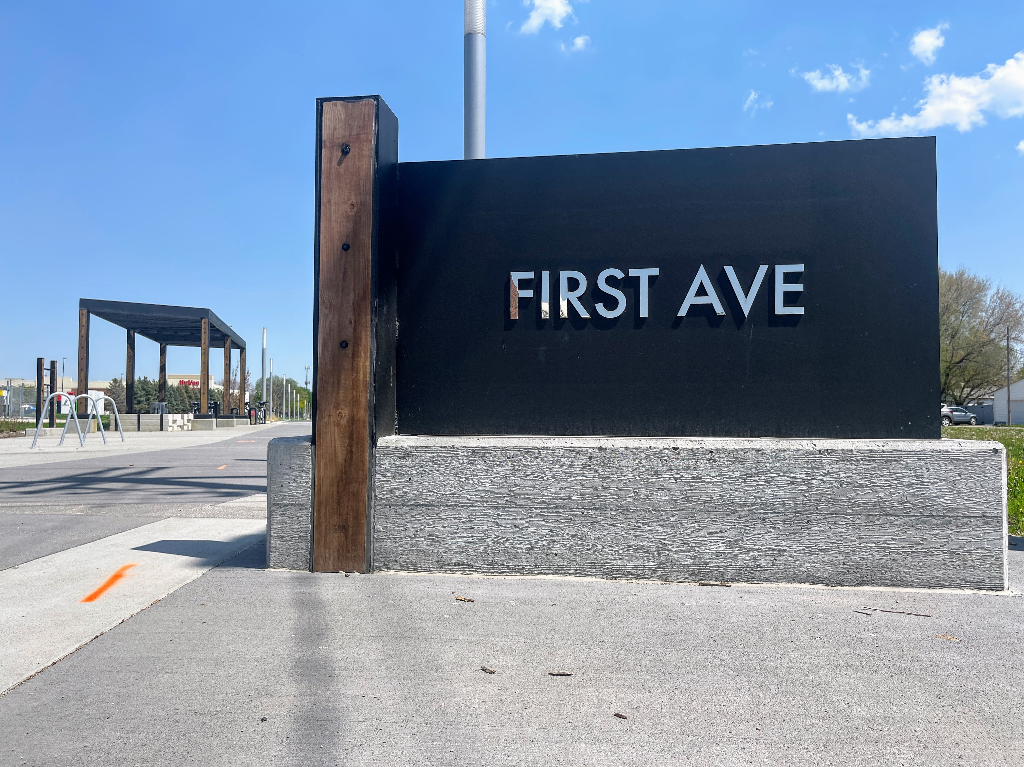
FIRSTAVECB.com

Slide 38
Please contact me if you would like more information:
Brandon Garrett, Chief of Staff
712-890-5268
bgarrett@councilbluffs-ia.gov

