Slide 1
Southwest Iowa Planning Council
And
Southwest Iowa Transit Agency

Slide 2
SWIPCO is governed by a 17-member Policy Council, which includes one supervisor from each county board, six citizens who are appointed by the county boards, and three at-large members that are selected by the Policy Council. These members represent business, education, human services, economic development, etc.
The Policy Council is designed to provide a strong communication link between SWIPCO and the residents of Southwest Iowa. This channel of communication and the support of our member governments helps to keep SWIPCO aware and responsive to our members’ needs and concerns.
Current SWIPCO Policy Council Members
Todd Valline, Chair, At-Large, Shelby
Charles Parkhurst, Past Chair, Shelby
Sherman Struble, Secretary, Harrison
Terry Arentson, Shelby Richard Crouch, Mills
Chris Clark, Fremont Susan Shepherd, Fremont
Steve Green, Cass Grace Garrett, Cass
AJ Lyman, Page Todd Maher, Page
John Straight, Harrison Susan Miller, Pottawattamie
Donna Robinson, Montgomery Jenna Ramsey, Montgomery
Joe George, At-Large, Mills Fran Branan, At-Large, Pottawattamie

Slide 3

Transit
Southwest Iowa Transit Agency (SWITA) is Southwest Iowa’s public transportation system! Transportation is available for all residents in Cass, Fremont, Harrison, Mills, Montgomery, Page, Pottawattamie, and Shelby Counties. SWITA has a variety of services to meet the transportation needs of area residents.
Student Transportation- Rides to and from preschool or school is available to students who live in town and are not served by their school bus system in Atlantic, Glenwood, Harlan, and Red Oak. $1.50 per ride per child and all rides are open to the public.
Work Routes- SWITA provides round trip transportation to employees of OSI from Omaha, Council Bluffs, and Atlantic to Oakland seven days a week. Round trip transportation for employees of Monogram Foods in Harlan is available from Omaha, Council Bluffs, and Atlantic. SWITA has also partnered with Commute with Enterprise to support vanpool options in the region as well.
Taxi- SWITA offers taxi services in Atlantic, Glenwood, Harlan, Missouri Valley, Red Oak, and Shenandoah. This offers residents of those communities a quick, affordable option to get where they need to go within the community.

Slide 4
Medical Transportation- SWITA offers medical transportation services for seniors, dependents, clients, or anyone else who needs a medical related ride. People with disabilities and mobility issues are welcome and accommodated. Medical trips can sometimes be funded through support services or insurance, otherwise can be billed at an hourly rate.
Special Trips- Subject to driver and bus availability special trips can be booked through SWITA to get wherever you need to go in the region. Cost is $40 per hour for non-medical transportation.
Find out details about our services, make payments, and sign up for programs on our website www.swita.com

Slide 5
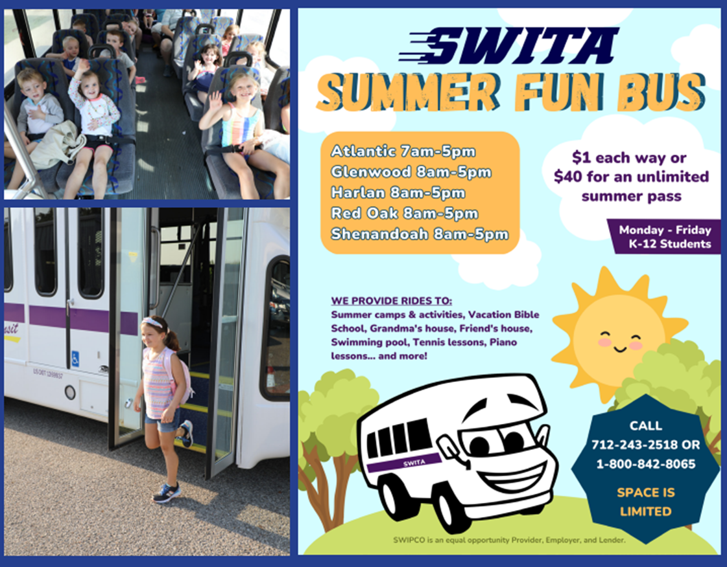

Slide 8
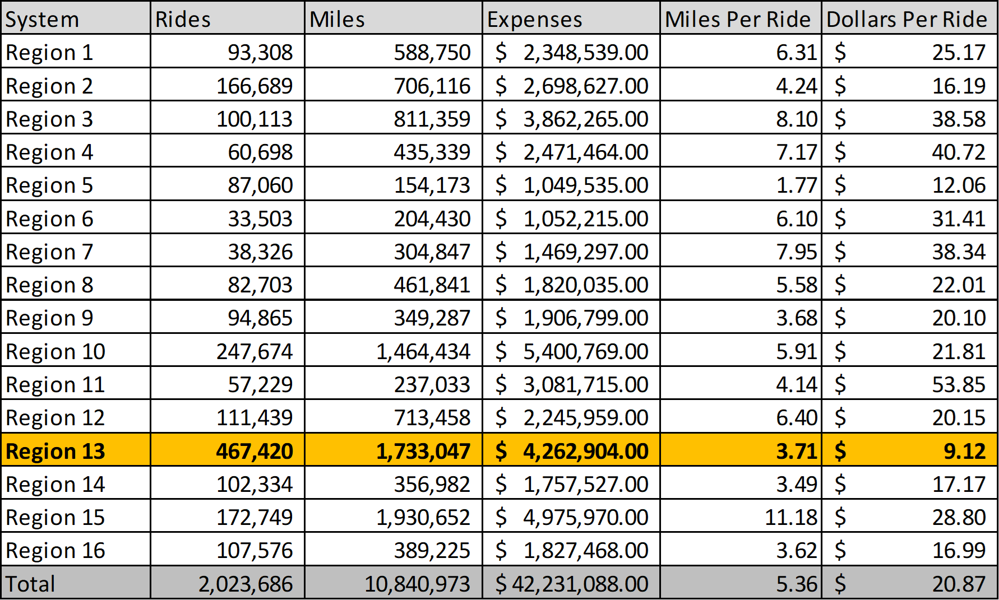

Slide 9



