Slide 1
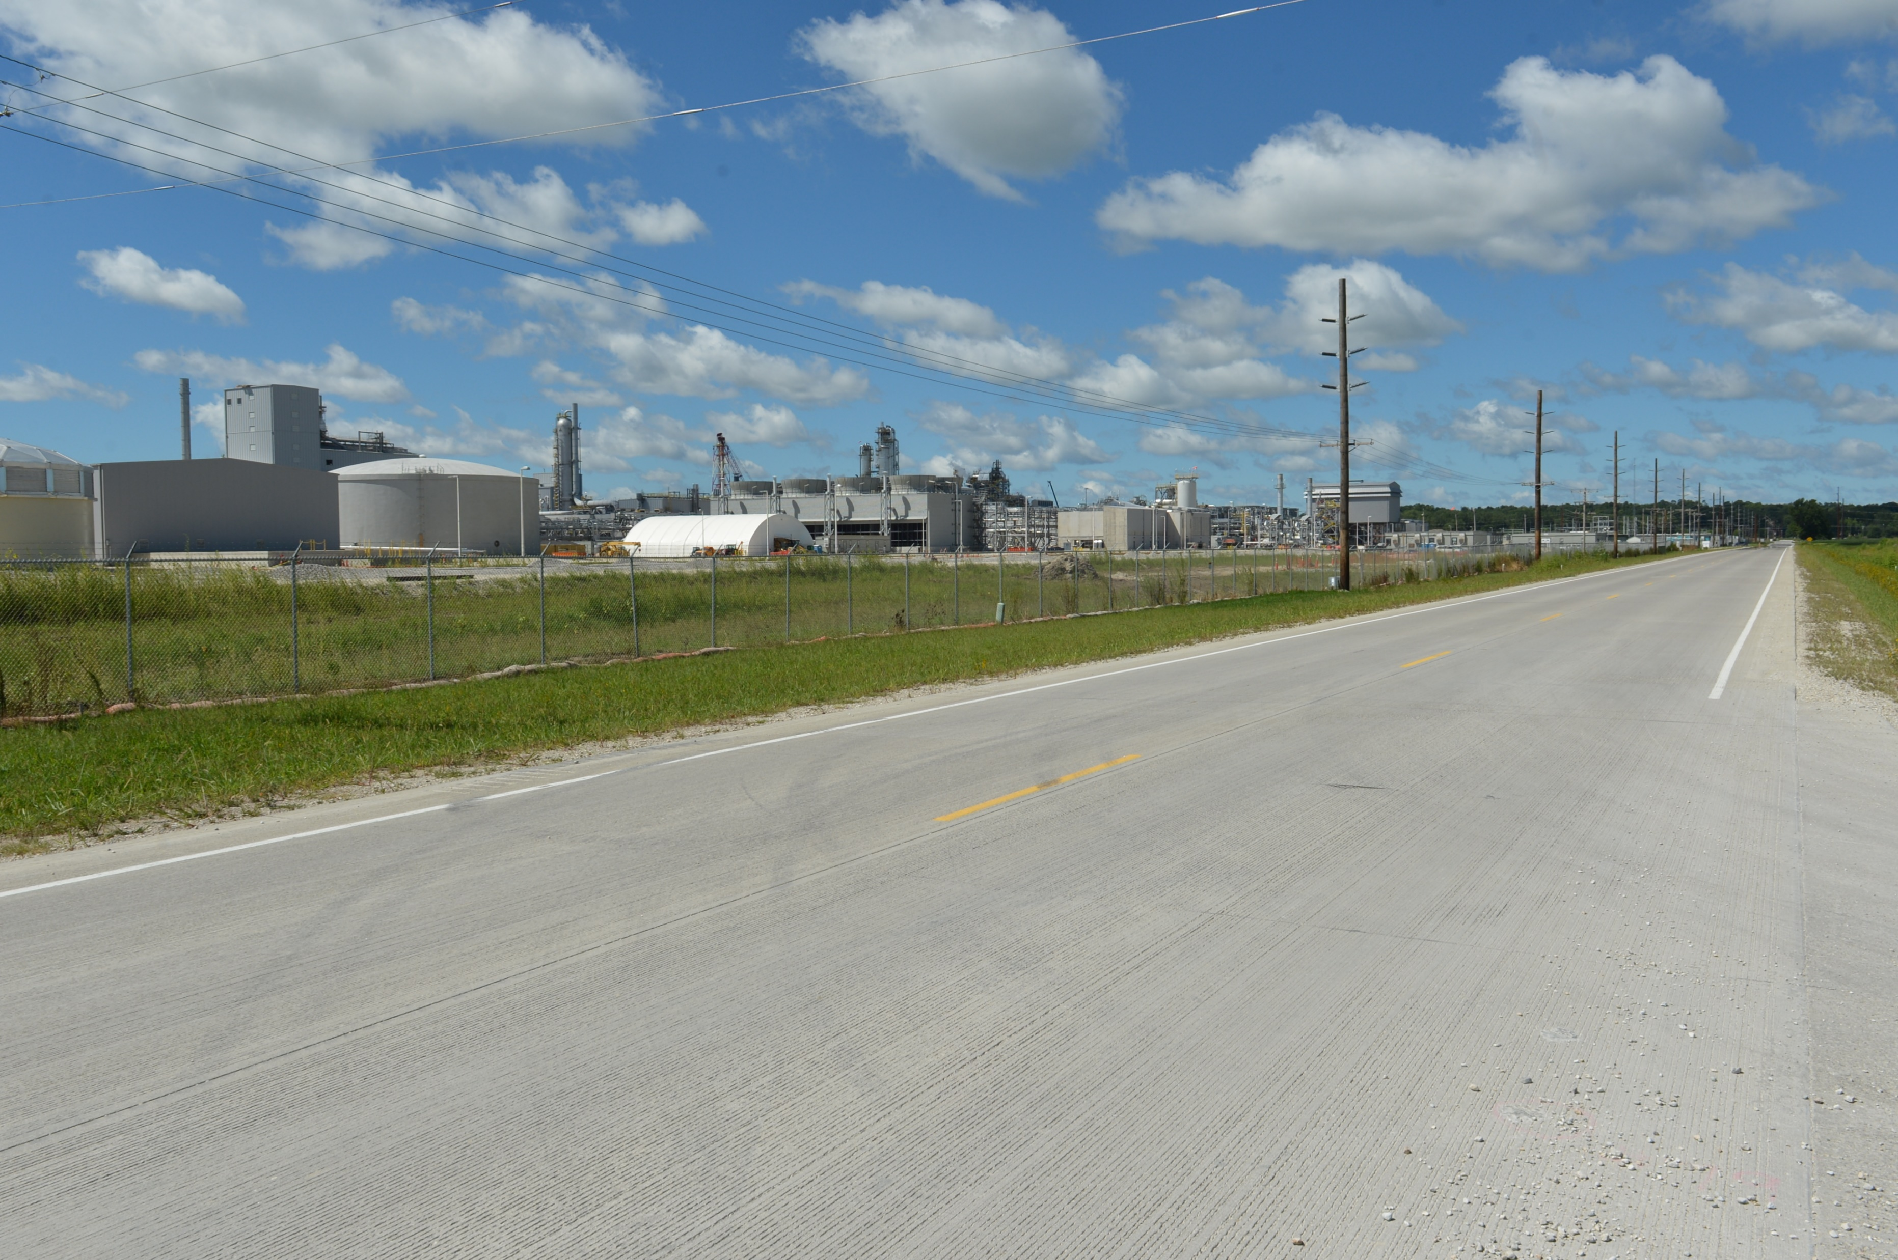
Revitalize Iowa’s Sound Economy Program
Funding Recommendation
Debra Arp
Grant Program Administration Team Lead
6/11/2024

Slide 2
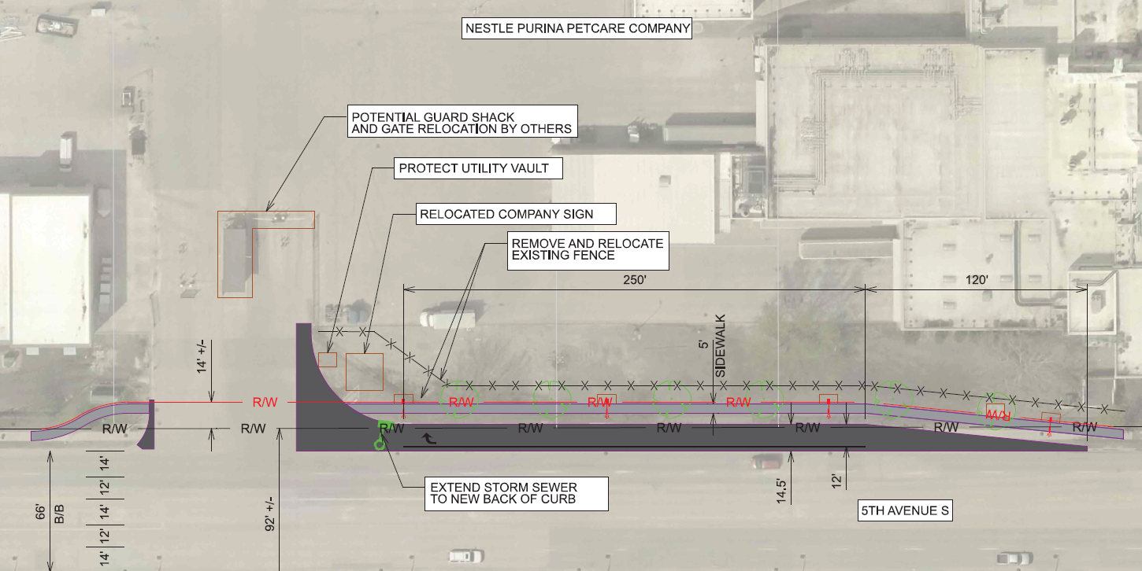
Immediate Opportunity Recommendation
PROJECT | SPONSOR | JOBS | TOTAL PROJECT COST | PERCENT PARTICIPATION | RECOMMENDED AMOUNT
Construction of a right turn lane on 5th Avenue South providing improved access to Nestle Purina PetCare Company | Fort Dodge | 29 | $430,563 | 80% | $344,450
2
2

