Slide 1
MAPA & RPA-18 Updates
Iowa DOT Transportation Commission
Michael Helgerson
Executive Director
June 2024

Slide 2
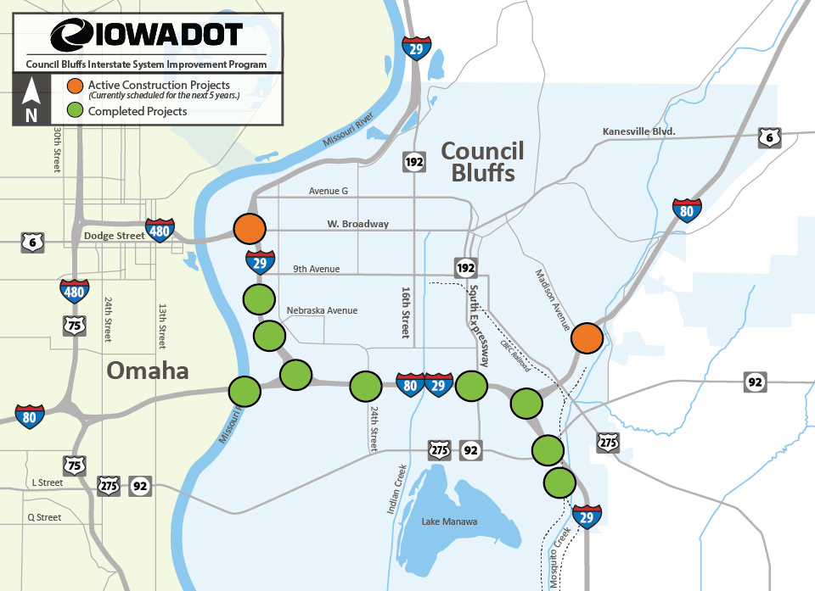
Council Bluffs Interstate System (CBIS)

Slide 3
Council Bluffs Interstate System
I-29/I-480/W Broadway Interchange

Slide 5
Project Purpose & Need
Reasonable Alternatives
Operations & Financial Plans
Final Report & Questionnaire
Missouri River Multimodal Bridge
Planning & Environmental Linkages Study

Slide 6
Missouri River Multimodal Bridge
FIRST AVE Multimodal Corridor

Slide 7
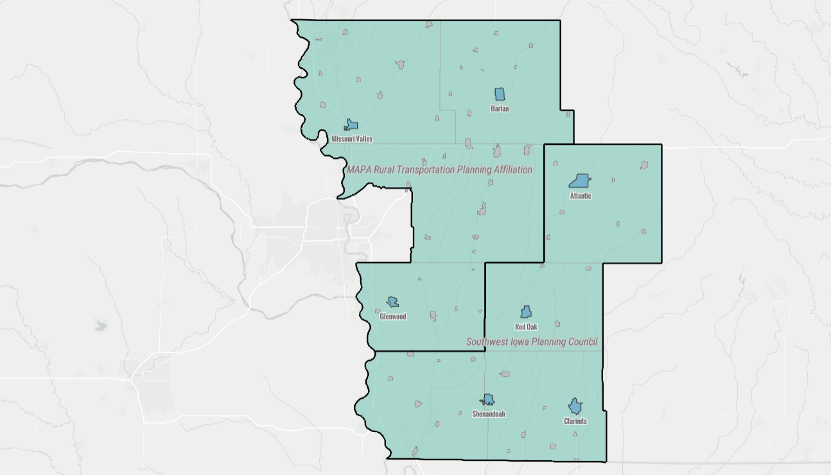
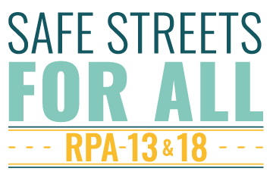
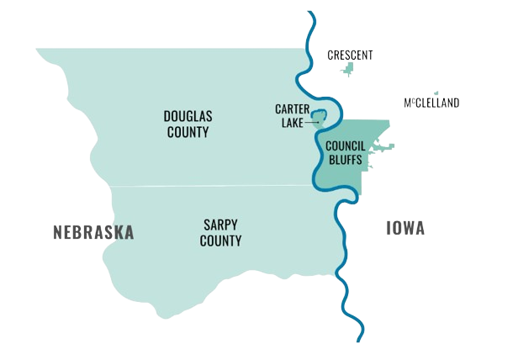

Slide 8
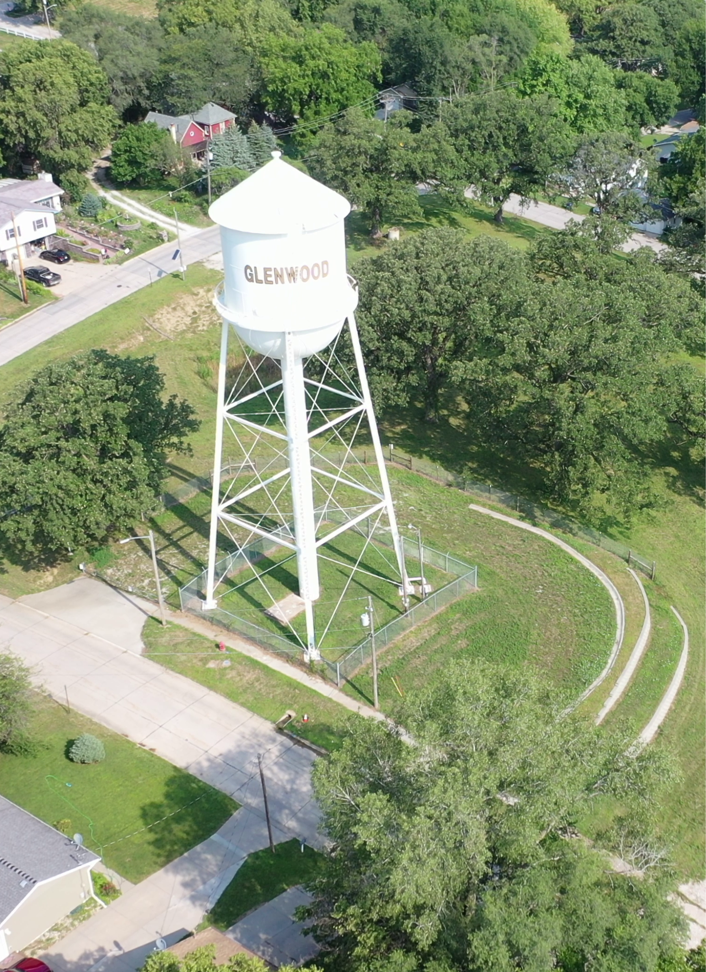
RPA-18 2045 Long Range Transportation Plan
Preservation | Maintain existing assets
Safety | Invest in enhanced safety of transportation system
Economic | Transportation facilities that promote economic development
Environment | Balance investment in all modes and protect the environment
Transportation Options | Enhance connectivity between modes & choices available to residents in the region
Land Use and Growth | Support coordinated, compact development

Slide 9
Thank You!
Michael Helgerson
Executive Director
mhelgerson@mapacog.org
402-444-6866 x3224

