Slide 1
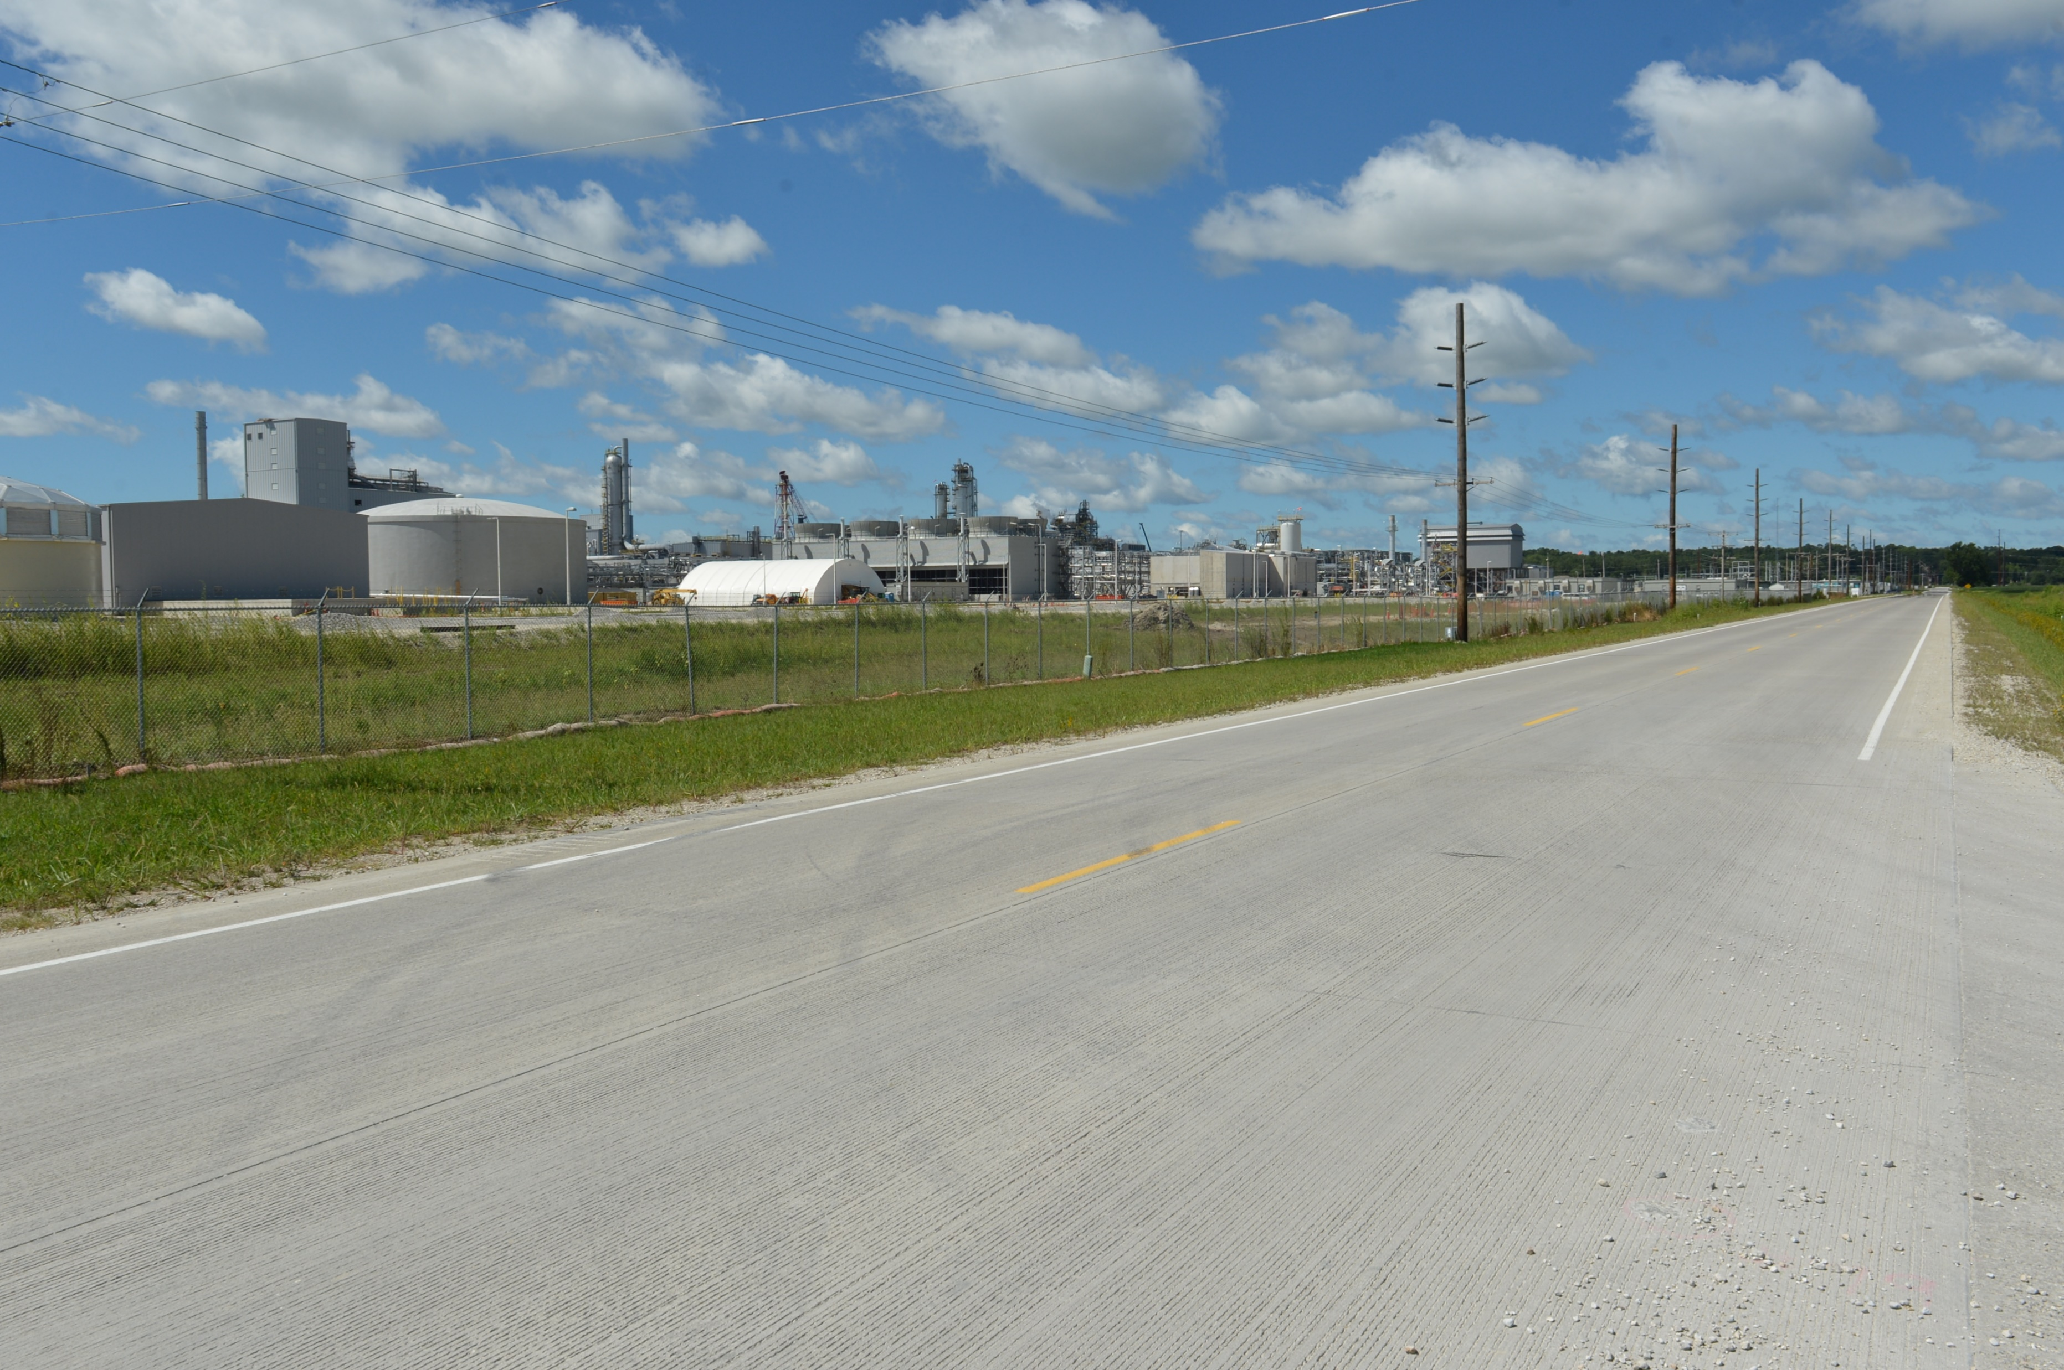
Revitalize Iowa’s Sound Economy Program
Funding Recommendation
Debra Arp
Grant Program Administration Team Lead
6/10/2024

Slide 2
Revitalize Iowa’s Sound Economy Program
Created in 1985
Purpose: To promote economic development through roadway improvements
Eligible development shall have value-adding activities that feed new dollars into the economy
Available to cities and counties through an application program
2
2

Slide 3
Monthly Program Financial Report
Funded annually with dedicated state motor fuel and special fuel tax revenues
 | City RISE Fund | County RISE Fund
FY2024 Projected Total RISE Road Use Tax Fund (RUTF) Revenue ¹ | $11,759,666 | $5,879,833
Actual RISE Revenue Received as of 4/30/2024 ² (% of FY2024 Projected Revenue) | $10,084,395 (85.8%) | $4,893,074 (83.2%)
FY2024 RISE Funds Awarded as of 4/30/2024 (% of Projected Total RUTF committed) | $8,932,847 (76%) | $0 (0%)
Fund Balance as of 4/30/2024 | $53,159,929 | $20,112,140
Outstanding Commitments as of 4/30/2024 | ($41,108,657) | ($17,254,473)
Uncommitted Balance as of 4/30/2024 | $12,051,272 | $2,857,667
¹ Calculation based on FY2023 average monthly RISE RUTF revenue of $979,972 to the city RISE fund and $489,986 to the county RISE fund. As of 4/30/2024, FY2024 is 83.3% complete.
² Actual RISE revenue includes RUTF revenue, loan repayments, and project settlements. These revenue sources are variable and are not included in projections.
3
3

Slide 4
Immediate Opportunity Project Evaluation
Job Creation and/or Retention | Economic Development Assisted
Quality of jobs | Diversifies Iowa’s economy
Potential for future job growth | Few in-state competitors
Hiring Iowa residents | Higher proportion of in-state suppliers
Average wages 100% of laborshed rate | Higher proportion of out-of-state sales
 | Import substitution
 | No pattern of violations
4
4

Slide 5
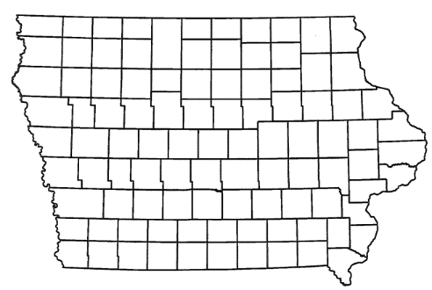
Immediate Opportunity Recommendation
PROJECT | SPONSOR | JOBS | TOTAL PROJECT COST | PERCENT PARTICIPATION | RECOMMENDED AMOUNT
Construction of a right turn lane on 5th Avenue South providing improved access to Nestle Purina PetCare Company | Fort Dodge | 29 | $430,563 | 80% | $344,450
5
5

Slide 6
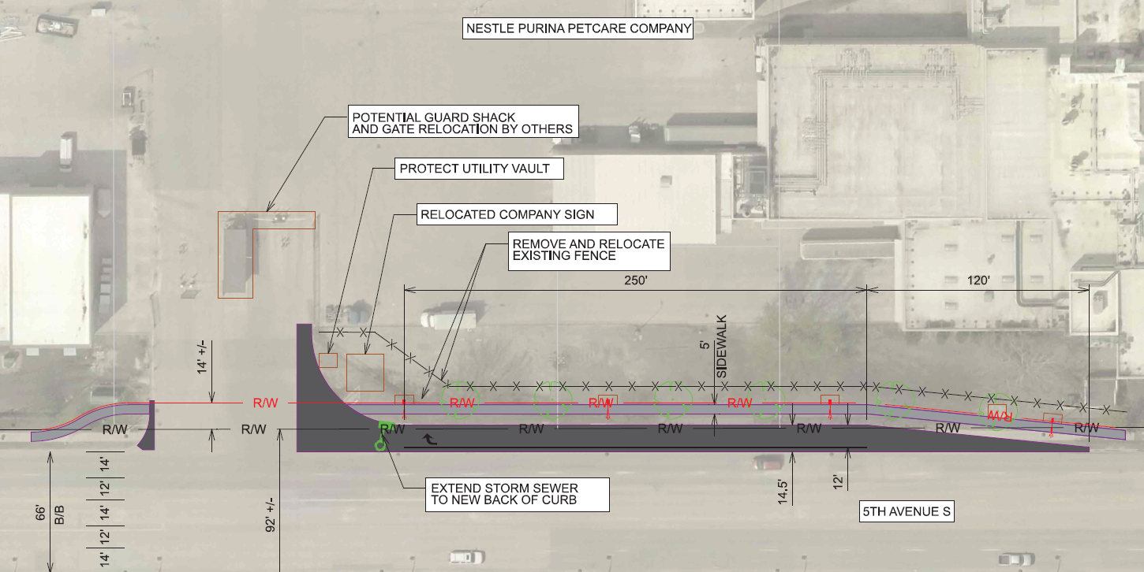
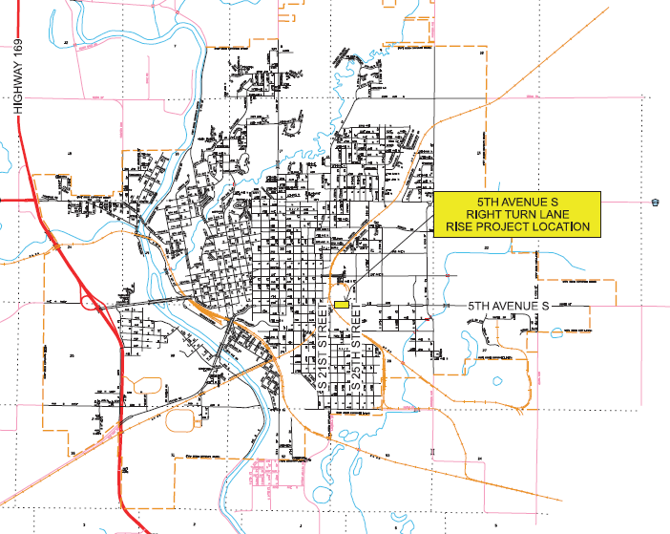
Fort Dodge
Immediate Opportunity
Construction of a right turn lane on 5th Avenue South located on the southeast side of town providing improved access to Nestle Purina PetCare Company in support of a plant expansion.
Total Cost: $430,563
Requested: $344,450 (80%)
Jobs Committed: 29
RISE Cost/Job Assisted: $11,878
Capital Investment/RISE: $508.31
Ave Wage of Committed Jobs: $27.00
Percent of Laborshed Wage: 124%
6

Slide 7
Questions?
jennifer.kolacia@iowadot.us
515-239-1738

