Slide 1
Revitalize Iowa’s Sound Economy Program

Slide 2
Proposed RISE Cost Per Job Increase
Maximum RISE Cost Per Job was set at $12,000 in April 2015 for projects with high capital investment and/or high quality wage rates/benefits that exceed normal applications
Highway Construction Cost Index from 2017-2018 increased by 7.9%
No change recommended

Slide 3
Revitalize Iowa’s Sound Economy Program
Created in 1985
Purpose: To promote economic development through roadway improvements.
Eligible development shall have value-adding activities that feed new dollars into the economy
Available to cities and counties through an application program

Slide 4
Available Funding and Application Summary
Available Funding
Funded annually with dedicated state motor fuel and special fuel tax revenues
Application Summary for SFY2019
Total number of projects awarded: 6
Total project costs: $8,501,342
Total amount awarded: $5,021,017
 | CITY | COUNTY
Average funding generated monthly | $997,556 | $498,778
SFY 2019 current Road Use Tax Revenue (as of 2/4/2019) | $7,025,907.04 | $3,512,953.53
Current Unobligated Balance (as of 2/4/2019) | $12,901,621.01 | $3,615,312.45

Slide 5
Local Development Project Evaluation Criteria
Development Potential (35 points)
Economic impact and Cost Effectiveness (20 points)
Local Commitment and Initiative (33 points)
Transportation Need and Justification (4 points)
Local Economic Need (6 points)

Slide 6
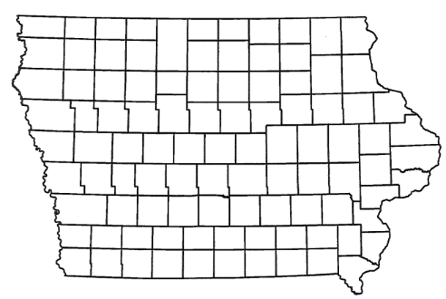
List of Local Development Applications Recommended
PROJECT NAME
SPONSOR
SCORE
TOTAL PROJECT COST
PERCENT PARTICIPATION
RECOMMENDED AMOUNT
Construction of approximately 1,150 feet of Lone Tree Road. | Waterloo | 47 | $766,720 | 50% | $383,360

Slide 7
Waterloo
(Local Development)
Construction of approximately 1,150 feet of Lone Tree Road. This project is necessary to provide access to five lots totaling more than 38 acres for light industrial and manufacturing purposes.
Total Cost: $766,720
Requested: $383,360 (50%)

Slide 8
Bettendorf
(Local Development February 2018 round)

Slide 9
Clear Lake
(Local Development February 2018 round)

Slide 10
Polk County
(Local Development February 2018 round)

Slide 11
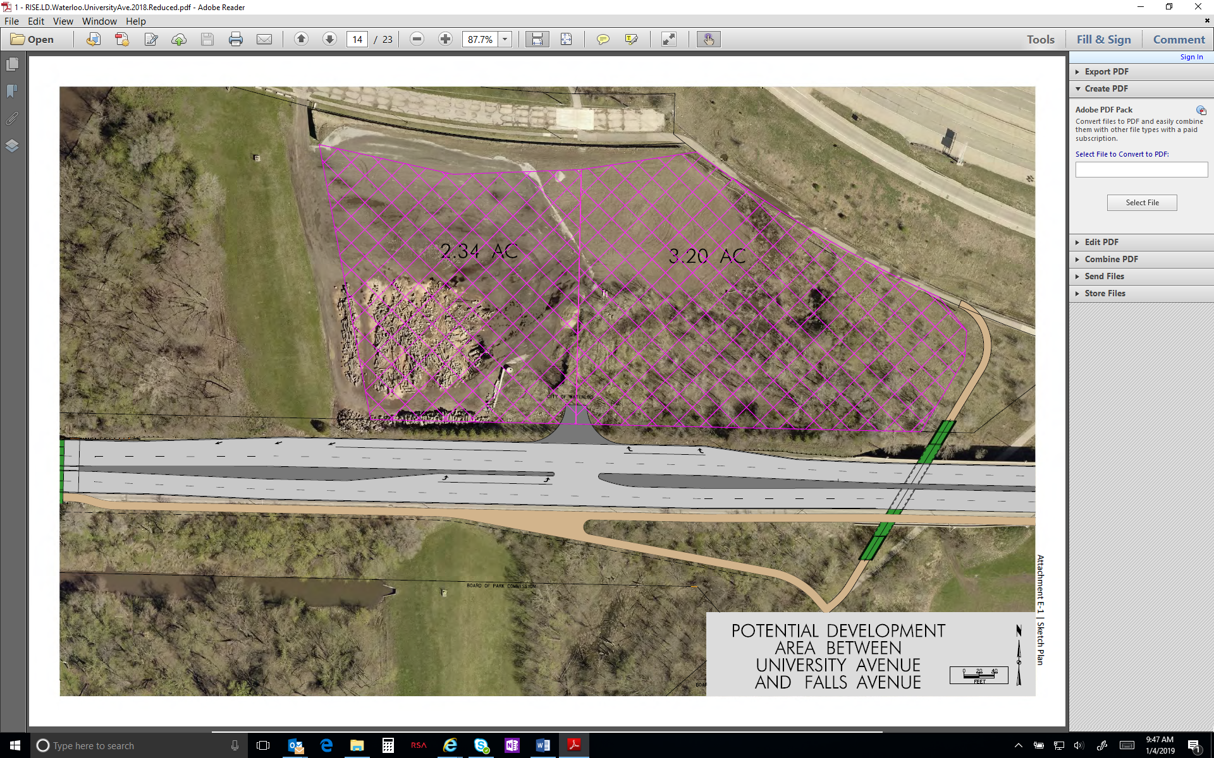
Waterloo
(Local Development September 2018 round)

Slide 12
QUESTIONS?
Craig Markley, Office of Systems Planning
craig.markley@iowadot.us
515-239-1027

