Slide 1
FY 2020 Highway-Railroad Crossing Safety Program (Amendment)
March 12, 2019

Slide 2
Program
FHWA Funding available for states to improve warning devices at railroad crossings. (23 USC Section 130)
Amount of appropriation funded by FHWA is determined by the number of public crossings in the state.
Iowa currently has 5,059 public railroad crossings.

Slide 3
Project Evaluation Criteria
Benefit-Cost Ratio
Formula includes:
Number of accidents
Exposure Index: (number of trains x number of vehicles)
Train traffic
Vehicle traffic
Predicted Accidents: (train speed, roadway speed, number of traffic lanes, number of tracks)
Existing warning devices vs. possible upgrades
On-site safety diagnostic review
An application must be filed with the department

Slide 4
Available Funding and Application Summary
90% Federal Funds from FHWA
10% match by Highway Authority or Railroad
Applicant can be either Highway Authority or Railroad, or combination of the two
FFY 2020 FHWA appropriation for Iowa was $5,345,898

Slide 5
Proposed Action
Remove four FY 2020 projects previously approved for funding by the Transportation Commission
Diagnostic Review revealed the railroad that submitted the applications did not conduct a comprehensive location review before submitting the applications.
The local road authority perspective was not taken into account
Replace the removed projects with four projects that enhance safety in a greater capacity
The four projects to be removed have a total estimated cost of $1,425,000
The four projects to be supplemented have a total estimated cost of $1,435,000
The cost difference is $ -10,000
One project has already been cancelled by the railroad since Transportation Commission approval, with an estimated cost of $50,000
This leaves an overall balance of $40,000

Slide 6
List of Previously Awarded Applications to Remove from Program
PROJECT NAME
SPONSOR
SCORE
REQUESTED AMOUNT
RECOMMENDED AMOUNT
Canfield Avenue, 190676E | Union Pacific Marshall County | 0.7 | $350,000 | $350,000
4th Avenue, 190435R | Union Pacific City of Clarence | 1.4 | $350,000 | $350,000
720th Avenue, 190682H | Union Pacific Story County | 0.7 | $350,000 | $350,000
Three Bridges Road, 190616V | Union Pacific Marshall County | 0.6 | $375,000 | $375,000
TOTAL: $1,425,000

Slide 7
List of Applications to Supplement for the Proposed Removed Projects
PROJECT NAME
SPONSOR
SCORE
REQUESTED AMOUNT
RECOMMENDED AMOUNT
4th Avenue East, 385710B | DME Railroad City of Spencer | 2.1 | $275,000 | $275,000
Lincoln Street / HWY IA 14, 063404U | BNSF Railroad City of Knoxville | 1.3 | $500,000 | $500,000
28th Street NE, 307841T | CCP Railway Company City of Cedar Rapids | 1.1 | $300,000 | $300,000
HWY IA 333, 074051L | BNSF Railroad Iowa DOT | 0.8 | $360,000 | $360,000
TOTAL:
Amount of Removed projects:
Difference between Removed & Supplemented:
Additional Project Cancelled by a Railroad
Balance:
$1,435,000
$1,425,000
-$10,000
+$50,000
$40,000

Slide 8
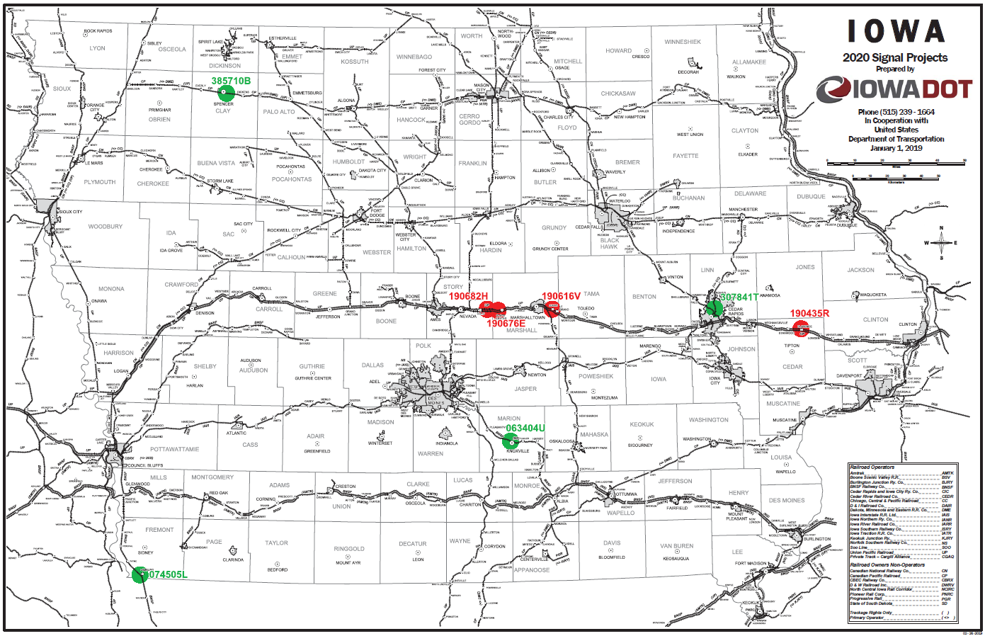
Map of Projects to Remove & Replacement Projects
Remove
Supplement

Slide 9
QUESTIONS?
Kristopher Klop
Interim Section 130 Program Manager
kristopher.klop@iowadot.us

