Slide 1
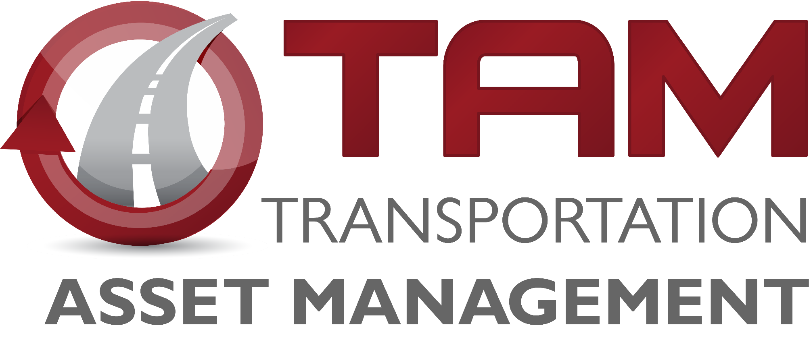
Transportation Commission Workshop
March 12, 2019

Slide 2
Transportation Asset Management
Charlie Purcell, PE
Project Delivery Bureau

Slide 3
Information to Inform Decisions
Dec-2018 - Bridge Management
Jan-2019 - Pavement Management
Feb-2019 - Interstate System Planning
Mar-2019 - Investment Alternatives
Apr-2019 - Mobility Strategies (ICM)
May-2019 - Draft Program Asset Management Summary

Slide 4
Program Trade-off Analysis
Matt Haubrich
Strategic Performance Division

Slide 5
Program Summary
Table below adapted from program development materials presented in previous Commission workshops
Key assumptions:
Flat revenue in outer years
Interstate investment will be funded at approximately $330M per year
Program targets for future years will be adopted by future Commission action
Year | 2020 | 2021 | 2022 | 2023 | 2024 | 2025 | 2026 | 2027 | 2028 | 2029
Revenue (forecast from March 2018) | 649.3 | 643.2 | 633.7 | 657.7 | 657.7 | 657.7 | 657.7 | 657.7 | 657.7 | 657.7
Expenditures
Non-Interstate Pavement Modernization (3R) | 100 | 105 | 115 | 125 | 130 | 135 | 140 | 150 | 160 | 170
Non-Interstate Bridge Modernization (BR) | 54.7 | 57.1 | 64.6 | 100.2 | 110 | 125 | 140 | 155 | 170 | 185
Safety Specific (SR) | 25 | 25 | 25 | 25 | 25 | 25 | 25 | 25 | 25 | 25
Non-Interstate Stewardship | 179.7 | 187.1 | 204.6 | 250.2 | 265 | 285 | 305 | 330 | 355 | 380
Interstate Stewardship (4R) | 148.2 | 173.1 | 175.8 | 162.5
Major Interstate (MI) | 191.4 | 209.3 | 150.3 | 95.6
Interstate Programs | 339.6 | 382.4 | 326.1 | 258.1 | 330 | 330 | 330 | 330 | 330 | 330
Non-Interstate Capacity/Enhancement (NR) | 155.6 | 110.4 | 106.5 | 166.7 | 104.4 | 44.1 | 63.4 | 40.1 | 30 | 30
Total | 674.9 | 679.9 | 637.2 | 675 | 699.4 | 659.1 | 698.4 | 700.1 | 715 | 740
Net | (25.6) | (36.7) | (3.5) | (17.3) | (41.7) | (1.4) | (40.7) | (42.4) | (57.3) | (82.3)
Notes:
Make sure to mention the assumptions

Slide 6
Stewardship Funding Scenarios
Notes:
Only difference is the Non-Interstate Stewarship

Slide 7
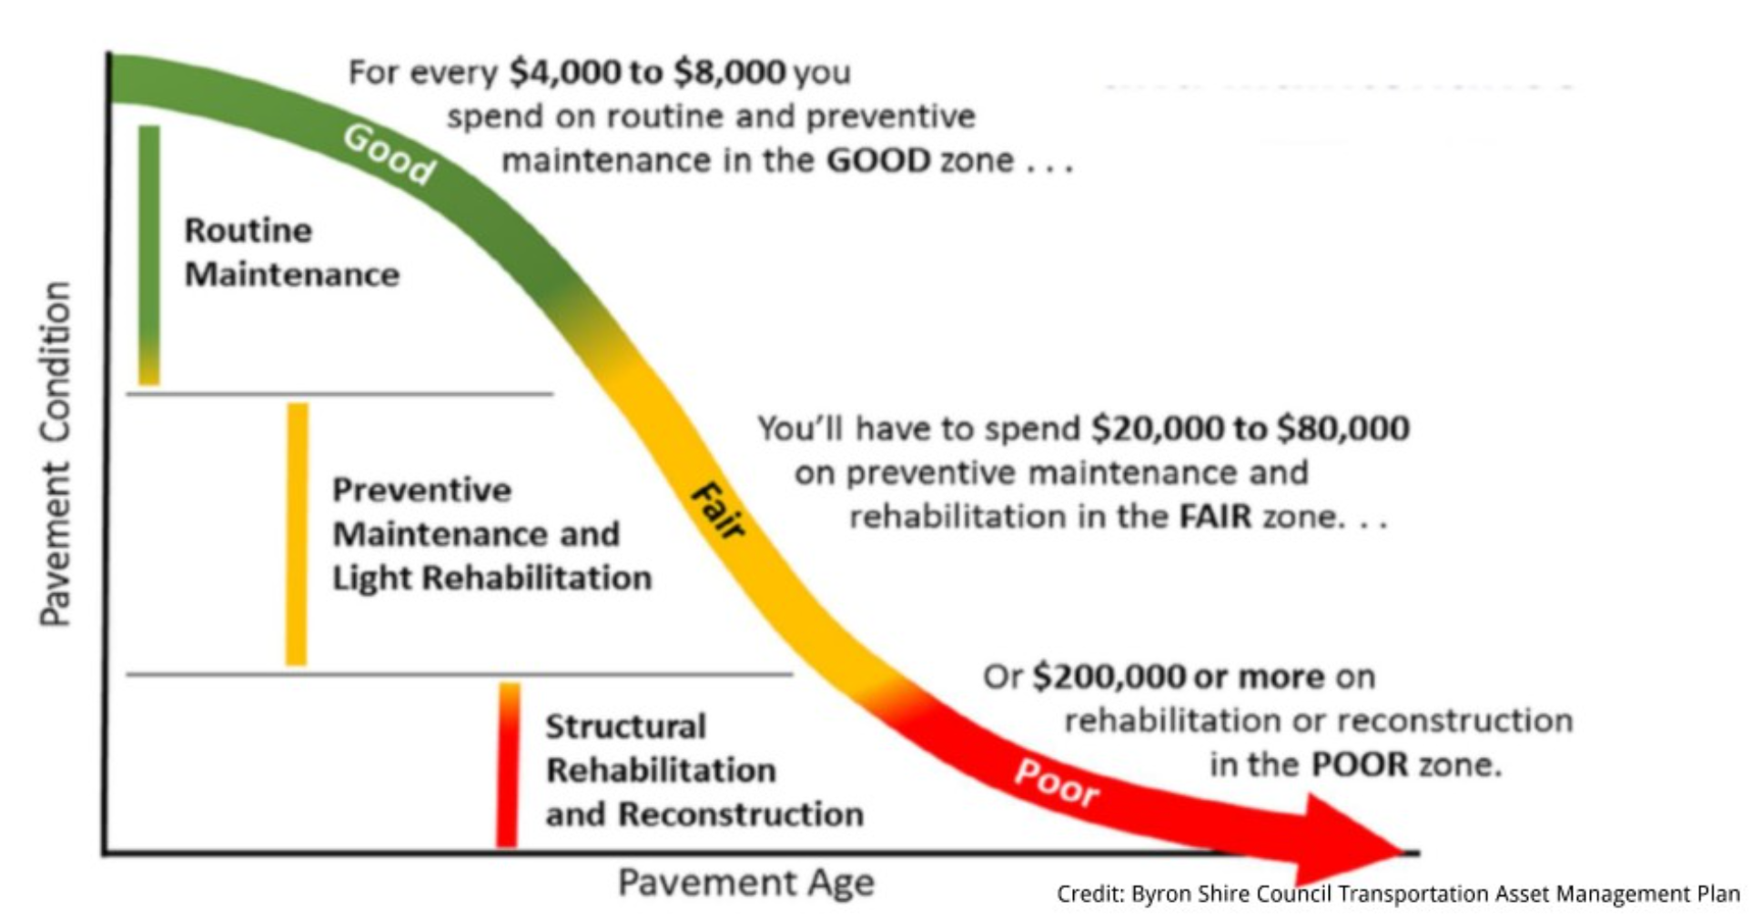
How We Set Targets
Good roads cost less. If we maintain assets in good condition, we can minimize their lifecycle cost. In the long run, this allows us to invest in other priorities.
Notes:
As shown in the January pavement stewardship presentation.

Slide 8
Stewardship Performance Comparison
Notes:
Add another slide after this showing a summary of each funding scenario – the 75% funding scenario and the % change in condition over 10 years at that level, likewise with the other funding levels.

Slide 9
Scenario Comparison
Scenario | Category | 5-year |  | 10-year
 |  | Investment (Total, $M) | Performance (vs. Target) | Investment (Total, $M) | Performance (vs. Target)
75% | Non-Interstate Pavement Modernization | 431.3 | -6.9 | 997.5 | -8.1
 | Non-Interstate Bridge Modernization | 290.0 | -3.3 | 871.2 | -7.5
100% | Non-Interstate Pavement Modernization | 575.0 | -6.0 | 1,330.0 | -6.0
 | Non-Interstate Bridge Modernization | 386.6 | -2.5 | 1,161.6 | -5.8
150% | Non-Interstate Pavement Modernization | 862.5 | -4.3 | 1,995.0 | -2.1
 | Non-Interstate Bridge Modernization | 579.9 | -0.6 | 1,742.4 | -2.1
200% | Non-Interstate Pavement Modernization | 1,150.0 | -2.6 | 2,660.0 | 1.2
 | Non-Interstate Bridge Modernization | 773.2 | 0.6 | 2,323.2 | -0.1

Slide 10
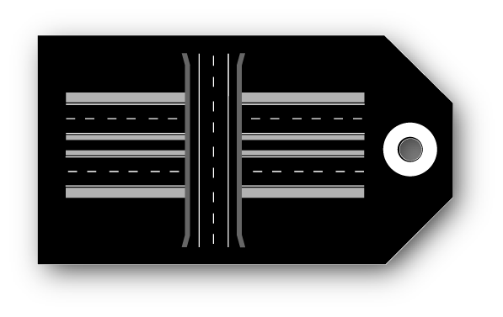
Cost Comparisons for Alternatives
1 mile of new expressway at $7.7M would buy nearly 17 miles of 2-lane pavement resurfacing
$30M can get us:
Not quite 4 miles of new expressway
12.3 miles of Super 2 (new pavement)
15 miles of 2-lane pavement reconstruction
60+ miles of pavement resurfacing
10 bridge replacements
From previous presentations:
We have a “wave” of bridges built in the 1960s and 1970s that are all getting to the point where major rehab or replacement is needed
At current replacement rates, we’re implicitly expecting pavements to last over 100 years (40-year design life)
Notes:
Using average costs from the Office of Design “Transportation Construction Costs” fact sheet., Scott Neubauer gave bridge estimates (replacement = $3M each).

Slide 11
Summary & Recommendations
Significant deterioration of pavements and bridges is forecast to occur without steady growth in stewardship spending.
Based on these forecasts, prior scenario analysis, the Commission’s long-range transportation plan Iowa In Motion 2045, and the Transportation Asset Management Plan, staff recommends program objectives that:
Limit future capacity expansion to locations with forecast congestion that cannot be addressed effectively through operational improvements
Target steady growth in overall stewardship spending in order to maintain a state of good repair across the primary highway system.

