Slide 1
34.3 As of Feb 27
FY 14
FY 18
FY 10
FY 09
FY 11

Slide 2
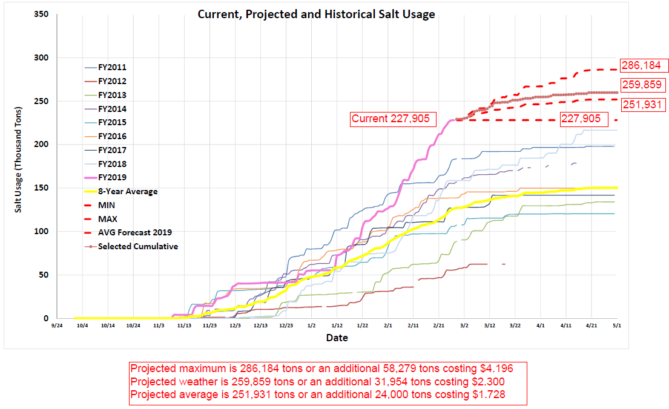

Slide 3
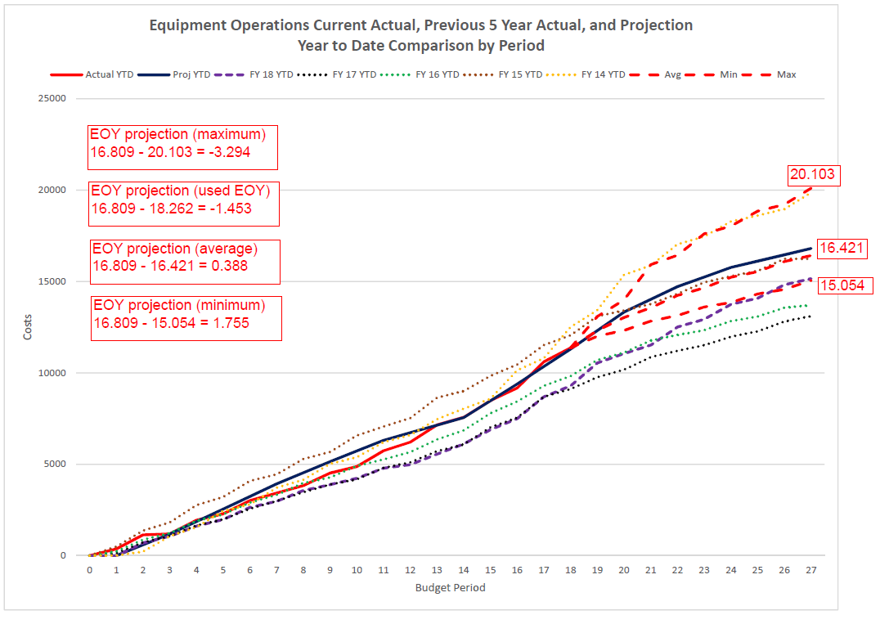

Slide 4
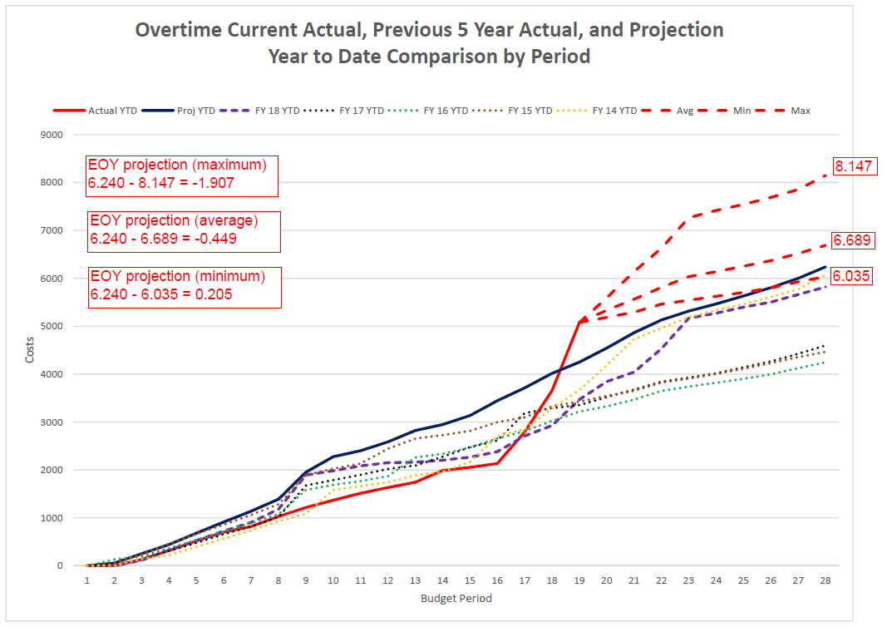

Slide 5
