Slide 1
Passenger Rail Overview and Depot Grant Recommendation
Transportation Commission Workshop
March 12, 2019

Slide 2
Passenger Rail Overview
Overview
Intercity Passenger Rail History
Quad Cities to Iowa City
Iowa City to Cedar Rapids Commuter Rail
Fort Madison Depot Grant Recommendation

Slide 3
Passenger Rail Overview
Intercity Passenger Rail History in Iowa
1996 – Iowa becomes one of the Midwest States to study intercity passenger rail for the Midwest through the Midwest Regional Rail Initiative (MWRRI)
2004 – MWRRI publishes a comprehensive plan to improve and expand passenger rail in the Midwest
2007 – Amtrak is asked by Illinois DOT to complete a feasibility study and ridership of extending the Chicago to Moline service to Iowa City
2009 – Iowa DOT/Illinois DOT apply for federal funding to introduce intercity passenger rail between Chicago to Iowa City
2010 – A $230M grant is awarded to Illinois and Iowa
2011 – Project split into two phases
Notes:
The states of Iowa and Illinois jointly submitted an application seeking $248 million of federal funding for environmental studies and capital expenditures to initiate passenger rail service from Chicago to Iowa City. In 2010, a $230 million grant was awarded to both states which will be matched with 20 percent state and local funds in both Iowa and Illinois. In order to adequately assess demand and costs for a broader regional high-speed passenger rail system across Iowa, the Iowa DOT requested that FRA split the grant into two multiple phases. In 2011, FRA agreed to the phased approach which permitted Illinois to move forward with implementing service from Chicago to Moline. In September 2014, Iowa obligated a portion of the federal funds to complete Preliminary Engineering (PE) and National Environmental Protection Act (NEPA) activities from Moline to Iowa City. Illinois continues work activities for their phase of the project to implement service to Moline. It has not yet been determined if Iowa will move forward with final design and construction from Moline to Iowa City.

Slide 4
Passenger Rail Overview
Iowa DOT’s Phase 2 Project (Quad Cities to Iowa City Extension)
Preliminary Engineering / Tier 2 NEPA
Rail Traffic Controller (RTC) Operations Modeling - in progress 90% complete
30% Preliminary Engineering Development – in progress 40% complete
Completion of an Tier 2 Project Level Environmental Assessment (EA) – in progress 20% complete
Service Development Plan Update - in progress 40% complete
Notes:
RTC (Rail Traffic Controller) Operations Modeling
Defines passenger and freight transportation service performance and infrastructure needs, and an operating and maintenance plan.
Establishes an environmental footprint for the Tier 2 NEPA process.
Conducted to FRA standards, conforms with Federal law, and mitigates impacts of passenger service on host freight railroads.
Compares existing case and proposed future case operating plan.
Outcomes of RTC Modeling
Define infrastructure and the maintenance types, quantities, and frequencies needed for a complete Chicago-Iowa City service over the first 20 years.
Develop a passenger service operating plan that is compatible with the existing and likely future transportation service plan of the host railroads.
Provide an understanding of capital and operating and maintenance costs for the service.
Create a mutually agreed-on basis for future agreements between stakeholders.

Slide 5
Passenger Rail Overview
Outcome of the Study – Quad Cities to Iowa City
RTC Modeling
Preliminary Engineering
Capital Costs Estimate
Operating and Maintenance Costs Estimate
Ridership and Revenue Forecast
Financial Plan
Benefit/Cost Analysis
Economic Impact Analysis
Site-specific environmental field studies and analysis with refined study area
Tier 2 Environmental Document for Moline to Iowa City Section
Identify project-level environmental commitments (mitigation)
Permit decisions
Localized option selection (ex., Iowa City Station; Iowa City Layover Facility; Track Improvements)
Estimated Completion: Fall 2020
Notes:
We plan to have the study completed by Fall 2020

Slide 6
Passenger Rail Overview
Iowa City-Cedar Rapids Passenger Rail Conceptual Feasibility Study
2015 - CRANDIC Railway, MPO JC (the Metropolitan Planning Organization for the Iowa City area) and Iowa DOT agreed to support study activities to further examine the conceptual feasibility of a passenger rail service operating between Iowa City, Iowa and Cedar Rapids, Iowa
Fall 2015 - Initial feasibility study completed
Fall 2016 - Further refined study investigating the feasibility between Iowa City and North Liberty was completed
Summer 2018 - Third phase of the Iowa City to North Liberty study was initiated to further determine estimated ridership and revenue opportunities as well as a more detailed cost estimate
Next Steps - Depending on the outcome of the third and final phase of this study, any future action for implementation of a service would be led by local and metropolitan jurisdictions

Slide 7
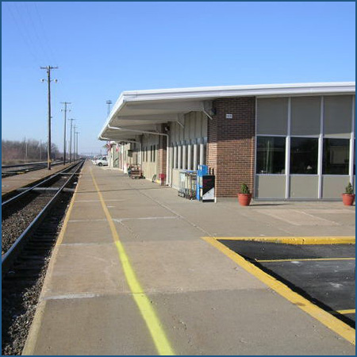
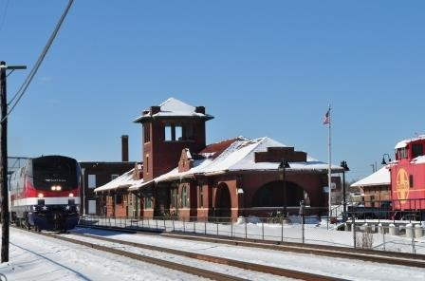
Passenger Rail Overview
Fort Madison Depot Grant Recommendation
Fort Madison is a stop on Amtrak’s Southwest Chief route (daily Chicago to Los Angeles service)
Multiyear effort to renovate historic depot

Slide 8
Passenger Rail Overview
Fort Madison Depot Grant Recommendation (cont.)
Depot renovation
Phase I: Depot Restoration
Commission awarded Transportation Enhancement (TE) funding February of 2007
Total Project Cost: $382,861
Grant: $280,000
Project complete: May 2012
Phase II: Flood Mitigation and ADA Improvement
Commission awarded Transportation Enhancement (TE) funding October 2009
Total Project Cost: $1,101,053
Grant: $427,773
Project complete: August 2011

Slide 9
Passenger Rail Overview
Fort Madison Depot Grant Recommendation (cont.)
Depot renovation (cont.)
Phase III: Platform Improvements
Commission awarded Transportation Enhancement (TE) funding February of 2005
Total Project Cost: $1,290,000
Grant: $750,000
Project complete: TBD
Due to project delays and increased costs, additional funds are necessary to complete this phase.
Option: Funding from the Passenger Rail Service Revolving Fund

Slide 10
Passenger Rail Overview
Fort Madison Depot Grant Recommendation (cont.)
Passenger Rail Service Revolving Fund (Iowa Code Chapter 327J)
Administered by Iowa DOT Director and “used to pay the costs associated with the initiation, operations, and maintenance of passenger rail service.”
Funds used to support Quad Cities to Iowa City and Iowa City to North Liberty studies.
Current unobligated balance: Approximately $2 million
Recommendation: Allocate $400,000 to the Fort Madison Depot Project

Slide 11
Passenger Rail Overview
Questions?

